Slide 1



Winter School in Marine Environmental Prediction
Code Automation
6 Mar 2017
Doug Latornell
dlatornell@eoas.ubc.ca

Slide 2
Links
Slide Deck: https://bitbucket.org/douglatornell/uqar-winter-school/src/tip/slides.pdf
Repository: https://bitbucket.org/douglatornell/uqar-winter-school

Slide 3
Session Plan
Definition
Software Tools
Organizing Your Modeling Research Life
Exercise #1
Writing Automation Tools
Exercise #2
NEMO command processor

Slide 4
Code Automation - Definition
Use software tools to automate tasks that are:
tedious
error-prone
complicated
repeated often
To document the story of your research
To make it more likely to be well organized and reproducible

Slide 5
Code Automation - Definition
Use software tools to automate tasks that are:
tedious
error-prone
complicated
repeated often
To document the story of your research
To make it more likely to be well organized and reproducible
Your most important collaborators are your past and future selves
Be kind to them!

Slide 6
Software Tools
Version Control
Backups
Model Runs Management
Results Visualization

Slide 7
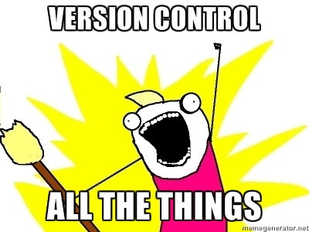
Version Control
The most important automation tool you'll learn about this week!

Slide 8
Version Control All The Things!
(Almost...)
Code
Manuscripts of proposals, papers
Research notes, work log
Course work assignments
Pre- and Post-processing techniques and code
...

Slide 9
Version Control
If you are not using version control already, start! Today!
Find a local expert and use the version control tool that they use if it is:
  Git
  Mercurial (hg)
  Subversion (maybe)
But probably not if they have a grey beard like mine (or even if they don't) and say "We don't use traditional version control, per se", or "I have this system of shell scripts that I wrote that does that..."

Slide 10
Assignment
Create a repository for notes from this week
Add and commit something about each session
Bonus points for putting it on GitLab or another web hosting service
More bonus points for making it public and sharing the URL

Slide 11
Version Control
Commit early, commit often
Version control can be used as a time machine, but you can’t revert back to something that you didn’t commit
Use your commit messages to tell a story to your future self

Slide 12
What Not to Version Control
Ephemeral files that are products of compilation, LaTeX, etc.
Fortran: .o, .mod, and executables
Python: .pyc (in __pycache__ since Python 3)
LaTeX: .aux, .log, .nav, .out, .snm, .toc

Slide 13
What Not to Version Control
Most large binary files:
Run results
Animation movies
Maybe images, PDFs, etc.

Slide 14
Binary Files and Version Control
Issues:
They require lots of memory to manage; on the order of 2x their size
A full copy is stored on every commit, rather than a diff. So frequently changed binary files can make a repository grow rapidly. That affects performance, and hosting services have size limits.

Slide 15
Binary Files and Version Control
Less of an issue for "hard won" binary files that aren't changed often:
bathymetry, coordinates, mesh masks, initialization fields, climatology
  Consider using a separate repository as you are developing these, and then commit the "final" versions in your working model configuration repository
Finished products (like the PDF of this slide deck) in a single purpose repository

Slide 16
Binary Files and Version Control
If they aren’t under version control, they need to be backed up, redundantly

Slide 17
Backups
Hard drives and SSD drives fail
Computers get lost and stolen
Bad things happen
Your files and data needs to be stored in multiple, geographically separate places
If you don't feel that you can recover in less than a day to the point where you can do research again, you should be worried, and you should take action to get less worried

Slide 18
Backups
Every clone of a Git or Mercurial repository is a full backup of the repository and its history
Repositories that have been pushed to hosting services like Gitlab, Bitbucket, Github automatically have at least one backup

Slide 19
Backups For Your Laptop
Get at least one portable USB drive
Use a tool to back up to it regularly
Keep the drive separate from your laptop as much as possible
Even better to have 2 portable drives stored in different locations
Better still, use a cloud backup service in addition to at least one portable drive

Slide 20
Backup Tools
Mac:
Time Machine: www.support.apple.com/kb/ht1427
SuperDuper: www.shirt-pocket.com/SuperDuper
Silverkeeper: www.lacie.com/silverkeeper
ArRsync: www.arrsync.sourceforge.net
Windows:
Syncback: www.2brightsparks.com/syncback/syncback-hub.html
Fbackup: www.fbackup.com
AOMEI Backupper: www.backup-utility.com
EaseUS Todo: www.todo-backup.com
Linux:
Déjà-dup: https://launchpad.net/deja-dup
This is a list, not recommendations. Read the docs and choose a tool you like and understand.

Slide 21
Model Runs Management
Model configurations
Files for:
  Initialization
  Boundary conditions
  Forcing
Executing model runs
Run results files
Analysis and visualization

Slide 22
Custom Model Code
Most models have a mechanism to let you provide modified or extra code modules without changing the shipped model code:
  MY_SRC directory in NEMO
  ln3 tool in WaveWatch
You should be able to keep your custom code in a version control repository that you control
  Create a repository inside MY_SRC/
  Symlink files into place from an external repository

Slide 23
Executing Model Runs
Try to use tools that other people create and maintain
  NEMO-Cmd
  WaveWatch run_tests ??
  Avoiding "not invented here" is hard
If the tools are open-source on GitLab, Github, Bitbucket, etc. learn how to look at their repositories to judge their maturity, quality, and how well maintained they are

Slide 24
Model Runs Management Tools
Sooner or later, though, you will have to write your own tools
If you don't or can't script it, write notes/documentation about the exact steps
Put those notes/docs under version control, of course!

Slide 25
Results Visualization
Try to use tools that let you write code to create and adjust figures and animations rather than using a GUI tool to make adjustments:
  Python and matplotlib, panda, xarray
  Matlab
  R and ggplot2
If you don't or can't script it, write notes/documentation about the exact steps
Put those notes/docs under version control, of course!

Slide 26
Session Plan
Definition
Software Tools
Organizing Your Modeling Research Life
Exercise #1
Writing Automation Tools
Exercise #2
NEMO command processor

Slide 27
Organizing Your Modeling
Research Life
Why?
What?
How?

Slide 28
Why Does Directory and File Organization Matter?
A well structured directory tree with meaningful, consistent directory and file names is:
Easier for humans (future you!, your supervisor) to understand
Easier to write automation scripts against
A step towards reproducibility

Slide 29
What Needs to be Organized?
Model source code and executables
Model configurations
Files for:
  Initialization
  Boundary conditions
  Forcing
Directories for executing model runs
Run results directories and files
Analysis and visualization code and products

Slide 30
Exercise #1a
Create a list of the things that you need to organize for your model research

Slide 31
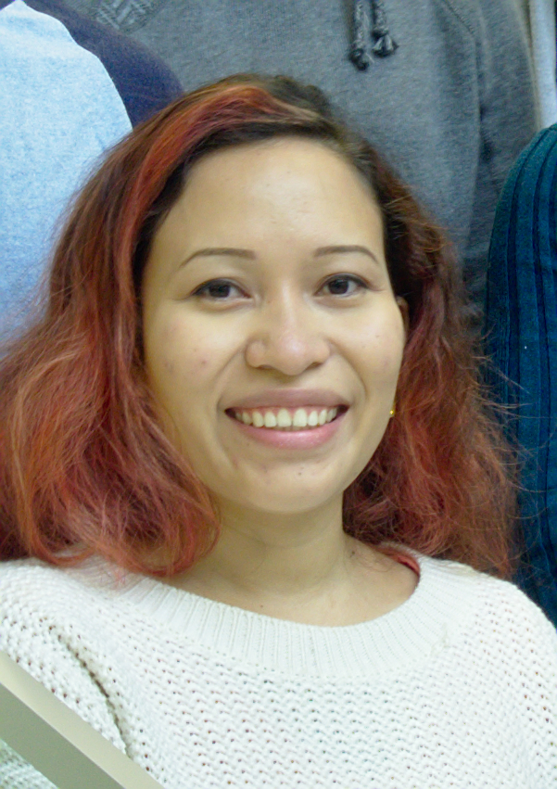
Idalia Machuca – Mackenzie Canyon Circulation & Upwelling
“My research is, in short, looking at the circulation around Mackenzie Canyon, in particular the upwelling dynamics. To that goal, I'm using the NEMO model to simulate the circulation and comparing the results between idealized and realistic cases. The idealized bathymetry is constantly being modified to represent the realistic bathymetry more accurately. What's great about keeping my files organized is that it helps me keep track of the constantly changing bathymetry files - which in turn sometimes require new coordinates and initial conditions files.”
Link to figures showing Idalia’s idealized and realistic bathymetries

Slide 32
Directories and Repositories
Choose a top level project name; e.g. CANYONS
Be consistent across platforms when you set up your file space:
  /home/doug/Documents/CANYONS/ on my laptop
  /ocean/dlatorne/CANYONS/ on our dev compute server
  /home/dlatorne/CANYONS/ on HPC

Slide 33
Model Code and Executables
One or more directories:
Cloned or checked out from upstream repositories if possible
  NEMO-3.6/, XIOS-2.0/ by svn checkout
  wwatch3-5.16/ by unpacking downloaded tarball

Slide 34
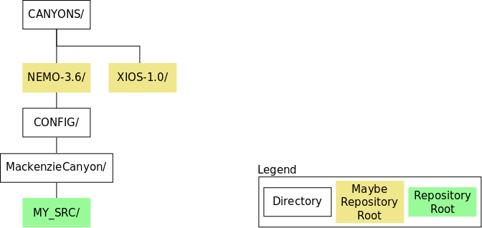

Slide 35
Naming Things
Don't use spaces in file or directory names
They won’t tab-complete well
They can be hard to handle in automation scripts
Instead use:
CamelCase
snake_case
separate-words-with-hyphens

Slide 36
Directories and Repositories
Model configuration repository:
Coordinates, bathymetry, namelists, output file definitions, etc.
Automation scripts might live here, or in a separate repository
Absolutely a version control repository
Example path:
  mackenzie_canyon/

Slide 37
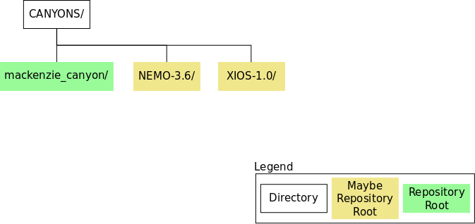

Slide 38
Directories and Repositories
results/ directory:
Tree of systematically named directories that hold run results
Not a version control repository
Example path:
  results/idealized/237x177grid/lat_visc_sensitivity/10m2ps/

Slide 39
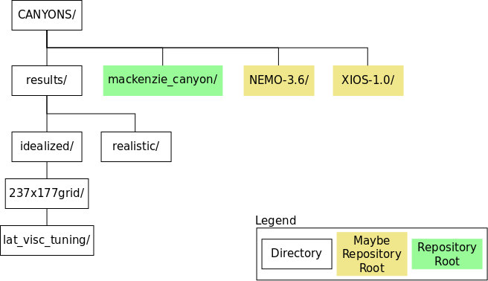

Slide 40
Directories and Repositories
analysis/ directory:
Code and Jupyter Notebooks for analysis and visualization of results
Absolutely a version control repository

Slide 41
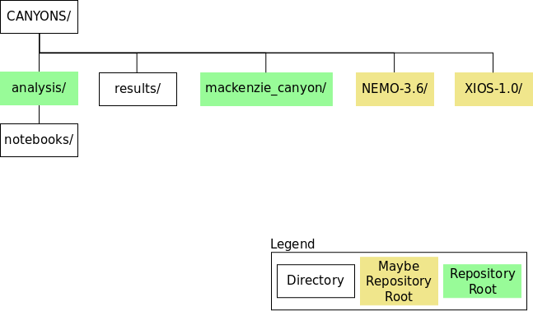

Slide 42
Directories and Repositories
forcing/ directory:
A tree of systematically named directories that hold initialization and/or forcing files; e.g.
  atmospheric/
  init_fields/
  open_boundaries/
  runoff/
You might not need all of these, any of them, or you might need different forcing files
Not a version control repository, but the code that produces these files should be under version control in the model configuration repository, or a separate tools repository

Slide 43
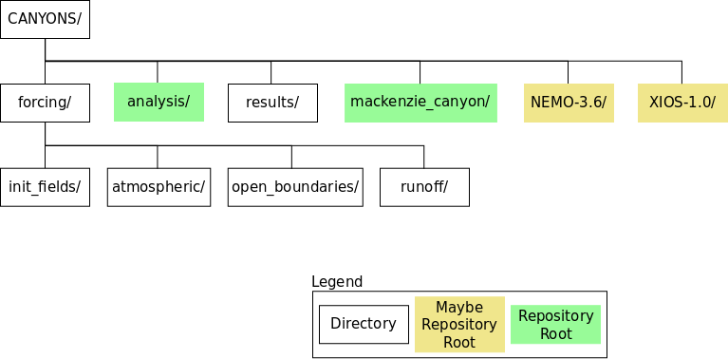

Slide 44
Model Configuration Repository
Coordinates, bathymetry, namelists, output file definitions, etc.
Automation scripts might live here, or in a separate repository
Absolutely a version control repository
Example:
  Idalia’s mackenzie_canyon/ repository for NEMO-3.6

Slide 45
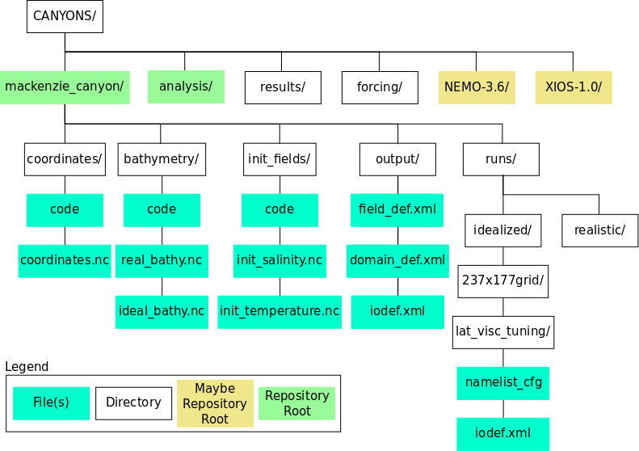

Slide 46
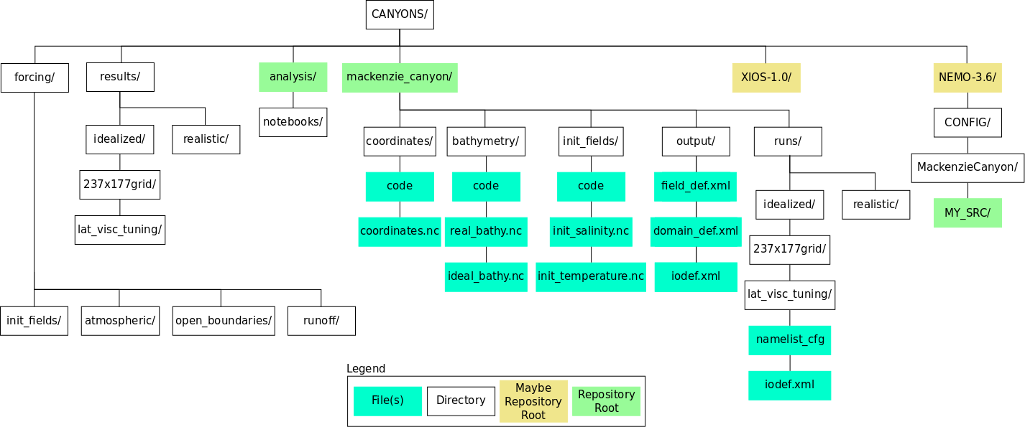

Slide 47
Exercise #1b
Create a diagram of repositories and directories for your model research

Slide 48
Temporary Run Directories
Execute each model run in a directory that you set up for that run only. Move the run results and the run configuration files to results storage.
Provides checks on run intent and ready-to-run status
Helps ensure reproducibility
Well-suited to automation

Slide 49
Temporary Run Directories
Create a specific, temporary directory for each model run
Assemble the files needed for the run by copying or symbolic linking
Configure the run so that its output goes into the directory
Execute the run
Do routine post-processing of model output
Move the run results to a directory in the results/ tree
Delete the symbolic links and the temporary directory

Slide 50
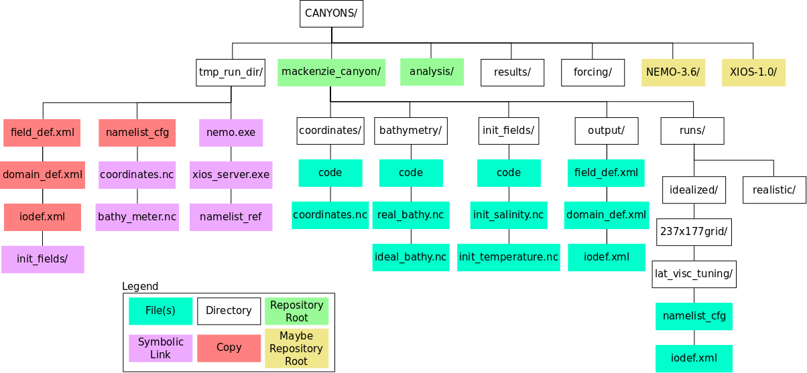

Slide 51
Directories and Repositories
It will probably take you a few iterations to get a structure that works well for you, your research, and your automation
Don't be afraid to change the structure if you need to, but think about your changes to make sure that they are an improvement, then commit to them

Slide 52
Session Plan
Definition
Software Tools
Organizing Your Modeling Research Life
Exercise #1
Writing Automation Tools
Exercise #2
NEMO command processor

Slide 53
Writing Automation Tools
Shell scripts
Python

Slide 54
Shell Scripts
bash on Linux, cmd.exe on Windows
Good starting point for repeated commands

Slide 56
Shell Scripts
NEMO=${HOME}/CANYONS/NEMO-3.6/CONFIG/MackenzieCanyon
CONFIG=${HOME}/CANYONS/mackenzie_canyon
RUN=${CONFIG}/runs/idealized/237x177grid/lat_visc_tuning
TMP_RUN=${HOME}/CANYONS/tmp_run_dir
cd ${TMP_RUN}
ln -s ${NEMO}/EXP00/opa nemo.exe
ln -s ${NEMO}/EXP00/xios_server.exe
ln -s ${CONFIG}/bathymetry/ideal_bathy.nc bathy_meter.nc
...
cp ${CONFIG}/output/field_def.xml ./
cp ${RUN}/iodef.xml ./
cp ${RUN}/namelist_cfg ./
$ mkdir -p ${HOME}/CANYONS/tmp_run_dir
$ bash prep_run_dir.sh

Slide 57
Shell Scripts
Easy to loop over collections of files, sequences of numbers:
for d in {15..21}
do
python -m nowcast.workers.download_PSY4 \
${NOWCAST_YAML} --run-date 2017-02-${d}
done
$ for d in {15..21}; do python -m nowcast.workers.download_PSY4 $NOWCAST_YAML --run-date 2017-02-$d; done

Slide 58
Shell Scripts
Fairly easy to accept arguments from command-line:
NEMO=${HOME}/CANYONS/NEMO-3.6/CONFIG/MackenzieCanyon
CONFIG=${HOME}/CANYONS/mackenzie_canyon
RUN=${CONFIG}/runs/${1}
TMP_RUN=${2}
cd ${TMP_RUN}
ln -s ${NEMO}/EXP00/opa nemo.exe
ln -s ${NEMO}/EXP00/xios_server.exe
ln -s ${CONFIG}/bathymetry/ideal_bathy.nc bathy_meter.nc
...
cp ${CONFIG}/output/field_def.xml ./
cp ${RUN}/iodef.xml ./
cp ${RUN}/namelist_cfg ./
$ TMP_RUN=${HOME}/CANYONS/tmp_run_dir
$ mkdir -p ${TMP_RUN}
$ bash prep_run_dir.sh idealized/237x177grid/lat_visc_tuning ${TMP_RUN}

Slide 59
Shell Scripts
Syntax is somewhat clunky and dated
Processing options from command-line is verbose and painful

Slide 60
Python
General purpose programming language
Choose Python 3
“Code is more often read than written”
Core language: https://docs.python.org/3/
Standard library: https://docs.python.org/3/library/
3rd party packages: https://pypi.python.org/pypi
Anaconda distribution: https://www.continuum.io/downloads

Slide 61
Exercise #2
Managing Ariane output
Create a Python tool to run in an Ariane run directory that takes 2 arguments:
a model run date
a results directory parent
The tool will:
Create a new results directory under the results directory parent.
The name of the directory will be derived from the model run date argument.
Move the input and output files from Ariane into the new results directory
Rename the files to include the model run date; e.g. traj_20160417.txt

Slide 62
Intro to Python for Code Automation
Jupyter Notebook link on nbviewer
Boilerplate for a Python module to run from the command-line
Handling command-line arguments
Working with dates and times
Working with files and directories

Slide 63
Ariane Particle Tracking Tool
http://stockage.univ-brest.fr/~grima/Ariane/
Offline calculation of 3D streamlines in the output velocity field of ocean models
NEMO, ROMS, Symphonie, MIT-GCM

Slide 64
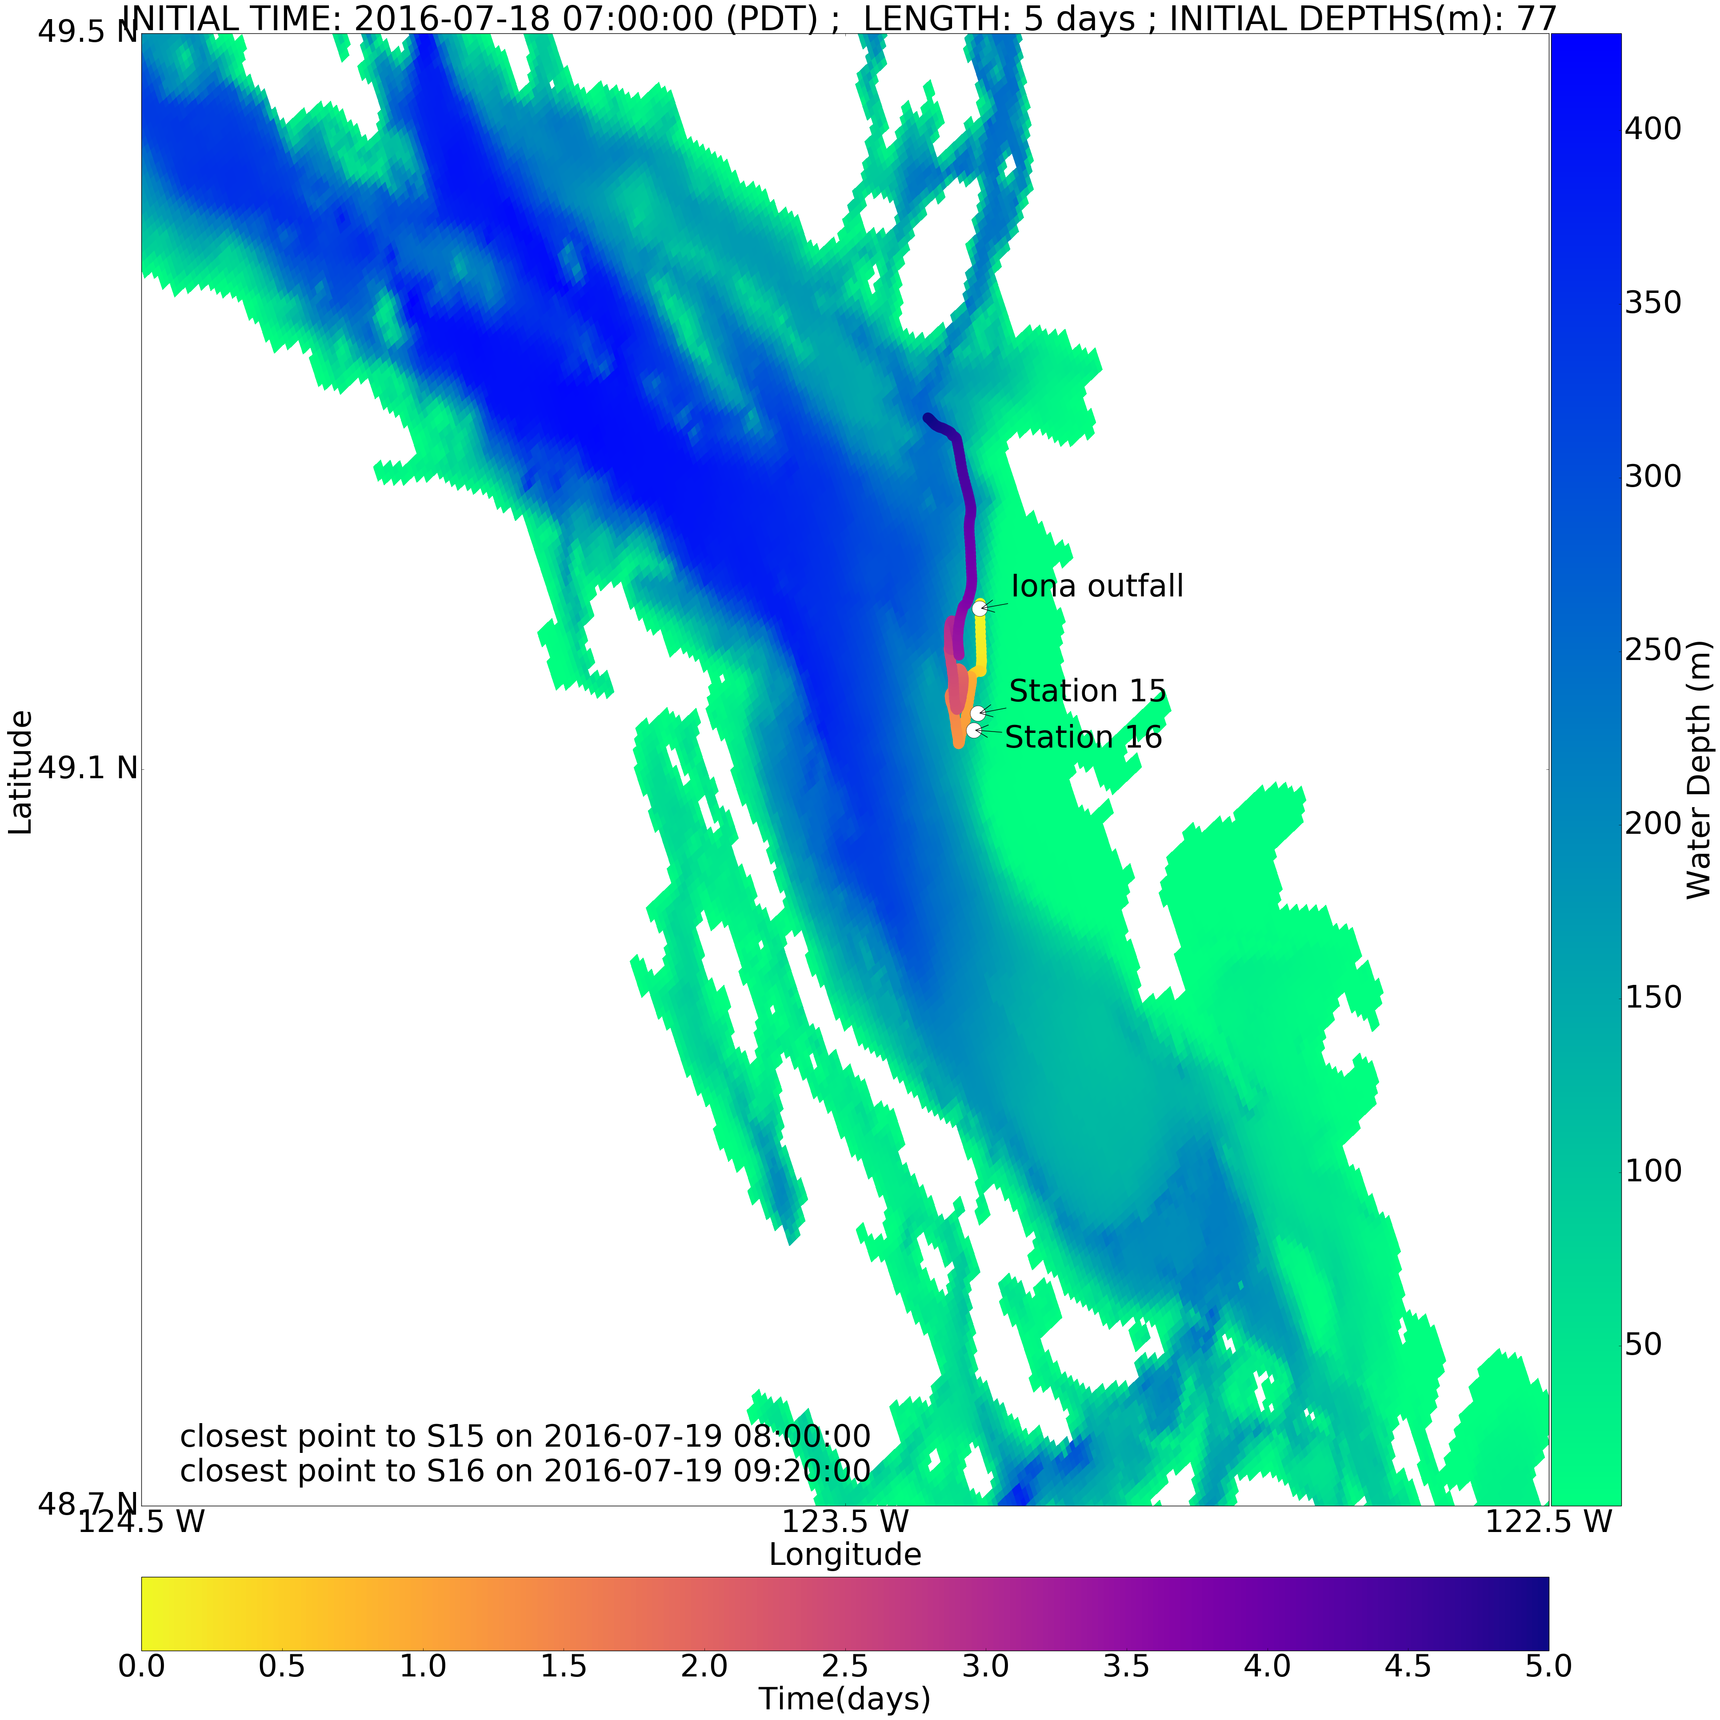

Slide 65
Ariane Runs
Input files:
namlist, initial_positions.txt
Output files:
traj.txt, log.txt

Slide 66
Exercise #2
Managing Ariane output
Create a Python tool to run in an Ariane run directory that takes 2 arguments:
a model run date
a results directory parent
The tool will:
Create a new results directory under the results directory parent.
The name of the directory will be derived from the model run date argument.
Move the input and output files from Ariane into the new results directory
Rename the files to include the model run date; e.g. traj_20160417.txt

Slide 67
Exercise #2
$ wget https://bitbucket.org/douglatornell/uqar-winter-school/downloads/particle_tracking.tar.gz
$ tar -xvzf particle_tracking.tar.gz
particle_tracking/
├── ariane_run/
│ ├── initial_positions.txt
│ ├── log.txt
│ ├── namelist
│ └── traj.txt
└── move_ariane_results.py
If your favourite editor isn’t available, try nano. (Minimal, but almost always available on Linux.)
$ cd ariane_run
$ python ../move_ariane_results.py ...
$ rsync -a particle_tracking/ particle_tracking_test

Slide 68
Other Packages
Standard llibrary:
glob
pathlib
subprocess
3rd party:
arrow
pytz
python-dateutil

Slide 69
3rd Party Python Packages
Package managers:
  conda
  pip
If you’re using Anaconda, try conda first; pip may trigger compilation of C extensions
Both have search, install, list, uninstall, etc. sub-commands

Slide 70
Session Plan
Definition
Software Tools
Organizing Your Modeling Research Life
Exercise #1
Writing Automation Tools
Exercise #2
NEMO command processor

Slide 71
NEMO Command Processor
* Example of building out automation tools over time to the point of a complete NEMO run executed from one file with one command
* Docs and repo URLs
* Walk through my implementation of Idalia's Mackenzie Canyon directory organization on salish
* nemo sub-commands:
* prepare
* combine
* deflate
* gather
* run
* nemo run turb_diff.yaml /ocean/dlatorne/CANYONS/results/turb_diff_1e-5/
* Walk through run description YAML file

Slide 72
Wrap-Up
Software Tools
  Version Control and Backups
  Model Run Automation and Visualization Scripting
Organizing Your Modeling Research Life
  Reproducibility and Automatability
Writing Automation Tools
  Shell and Python
  Shift focus from details of running model to gaining research insights into model run results
NEMO command processor

Slide 73
