Slide 1


PyYAML, flickrapi and Tkinter
In a Desktop Image Display App
Doug Latornell <djl@douglatornell.ca>
VanPyZ :: 1 December 2009

Slide 2
2 Cool Things
YAML as an alternative to INI for configuration files
Access to Flickr from Python

Slide 3
...And 1 Useful One
Tkinter
  GUI interface toolkit in Python stdlib
  Cross platform

Slide 4
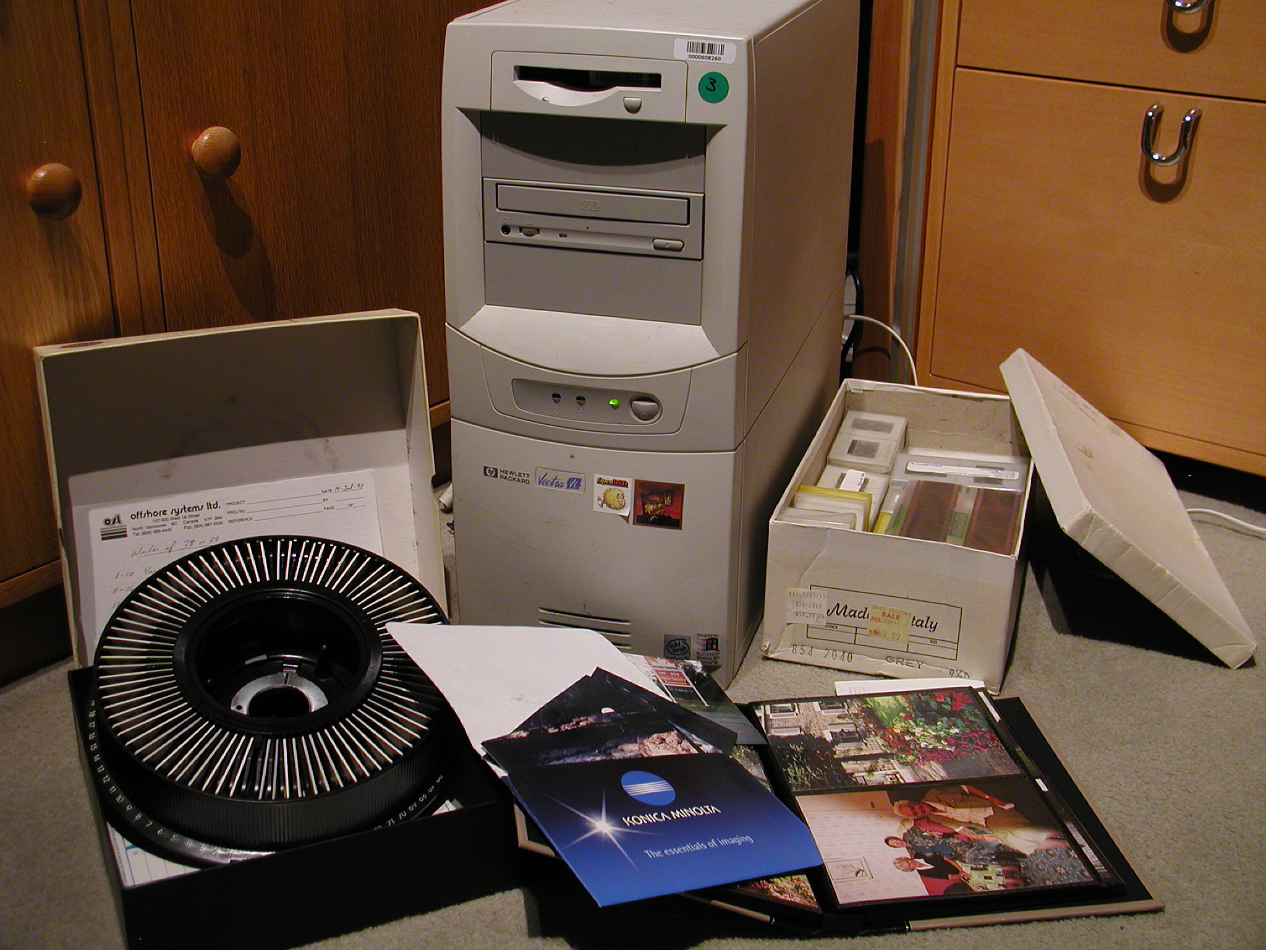
Dude, Where are the Pictures?

Slide 5
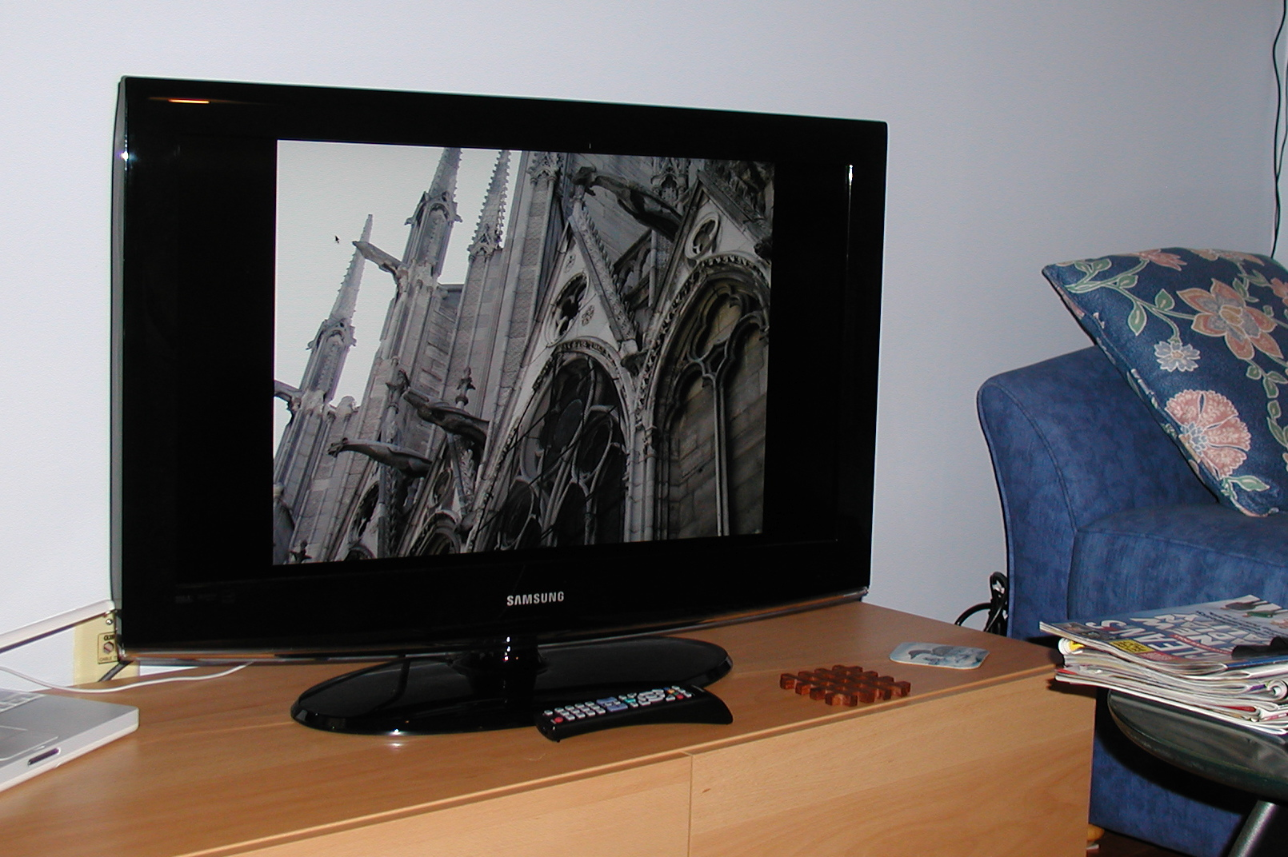
The Big Picture

Slide 6
But How?
Sequential
boring...
Random
annoyingly... random...

Slide 7
LivingPics
Display images from local or network connected storage, or Flickr
Control the randomness and repetitiousness of the display
Something to do while recovering from 2 broken wrists!

Slide 9
INI Config
[Timing]
noshowhrs = 4.0
displaysecs = 10
[Exclusion List]
exclusionlist = ./exclusion_list.txt
[Image Sources]
defaultsource = /Users/doug/Pictures/iPhoto Library/Originals
imagesources = /Users/doug/Pictures/iPhoto Library/Originals, ""
/Users/doug/Pictures/iPhoto Library/Modified/2006/Big Island of Hawaii, ""
/Users/doug/Pictures/iPhoto Library/Originals/2005, ""
http://www.flickr.com/photos/sada_images/, "Our flickr Stream"
[Image Selection]
probofjump = 0.05
rangeincr = 20
rangedecr = -10

Slide 10
YAML
YAML Ain't Markup Language
“a human friendly data serialization standard for all programming languages”

Slide 11
YAML Config
exclude_file: exclusions.yaml
img_selection:
prob_of_jump: 0.05
range_decr: -10
range_incr: 20
img_srcs:
current_src: /Users/doug/Pictures/iPhoto Library/Originals
stored_srcs:
- nickname: null
src: /Users/doug/Pictures/iPhoto Library/Originals
- nickname: Our flickr Stream
src: http://www.flickr.com/photos/sada_images/
- nickname: Spectacular Landscapes
src: http://www.flickr.com/groups/spectacular_landscapes/
timing:
display_secs: 10
no_show_hrs: 4.0

Slide 12
So What?
~120 lines of ConfigParser code replaced by 20 lines of code using PyYAML
  For the price of an external dependency
~50 lines of list subclass code for the exclusion list replaced by 20 lines of code using PyYAML

Slide 13
LivingPics ConfigMgr
class ConfigMgr(object):
def __init__(self, config_file):
"""Create a ConfigMgr instance and populate its attributes
from the specified config_file.
"""
self.config_file = config_file
with open(config_file, 'r') as fp:
config = yaml.load(fp)
for attr in 'timing exclude_file img_selection img_srcs'.split():
self.__setattr__(attr, config[attr])
def write(self):
"""Write the current configuration to the config file.
"""
config = dict()
for attr in 'timing exclude_file img_selection img_srcs'.split():
config[attr] = self.__getattribute__(attr)
with open(self.config_file, 'w') as fp:
yaml.dump(config, stream=fp, default_flow_style=False)

Slide 14
How?
Everything in an INI file is interpreted as a string, whereas YAML understands types

Slide 15
YAML Config
exclude_file: exclusions.yaml
img_selection:
prob_of_jump: 0.05
range_decr: -10
range_incr: 20
img_srcs:
current_src: /Users/doug/Pictures/iPhoto Library/Originals
stored_srcs:
- nickname: null
src: /Users/doug/Pictures/iPhoto Library/Originals
- nickname: Our flickr Stream
src: http://www.flickr.com/photos/sada_images/
- nickname: Spectacular Landscapes
src: http://www.flickr.com/groups/spectacular_landscapes/
timing:
display_secs: 10
no_show_hrs: 4.0
Key-Value pairs
parse into dicts
List of dicts

Slide 16
LivingPics ConfigMgr
class ConfigMgr(object):
def __init__(self, config_file):
"""Create a ConfigMgr instance and populate its attributes
from the specified config_file.
"""
self.config_file = config_file
with open(config_file, 'r') as fp:
config = yaml.load(fp)
for attr in 'timing exclude_file img_selection img_srcs'.split():
self.__setattr__(attr, config[attr])
def write(self):
"""Write the current configuration to the config file.
"""
config = dict()
for attr in 'timing exclude_file img_selection img_srcs'.split():
config[attr] = self.__getattribute__(attr)
with open(self.config_file, 'w') as fp:
yaml.dump(config, stream=fp, default_flow_style=False)
Promote the top level
dict keys to instance
attributes

Slide 17
YAML and JSON
JSON is a subset of YAML
Encoder / decoder included in standard library as of Python 2.6
  Grab simplejson from the Cheeseshop for versions back to 2.4
But JSON syntax is stricter
  you have to quote strings, include {}, etc.

Slide 18
PyYAML
http://pypi.python.org/pypi/PyYAML/
Python Magazine Dec-2008 article by Jesse Noller
  http://jessenoller.com/2009/04/13/yaml-aint-markup-language-completely-different/

Slide 20
Getting the Image List
From a file system
  Use os.walk()
From a Flickr photostream or group
  Use flickrapi

Slide 21
http://www.flickr.com/services/api/

Slide 22
Using the Flickr API
Get an API key for your app
  Flickr gives you a key and a shared secret
Get a frob
Give the app permission to access your photos
Convert the frob to a token
Make authenticated calls to the API
Or, use flickrapi to do the heavy lifting

Slide 23
Flickr Authentication
# Authenticate against Flickr for images from there
self.API_key = '...'
API_secret = '...'
self.flickr = FlickrAPI(self.API_key, API_secret)
try:
token, frob = self.flickr.get_token_part_one()
if not token:
raw_input('Press ENTER after you authorize ' 'LivingPics on Flickr')
self.flickr.get_token_part_two((token, frob))
except IOError:
print 'Warning: Unable to connect to Flickr'

Slide 24
After That, It's Easy!
The FickrAPI() instance that you created and authenticated has a clever __getattr__() method that maps any method call you want to an API request to Flickr, and returns the results as an ElementTree object

Slide 25
flickapi Examples
def build_list_from_photostream(self, img_src):
"""Build the image list from a Flickr photostream.
"""
resp = self.flickr.urls_lookupUser(api_key=self.API_key, url=img_src)
user_id = resp.find('user').attrib['id']
self.build_list_from_flickr(self.flickr_photos_search, user_id)
def build_list_from_group(self, img_src):
"""Build the image list from a Flickr pool.
"""
resp = self.flickr.urls_lookupGroup(api_key=self.API_key,
url=img_src)
group_id = resp.find('group').attrib['id']
self.build_list_from_flickr(self.flickr_groups_pools_getPhotos,
group_id)
Replace the dots
with underscores

Slide 26
flickrapi
http://pypi.python.org/pypi/flickrapi
http://stuvel.eu/projects/flickrapi
http://www.flickr.com/services/api/

Slide 27
Tkinter
http://docs.python.org/library/tk.html
Cross platform
Gets the job done...

Slide 28
Tkinter
Widgets
Geometry managers
  Packer
  Grid
Event loop

Slide 29
Questions?

Slide 30
Thanks for listening!

