Slide 1
Demeter Aspects
We study techniques for the emerging area of Aspect-Oriented Software Development and focus on the following areas:
Aspectual Collaborations
      Each aspect has its own formal class graph
Programming with Branches and Bundles
      Extending predicate dispatch with aspects and units
Semantics for Elements of AspectJ
      Pointcut designators and advice
Adaptive Programming
      Freeing the programmer from the details of a graph aspect
Write and evolve large, complex applications quickly
  Separation
    Into crosscutting concerns
  Interaction
    Between crosscutting concerns
  Composition
    Of crosscutting concerns
Who Are We
Karl Lieberherr
David H. Lorenz
Doug Orleans
Johan Ovlinger
Therapon Skotiniotis
Mitchell Wand
Pengcheng Wu
College of Computer Science
Northeastern University
Boston, MA 02115

Slide 2
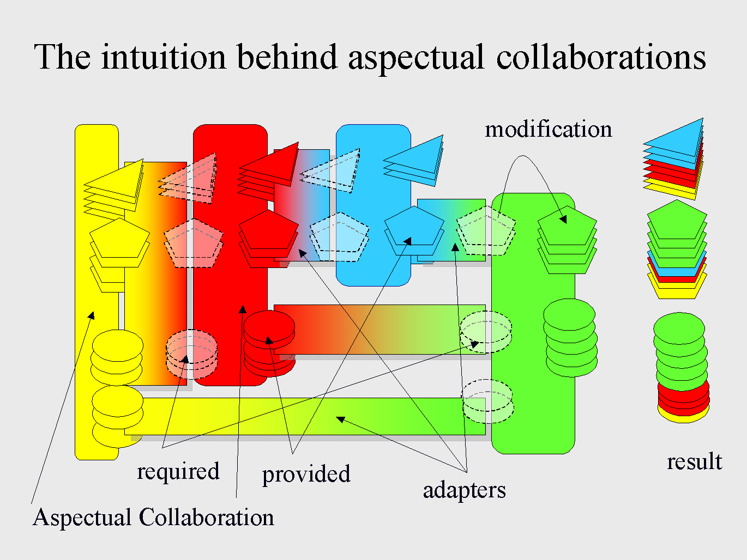
Aspectual Collaborations*
Aspectual Collaborations (AC) capture both structural and behavioral concerns in a single unit. AC are modular building blocks that can be composed to construct AC with complex sharing between the constituent collaborations.
Composition is used to attach aspectual methods, provide deferred features, and control the interface of the resulting collaboration.
Collaborations with differing structural assumptions can be composed by reconciling any differences in the composition declaration, greatly increasing the scope for reuse of concerns.
AC have been implemented on top of AspectJ, and a separate byte code-rewriting implementation is underway. We apply AC to both real-time embedded applications with BBN and banking applications with UBS.
* Supported by the National Science Foundation (NSF) under Grant No. CCR-0098643.

Slide 3

Branches and Bundles
Incremental Programming (branch is basic building block)
  Branch has a
    condition expressed in terms of a decision point and
    body
  Decision point = message send
  Program = collection of branches organized into bundles.
  Each bundle describes one concern.
  Branch condition may involve:
    run-time type and state of arguments,
    message, enclosing branch, global properties.
A branch is fundamentally different than a procedure or a method:
Describes in detail the conditions under which it will be applied. A procedure has no control over when it will be applied and a method has a little control.
Predicate dispatching uses an arbitrary predicate expression over the message arguments to specify when a method is executed. By making the "when to execute" part of a behavioral unit definition more flexible, we can better separate behavioral concerns that would otherwise need to be tangled together in an explicit dispatch expression.
We are developing an extension to predicate dispatching that can lead to separation of cross-cutting behavioral concerns, by allowing methods to specify that they modify other methods (around methods),
as well as by allowing their predicates to take into account other parts
of a message send context such as the control flow history. These
extensions build a bridge between method dispatch research and
aspect-oriented programming research, by unifying the mechanisms
underlying both.
A common feature of the predicate dispatch work and the aspectual
collaborations work is that they basically add around methods to
achieve aspectual capability.

Slide 4
Formal Semantics for AOP*
In order to better understand and precisely specify the mechanisms for
modularizing cross-cutting concerns, we are building up a set of
formal semantics for aspect-oriented programming. We have started
with a denotational semantics for the basic building blocks of dynamic
join points and advice as embodied by AspectJ, using a variant of
store-passing monads to model computations and modeling
advice as procedure transformers. Our goal is to develop a theory of
AOP that accounts for other models such as Demeter and HyperJ.The second stage of the project was to design a system that would satisfy the specifications.
Adaptive Programming*
Adaptive Programming (AP) is a technology that helps to
disentangle the structural concern from the behavioral concerns by
allowing traversals of composite objects to be specified in a
structure-shy way, as traversal strategies. We actively use and
improve this technology in the form of DJ, a pure-Java package for
constructing traversal strategies dynamically; the AP library, a
pure-Java package for parsing and expanding traversal strategies; and
DemeterJ, which generates static traversal code from input in the form
of Java code extended with traversal strategies. Recently, we
developed a simplified, object based semantics for
AP.
E-mail: dem@ccs.neu.edu
http://www.ccs.neu.edu/research/demeter
* Supported by DARPA under agreement F33615-00-C-1694 and NSF under grant CCR-0098643.

