Slide 1
basis of crosscutting
a join point model (JPM) has 3 critical elements
  what are the join points
    in AspectJ
      points in runtime call graph
      class members
  means of identifying join points
    in AspectJ
      pointcuts
      member signatures (plus …)
  means of affecting implementation at join points
    in AspectJ
      advice
      define members

Slide 2
basis of crosscutting
a join point model (JPM) has 3 critical elements
  what are the join points
    in AspectJ
      points in runtime call graph
      class members
  means of identifying join points
    in AspectJ
      pointcuts
      member signatures (plus …)
  means of affecting implementation at join points
    in AspectJ
      advice
      define members
dynamic JPM
static JPM

Slide 3
range of AOP languages
 |  | means of … JPs
JPM | join points | identifying | specifying semantics at
AspectJ dynamic JPM | points in execution call, get, set… | signatures w/ wildcards & other properties of JPs | advice
static JPM | class members | signatures | add member definitions
Composition Filters | message sends & receptions | signature & property based object queries | wrappers declarative (filters) imperative (advice)
Hyper/J | members | signatures | add, compose (and remove) members
Demeter traversals | types | succinct traversal specifications | generate traversals

Slide 4
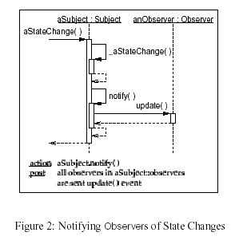
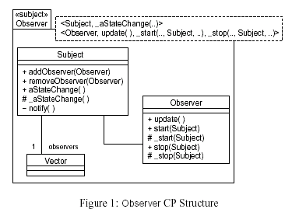
AO design in UML
[Clarke, Walker]
Composition Patterns
  static JPM
  (like Hyper/J)
class & interaction diagrams already crosscut
  by-class vs. by-interaction organizations
f
  dynamic JPM
  (like AspectJ advice)

Slide 5
aspect sand-box
toolkit for AOP research
formal system for modeling AOP semantics
  Scheme interpreter framework
  range of semantics
    AspectJ static and dynamic
    proto Hyper/J, Demeter
tool for prototyping new semantics

Slide 6
semantics on reaching call
(set! call-method
(around-wrap call-method
(lambda (proceed mname obj args)
(fluid-let ((*current-jp*
(make-jp 'call
*within* mname
(jp-this *current-jp*) obj args)))
(fluid-let ((*jp-stack*
(cons *current-jp* *jp-stack*)))
(ajd-rt-weave *current-jp*
(lambda (args)
(proceed mname (car args) (cdr args)))
(cons obj args)))))))
1. on reaching a method call
3. push that on *jp-stack*
2. make a jp that describes it
4. run applicable advice

