Slide 1
Evaluation only.
Created with Aspose.Slides for .NET 4.0 16.1.0.0
Copyright 2004-2016 Aspose Pty Ltd.

Slide 2
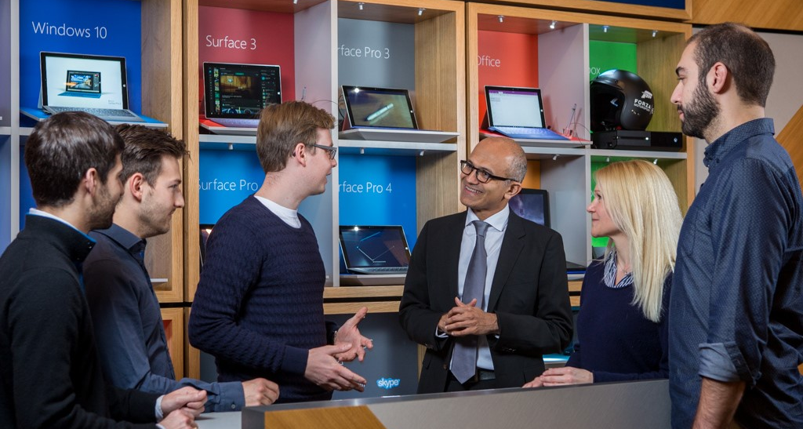
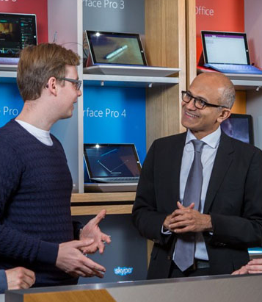





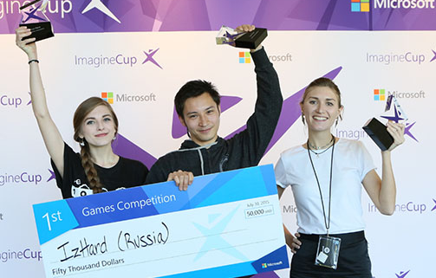








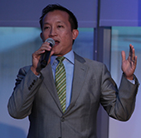
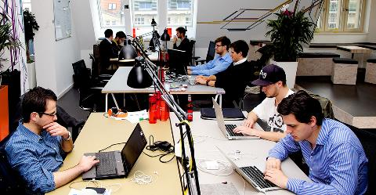
12 January
2016
ACCELERATING THE DEVELOPER-LED TRANSFORMATION
Evaluation only.
Created with Aspose.Slides for .NET 4.0 16.1.0.0
Copyright 2004-2016 Aspose Pty Ltd.
MISSION:
DX leads and accelerates the creation of successful applications and services across Microsoft devices and cloud platforms through its work with ISVs and technical audiences
MYR16 | Developer Experience and Evangelism – DX

Slide 3
DX | Agenda
Presenter: Steve Guggenheimer | OneNote Page: 2 | Slide 2 of 43
ONENOTE PAGE | TOPIC | TIME ALLOCATION | PRESENTER
Introduction
1 | Introduction | 20 minutes | Steve Guggenheimer
2 | Agenda
3 | DX Organization
4 | Transformation Journey
State of the Business
5 | State of the Business | 30 minutes | Steve Guggenheimer
6 | Area Performance |  | Joe Wilson
Evangelism
7 | Evangelism Model | 35 minutes | Kurt Steck (Scott Coleman)
8 | Startup & Student
9 | Trial Offers
ISV
10 | ISV Motion | 35 minutes | Kim Akers (Neil Leslie, Jeana Jorgensen)
11 | Azure Drill Down
12-13 | A Partner’s Experience
Tools
14 | Developer Tools | 10 minutes | Joe Wilson
LeX
15 | Learning eXperience | 10 minutes | Alison Cunard
Closing Summary
16 | Closing | 10 minutes | Steve Guggenheimer
 | Feedback from Reviewing Team | 30 minutes
Evaluation only.
Created with Aspose.Slides for .NET 4.0 16.1.0.0
Copyright 2004-2016 Aspose Pty Ltd.

