Slide 1
AOP
Aspect Orientated Programming

Slide 2
What is AOP?
AOP:
Programming paradigm to separate functional code from cross cutting concerns
Functional code example:
Add subscription to Advantage
Cross cutting concerns examples:
Logging
Caching
Exception Handling

Slide 3
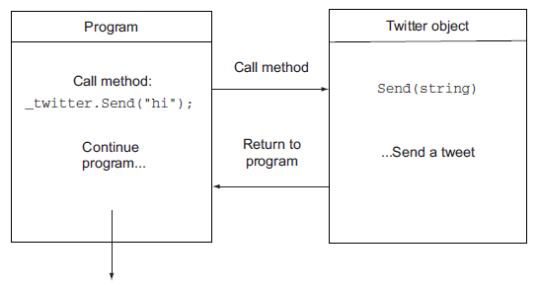
How is it done?
Normal execution

Slide 4
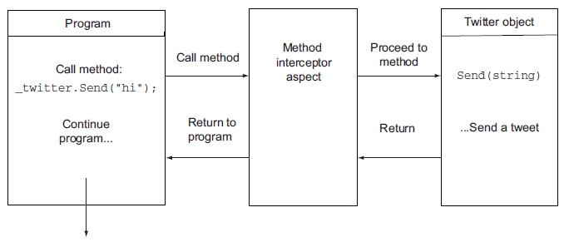
How is it done?
Method interception

Slide 5
MVC ActionFilters
[Authorize]
Restricts access to controller action
[OutputCache]
Caches output of controller action
[HandleError]
Handle errors raised by controller action

Slide 6
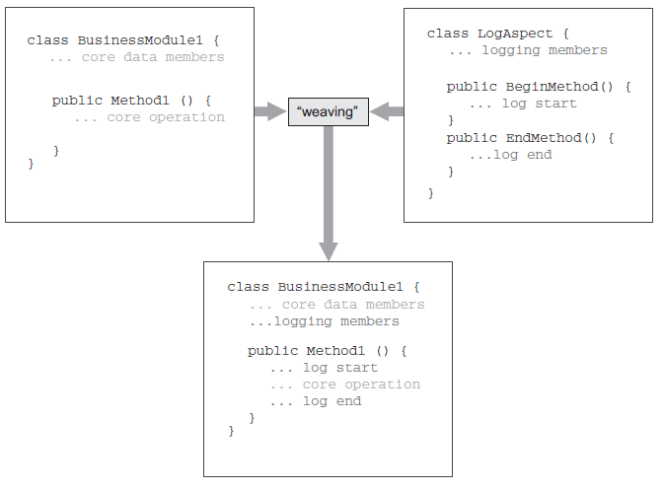
Weaving

Slide 7
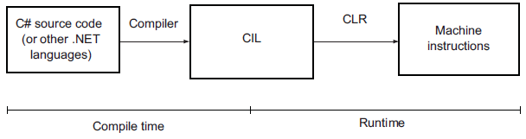
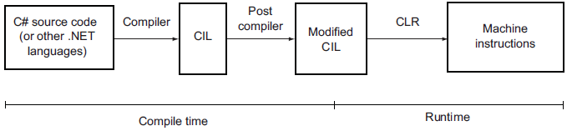
Compile Time Weaving
Normal compilation
With compile time weaving

Slide 8
Compile Time Frameworks
PostSharp
Mature framework
Free Express Edition
Lots of pre-written aspects in v3 (esp. Ultimate Ed.)
LinFu
DI, AOP etc…
Compile time & Runtime AOP
Free & Open source
SheepAspect
Fody

Slide 9
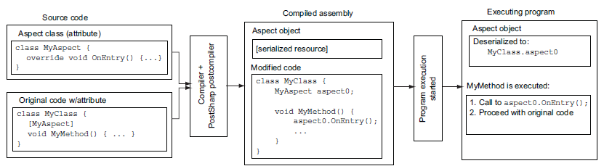
PostSharp Flow

Slide 10
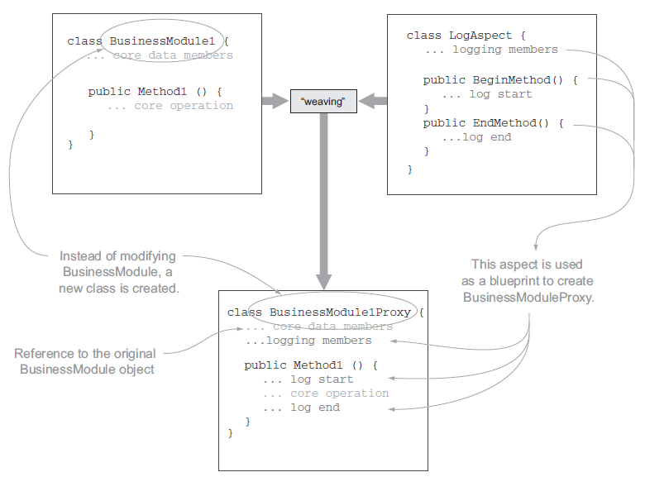
Runtime Weaving

Slide 11
Runtime Frameworks
Dynamic Proxy
Mature product
Works with Castle Windsor IoC
Free & Open Source
Unity.Interception
Part of Microsoft Unity Application Block
Works with Unity IoC
Free
Spring.Net
Based on Spring for Java
Use Spring.Core (DI)

