Slide 1
Homework3
Touch Chiva(sky)

Slide 2
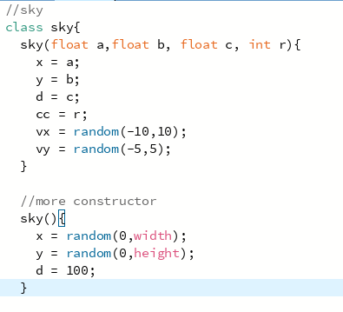
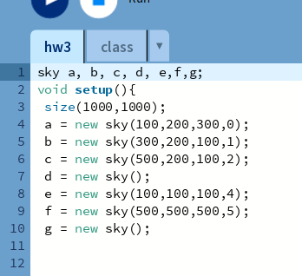
More constructor

Slide 3
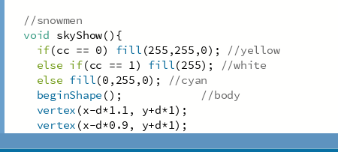
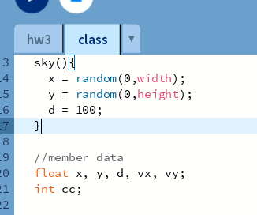
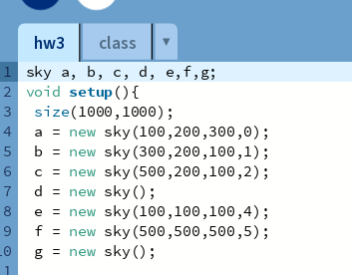
More member data

Slide 4
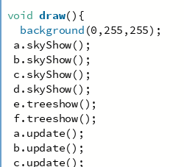
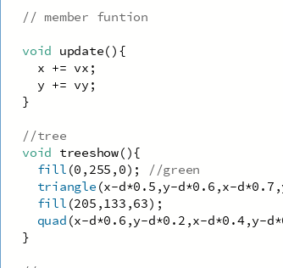
More member function

Slide 5
Resource code
processing/hw3 at main · Touchchiva/processing (github.com)
https://mega.nz/folder/lzw2wZJL#XnGYv4zO7yU6KzDk2-czdA

