Slide 1
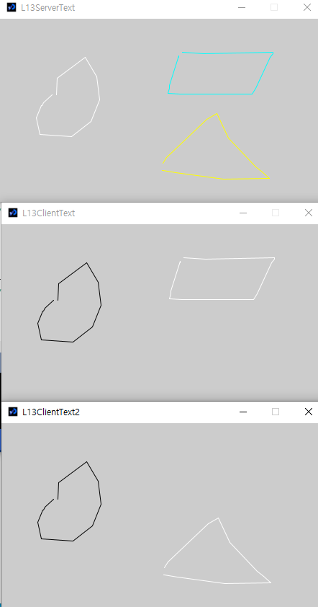

Multi-client
L13ClientText, L13ServerText에서 수정
L13ClientText를 열어서 save as L13ClientText2
L13ServerText 수정
if(data[4] > 100) stroke(255,255,0); // yellow
else stroke(0,255,255); // cyan
line(data[0], data[1], data[2], data[3]);
L13ClientText 수정
c.write(pmouseX + " " + pmouseY + " " + mouseX + " " + mouseY + " 50\n");
L13ClientText2 수정
c.write(pmouseX + " " + pmouseY + " " + mouseX + " " + mouseY + " 150\n”);

