Slide 1
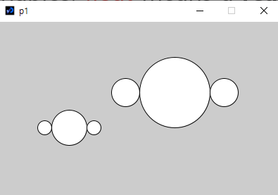
void setup(){
size(400,250);
// object 1
mars(250,100,100);
mars(100,150,50);
}
Name in English:
P1: Change the location of the circles in terms of (x, y) and the size in terms of d to have the same result.
void setup(){
size(400,250);
// object 1
circle(250,100,100);
circle(180,100,40);
circle(320,100,40);
// object 2
circle(100,150,50);
circle(65,150,20);
circle(135,150,20);
}
P3: Make a program which calculates y values and show in the console window for y = 3x + 5 for x=10, 20, 30, 40, 50, 60, 70, 80, 90, 100. Use for-loop and function.
The following program shows a and b values in the console window.
void setup(){
float a, b;
a = 100;
b = 200;
println(a);
println(b);
}
Your answer
void setup(){
size(400,250);
// object 1
float x, y, d;
Your answer
void setup(){
P2: Fill the blank to simplify the program in P1 by using your function mars().
P4: Draw the result of the following program.
void setup(){
size(400,300);
float a, b, c, d;
a = 100;
b = 200;
c = 150;
d = 250;
if(a>b || c<d)
circle(a, b, 50);
if(a>b && c<d)
circle(a, b, 80);
a = b + c;
if(a>b || c<d)
circle(c+200, d-100, 100);
if(a>b && c<d)
circle(c, b-100, 150);
}
void setup(){
size(400,250);
// object 1
mars(250,100,100);
mars(100,150,50);
}
(0,0)
Your answer
// function mars( )
(400,300);

