Slide 1
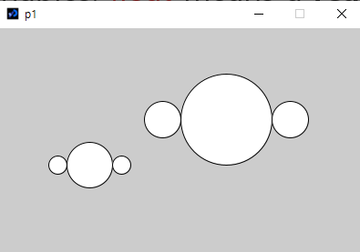
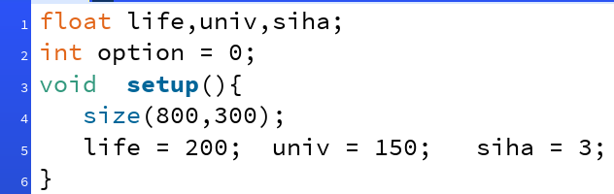
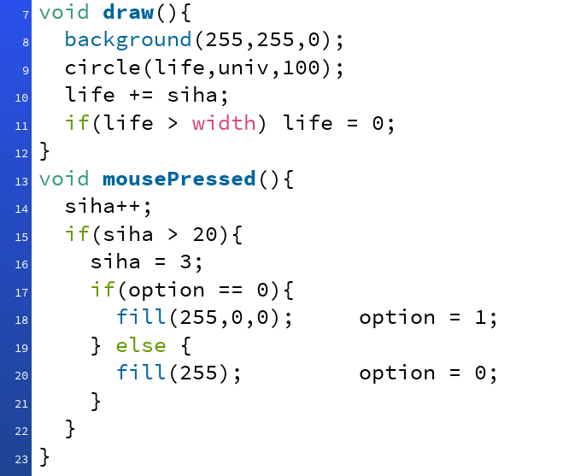
Name in English:
P1: Change the location of the circles in terms of (c, d) and the size in terms of e to have the same result.
void setup(){
size(400,250);
// object 1
circle(240,100,80);
circle(180,100,40);
circle(300,100,40);
// object 2
circle(100,150,40);
circle(70,150,20);
circle(130,150,20);
}
P3: Make a program which calculates y values and show in the console window for y = 3x + 5 where x=10, 20, 30, 40, 50, 60, 70, 80, 90, 100. Use for-loop and function. The function returns y of y = 3x + 5.
The following program shows a and b values in the console window.
void setup(){
float a, b;
a = 100;
b = 200;
println(a);
println(b);
}
Your answer
void setup(){
size(400,250);
// object 1
float c, d, e;
c = 240; d = 100; e = 80;
circle(c, d, e); // example
Your answer
void setup(){
P2: Fill the blank to simplify the program in P1 by using your function mars().
P4: Draw the result of the following program.
void setup(){
size(400,300);
float a, b, c, d;
a = 100;
b = 200;
c = 150;
d = 250;
if(a>b || c<d)
circle(a, b, 50);
if(a>b && c<d)
circle(a, b, 80);
a = b + c;
if(a>b || c<d)
circle(c+200, d-100, 100);
if(a>b && c<d)
circle(c, b-100, 150);
}
void setup(){
size(400,250);
mars(250,100,100); // object 1
mars(100,150,50); // object 2
}
(0,0)
Your answer
// write the function mars( … ).
(400,300)
Which direction does the circle move?
When you click the mouse 5 times, what is the speed of circle? What is the color of the circle?
When you click the mouse 25 times, what is the speed of circle? What is the color of the circle?
When you click the mouse 55 times, what is the speed of circle? What is the color of the circle?
Why is (life>width) in Line 11, instead of (life == width)?
P5: Answer the questions.
Your answer

