Slide 1
Among us and bear
teammate’s name:
Kimchar
Seng hour

Slide 2
Our goal
we will make a program in which user interfaces are enabled.
- Amoung us move to the mouse.
-A bear move by the keyboard.Key ‘a’ is move to left and key ‘d’ move to right.Other key lets it move to the mouse position.

Slide 3
float x1, x2, y1, y2, d1, d2;
void setup() {
size(1000, 800);
x1 = 300;
y1 = 200;
d1 =100;
x2 = 300;
y2 = 200;
d2 =50;
}
void draw() { // called 60 times in 1 second
background(255, 255, 0); // yellow
kimchar(x1, y1, d1);
Hour(x2, y2, d2);
}
void mouseReleased() {
x1 = mouseX;
y1 = mouseY;
}
void keyPressed() {
if (key == 'a') x2 -= 5;
else if (key == 'd') x2 += 8;
else {
x2 = mouseX;
y2 = mouseY;
}
}
void Hour(float x, float y, float d) {
//body
fill(149, 120, 106);
ellipse(x-1*d, y+3.4*d, d*6.4, d*4.4);
// ears
ellipse(x-2.75*d, y-1.35*d, d*1.7, d*1.7);
ellipse(x+0.75*d, y-1.35*d, d*1.7, d*1.7);
// inner ears
fill(112, 90, 87);
ellipse(x-2.75*d, y-1.35*d, d*1.4, d*1.4);
ellipse(x+0.75*d, y-1.35*d, d*1.4, d*1.4);
//face
fill(149, 120, 106);
ellipse(x-1*d, y+0.3*d, d*4.5, d*4.4);
//eye
fill(251, 251, 251);
ellipse(x-1.7*d, y-0.5*d, d*0.65, d*0.65);
ellipse(x-0.3*d, y-0.5*d, d*0.65, d*0.65);
//eye
fill(15, 15, 11);
ellipse(x-1.7*d, y-0.5*d, d*0.40, d*0.40);
void kimchar(float x,float y, float d){
strokeWeight(d*0.05);
fill(255,105,180);
arc(x+1.8*d,y+2.2*d,d*0.55,d*1.5,0,PI); //feet
arc(x+2.3*d,y+2.2*d,d*0.55,d*1.5,0,PI);
//feet
fill(0,200,255);
rect(x+0.7*d,y+0.3*d,d*0.8,d*1.8); //beg
fill(255,105,180);
ellipse(x+2*d,y+1*d,d*2,d*3);
// body
ellipse(x+2.5*d,y+0.5*d,d*1.5,d*0.8); //eye
fill(0,255,255);
ellipse(x+2.5*d,y+0.5*d,d*1.2,50); //glasses
//eye
fill(50,150,200);
rect(x+1.8*d,y-1.1*d,d*0.4,d*0.2);
circle(x+2*d,y-1.5*d,d); // balloon
strokeWeight(5);
line(x+2*d,y-0.9*d,x+2*d,y-0.5*d);
}

Slide 4
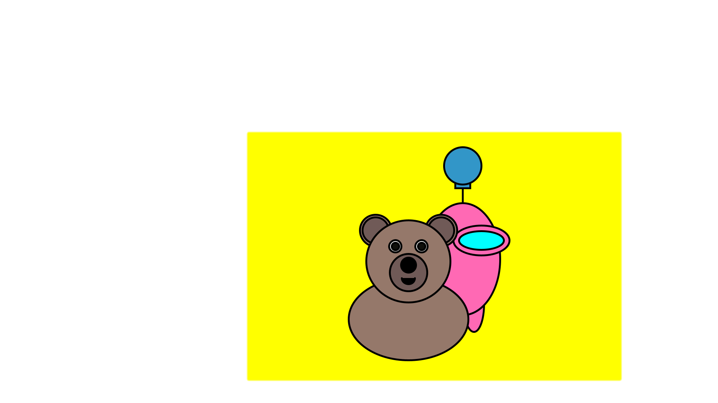
ellipse (x-0.3*d, y-0.5*d, d*0.40, d*0.40);
fill(112, 90, 87);
//snout
ellipse(x-1*d, y+0.90*d, d*2, d*2);
//mouth
fill(0, 0, 0);
arc(x-1*d, y+1.2*d, d*0.70, d*0.65, 0, PI);
ellipse(x-1*d, y+0.50*d, d*0.80, d*0.80);
}

Slide 5
Feeling about this homework
After this homework ,I think it isn’t easy for me but I still make it .I’m so excited that I can make user interfaces for my character.Thank you,prof.

