Slide 1
Homework5 “User interfaces for my character”
Student’s name: Thirng Ly and Phai Lychhy

Slide 2
Goal
We will make a program in which user interfaces are enabled.
A motor bike moves to left by key “a” , moves to right by key “d” , goes down by key “s” and goes up by key “w”. Other key lets it move to the mouse position (បើយើងចុចទៅលើ key ក្រៅពី ”a, d, s, w” នោះវានឹងផ្លាស់ទីទៅតាម Mouse pointer ដែលបានបង្ហាញនៅលើអេក្រង់ computer ក្នុងទំហំផ្ទៃដែលយើងបានកំណត់ជាក់លាក់កាលណា​បើយើងអូស Mouse ចុះលើង).
A bear moves to the mouse (វាផ្លាស់ទីទៅតាម Mouse pointer ដែលបានបង្ហាញនៅលើអេក្រង់computer​​​ ក្នុងទំហំផ្ទៃដែលយើងបានកំណត់ជាក់លាក់កាលណា​បើយើង click ទៅលើ Mouse).

Slide 3
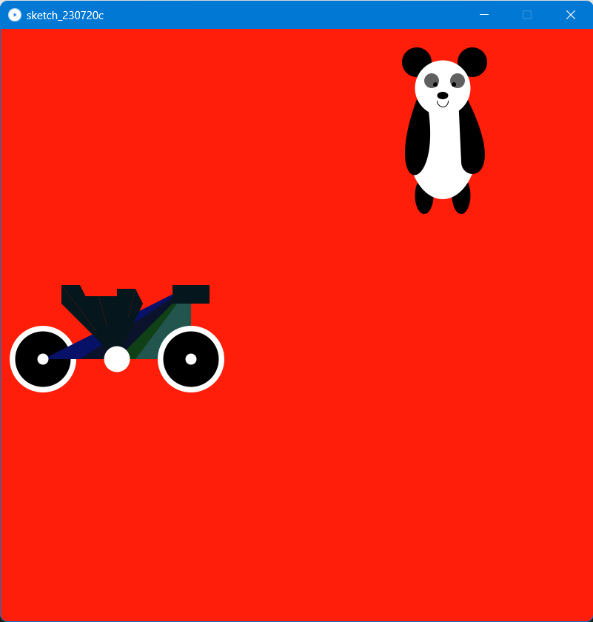
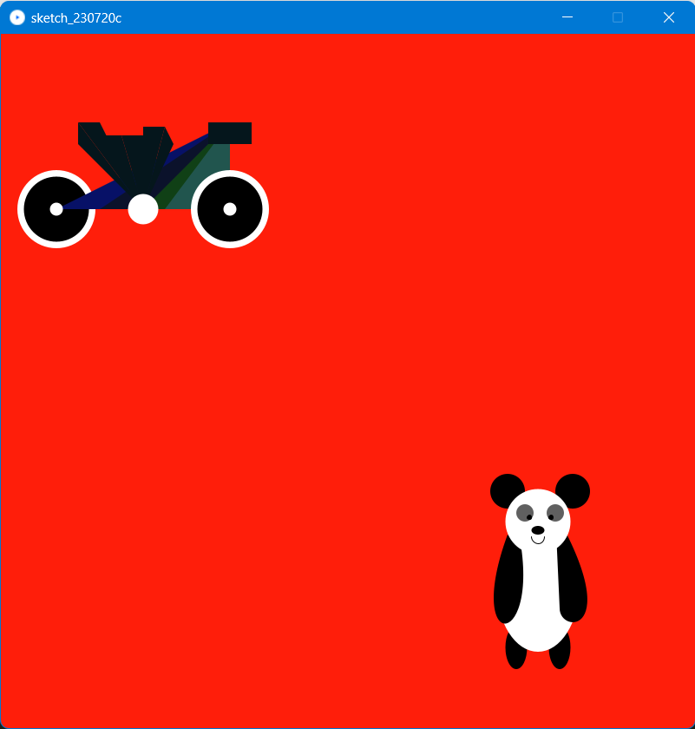
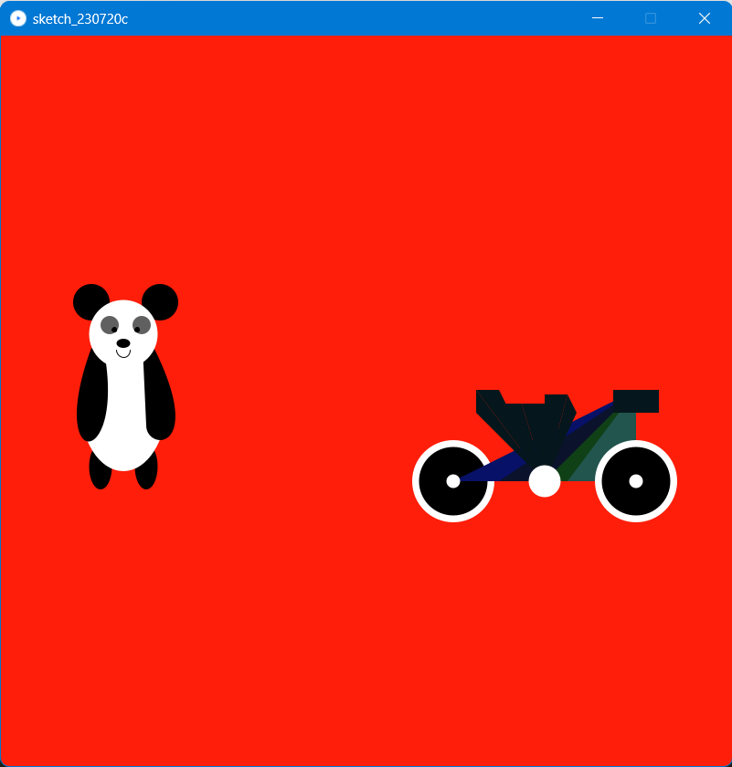
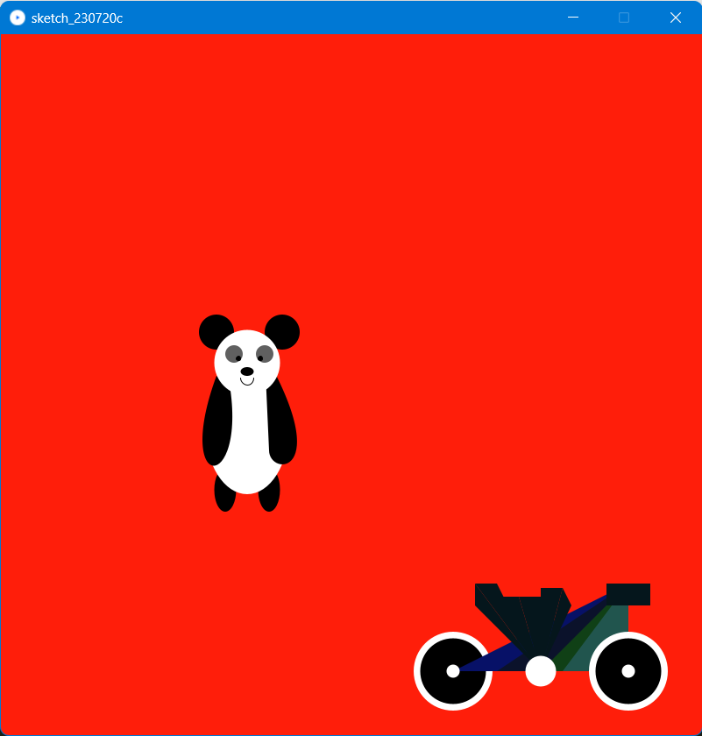
sources
float x1, x2, y1, y2, d1, d2;
void setup() {
size(800,800);
x1=100; y1=300; d1=50;
x2=100; y2=200; d2=50;
}
void draw() { // called 60 times in 1 second
background(255,30,10); // yellow
lychhy(x1, y1, d1);
thirngly(x2, y2, d2);
}
void mouseReleased() {
x1 = mouseX;
y1 = mouseY;
}
void keyPressed() {
if (key == 'd') x2 +=4; //turn right
else if (key == 'a') x2 -=4; //turn left
else if(key == 'w') y2 +=4; // go up
else if(key == 's') y2 -=4; // go down
else {
x2 = mouseX;
y2 = mouseY;
}
}

Slide 4
Thirngly’s character (Motor bike)
void ly(float x, float y, float d){
noStroke();
fill(255,255,255);
circle(x,y+4*d,1.8*d);//left
fill(0);
circle(x,y+4*d,1.5*d);
fill(7,17,103);
triangle(x,y+d*4,x+d*4,y+d*4,x+d*4,y+d*2); triangle(x+d*0.5,y+d*4,x+d*4,y+d*4,x+d*4,y+d*2);
fill(11,18,43);
triangle(x+d,y+d*4,x+d*4,y+d*4,x+d*4,y+d*2); triangle(x+d*1.5,y+d*4,x+d*4,y+d*4,x+d*4,y+d*2);
fill(16,64,22); triangle(x+d*2,y+d*4,x+d*4,y+d*4,x+d*4,y+d*2);
triangle(x+d*2.5,y+d*4,x+d*4,y+d*4,x+d*4,y+d*2);
fill(33,85,78); triangle(x+d*3,y+d*4,x+d*4,y+d*4,x+d*4,y+d*2);
triangle(x+d*2.5,y+d*4,x+d*4,y+d*4,x+d*4,y+d*2);
fill(5,22,28);
triangle(x+d*2,y+d*4,x+d*0.5,y+d*2,x+d,y+d*2); triangle(x+d*2,y+d*4,x+d*0.5,y+d*2.5,x+d*0.5,y+d*2);
triangle(x+d*2,y+d*4,x+d*1.5,y+d*2.3,x+d*2,y+d*2.3); triangle(x+d*2,y+d*4,x+d,y+d*2.3,x+d*1.5,y+d*2.3);
triangle(x+d*2,y+d*4,x+d*2,y+d*2.1,x+d*2.5,y+d*2.1); triangle(x+d*2,y+d*4,x+d*2.5,y+d*2.1,x+d*2.7,y+d*2.5);
fill(255,255,255); circle(x+d*4,y+d*4,d*1.8);//right
fill(0);
circle(x+d*4,y+d*4,d*1.5);
fill(255,255,255);
circle(x+d*4,y+d*4,d*0.3);//kam left
circle(x+d*2,y+d*4,d*0.7);//jvak
circle(x,y+d*4,d*0.3);//kam righ
fill(5,22,28); rect(x+d*3.5,y+d*2,d,d*0.5);
}

Slide 5
Lychhy’s character (Bear)
void lychhy(float x,float y,float d){
fill(0);
ellipse(x-1.5*d2,y+d2*2.9,d2/2,d2); //left leg
ellipse(x-0.5*d2,y+d2*2.9,d2/2,d2); //right leg
circle(x-0.2*d2,y-0.7*d2,d2-10); //right ear
circle(x-1.7*d2,y-0.7*d2,d2-10); //left ear
fill(255);
ellipse(x-d2,y+1.5*d2,1.9*d2,3*d2); //body
fill(0);
bezier(x-1.7*d2,y+0.3*d2,x-2.7*d2,y+3*d2,x-d2,y+3*d2,x-1.4*d2,y+0.5*d2); //left hand
bezier(x-0.5*d2,y+2*d2,x-0.5*d2,y+2.6*d2,x+d2,y+2.6*d2,x-0.6*d2,y-0.2*d2); //right hand
fill(255);
circle(x-d2,y,1.5*d2); //face
fill(96);
circle(x-1.3*d2,y-0.2*d,0.4*d2); //left eye
circle(x-0.6*d,y-0.2*d,0.4*d); //right eye
fill(0);
ellipse(x-d,y+0.2*d,0.3*d,0.2*d); //nose
stroke(0);
circle(x-1.2*d,y-0.1*d,0.1*d); //button left eye
circle(x-0.7*d,y-0.1*d,0.1*d); //button right eye
noFill();
arc(x-d,y+0.35*d,0.3*d,0.3*d,0,PI); //mouse
}
GitHub Link
https://github.com/thirnglyingzz/hw5-programming

Slide 6
Feeling for this homework
Thirng Ly: This homework is not easy but it’s not more difficult, I am not sure at void keypressed point and upload file in GitHub is the new thing for me.
Phai Lychhy: It looks so interesting in by making the character move. I enjoy create those characters, it is fun.

