Slide 1
HW 2
Due on Feb. 13, 2023
Send to suh@khu.ac.kr .

Slide 2

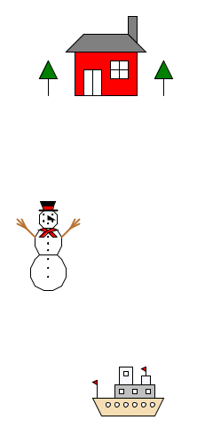



https://github.com/dougsuh/artCoding/tree/master/c1-c3variableFunction/hw3Move
Rina
Sengaun
Parady
Sky
Chanra
Somaram
Punleu
Samrech
Piseth
Phanith
Hong
Sreyleak
Panha

Slide 3
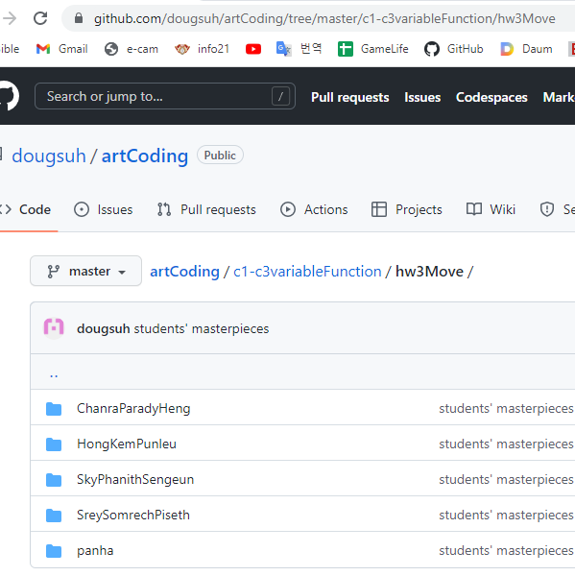
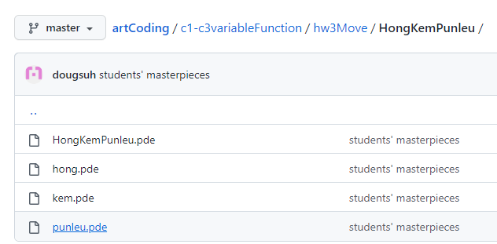
1. Copy your character
https://github.com/dougsuh/artCoding/tree/master/c1-c3variableFunction/hw3Move
Double click

Slide 4
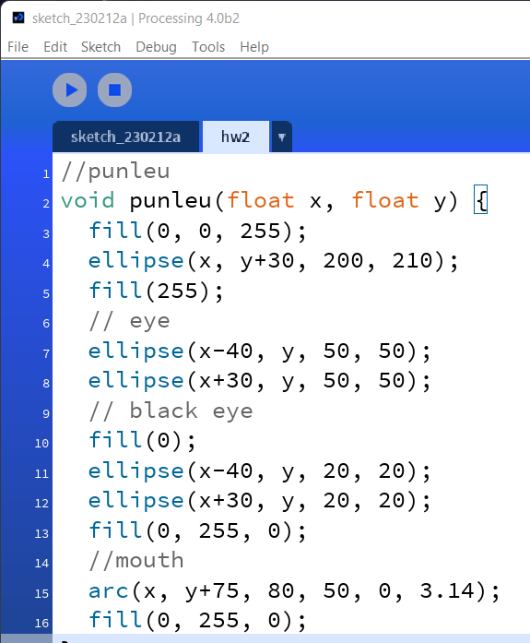
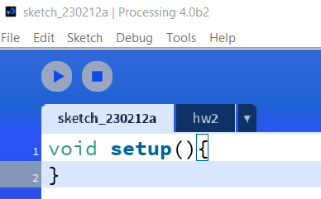
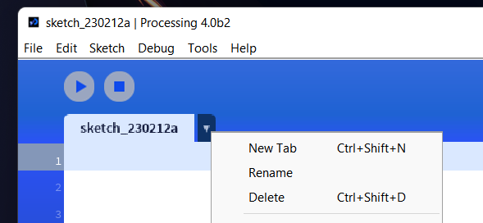
2. Copy/paste the program to Processing4.0
Make a simple setup()
Copy/paste the program in a new tab.

Slide 5
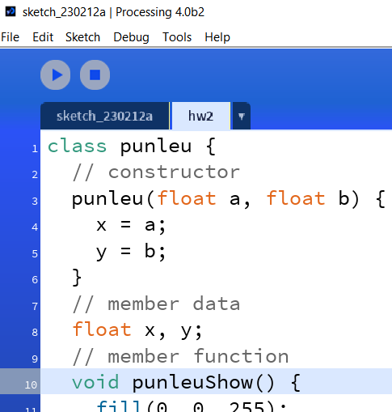
3. Change to class
Constructor (the same name with the class name)
Member data
Member function
class classname{
// constructor
classname(…);
// member data
// member function
} // end of class

Slide 6
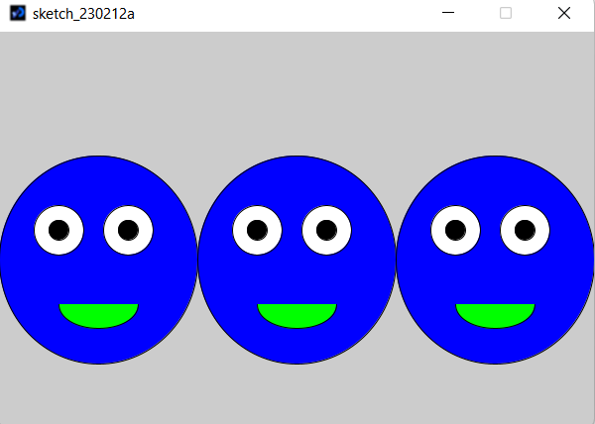
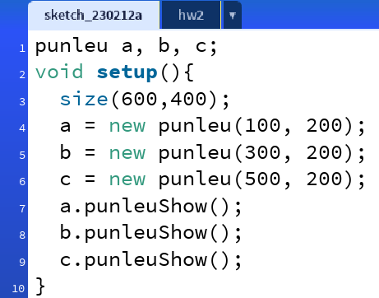
4. Make objects in setup( )
classname
classname
member function

Slide 7
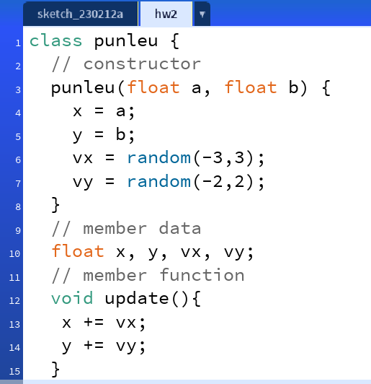
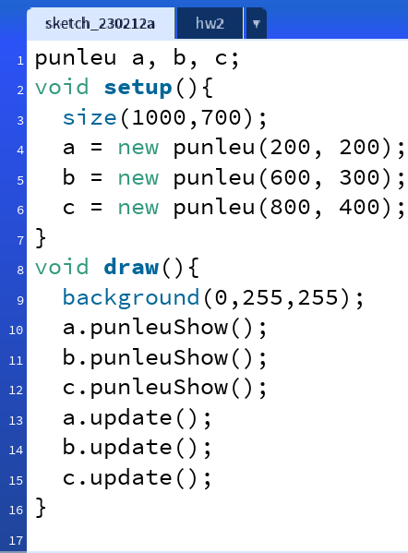
5. Move the objects
Add member data vx and vy;
Add a member functions for movement.
Add draw( ) function

Slide 8
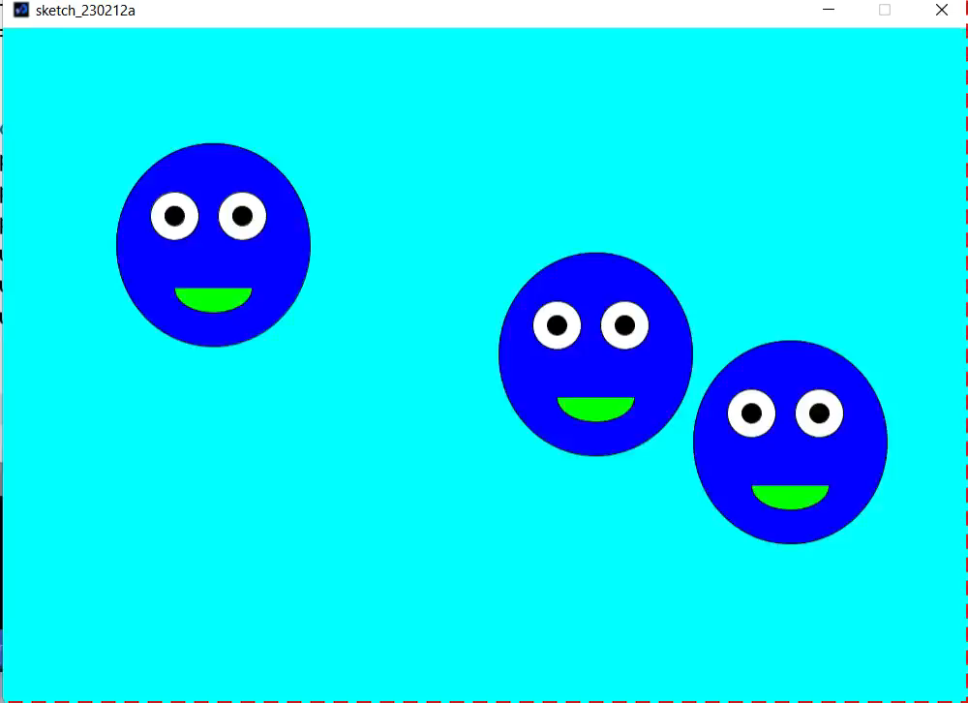
Play video

Slide 9
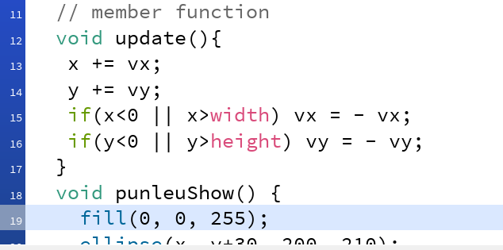
6. Modify member function update( ).

Slide 10
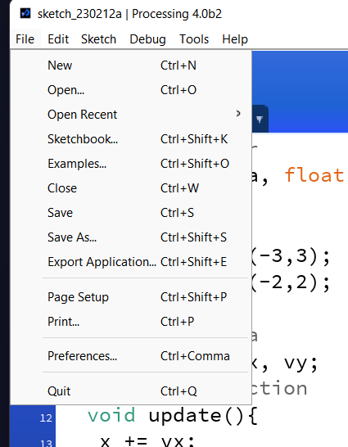
7. Make a homework report and Email
Store in your folder and copy/paste in the homework.

Slide 11
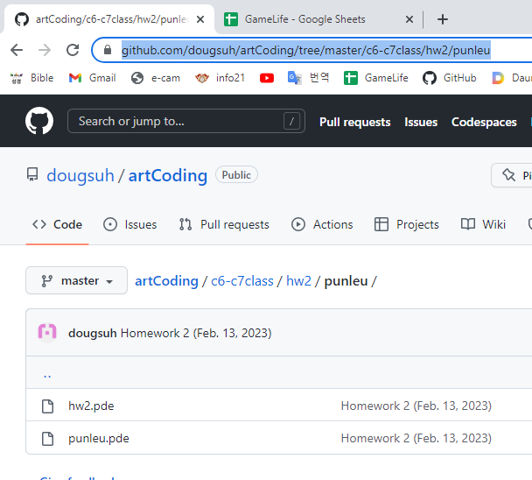

8. (optional) your own GitHub site
You may make your own GitHub site.
Upload on your own repository.
Send the link of the uploaded files.

Slide 12
Report
Hong https://github.com/tainglyhong/coding/tree/main

