Slide 1
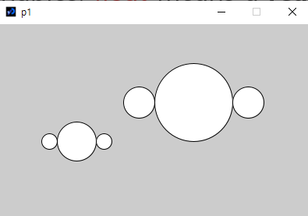
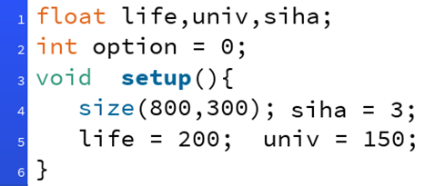
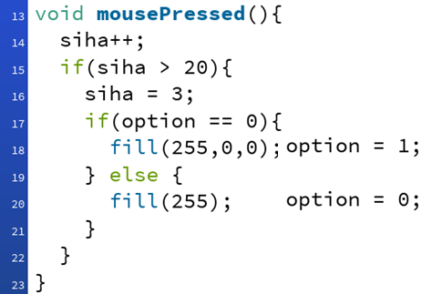
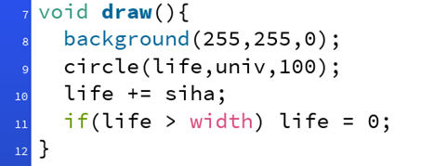
P1: Modify the program in which the location and size of the circles are described in terms of c, d, and e.
void setup(){
size(400,250);
// object 1
circle(240,100,80);
circle(180,100,40);
circle(300,100,40);
// object 2
circle(100,150,40);
circle(70,150,20);
circle(130,150,20);
}
P3: Make a program which calculates y values and show in the console window for y = 3x + 5 where x=10, 20, 30, 40, 50, 60, 70, 80, 90, 100. Use for-loop and function. The function returns y of y = 3x + 5.
The following program shows a and b values in the console window.
void setup(){
float a, b;
a = 100; b = 200;
println(a); println(b);
}
P2: In order to simplify the program in P1, make a function mars().
P4: Draw the result of the following program.
void setup(){
size(400,300);
float a, b, c, d;
a = 100; b = 200; c = 150; d = 250;
if(a>b || c<d) circle(a, b, 50);
if(a>b && c<d) circle(a, b, 80);
a = b + c;
if(a>b || c<d) circle(c+200, d-100, 100);
if(a>b && c<d) circle(c, b-100, 150);
}
void setup(){
size(400,250);
mars(250,100,100); // object 1
mars(100,150,50); // object 2
}
P5: Answer the questions.

Slide 2
Your name in English:
// P1: Your answer
void setup(){
size(400,250);
// object 1
float c, d, e;
c = 240; d = 100; e = 80;
circle(c, d, e); // example
// P3: your answer
void setup(){
P4 Your answer
(400,0)
// P2 : write the function mars( … ).
(0,300)
(400,300)
Which direction does the circle move?
When you click the mouse 5 times, what are the speed and the color of the circle?
When you click the mouse 25 times, what are the speed and the color of the circle?
When you click the mouse 55 times, what are the speed and the color of the circle?
Why is it (life>width) in Line 11, instead of (life == width)?
P5 Your answer

