Slide 1
Homework 1
Due on June 16, 2023

Slide 2
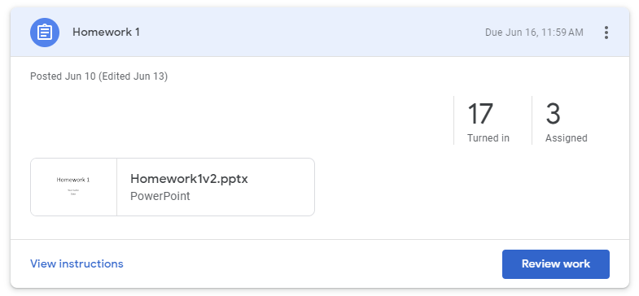
Good!! 17 out of 20 students submitted!!

Slide 3

MOBA 5vs5

Slide 4
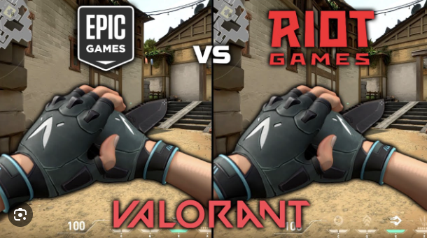
MOBA + shooter

Slide 5


Slide 6

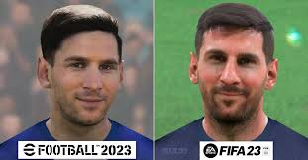

Slide 7


Slide 8
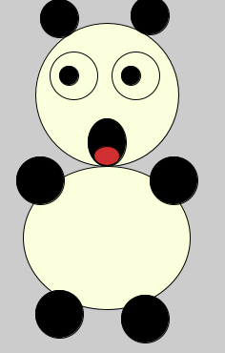


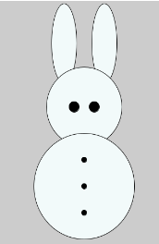
Wow!! only with circle()s and ellipse()s
Leng Chanvichea
Chan Davin Preap
Visal Sieng
Chin Srey Pich
Soklin Ren
Srey Ka

Slide 9
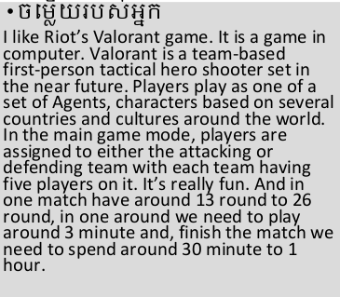

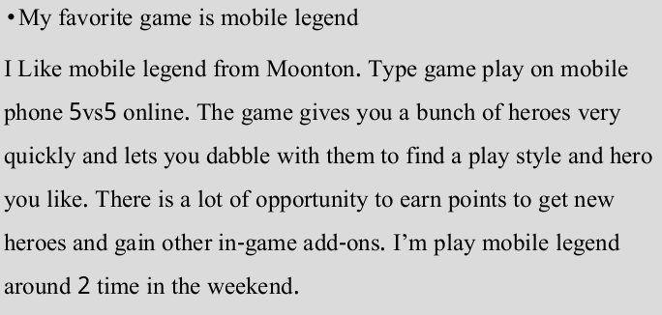
It is very good for you to help each other. But, submit different results.
HengLy Ti, Ngeap Thany
BoreyReach, Huor Seng, Sovann Panharong
Chan Davin Preap, Soklin Ren

