Slide 1
Break bricks
Doug Young Suh
Feb. 15, 2023
https://github.com/dougsuh/artCoding/tree/master/BrickBreak

Slide 2
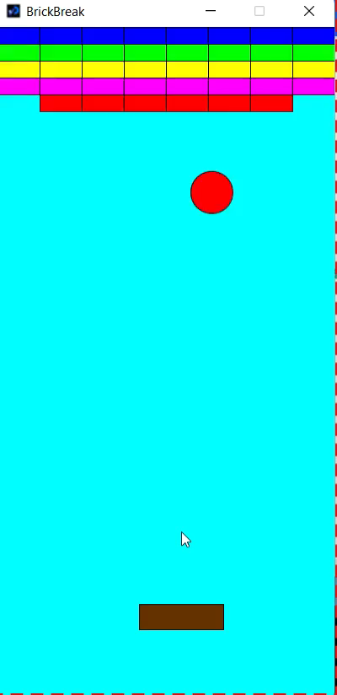
Brick break game
Ball
d : diameter
(x, y) determined by (sx, sy).
If it hits the Bat, sy = -sy.
If it hits Bricks[i], sy = -sy and Bricks[i].Layers--.
Bat
x = mouseX, y is fixed
(W, H) = width and height
Bricks
Layers: originally 5. If hit by Ball, Layers—
(W, H) : width and height
x : horizontal position

Slide 3
To be advanced
Quit or restart the game if the Ball hits the bottom.
Restart button
Score board
Ball speed up
Bat width gets smaller

