Slide 1

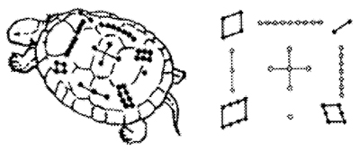
Number theory
Galois field (GF)
Hash code
Packet loss recovery
Doug Young Suh
Nov. 22, 2019
마방진 BC2200
1811~1831

Slide 2
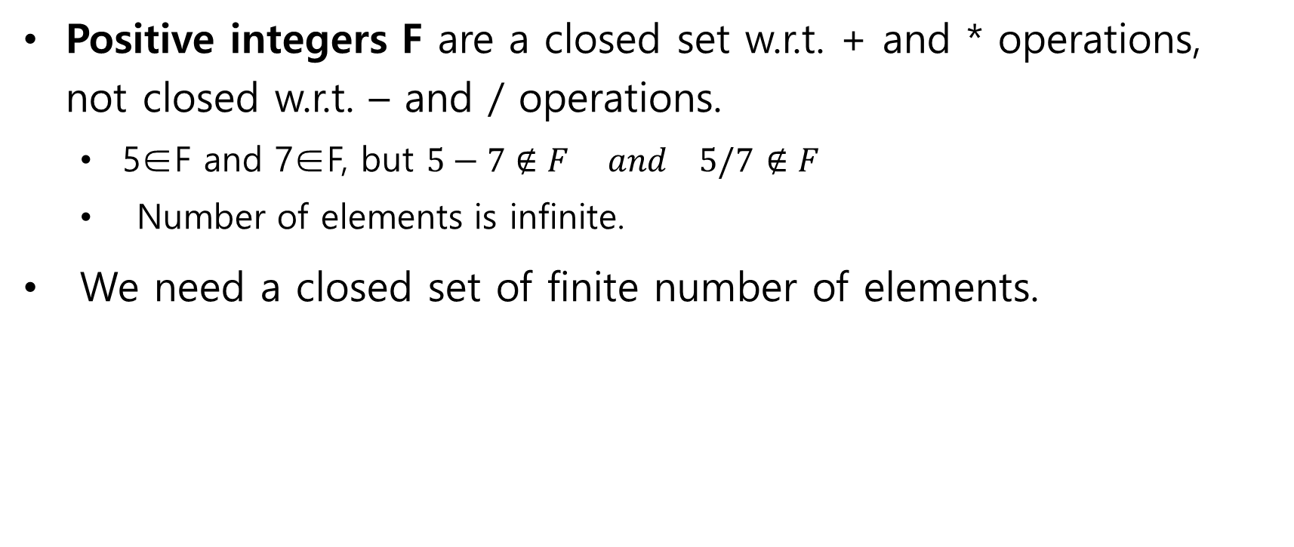
Field
Positive integers F are a closed set w.r.t. + and * operations, not closed w.r.t. – and / operations.
5∈F and 7∈F, but $5−7∉F and 5/7$ $∉F$
Number of elements is infinite.
We need a closed set of finite number of elements.

Slide 3
GF(2), Galois Field (2)
Closed in [0, 1] w.r.t. + and * operations with f(X)=X+1.
XOR | 0 | 1
0 | 0 | 1
1 | 1 | 0
AND | 0 | 1
0 | 0 | 0
1 | 0 | 1

Slide 4
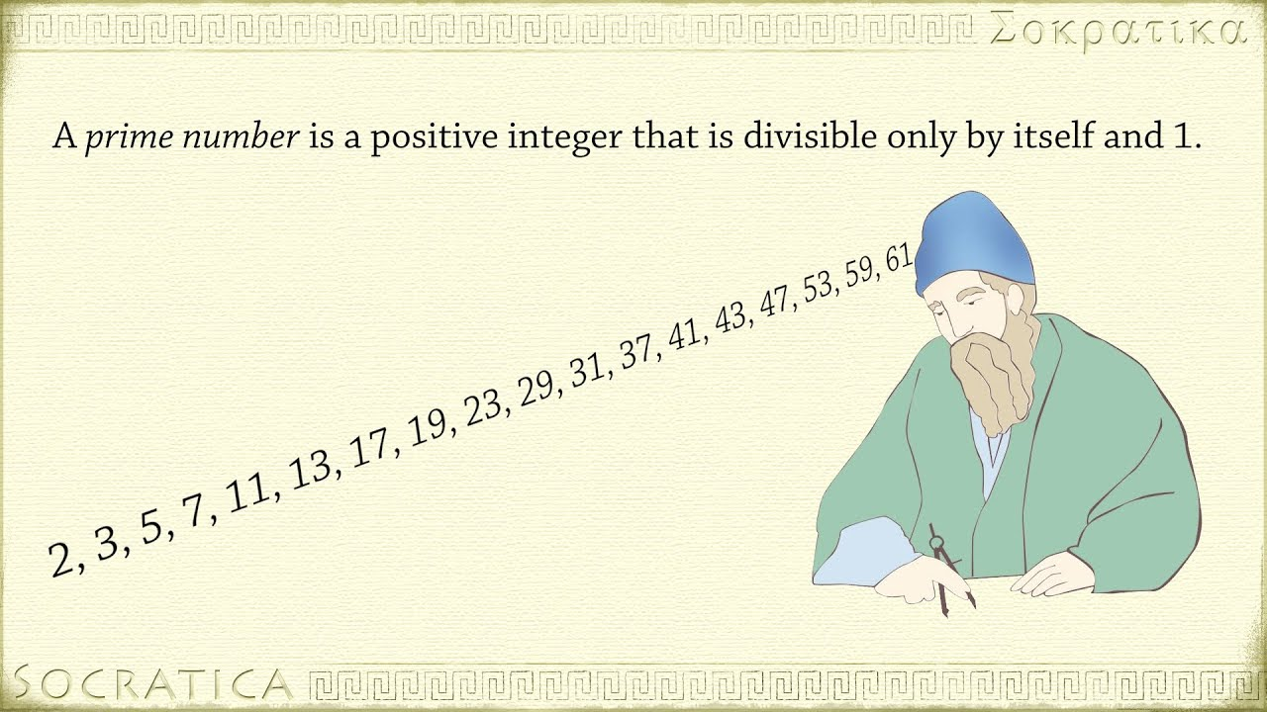

GF(2³) (1)
Closed in [0~7] w.r.t. + and * operations.
Primitive function
$$f\left(X\right)=1+X+X^{3} or 1+X^{2}+X^{3}$$
$$Then, X^{7}=1$$

Slide 5
GF(2³) (2)
Let the primitive function as,

Slide 6
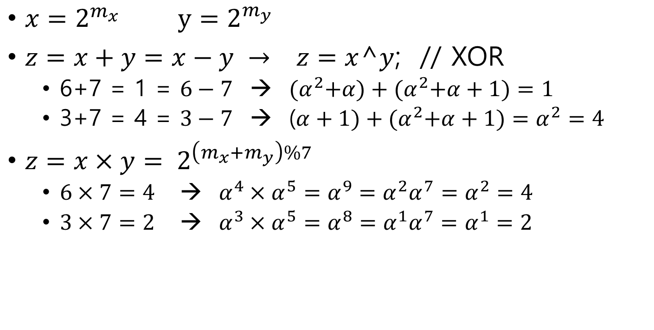
GF(2³): 2 operations
$x=2^{m_{x}}$ $y=2^{m_{y}}$
$z=x+y=x−y → z=x$^$y$; // XOR
6+7 = 1 = $6−7$ → ${(α}^{2}+α)+{(α}^{2}+α+1)=1$
3+7 = 4 = $3−7$ → ($α+1)+{(α}^{2}+α+1)=α^{2}=4$
$z=x×y= 2^{\left(m_{x}+m_{y}\right)\%7}$
$6×7=4$ → $α^{4}×α^{5}=α^{9}=α^{2}α^{7}=α^{2}=4$
$3×7=2$ → $α^{3}×α^{5}=α^{8}=α^{1}α^{7}=α^{1}=2$

Slide 7
GF(2³) in 2 Operations (3)
Addition table multiplication table
채워볼 것

Slide 8

GF(2⁸), Galois Field(2⁸)
GF(2⁸)
Closed in [0~255] w.r.t. + and * operations.
Primitive polynomial
${P\left(α\right)=α^{0}+α^{2}+α^{3}+α}^{4}+α^{8}=0$ where $α$ is a root of ${1+X}^{255}$.
${1+X}^{255}=(1+X)\left(…\right)\left(…\right)…$(${X^{0}+X^{2}+X^{3}+X}^{4}+X^{8})=0$
Recall GF(2³).

Slide 9
Conversion table
BYTE System::OCT_EXP[]= // OCT_EXP[8] = 2^8 = 29
{1, 2, 4, 8, 16, 32, 64, 128, 29, 58, 116, 232, 205, 135, 19, 38, 76,
152, 45, 90, 180, 117, 234, 201, 143, 3, 6, 12, 24, 48, 96, 192, 157,
39, 78, 156, 37, 74, 148, 53, 106, 212, 181, 119, 238, 193, 159, 35,
70, 140, 5, 10, 20, 40, 80, 160, 93, 186, 105, 210, 185, 111, 222,
161, 95, 190, 97, 194, 153, 47, 94, 188, 101, 202, 137, 15, 30, 60,
120, 240, 253, 231, 211, 187, 107, 214, 177, 127, 254, 225, 223, 163,
91, 182, 113, 226, 217, 175, 67, 134, 17, 34, 68, 136, 13, 26, 52,
104, 208, 189, 103, 206, 129, 31, 62, 124, 248, 237, 199, 147, 59,
118, 236, 197, 151, 51, 102, 204, 133, 23, 46, 92, 184, 109, 218,
169, 79, 158, 33, 66, 132, 21, 42, 84, 168, 77, 154, 41, 82, 164, 85,
170, 73, 146, 57, 114, 228, 213, 183, 115, 230, 209, 191, 99, 198,
145, 63, 126, 252, 229, 215, 179, 123, 246, 241, 255, 227, 219, 171,
75, 150, 49, 98, 196, 149, 55, 110, 220, 165, 87, 174, 65, 130, 25,
50, 100, 200, 141, 7, 14, 28, 56, 112, 224, 221, 167, 83, 166, 81,
162, 89, 178, 121, 242, 249, 239, 195, 155, 43, 86, 172, 69, 138, 9,
18, 36, 72, 144, 61, 122, 244, 245, 247, 243, 251, 235, 203, 139, 11,
22, 44, 88, 176, 125, 250, 233, 207, 131, 27, 54, 108, 216, 173, 71,
142, 1, 2, 4, 8, 16, 32, 64, 128, 29, 58, 116, 232, 205, 135, 19, 38,
76, 152, 45, 90, 180, 117, 234, 201, 143, 3, 6, 12, 24, 48, 96, 192,
157, 39, 78, 156, 37, 74, 148, 53, 106, 212, 181, 119, 238, 193, 159,
35, 70, 140, 5, 10, 20, 40, 80, 160, 93, 186, 105, 210, 185, 111,
222, 161, 95, 190, 97, 194, 153, 47, 94, 188, 101, 202, 137, 15, 30,
60, 120, 240, 253, 231, 211, 187, 107, 214, 177, 127, 254, 225, 223,
163, 91, 182, 113, 226, 217, 175, 67, 134, 17, 34, 68, 136, 13, 26,
52, 104, 208, 189, 103, 206, 129, 31, 62, 124, 248, 237, 199, 147,
59, 118, 236, 197, 151, 51, 102, 204, 133, 23, 46, 92, 184, 109, 218,
169, 79, 158, 33, 66, 132, 21, 42, 84, 168, 77, 154, 41, 82, 164, 85,
170, 73, 146, 57, 114, 228, 213, 183, 115, 230, 209, 191, 99, 198,
145, 63, 126, 252, 229, 215, 179, 123, 246, 241, 255, 227, 219, 171,
75, 150, 49, 98, 196, 149, 55, 110, 220, 165, 87, 174, 65, 130, 25,
50, 100, 200, 141, 7, 14, 28, 56, 112, 224, 221, 167, 83, 166, 81,
162, 89, 178, 121, 242, 249, 239, 195, 155, 43, 86, 172, 69, 138, 9,
18, 36, 72, 144, 61, 122, 244, 245, 247, 243, 251, 235, 203, 139, 11,
22, 44, 88, 176, 125, 250, 233, 207, 131, 27, 54, 108, 216, 173, 71,
142};
// P(X) = X^8 + X^4 + X^3 + X^2 + X^0 = 0
BYTE System::OCT_LOG[]= // OCT_LOG[2^x] = x
{0, // suh inserted... 2012. 10. 23
0, 1, 25, 2, 50, 26, 198, 3, 223, 51, 238, 27, 104, 199, 75, 4, 100,
224, 14, 52, 141, 239, 129, 28, 193, 105, 248, 200, 8, 76, 113, 5,
138, 101, 47, 225, 36, 15, 33, 53, 147, 142, 218, 240, 18, 130, 69,
29, 181, 194, 125, 106, 39, 249, 185, 201, 154, 9, 120, 77, 228, 114,
166, 6, 191, 139, 98, 102, 221, 48, 253, 226, 152, 37, 179, 16, 145,
34, 136, 54, 208, 148, 206, 143, 150, 219, 189, 241, 210, 19, 92,
131, 56, 70, 64, 30, 66, 182, 163, 195, 72, 126, 110, 107, 58, 40,
84, 250, 133, 186, 61, 202, 94, 155, 159, 10, 21, 121, 43, 78, 212,
229, 172, 115, 243, 167, 87, 7, 112, 192, 247, 140, 128, 99, 13, 103,
74, 222, 237, 49, 197, 254, 24, 227, 165, 153, 119, 38, 184, 180,
124, 17, 68, 146, 217, 35, 32, 137, 46, 55, 63, 209, 91, 149, 188,
207, 205, 144, 135, 151, 178, 220, 252, 190, 97, 242, 86, 211, 171,
20, 42, 93, 158, 132, 60, 57, 83, 71, 109, 65, 162, 31, 45, 67, 216,
183, 123, 164, 118, 196, 23, 73, 236, 127, 12, 111, 246, 108, 161,
59, 82, 41, 157, 85, 170, 251, 96, 134, 177, 187, 204, 62, 90, 203,
89, 95, 176, 156, 169, 160, 81, 11, 245, 22, 235, 122, 117, 44, 215,
79, 174, 213, 233, 230, 231, 173, 232, 116, 214, 244, 234, 168, 80,
88, 175
};
255=2¹⁷⁵

Slide 10
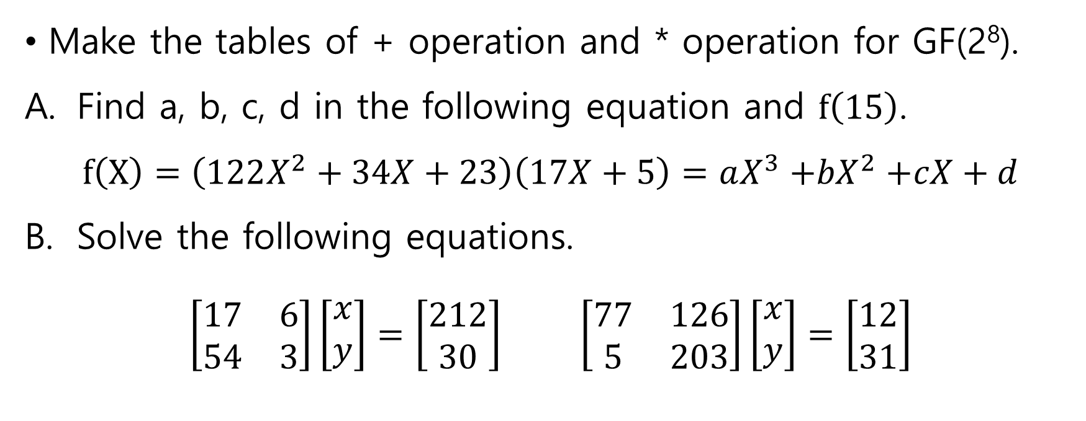
Assignment on GF(2⁸)
Make the tables of + operation and * operation for GF(2⁸).
Find a, b, c, d in the following equation and $f\left(15\right)$.
$$f\left(X\right)=\left(122X^{2}+34X+23\right)\left(17X+5\right)=aX^{3}{+bX}^{2}+cX+d$$
Solve the following equations.
$$\left[\begin{matrix}17 & 6 \\ 54 & 3\end{matrix}\right]\left[\begin{matrix}x \\ y\end{matrix}\right]=\left[\begin{matrix}212 \\ 30\end{matrix}\right] \left[\begin{matrix}77 & 126 \\ 5 & 203\end{matrix}\right]\left[\begin{matrix}x \\ y\end{matrix}\right]=\left[\begin{matrix}12 \\ 31\end{matrix}\right]$$

Slide 11
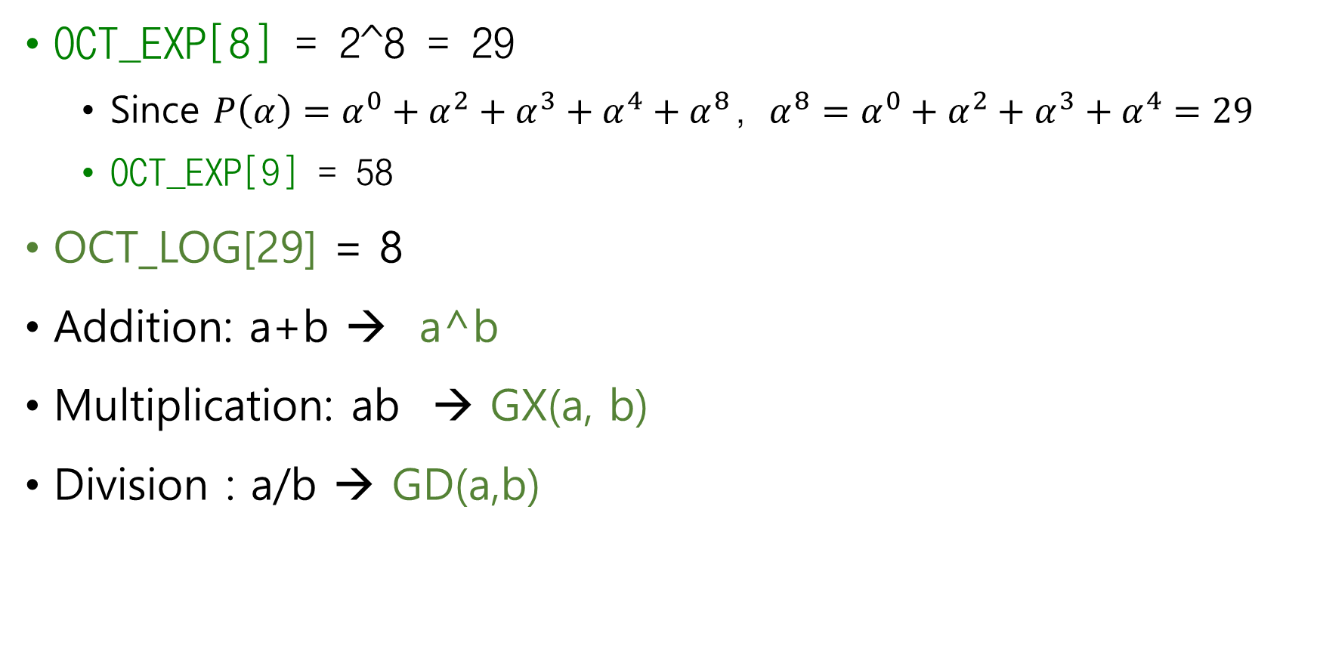
Hint) GF256.cpp
OCT_EXP[8] = 2^8 = 29
Since ${P\left(α\right)=α^{0}+α^{2}+α^{3}+α}^{4}+α^{8}$, $α^{8}={α^{0}+α^{2}+α^{3}+α}^{4}=29$
OCT_EXP[9] = 58
OCT_LOG[29] = 8
Addition: a+b → a^b
Multiplication: ab → GX(a, b)
Division : a/b → GD(a,b)

Slide 12


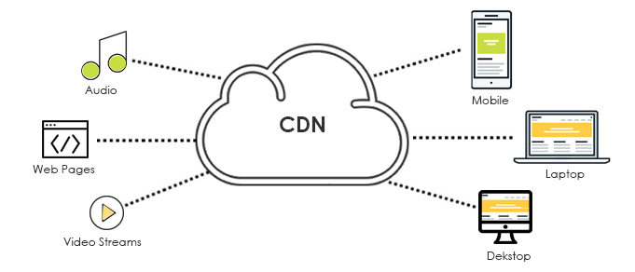
Hash code
Doug Young Suh
Nov. 23, 2019

Slide 13
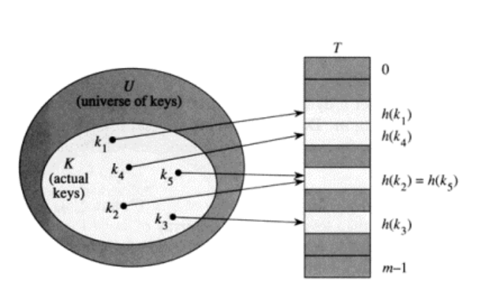
Hash code
An arbitrary size content of → key of a fixed size
Addressing for search with complexity of O(1)
How to make keys without collusion?

Slide 14
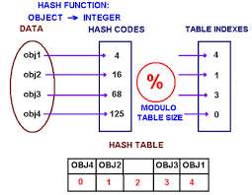
Division method (1)
Hash key is used for addressing
Content = m(X)
H(X) = m(X)X^{m} % P(X)
Then, (m(X)X^{m} +H(X)) % P(X) = 0
Could be used for error detection
Data storage
Data communication

Slide 15
Division method (2): Hamming(7,4)
Example) In binary(GF(2)) case where P(X)=X³+X+1 (m=3)
m(X) = 1101
m(X) X^{m} = 1001000
H(X) = m(X)X^{m} % P(X) = 110
m(X)X^{m} + H(X) = 1001110
How many cases of H(X) is possible? 3bits
What is probability that parity of 3 different m(X) are different?
Note that P(X) is a prime number, 11.
What happen if it is not prime number?
1001000
1011
10000
1011
110

Slide 16
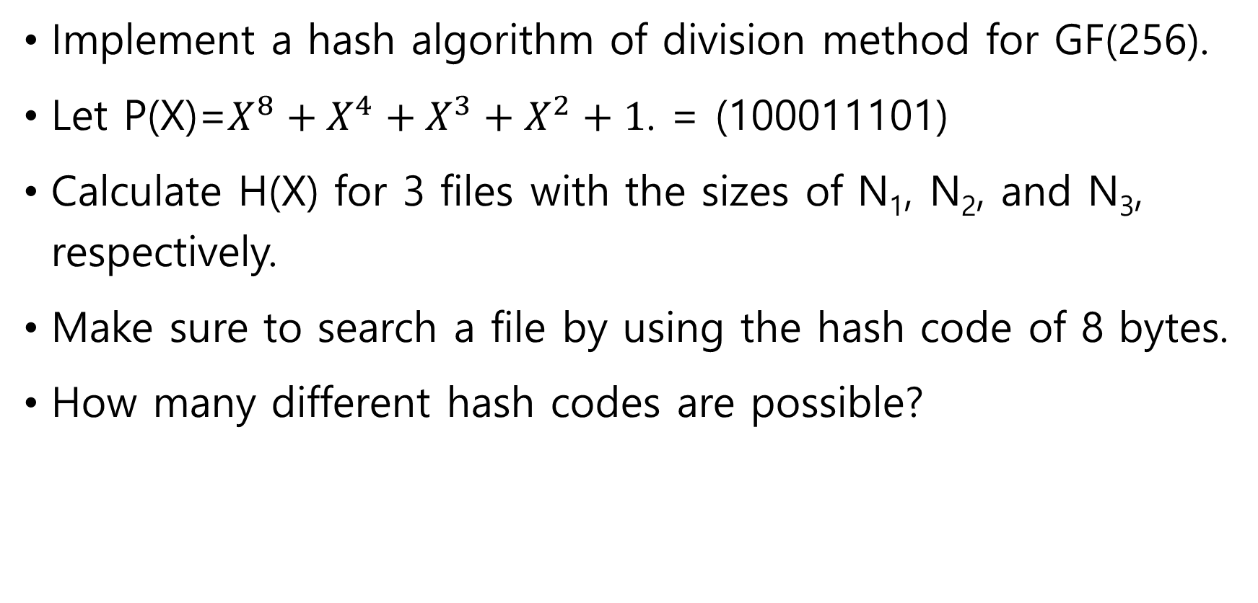
Assignment
Implement a hash algorithm of division method for GF(256).
Let P(X)=${X^{8}+X^{4}+X^{3}+X}^{2}+1$. = (100011101)
Calculate H(X) for 3 files with the sizes of N₁, N₂, and N₃, respectively.
Make sure to search a file by using the hash code of 8 bytes.
How many different hash codes are possible?

Slide 17
“hash.h”
ContentHash( )
Update H[M+1] n times
n bytes
contents[ ]
M bytes
Hash[ ]
…
0 | 1 | 2 | 3 |  |  |  |  |  | n-1
X^{n-1}
X²
X¹
X⁰
newHX( ): contents[ ]의 첫 M+1 bytes에서 aP(X)를 뺀다. 여기서 a는 contents의 첫 바이트.
즉, 첫번째 digit에 대해서 나눗셈을 실시한다.
만일 첫 M+1 byte가 abcd efgh i라면, H(X)=abcd efgh i + a000 aaa0 a가 된다.
즉, H(X) = 0bcd (e+a)(f+a)(g+a) h(i+a)가 된다.
nextByte( ): 그 다음부터는 한 digit씩 내려가면서, contents에서 다음 digit을 받아 나눗셈을 실시한다.
두번째는 H(X) = bcd(e+a) (f+a)(g+a)h(i+a) j + b000 bbb0 b
다음 digit은 content[i+M]이다. i=n-M부터는 contents의 끝을 지났으므로 0을 받는다.

Slide 18
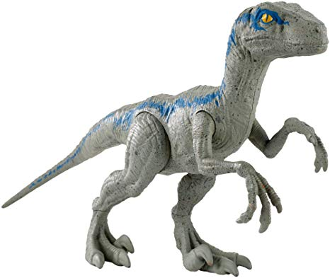
Raptor code
Doug Young Suh
2016. 9. 1

Slide 19
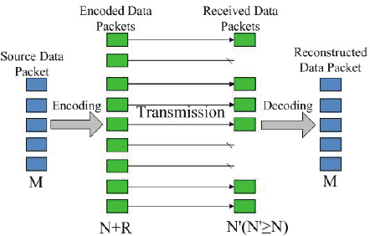





Erasure recovery
Reliable storage
Reliable transmission (real-time service, multicast service)
(9, 5)
N
K$=5$
K$=5$
N
K$=5$
$$N=9$$
N+K
$$M=6≥K$$

Slide 20
Example (1)
Let’s assume ,
Total number of encoded symbols , $N=6$
Total number of source symbols , $K’=3$
Symbol Size , $T=3$
Total number of received symbols , $M=4$
Then our $Q_Matrix$is $NXK’$ and $Source Symbol Matrix$is
Source Symbols=
Q_Matrix=

Slide 21
Example (2)
$Encoded Symbol Matrix = Q_Matrix × Source Symbols$
0
1
Adding Symbol Identifier
Encoded Symbols=
2
3
4
5
2
Received Symbols=
Symbols 0 and 1 are lost.
3
4
5

Slide 22
Example (3)
From this information, we can generate Matrix A out of Q Matrix such that
Matrix A will be used for decoding purpose.
Matrix A out of Q Matrix
Q Matrix =
Matrix A=

Slide 23
Example (4)
Gauss Jordon Elimination is performed to both Matrix A and Received Symbol
Gauss Jordon Elimination must provide identity matrix to Matrix A in order to recover the symbols.
Gauss Jordon
Matrix A
Received Symbol
Matrix A
Received Symbol
Original Source Symbols Decoded
Matrix A
Received Symbol

Slide 24



Example (2)
“assign3FEC.cpp”
Let’s assume ,
Total number of encoded symbols , $N=5$
Total number of source symbols , $K’=3$
Symbol Size , $T=5$
Total number of received symbols , $M=3$
Then our $Q_Matrix$is $NXK’$ and $Source Symbol Matrix$is
Source Symbols=
Q_Matrix=

Slide 25

Encoded packets
3 data packets
=
X
2 repair packets

Slide 26
If the 1st packet is lost,
165 = 41x + 35·6 + 190·11
→ x = (165 + 35·6 + 190·11)/41
224 = 41x + 35·7 + 190·12
→ x = (224 + 35·7 + 190·12)/41

Slide 27
If the 2nd packet is lost,
165 = 41·1 + 35·x + 190·11
→ x = (165 + 41·1 + 190·11)/35
224 = 41·2 + 35·x + 190·12
→ x = (224 + 41·2 + 190·12)/35

Slide 28


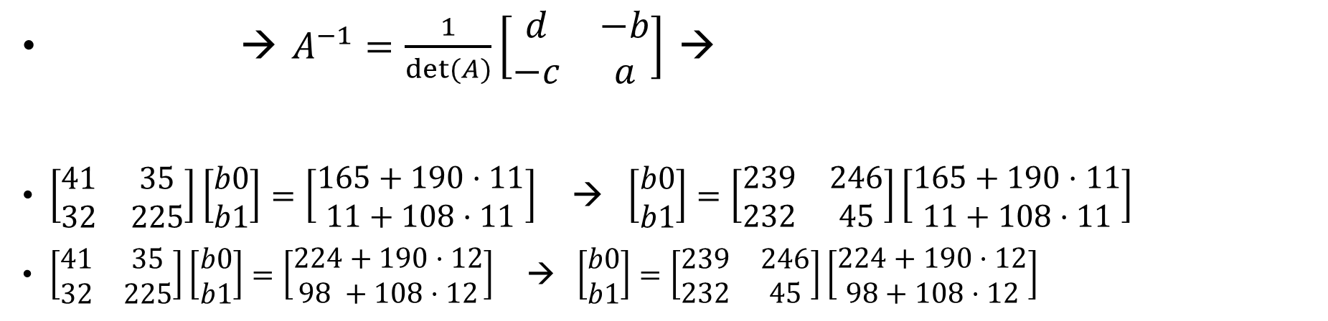
If 1st and 2nd packets are lost,
→ $A^{−1}=\frac{1}{det⁡(A)}\left[\begin{matrix}d & −b \\ −c & a\end{matrix}\right]$ →
$\left[\begin{matrix}41 & 35 \\ 32 & 225\end{matrix}\right]\left[\begin{matrix}b0 \\ b1\end{matrix}\right]=\left[\begin{matrix}165+190·11 \\ 11+108·11\end{matrix}\right]$ → $\left[\begin{matrix}b0 \\ b1\end{matrix}\right]=\left[\begin{matrix}239 & 246 \\ 232 & 45\end{matrix}\right]\left[\begin{matrix}165+190·11 \\ 11+108·11\end{matrix}\right]$
$\left[\begin{matrix}41 & 35 \\ 32 & 225\end{matrix}\right]\left[\begin{matrix}b0 \\ b1\end{matrix}\right]=\left[\begin{matrix}224+190·12 \\ 98 +108·12\end{matrix}\right]$ → $\left[\begin{matrix}b0 \\ b1\end{matrix}\right]=\left[\begin{matrix}239 & 246 \\ 232 & 45\end{matrix}\right]\left[\begin{matrix}224+190·12 \\ 98+108·12\end{matrix}\right]$

Slide 29
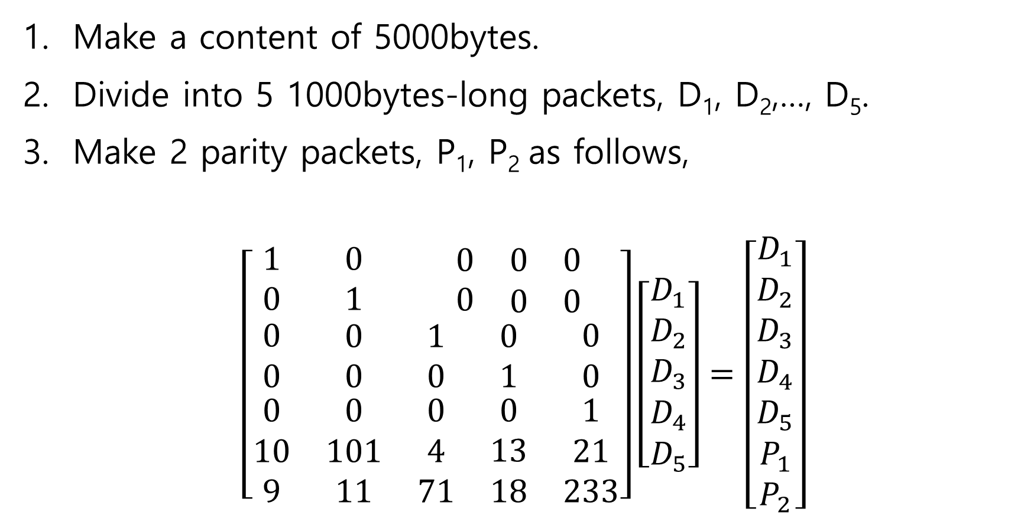
Assignment: erasure recovery (1)
Make a content of 5000bytes.
Divide into 5 1000bytes-long packets, D₁, D₂,…, D₅.
Make 2 parity packets, P₁, P₂ as follows,
$$\left[\begin{matrix}1 & 0 & \begin{matrix}0 & 0 & 0\end{matrix} \\ 0 & 1 & \begin{matrix}0 & \begin{matrix}0 & 0\end{matrix}\end{matrix} \\ \begin{matrix}0 \\ 0 \\ \begin{matrix}0 \\ 10 \\ 9\end{matrix}\end{matrix} & \begin{matrix}0 \\ 0 \\ \begin{matrix}0 \\ 101 \\ 11\end{matrix}\end{matrix} & \begin{matrix}\begin{matrix}1 \\ 0 \\ \begin{matrix}0 \\ 4 \\ 71\end{matrix}\end{matrix} & \begin{matrix}0 \\ 1 \\ \begin{matrix}0 \\ 13 \\ 18\end{matrix}\end{matrix} & \begin{matrix}0 \\ 0 \\ \begin{matrix}1 \\ 21 \\ 233\end{matrix}\end{matrix}\end{matrix}\end{matrix}\right]\left[\begin{matrix}D_{1} \\ D_{2} \\ \begin{matrix}D_{3} \\ D_{4} \\ D_{5}\end{matrix}\end{matrix}\right]=\left[\begin{matrix}D_{1} \\ D_{2} \\ \begin{matrix}D_{3} \\ D_{4} \\ \begin{matrix}D_{5} \\ P_{1} \\ P_{2}\end{matrix}\end{matrix}\end{matrix}\right]$$
Raptor(7, 5)

Slide 30
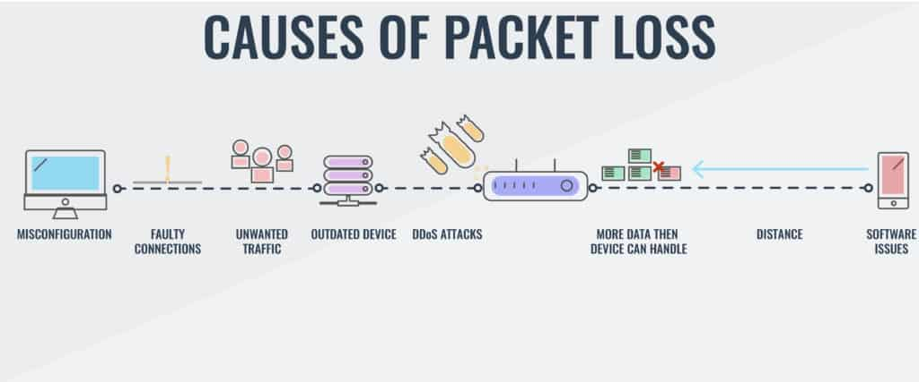
Assignment: erasure recovery (2)
When D₃ and P₁ are lost, recover D₃.
When D₁ and D₄ are lost, recover D₁ and D₄.

Slide 31
Example 2

Slide 32
Raptor test
Doug Young Suh
2016. 9. 1

Slide 33
Class diagram
CSender
CReceiver
FECEncoder
FECDecoder
GF256
FECconstants

Slide 34
Basic classes
FECconstants: K=49, N=99, L=1900, MAX_Packet=2000
System
GF(256) arithmetic
Qmatrix[][49]: coefficients of repair packets
Allocate/delete 2D memory
Matrix_multiply(BYTE **a,BYTE **b,int k,int m,int n,BYTE **c);
Qmatrix에서 (N-K)개를 선택해서, repair packet을 만든다.

Slide 35
FECEncoder
Encode a bufflet(an associated)
Symbols[N][T] = MatrixA[N][K] X Data[K][T]
Adaptive coding rate 가능 (K 고정, currentN을 적응)
Matrices
**MatrixA K*N
**Data K*T
**Symbols N*T
**TAIL (N-K)*3
SBN(bufflet number), ESI(0 ~ N-1)
MatrixA는 K*K identity matrix와 Qmatrix에서 가져온 (N-K) rows로 만들어진다.

Slide 36
UNIT FECEncoder::pushPacket(BYTE *mmtp,int size)
크기 size의 패킷을 받아, bufflet에 밀어 넣는다.
크기 size는 패킷의 6번째 byte부터 short로 들어간다. i.e. fseek(readp,5,SEEK_SET);
여러 심볼일 수 있다. 남으면 zero padding
ESI가 update된다.
패킷 뒤에는 3byte tail을 붙인다.
SBN(bufflet number): 2 bytes
ESI(symbol ID): 1 byte
Tail 부분은 encoding 되지 않는다.(decoding하기 전에 떼야한다.)
Repair packet의 tail은 왜 sender에서 붙일까?
Return 1. normal
N’-K+1. repair packets 개수, encoding 계산되었음
Bufflet이 넘치는 순간, ending()을 호출하여 repair packets 계산
Repair packets는 **Symbols에 line K~N’-1 rows에 저장된다.
SBN은 1 증가한다.
N’<=N이며, N’는 QoS에 따라 coding ratio를 조절하는데 쓰인다.
관련 sender 내용 (repair packet의 크기는 어디에 넣나?)
numbers = myfec.pushPacket(packet,size);
if(numbers > 1){ // send also (n-K) repair packets
numbers--; // data packet is already sent.
for(i=0;i<numbers;i++){ // (n-K) repair packets
memcpy(packet,myfec.Symbols[K+i],L); // copy a repair packet
memcpy(packet+L,myfec.TAIL[i],3); // attach a tail 928suh

Slide 37
FECDecoder
Decode a bufflet
decode_bufflet(int SBNnumber); // SBNnumber 사용안됨
ReceivedSymbols[K][T] = InverseA[K][K] X ReceivedSymbols[K][T]
Matrices
MatrixA[K][N]
InverseA[K][K]
ReceivedSymbols[N][L]
Lost[N][L]
Hits[N] : 패킷이 손실되었는지 여부를 알려준다.
외부 조작
Cyclic memory: bufflet = new FECDecoder[MaxBufflet];
bufflet[NextBufflet].reset_bufflet();
bufflet[NextBufflet].decode_bufflet();
입력변수:
Hits[N] (못 받은 symbol은 0, header 포함 symbol 2, 나머지는 1),
ReceivedSymbols[N][L]에 수신된 내용 채워서 입력
출력: ReceivedSymbols[N][L]

Slide 38
Test scenario
(N,K) = (59,29)
Encoder
Pushpacket( )을 불러 패킷을 밀어넣기를 계속한다.
데이터패킷은 전송메모리에 쌓인다. (편의상 1packet/1symbol로 하자.)
만일 pushpacket()의 return값이 1이 아니면, 그 값만큼 repair packets를 전송메모리에 쌓는다.(1packet/1symbol)
전송메모리는 main에 allocate해 놓아야(나중에 반복적으로 decoding)
Channel_memory[N][L]
Loss: 임의의 패킷을 손실시킨다.
myDecoder.rest_bufflet();
myDecoder.Hits[ ]에서 손실된 것은 0, 받았으면 non-zero(Header있는 심볼은 2, 보통 1)
이 실험에서는 편의상 1packet/1symbo이다.
수신된 데이터는 tail은 떼고 myDecoder.receivedSymbols에 넣는다.
Decoder
myDecoder.decode_bufflet( );

Slide 39
Raptor(99,49) 수정사항 ➔ 201609
N만 99로 바꾸었다.
N을 키우나? Raptor(99, 49)로 한다.
K를 작게 한다. Qmatrix[i]에서 MatrixA를 만들 때, 그냥 N개 row를 copy하면 안된다. K-1개까지 identity copy하고, K부터는 parity row를 copy해야 한다.

Slide 40
Performance test, Raptor[99,49]
Channel_memory까지 채우는 것은 한번만 시행
Decoding은 1천번 수행하여 시간을 측정함
손실율을 고정하고 L을 변경한다.
L을 고정하고 손실율을 변경한다.
Release mode로 동작시킨다.
결론
Decoding 시간은 무시할만하다.(10ms이내)
심볼 크기 L에 거의 정비례한다.
PLR에 반비례한다.
예제) L=2000bytes, PLR=50%, time=11ms
2000*8*49bits/sec = 800kbps 비디오를 deFEC처리하는데 11ms 걸린다.
22ms을 사용한다면, 1.6Mbps 비디오 처리
Base layer를 decoding할 때에는 base layer만 decoding하면 되므로 충분하다.
Symbol sizeL(bytes) | time, µs (PLR 50%) | time (PLR 25%) | time (PLR 10%)
19 | 164 | 71 | 25
100 | 578 | 301 | 113
500 | 2618 | 1406 | 540
1000 | 5159 | 2789 | 1074
2000 | 10775 | 5565 | 2145

