Slide 1
RSA (Rivest–Shamir–Adleman)
Doug Young Suh

Slide 2
RSA Key Generation (1)
Select two Prime Numbers: P and Q
This really is as easy as it sounds. Select two prime numbers to begin the key generation. For the purpose of our example, we will use the numbers 7 and 19, and we will refer to them as P and Q.
Calculate the Product: (P*Q)
We then simply multiply our two prime numbers together to calculate the product:
N = 7 * 19 = 133
We will refer to this number as N. Bonus question: given the terminology we reviewed above, what kind of number is N? → only divided by P or Q

Slide 3
RSA Key Generation (2)
3. Totient of a Semi-Prime number, calculate P-1 times Q-1.
T = (7-1)*(19-1) = 6 * 18 = 108
We will refer to this as T moving forward.
Select a Public Key E
The Public Key is a value which must match three requirements:
It must be Prime
It must be less than the Totient
It must NOT be a factor of the Totient gcd(E, T)=1
Let us see if we can get by with the number 3: 3 is indeed Prime, 3 is indeed less than 108, but regrettably 3 is a factor of 108, so we can not use it. Can you find another number that would work? Here is a hint, there are multiple values that would satisfy all three requirements. For the sake of our example, we will select 29 as our Public Key, and we will refer to it as E going forward.

Slide 4
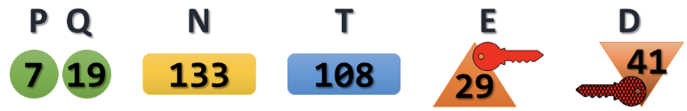
RSA Key Generation (3)
Select a Private Key
Finally, with what we have calculated so far, we can select our Private Key (which we will call D).The Private Key only has to match one requirement:
(D*E) MOD T = 1
There are a few values that would work for the Private Key as well. But again, for the sake of our example, we will select 41. To test it against our formula, we could calculate:
(41*29) MOD 108 = 1

Slide 5
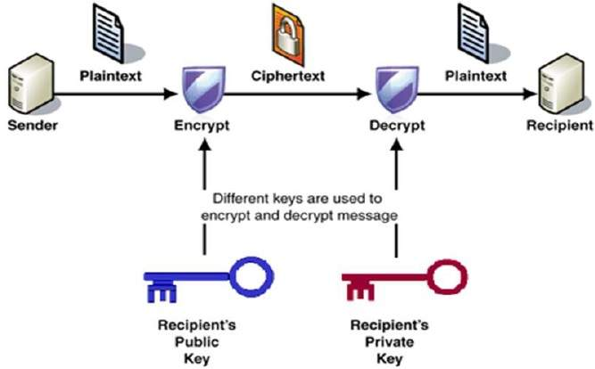

Slide 6
P=61, Q=53, N=PQ=3233, T=(61-1)(53-1)=3120, E=17, D=2753
P=7, Q=17, N=119, T=96, Select public key E=5 → private key D=77
P=13, Q=11, N=143, T=120, select e=13 → d=37
dd = (T * i) + 1) / e
d = (120 + 1) / 13 = 9.30 (∵ i = 1)
d = (240 + 1) / 13 = 18.53 (∵ i = 2)
d = (360 + 1) / 13 = 27.76 (∵ i = 3)
d = (480 + 1) / 13 = 37 (∵ i = 4))
P=5, Q=7, N=35, T=24, Select e=11 → d=11
P=13, Q=17, N=221, T=192, Select e=19 → d=91

Slide 7
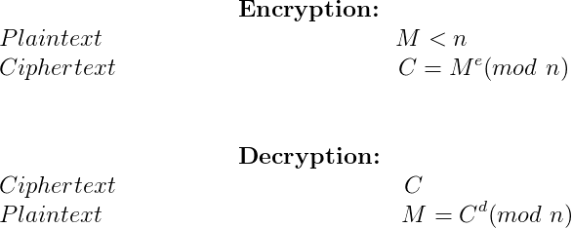

Slide 8
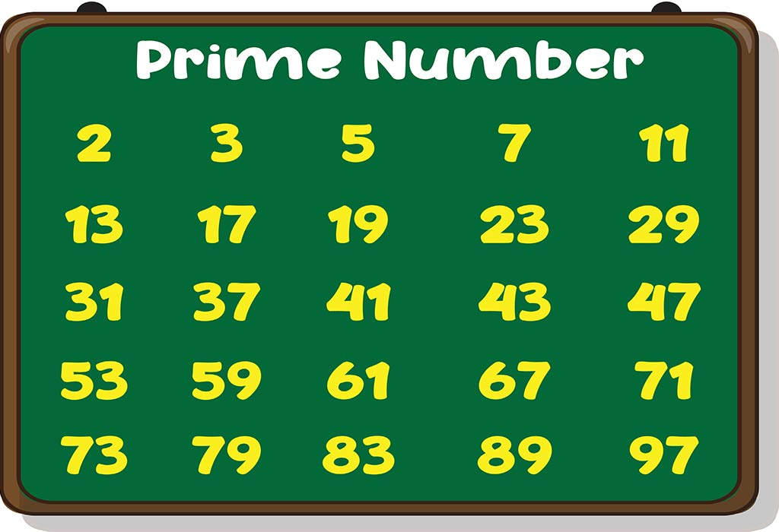

Slide 9
