Slide 1
Rule
The server has 2 ports for red team and blue team, respectively.
A team has N players.
Set the IP address and port number. The IP number is the same while a different port number(red 12345, blue 12346) is given to each team.
c = new Client(this, "127.0.0.1", 12345);
Each player is given an ID from 0 to N-1 and change ‘1’ to his ID.
else if (key == 'd') kk = 4;
c.write(1 + " " + kk+ "\n");
The server should be ready for listening.
Each player connects to the server.
At first, hit ‘b’ for connection.
Then, hit ‘wasd’ for movement.
The team of which all players reach to their target wins the game.
Once reaching, the player cannot move.
IP address
Port number

Slide 2
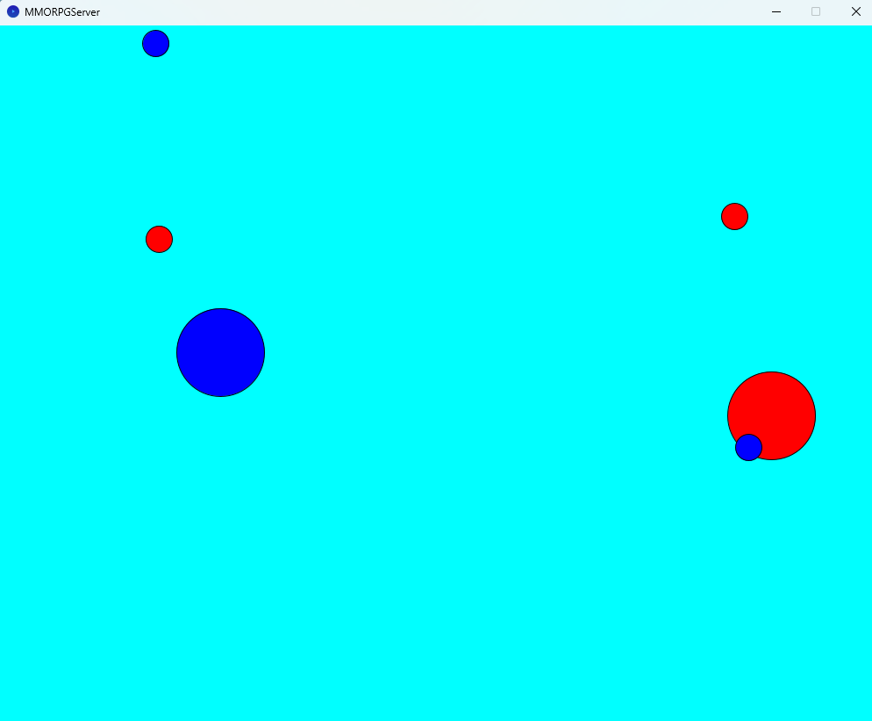
Game
In case of N = 2
2
server
N
server
players[ N]
count
target(x, y)
RedBlue
player
ID
x, y
RedBlue
state
update( )
move()
check()
display()

