Slide 1
HW4 Make a music file
https://github.com/dougsuh/oop/tree/main/waveFile/waveHW
July 2, 2024
Doug Young Suh

Slide 2
Sprint 1: parameters for a note
pitch : frequency in Hz(Hertz = times/sec)
duration in sec
amplitude < 20000 < maximum value of short
cin << pitch << duration << amplitude
Make a music file
A.wav
myMusic.wav

Slide 3
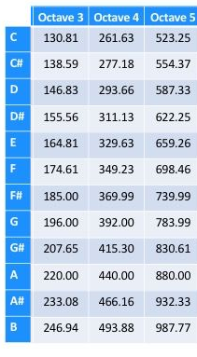
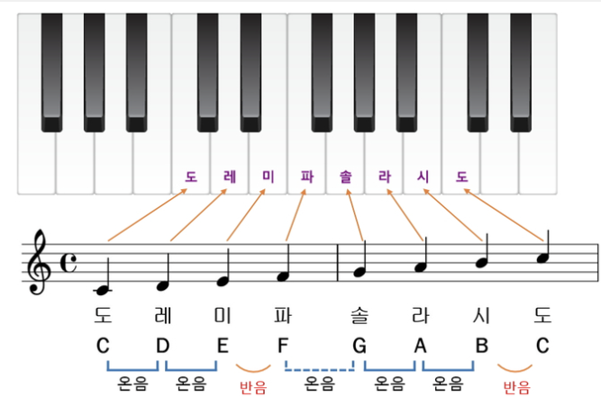
Parameters (1): pitch
pitch with 3 variables → frequency in Hz(Hertz)
Pitch : c d e f g a b
Semitone shift
_ flat
# semitone up
b semitone down
Octave : 3 4 5
Octave : 3
Octave : 4
Octave : 5

Slide 4
// note.h note.cpp
void cNote::setFrequency(char p, char s, char o) {
if (p == 'c' && s == '_') ff = 261.63;
else if (p == 'c' && s == '#') ff = 277.18;
else if (p == 'd' && s == 'b') ff = 277.18;
else if (p == 'd' && s == '_') ff = 293.66;
else if (p == 'd' && s == '#') ff = 311.13;
else if (p == 'e' && s == 'b') ff = 311.13; // #D = bE
else if (p == 'e' && s == '_') ff = 329.63;
else if (p == 'f' && s == '_') ff = 349.23;
/*#F bG 369.99
G 392.00
#G bA 415.30
A 440.00
#A bB 466.16
B 493.88 */
else ff = 0;
if (o == '3') ff /= 2;
else if (o == '5') ff *= 2;
}
C 261.63
#C bD 277.18
D 293.66
#DA bE 311.13
E 329.63
F 349.23
#F bG 369.99
G 392.00
#G bA 415.30
A 440.00
#A bB 466.16
B 493.88

Slide 5
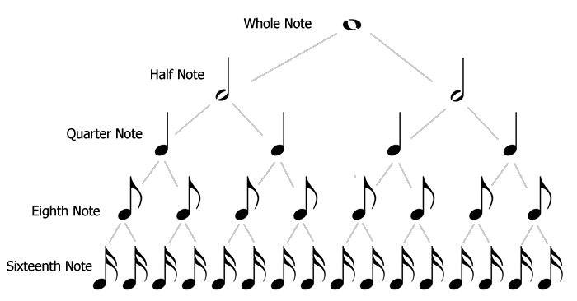
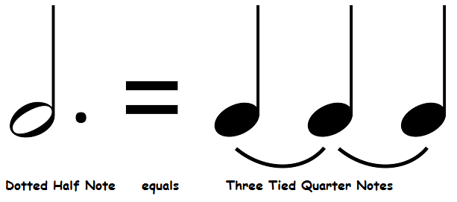
Parameters (2): duration
Duration: 1 1.5 2 2.5 4 4.5 8 8.5 16 16.5

Slide 6
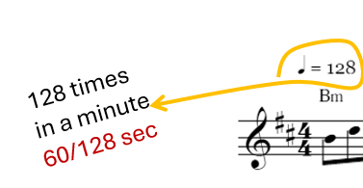
void cNote::setDuration(float b, float d) {
if (d == 1) T = b * 4;
else if (d == 1.5) T = b * 6;
else if (d == 2) T = b * 2;
else if (d == 2.5) T = b * 3;
else if (d == 4) T = b;
else if (d == 4.5) T = b * 1.5;
else if (d == 8) T = b / 2;
else if (d == 8.5) T = b * (0.5 + 0.25);
// else if (d == 16) T = ????;
// else if (d == 16.5) T = ????;
else T = b;
}
b = 60.0/128; // in sec

Slide 7
Parameters (3): Amplitude
Let
Strong A = 20000
Normal A = 5000
Weak A = 1000
$$f\left(t\right)=A\sin\left(2πf_{o}t\right) for 0<t<T$$

Slide 8
Test the class
// hw4.cpp
#include <iostream>
#include "note.h"
using namespace std;
int main() {
cNote myNote;
myNote.setBeat(100);
char pitch, semitone, octave;
float duration, T, beat;
float amplitude;
char c = 'y';
while (c == 'y') {
cout << " pitch semitone octave :";
cin >> pitch >> semitone >> octave;
myNote.setFrequency(pitch, semitone, octave);
cout << " duration :";
cin >> duration;
myNote.setDuration(beat, duration);
cout << " amplitude(<20000) :";
cin >> amplitude;
myNote.A = amplitude;
cout << myNote.A << " " << myNote.f0 <<
" " << myNote.T << endl;
cout << " continue? (y/n):";
cin >> c;
}
return 123;
}

Slide 9
Sprint 2: read a header and get the values
What you did in HW3.
samplingRate
monoStereo
Write the header at the beginning of my wav file.
ofstream xx("myWave.wav", ios::out | ios::binary);
if (!xx) { cout << " cannot open myWave.wav\n";}
xx.write((char*)header, 44);

Slide 10
Sprint 3: Make a wave file
Read a wav file
Read the header
Copy the header to my wav file
Decide samplingRate, mono/stereo.
Write notes
Get parameters for each note (cin)
Calculate music samples
Write the samples to my wav file

Slide 11
In note.h
#pragma once
#include <cmath>
using namespace std;
class cNote {
public:
cNote() {
…
// n : number of samples
// ms : mono(1) or stereo(2)
// dt : 1./samplingRate
void calculateSamples(int n, short ms, short* dat, float dt) {
float pi2f0dt = 2 * 3.141592 * f0 * dt;
for (int i = 0; i < n; i += ms) {
if (ms == 1) dat[i] = A * sin(pi2f0dt * i); // mono
else if (ms == 2) { // stereo
dat[i] = dat[i + 1] = A * sin(pi2f0dt * i / 2);
}
}
}
};
$$f\left(t\right)=A\sin\left(2πf_{o}t\right) for 0<t<T$$

Slide 12
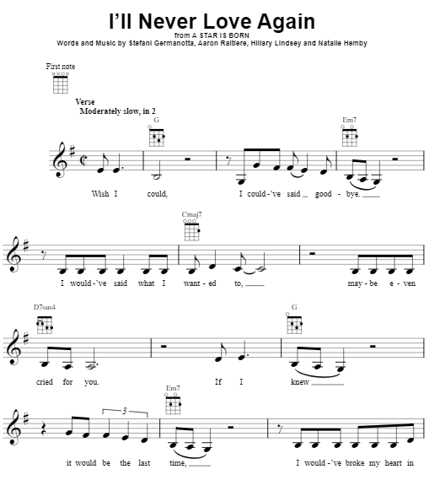
Sreyka likes…
56~108 times in a minute
♩= 60/80 sec

Slide 13

Upload your wav file

Slide 14
Feeling

