Slide 1
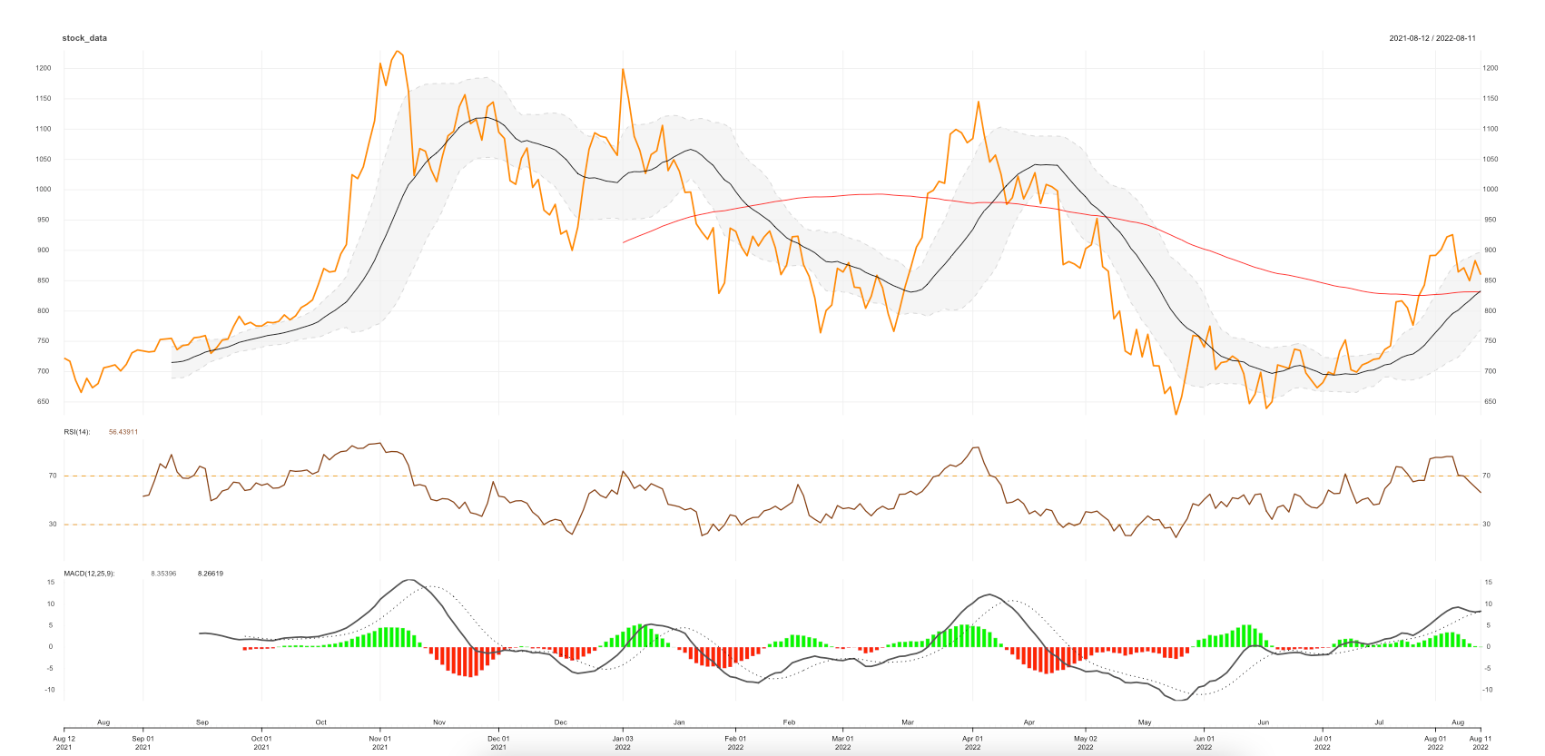
+425
-50
+175
+85
+250
-320
+175
+740

