Slide 1

Tax Rates & Economic Outcomes
Is There A Relationship?

Slide 2

Theory vs Theory
Practical

Slide 3
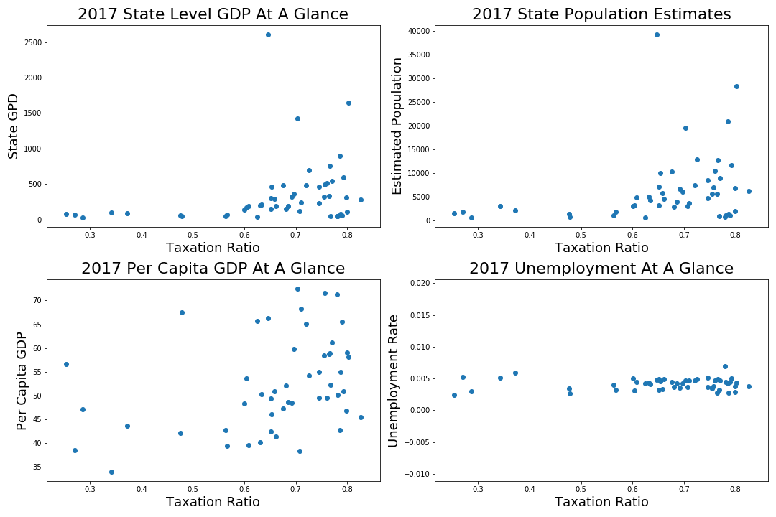

Slide 4
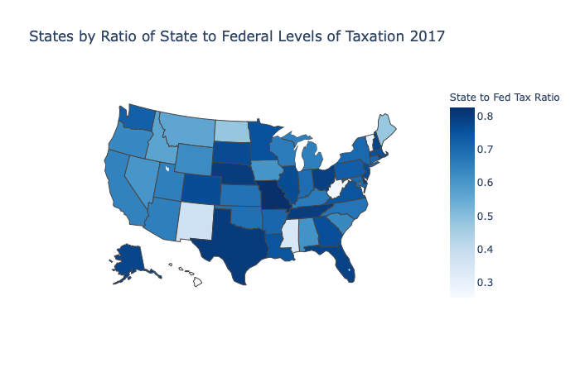
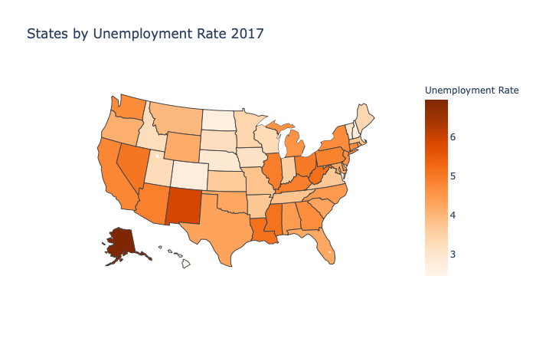
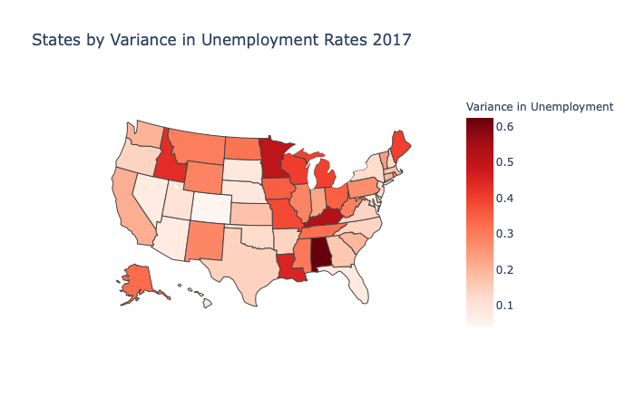
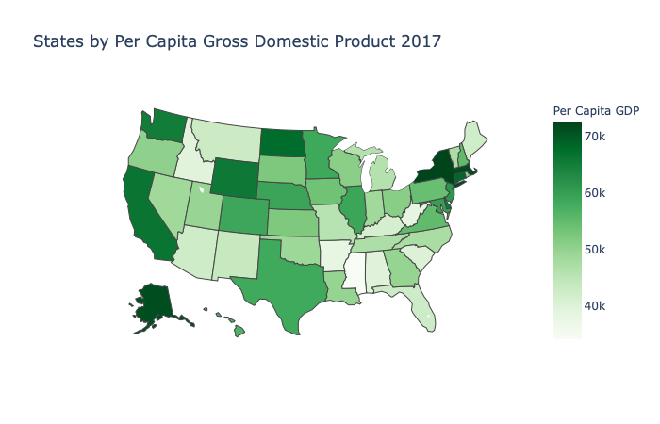

Slide 5
Testing Methods
Correlation
Hypothesis Testing

Slide 6
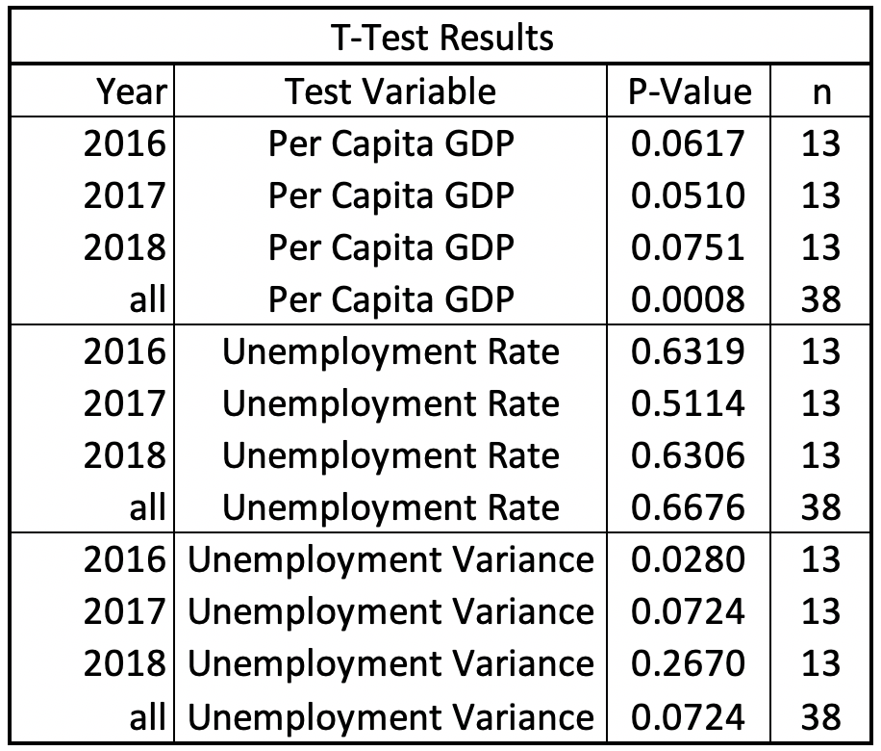
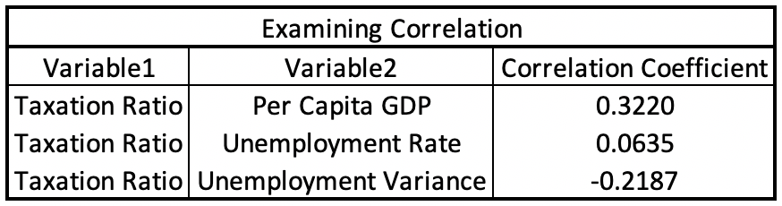

Slide 7
Conclusion & Next Steps
What does this tell us?
Further study

