Slide 1
Tax Rates & Economic Outcomes
Is There A Relationship?

Slide 2
Description And Motivation

Slide 3
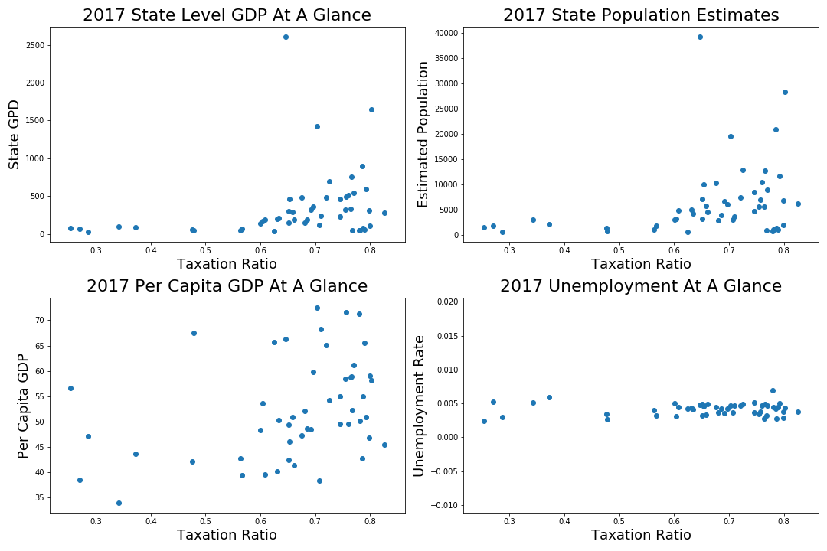

Slide 4
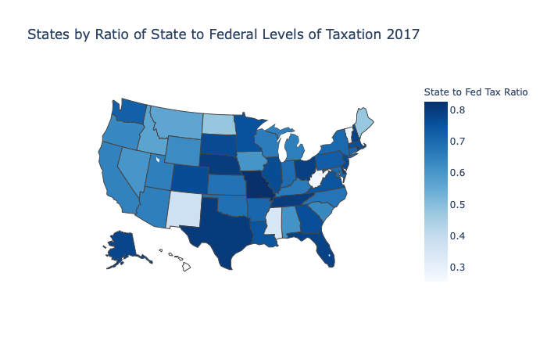
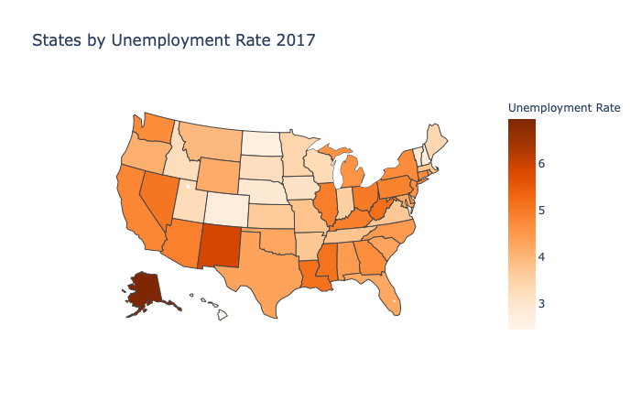
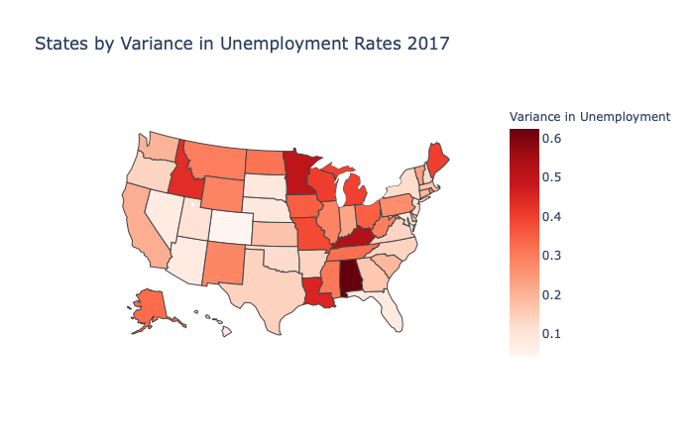
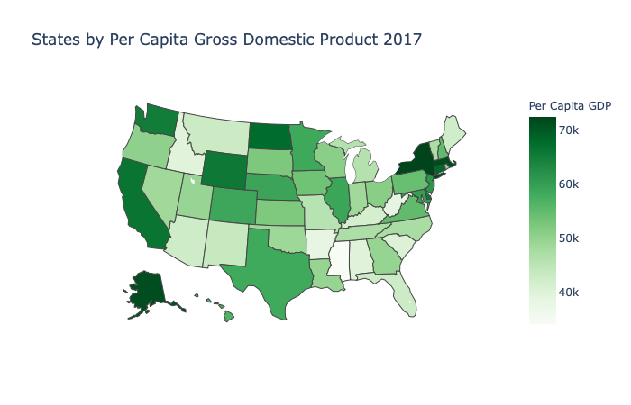

Slide 5
Hypothesis Testing Description
Null vs Alternate
Testing methods
Variables Used

Slide 6
The Results Table Goes Here
Results! Here!

Slide 7
Conclusion & Next Steps
What does this tell us?
Further study

