Slide 1
Comparison of GCP versions
Doug Tommet

Slide 2
Intro
When we first made the GCP, we made some mistakes and had questionable assumptions.
Now with this harmonization work we have a chance to revisit and possibly correct these mistakes and assumptions.

Slide 3
Mistakes
Text about mistakes in item recoding

Slide 4
Questionable assumptions
Text about the questionable item linking

Slide 5
Text about how because we are doing the harmonization process different from the original GCP, we won’t be able to get the exact same scores even if we repeat the same mistakes and decisions

Slide 6
So we have three options to redo the GCP
Retain the mistakes and questionable assumptions (GCP_v1)
Fix the mistakes but retain the questionable assumptions (GCP_v2a)
Fix the mistakes and questionable assumptions (GCP_v2b)

Slide 7
Fixing the item recoding mistake
VSAT: Comparison of parameter estimates
Version 1: Factor loading | Version 1: Factor loading
Parameter | Std. Estimate
g | 0.651
Version 2a: Factor loading | Version 2a: Factor loading
Parameter | Std. Estimate
g | 0.651
Version 1: Thresholds | Version 1: Thresholds
Parameter | Std. Estimate
T1 | -0.829
T2 | -0.044
T3 | 0.791
T4 | 1.512
T5 | 2.317
T6 | 3.262
T7 | 3.958
Version 2a: Thresholds | Version 2a: Thresholds
Parameter | Std. Estimate
T1 | -0.829
T2 | -0.044
T3 | 0.792
T4 | 1.513
T5 | 2.318
T6 | 3.264
T7 | 3.960

Slide 8
Fixing the item recoding mistake
HVLT Delayed: Comparison of parameter estimates
Version 1: Factor loading | Version 1: Factor loading
Parameter | Std. Estimate
g | 0.332
Version 2a: Factor loading | Version 2a: Factor loading
Parameter | Std. Estimate
g | 0.332
Version 1: Thresholds | Version 1: Thresholds
Parameter | Std. Estimate
T1 | -1.179
T2 | -0.738
T3 | -0.199
T4 | 0.507
T5 | 1.727
T6 | 2.809
Version 2a: Thresholds | Version 2a: Thresholds
Parameter | Std. Estimate
T1 | -1.179
T2 | -0.738
T3 | -0.199
T4 | 0.507
T5 | 1.728
T6 | 2.810
T7 | 3.254

Slide 9
Fixing the item recoding mistake
Digit symbol substitution: Comparison of parameter estimates
Version 1: Factor loading | Version 1: Factor loading
Parameter | Std. Estimate
g | 0.806
Version 2a: Factor loading | Version 2a: Factor loading
Parameter | Std. Estimate
g | 0.806
Version 1: Thresholds | Version 1: Thresholds
Parameter | Std. Estimate
T1 | -0.567
T2 | 0.360
T3 | 1.051
T4 | 1.858
T5 | 2.725
T6 | 3.470
Version 2a: Thresholds | Version 2a: Thresholds
Parameter | Std. Estimate
T1 | -0.567
T2 | 0.360
T3 | 1.052
T4 | 1.860
T5 | 2.727
T6 | 3.470
T7 | 3.960

Slide 10
Summary statistics for where there is a difference in GCP between fixing and not fixing the recoding mistakes
The recoding mistakes only affected 53 out of 560 participants
Mean absolute difference is only 0.02 GCP units
Characteristic | N = 53
Difference in GCP between v1 and v2a
Mean (SD) | 0.023 (0.063)
Median (IQR) | 0.010 (0.010, 0.010)
Range | 0.010, 0.410

Slide 11
Fixing the item linking
Animal vs Supermarket naming: Comparison of parameter estimates
Version 1: Factor loading | Version 1: Factor loading
Parameter | Std. Estimate
g | 0.679
Version 2b: Factor loading | Version 2b: Factor loading
Parameter | Std. Estimate
g | 0.598
Version 1: Thresholds | Version 1: Thresholds
Parameter | Std. Estimate
T1 | -2.938
T2 | -1.768
T3 | -0.851
T4 | -0.280
T5 | 0.415
T6 | 1.113
T7 | 1.598
T9 | 3.413
T8 | 2.295
T10 | 4.754
Version 2b: Thresholds | Version 2b: Thresholds
Parameter | Std. Estimate
T1 | -1.468
T2 | -0.576
T3 | 0.170
T4 | 0.796
T5 | 1.284
T6 | 1.857
T7 | 2.528
T8 | 3.969

Slide 12
Fixing the item linking
FAS : Comparison of parameter estimates
FAS summed and linked to CFL
FAS are separate, and F linked to F
Version 1: Factor loading | Version 1: Factor loading
Parameter | Std. Estimate
g | 0.726
Version 2b: Factor loading | Version 2b: Factor loading | Version 2b: Factor loading | Version 2b: Factor loading
Parameter | F | A | S
g | 0.815 | 0.736 | 0.768
Version 1: Thresholds | Version 1: Thresholds
Parameter | Std. Estimate
T1 | -2.300
T2 | -1.410
T3 | -0.710
T4 | -0.144
T5 | 0.475
T6 | 0.944
T7 | 1.425
T8 | 1.980
T9 | 3.001
Version 2b: Thresholds | Version 2b: Thresholds | Version 2b: Thresholds | Version 2b: Thresholds
Parameter | F | A | S
T1 | -2.039 | -0.487 | -0.560
T2 | -1.371 | 0.045 | -0.050
T3 | -0.567 | 0.437 | 0.412
T4 | -0.125 | 0.873 | 0.853
T5 | 0.439 | 1.265 | 1.251
T6 | 1.013 | 1.606 | 1.587
T7 | 1.636 | 1.992 | 1.910
T8 | 2.085 | 2.374 | 2.393
T9 |  | 2.675 | 2.822

Slide 13
Summary statistics for where there is a difference between fixing mistakes and item linkages and not fixing them
Fixing the item linkage affects nearly the whole sample
The mean absolute difference is 2.2 GCP units
Characteristic | N = 558
Difference in GCP between v1 and v2b
Mean (SD) | 2.15 (1.71)
Median (IQR) | 1.76 (0.77, 3.15)
Range | 0.02, 8.52

Slide 14
Summary statistics for GCP versions at baseline
Characteristic | N = 560
Original GCP
Mean (SD) | 57.61 (7.28)
Median (IQR) | 57.44 (52.79, 62.88)
Range | 34.17, 77.13
GCP_v1
Mean (SD) | 58.92 (7.23)
Median (IQR) | 58.80 (54.00, 64.20)
Range | 35.63, 78.29
GCP_v2a
Mean (SD) | 58.92 (7.23)
Median (IQR) | 58.80 (54.00, 64.20)
Range | 35.63, 78.28
GCP_v2b
Mean (SD) | 57.89 (7.40)
Median (IQR) | 57.45 (52.87, 63.40)
Range | 35.07, 78.60

Slide 15
Correlation of GCP versions at baseline
variable | vdgcp | GCP_v1 | GCP_v2a | GCP_v2b
vdgcp | 1.00 | 0.99 | 0.99 | 0.94
GCP_v1 | 0.99 | 1.00 | 1.00 | 0.94
GCP_v2a | 0.99 | 1.00 | 1.00 | 0.94
GCP_v2b | 0.94 | 0.94 | 0.94 | 1.00

Slide 16
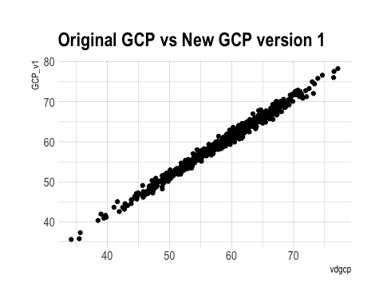
Repeating mistakes and item linkages

Slide 17
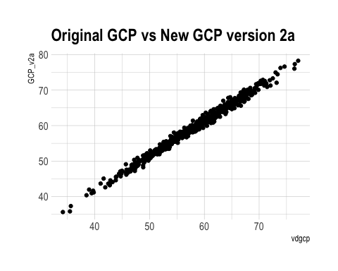
Fixing the mistakes

Slide 18
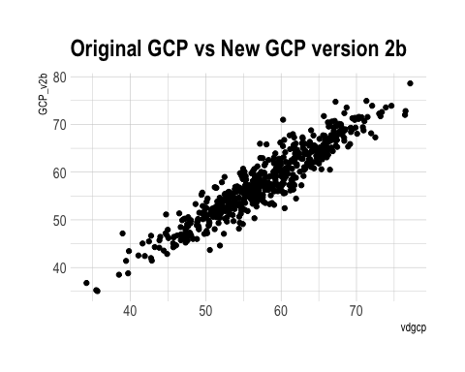
Fixing mistakes and item linkages

Slide 19
Absolute difference from original GCP
Characteristic | N = 560
GCP_V1
Mean (SD) | 1.36 (0.73)
Median (IQR) | 1.30 (0.82, 1.84)
Range | 0.00, 3.59
GCP_V2a
Mean (SD) | 1.36 (0.73)
Median (IQR) | 1.30 (0.82, 1.84)
Range | 0.00, 3.60
GCP_V2b
Mean (SD) | 2.04 (1.70)
Median (IQR) | 1.56 (0.76, 2.90)
Range | 0.02, 10.73

