Slide 1
Comparison of GCP versions
Doug Tommet

Slide 2
Intro
When we first made the GCP, we made some mistakes and had questionable assumptions.
Now with this harmonization work we have a chance to revisit and possibly correct these mistakes and assumptions.

Slide 3
Mistakes
GCP v 1.0 (Gross et al 2014, and as used in SAGES encoded in VDS) has a few minor errors and questionable decisions.
Error #1, #2, #3 & #4. Top two categories (based on quantiles) in VSAT, HVLT, HVLT delayed, and Digit Symbol Substitution are collapsed. This was unintentional, the data would have supported more categories.
The result of this is we may not have as precise a measure of cognitive performance among the very top (best) performers.

Slide 4
Questionable assumptions
Questionable assumption #1. We decided to treat HRS/ADAMS “C, F, and L” letter fluency as equivalent to SAGES “F, A, S” fluency. If this assumption of equivalence is a bad assumption, our linkage to HRS/ADAMS is biased.
Questionable assumption #2. We decided to treat HRS/ADAMS animal fluency as equivalent to SAGES supermarket. If this assumption of equivalence is a bad assumption, our linkage to HRS/ADAMS is biased.

Slide 5
Also…
The computational procedures we are using to generate the item bank and linked GCP scores is different now than in GCP 1.0
Therefore, the new GCP won’t be exactly the same as GCP 1.0.
But these procedural differences are expected to produce trivial differences in scores

Slide 6
So we have several options to redo the GCP
Retain the mistakes and questionable assumptions (GCP_v1)
Fix the mistakes but retain the animal/supermarket and CFL/FAS linking (GCP_v2a)
Fix the mistakes and separate linking for animal/supermarket and separate items for C/F/L and F/A/S (GCP_v2b)
Fix the mistakes and separate linking for animal/supermarket and separate linking for CLF/FAS (GCP_v2c)

Slide 7
Fixing the item recoding mistakes
VSAT: Comparison of parameter estimates
Version 1: Factor loading | Version 1: Factor loading
Parameter | Std. Estimate
g | 0.651
Version 2a: Factor loading | Version 2a: Factor loading
Parameter | Std. Estimate
g | 0.651
Version 1: Thresholds | Version 1: Thresholds
Parameter | Std. Estimate
T1 | -0.829
T2 | -0.045
T3 | 0.791
T4 | 1.512
T5 | 2.317
T6 | 3.263
Version 2a: Thresholds | Version 2a: Thresholds
Parameter | Std. Estimate
T1 | -0.829
T2 | -0.044
T3 | 0.792
T4 | 1.513
T5 | 2.318
T6 | 3.264
T7 | 3.960

Slide 8
Fixing the item recoding mistakes
HVLT: Comparison of parameter estimates
Version 1: Factor loading | Version 1: Factor loading
Parameter | Std. Estimate
g | 0.556
Version 2a: Factor loading | Version 2a: Factor loading
Parameter | Std. Estimate
g | 0.556
Version 1: Thresholds | Version 1: Thresholds
Parameter | Std. Estimate
T1 | -0.611
T2 | -0.097
T3 | 0.470
T4 | 0.916
T5 | 1.466
T6 | 2.247
T7 | 3.295
Version 2a: Thresholds | Version 2a: Thresholds
Parameter | Std. Estimate
T1 | -0.611
T2 | -0.097
T3 | 0.470
T4 | 0.916
T5 | 1.467
T6 | 2.248
T7 | 3.296

Slide 9
Fixing the item recoding mistakes
HVLT Delayed: Comparison of parameter estimates
Version 1: Factor loading | Version 1: Factor loading
Parameter | Std. Estimate
g | 0.332
Version 2a: Factor loading | Version 2a: Factor loading
Parameter | Std. Estimate
g | 0.332
Version 1: Thresholds | Version 1: Thresholds
Parameter | Std. Estimate
T1 | -1.179
T2 | -0.738
T3 | -0.199
T4 | 0.507
T5 | 1.727
T6 | 2.809
Version 2a: Thresholds | Version 2a: Thresholds
Parameter | Std. Estimate
T1 | -1.179
T2 | -0.738
T3 | -0.199
T4 | 0.507
T5 | 1.728
T6 | 2.810
T7 | 3.254

Slide 10
Fixing the item recoding mistakes
Digit symbol substitution: Comparison of parameter estimates
Version 1: Factor loading | Version 1: Factor loading
Parameter | Std. Estimate
g | 0.806
Version 2a: Factor loading | Version 2a: Factor loading
Parameter | Std. Estimate
g | 0.806
Version 1: Thresholds | Version 1: Thresholds
Parameter | Std. Estimate
T1 | -0.567
T2 | 0.360
T3 | 1.051
T4 | 1.858
T5 | 2.725
T6 | 3.470
Version 2a: Thresholds | Version 2a: Thresholds
Parameter | Std. Estimate
T1 | -0.567
T2 | 0.360
T3 | 1.052
T4 | 1.860
T5 | 2.727
T6 | 3.470
T7 | 3.960

Slide 11
Summary statistics for those where there is a difference in GCP between version 1 and version 2a
The recoding mistakes only affected 53 out of 560 participants
Mean absolute difference is only 0.02 GCP units
Characteristic | N = 85
Difference in GCP between v1 and v2a
N | 85
Mean (SD) | 0.020 (0.052)
Median (IQR) | 0.010 (0.010, 0.010)
Range | 0.010, 0.410

Slide 12
Fixing the item linking
Animal vs Supermarket naming: Comparison of parameter estimates
Version 1: Factor loading | Version 1: Factor loading
Parameter | Std. Estimate
g | 0.679
Version 2b: Factor loading | Version 2b: Factor loading
Parameter | Std. Estimate
g | 0.598
Version 1: Thresholds | Version 1: Thresholds
Parameter | Std. Estimate
T1 | -2.938
T2 | -1.768
T3 | -0.851
T4 | -0.280
T5 | 0.415
T6 | 1.113
T7 | 1.598
T9 | 3.413
T8 | 2.295
T10 | 4.756
Version 2b: Thresholds | Version 2b: Thresholds
Parameter | Std. Estimate
T1 | -1.468
T2 | -0.576
T3 | 0.170
T4 | 0.796
T5 | 1.284
T6 | 1.857
T7 | 2.528
T8 | 3.969

Slide 13
Fixing the item linking (Option 1)
FAS : Comparison of parameter estimates
Version 1: Factor loading | Version 1: Factor loading
Parameter | Std. Estimate
g | 0.726
Version 2b: Factor loading | Version 2b: Factor loading | Version 2b: Factor loading | Version 2b: Factor loading
Parameter | F | A | S
g | 0.815 | 0.736 | 0.768
The threshold parameter estimates are not really comparable, because the Version 1 thresholds are based on bins on number of F+A+S words, and the Version 2b thresholds are based on bins of F, A, and S words considered separately.
Version 1: Thresholds | Version 1: Thresholds
Parameter | Std. Estimate
T1 | -2.300
T2 | -1.410
T3 | -0.710
T4 | -0.144
T5 | 0.475
T6 | 0.944
T7 | 1.425
T8 | 1.980
T9 | 3.001
Version 2b: Thresholds | Version 2b: Thresholds | Version 2b: Thresholds | Version 2b: Thresholds
Parameter | F | A | S
T1 | -2.039 | -0.487 | -0.560
T2 | -1.371 | 0.045 | -0.050
T3 | -0.567 | 0.437 | 0.412
T4 | -0.125 | 0.873 | 0.853
T5 | 0.439 | 1.265 | 1.251
T6 | 1.013 | 1.606 | 1.587
T7 | 1.636 | 1.992 | 1.910
T8 | 2.085 | 2.374 | 2.393
T9 |  | 2.675 | 2.822

Slide 14
Summary statistics for those participants where there is a difference between GCP_v1 and GCP_v2b
GCP_v1 is not fixing mistakes or item linkages
GCP_v2b is fixing the mistakes, animal/supermarket not linked, CFL/FAS as three separate items
Fixing the item linkage affects nearly the whole sample
The mean absolute difference is 2.2 GCP units
Characteristic | N = 558
Difference in GCP between v1 and v2b
N | 558
Mean (SD) | 2.15 (1.71)
Median (IQR) | 1.75 (0.77, 3.15)
Range | 0.02, 8.52

Slide 15
Fixing the item linking (Option 2)
FAS and CFL summed but not linked
FAS : Comparison of parameter estimates
Version 1: Factor loading | Version 1: Factor loading
Parameter | Std. Estimate
g | 0.726
Version 2c: Factor loading | Version 2c: Factor loading
Parameter | Std. Estimate
g | 0.621
Version 1: Thresholds | Version 1: Thresholds
Parameter | Std. Estimate
T1 | -2.300
T2 | -1.410
T3 | -0.710
T4 | -0.144
T5 | 0.475
T6 | 0.944
T7 | 1.425
T8 | 1.980
T9 | 3.001
Version 2c: Thresholds | Version 2c: Thresholds
Parameter | Std. Estimate
T1 | -0.400
T2 | 0.010
T3 | 0.402
T4 | 0.618
T5 | 0.937
T6 | 1.225
T7 | 1.525
T8 | 1.959

Slide 16
Summary statistics for those participants where there is a difference between GCP_v1 and GCP_v2c
GCP_v1 is not fixing mistakes or item linkages
GCP_v2b is fixing the mistakes, animal/supermarket not linked, CFL/FAS summed but not linked
Fixing the item linkage affects nearly the whole sample
The mean absolute difference is 1.0 GCP units
Characteristic | N = 557
Difference in GCP between v1 and v2c
N | 557
Mean (SD) | 0.97 (0.68)
Median (IQR) | 0.87 (0.42, 1.41)
Range | 0.01, 2.83

Slide 17
Summary statistics for GCP versions at baseline
Characteristic | N = 560
Original GCP
Mean (SD) | 57.61 (7.28)
Median (IQR) | 57.44 (52.79, 62.88)
Range | 34.17, 77.13
GCP_v1
Mean (SD) | 58.92 (7.23)
Median (IQR) | 58.80 (54.00, 64.20)
Range | 35.63, 78.37
GCP_v2a
Mean (SD) | 58.92 (7.23)
Median (IQR) | 58.80 (54.00, 64.20)
Range | 35.63, 78.28
GCP_v2b
Mean (SD) | 57.89 (7.40)
Median (IQR) | 57.45 (52.87, 63.40)
Range | 35.07, 78.60
GCP_v2c
Mean (SD) | 58.00 (6.72)
Median (IQR) | 58.03 (53.43, 62.97)
Range | 35.85, 75.71
Great case to be made for fixing both errors and relaxing both questionable assumptions.

Slide 18
Correlation of GCP versions at baseline
variable | vdgcp | GCP_v1 | GCP_v2a | GCP_v2b | GCP_v2c
vdgcp | 1.00 | 0.99 | 0.99 | 0.94 | 0.99
GCP_v1 | 0.99 | 1.00 | 1.00 | 0.94 | 1.00
GCP_v2a | 0.99 | 1.00 | 1.00 | 0.94 | 1.00
GCP_v2b | 0.94 | 0.94 | 0.94 | 1.00 | 0.94
GCP_v2c | 0.99 | 1.00 | 1.00 | 0.94 | 1.00

Slide 19
Rank order correlation of GCP versions at baseline
variable | vdgcp | GCP_v1 | GCP_v2a | GCP_v2b | GCP_v2c
vdgcp | 1.00 | 0.99 | 0.99 | 0.93 | 0.99
GCP_v1 | 0.99 | 1.00 | 1.00 | 0.93 | 1.00
GCP_v2a | 0.99 | 1.00 | 1.00 | 0.93 | 1.00
GCP_v2b | 0.93 | 0.93 | 0.93 | 1.00 | 0.94
GCP_v2c | 0.99 | 1.00 | 1.00 | 0.94 | 1.00

Slide 20
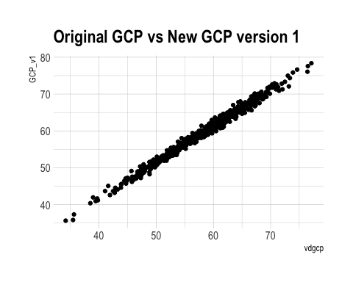
Repeating mistakes and item linkages

Slide 21
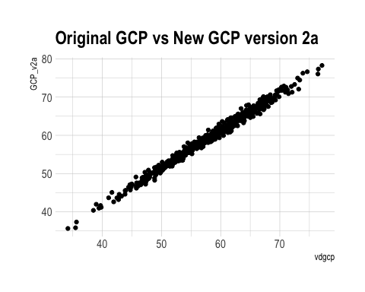
Fixing the mistakes

Slide 22
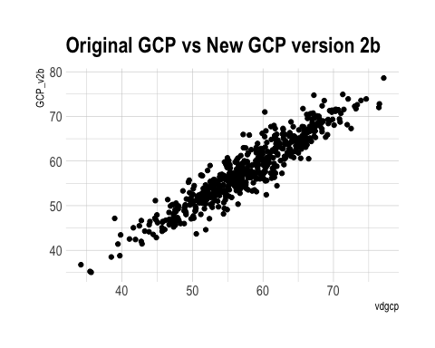
Fixing mistakes and item linkages (Option 1)
Animal/Supermarket not linked, CFL/FAS as three separate items

Slide 23
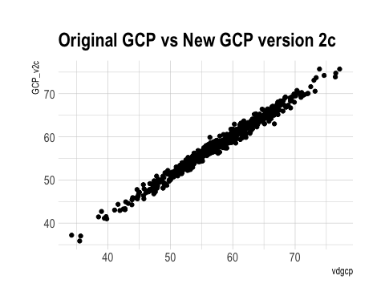
Fixing mistakes and item linkages (Option 2)
Animal/Supermarket not linked, CFL/FAS summed but not linked

Slide 24
Absolute difference from original GCP
Characteristic | N = 560
abs(Original GCP - V1)
Mean (SD) | 1.36 (0.73)
Median (IQR) | 1.30 (0.83, 1.84)
Range | 0.00, 3.59
abs(Original GCP - V2a)
Mean (SD) | 1.36 (0.73)
Median (IQR) | 1.30 (0.82, 1.84)
Range | 0.00, 3.60
abs(Original GCP - V2b)
Mean (SD) | 2.04 (1.70)
Median (IQR) | 1.56 (0.76, 2.90)
Range | 0.02, 10.73
abs(Original GCP - V2c)
Mean (SD) | 0.94 (0.69)
Median (IQR) | 0.81 (0.38, 1.35)
Range | 0.01, 3.74

