Slide 1
Serverless
The future of application delivery
Doug Vanderweide, MCSE, MCSD, MCT
https://www.dougv.com @dougvdotcom linkedin.com/in/dougvdotcom

Slide 2
Today’s Objectives
Describe its topology and benefits
01
Describe appropriate use cases
02
See an example in action
04
Define the Azure serverless stack
03

Slide 3
What Is Serverless?
“… a cloud computing execution model in which the cloud provider dynamically manages the allocation of machine resources.
Pricing is based on the actual amount of resources consumed by an application, rather than on pre-purchased units of capacity.”
-- Wikipedia

Slide 4
Translation
Serverless code runs on generic OS instances
The runtime environment is 100 percent predefined
You have some control over settings
Some dependencies are available
You can bring your own dependencies
You write code that runs in the environment, the host handles the rest
Provisioning
Scaling to workload
Networking, etc.

Slide 5
Translation, Continued
The environment is created when you need it, deprovisioned when you don’t
You only pay for actual use, not provisioned time
The host bills you based on the number of code executions you make and the memory/CPU needed to execute the code
Significant “free” allotments

Slide 6
Serverless Programming Model
Trigger: An external event which causes the code to execute
HTTP request
Message
File saved/modified/deleted in cloud file storage account
Some other capturable event
Input: Whatever data will be processed
Header/body of HTTP request
Message properties
Name/location of uploaded file
Output: Whatever data will be produced and “handed off”

Slide 7
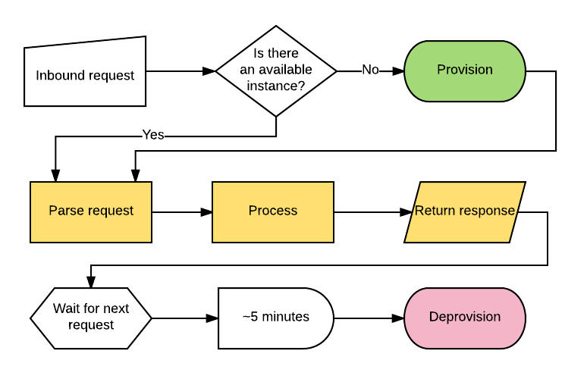
Serverless Workflow: HTTP Trigger

Slide 8
Serverless and Microservices
Serverless is the logical outcome of the microservices pattern
Narrowly focused concerns
Each developed independently
Communicating over standard protocols
Callable from multiple solution
Each adapting independently on its workload
Fast-paced implementation (CI/CD)

Slide 9
Serverless Benefits
Serverless frees us from configuring environments
This speeds the tempo at which we can develop
It eliminates significant DevOps tasks and roles
That makes operations leaner, agile and profitable
Serverless enables CI/CD
That destroys sprint-based development and its drawbacks

Slide 10
Where Does Serverless Make Sense?
Anyplace where a workflow can be easily defined with APIs
Each API powers a microservice
We chain together microservices into an implementation
Anything that doesn’t demand constant high CPU/memory/bandwidth
Not appropriate for big data crunching, video processing, etc.
Anyplace where state isn’t critical
Disconnected microservices aren’t state-friendly, but there are workarounds
Any time we don’t need complete control over environment

Slide 11
Serverless In Azure
Functions and Logic Apps

Slide 12
Azure Logic Apps
Used to create step-based workflows from APIs
Very similar to ifttt.com
Comes with many predefined “connectors,” or APIs
Any publicly accessible API can be a connector
You can “roll your own” connectors
Retains state for each step in a workflow
You can “cascade” the results of one step to subsequent steps
Completely programmable via JSON; can be integrated into source control

Slide 13
Azure Functions
Basically supercharged WebJobs
Has underlying Web App as environment
You can configure this environment as you would any Web App
Can run on consumption model or as an App Service application
Supports CI/CD, staging, request proxies
Supports multiple languages/runtimes
C#, node.js are primary; PHP, Java, PowerShell, Python, etc.
You can use any Nuget package you like
You can bring in custom DLLs

Slide 14
Azure Functions Components (C#)
run.csx: Your runtime code
1
function.json: defines the inputs, outputs and triggers for the Function
2
project.json: Defines the assemblies used by the Function
3
host.json: Global config for the WebJobs host
4

Slide 15
Demo Time!

Slide 16
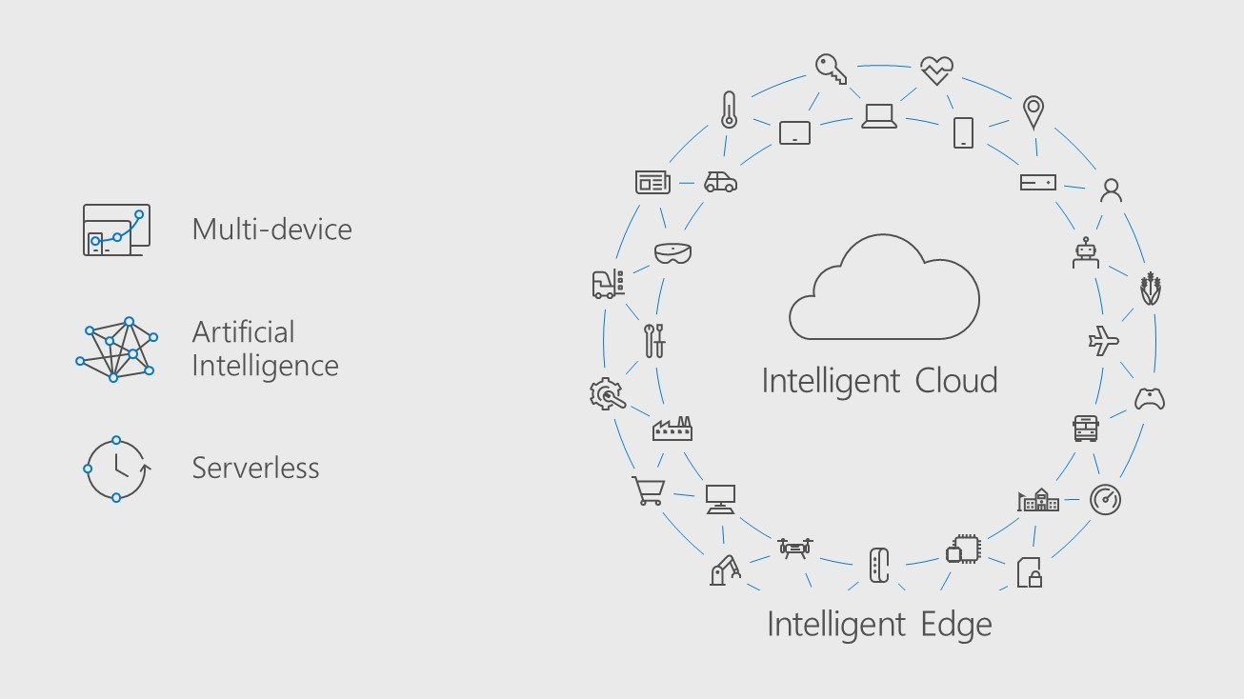
Three Attributes (Build 2017)

Slide 17
Azure Cognitive Services
https://docs.microsoft.com/en-us/azure/cognitive-services/
Speech, images, language, knowledge and search
Relatively low cost; some services have a free tier
Instrumental to Microsoft's near-term cloud strategy

Slide 18
Questions? Feedback? Thoughts?
Repo for this talk: https://github.com/dougvdotcom/fwdnug-serverless
This deck on SlideShare: https://www.slideshare.net/DougVanderweide/serverless-the-future-of-application-delivery
My contact info:
https://www.dougv.com
dougvanderweide@gmail.com
github.com/dougvdotcom
@dougvdotcom
linkedin.com/in/dougvdotcom

