Slide 1

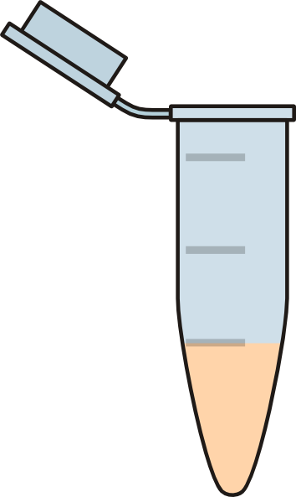

bulk samples protocol
add 5 volumes lysis buffer and incubate at 56°C for 60 hours
transfer 600 µl lysis buffer to a clean 1.5ml tube
add spike-in DNA
and vortex
co-purify
purified DNA with spike-in
bulk sample
mock soup protocol
add spike-in DNA
and vortex
mock soup,
already purified DNA
mock soup with spike-in

