Slide 1
The Squawk Java Virtual Machine
Doug Simon, Cristina Cifuentes
  Interns: Andrew Crouch, David Liu
    Sun Labs

Slide 2
The Squawk JVM
Squawk is a small, execute-in-place, CLDC 1.0 Java VM written in Java, designed for simplicity and ease of portability.
The JVM implements an isolate mechanism and can run on the bare metal, i.e., without need for an underlying OS.
Squawk runs on ARM7, PPC/MacOSX, (x86,PPC)/Linux, SPARC/Solaris, and x86/Windows.

Slide 3
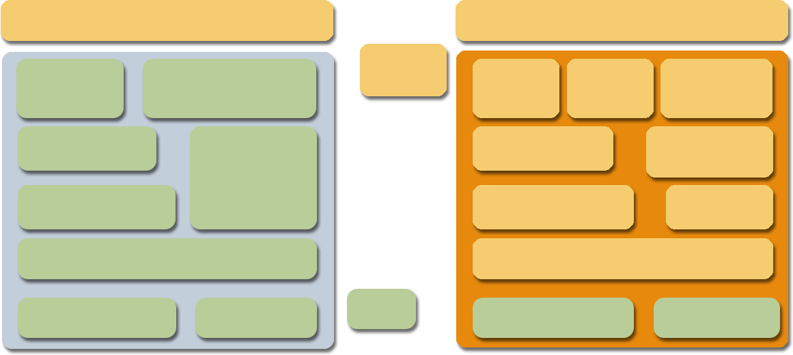
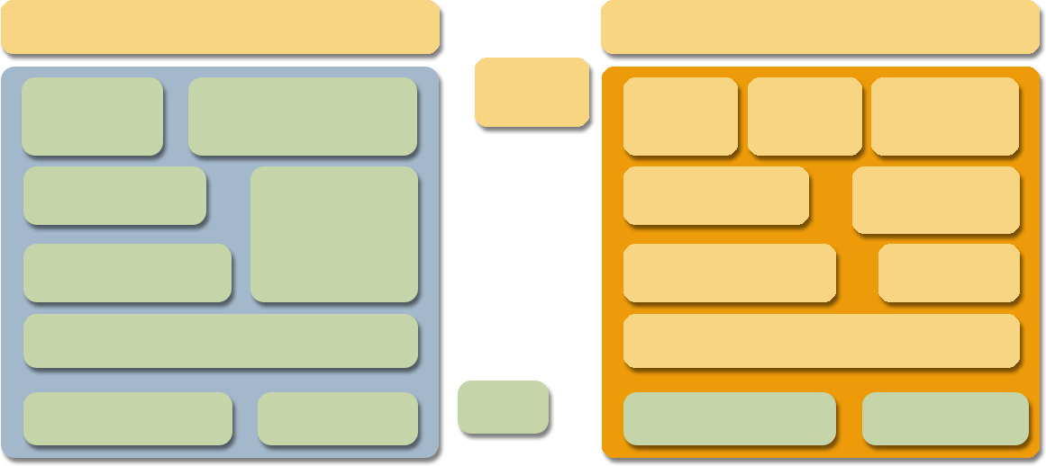
Standard JVM vs Squawk JVM
Standard JVM
Squawk JVM
Java class library
Java class library
Java code
Loader
Verifier
Loader
Verifier
Transformer
Garbage
collector
Garbage
collector
Interpreter
Interpreter
Thread Scheduler
Thread Scheduler
Exporter
Dynamic Compiler
Dynamic Compiler
I/O library
Native code
C code
I/O library
Native code
Note: There is a lighter blue behind this one, depending on How it prints

Slide 4
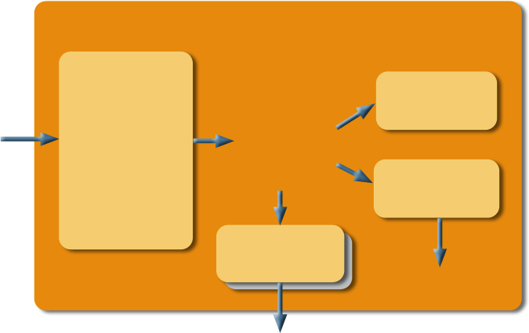
The Squawk Architecture
Interpreter
Loader
Verifier
Transformer
(Optimizer)
.class.
Squawk
bytecodes
Compiler
Exporter
machine code
.suite

Slide 5
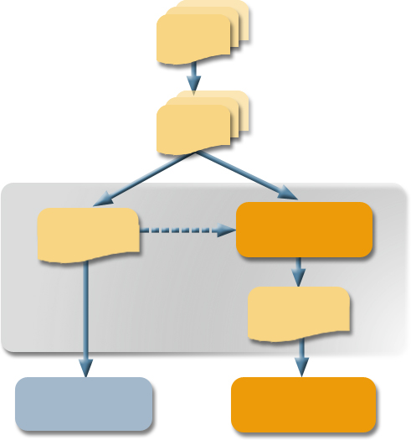
The Execute-in-Place File Format: Suites
.java
.class
Transformer +
exporter
app.jar
bundled application or library
app.suite
J2ME VM
Squawk VM

Slide 6
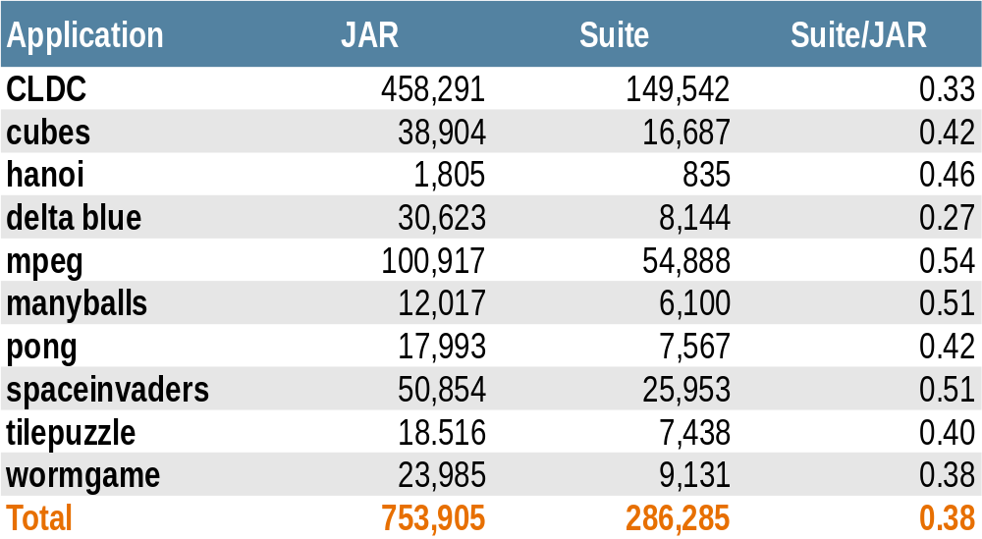
Uncompressed JAR vs Suite File Size Comparison

Slide 7

Squawk Bytecodes vs.
Java Bytecodes
Squawk Bytecode Property
Benefit
Commonly used bytecodes are
2 bytes instead of 3 bytes
References to fields and methods
resolve into physical offsets
Local variables are typed
One OOP map per method, nothing on the operand stack at GC points
More compact
More efficient for interpretation
More efficient for compilation
Simplifies garbage collection
Eliminates need for static interpretation to decipher activation frames

Slide 8
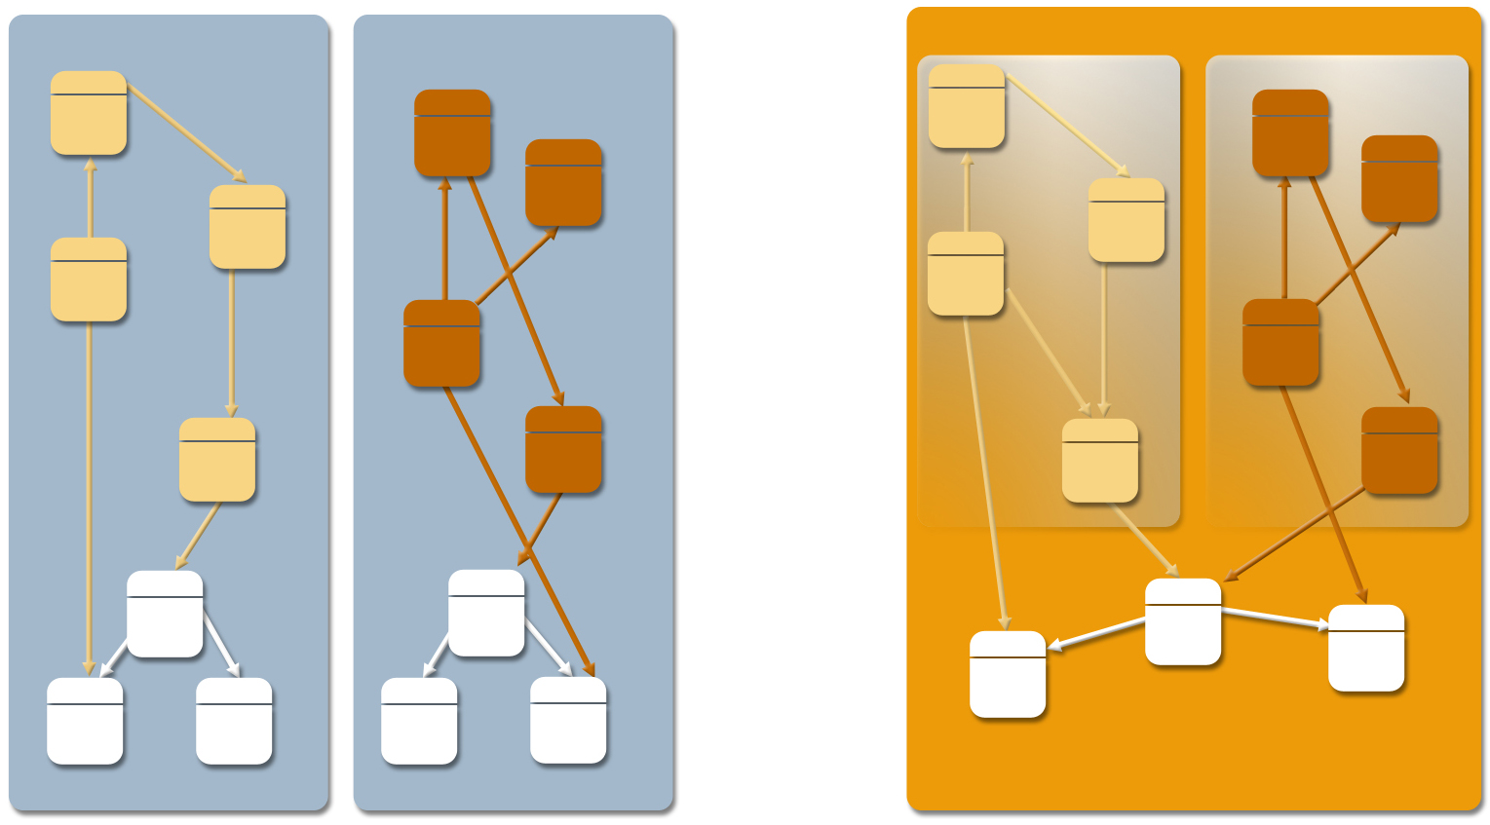
The Isolate Mechanism:
Multiple Applications in the One VM
Standard JVM
Squawk JVM
Isolate
Isolate
Non-shareable object memory
Shareable object memory
JVM OS process
JVM OS process
JVM OS process

Slide 9
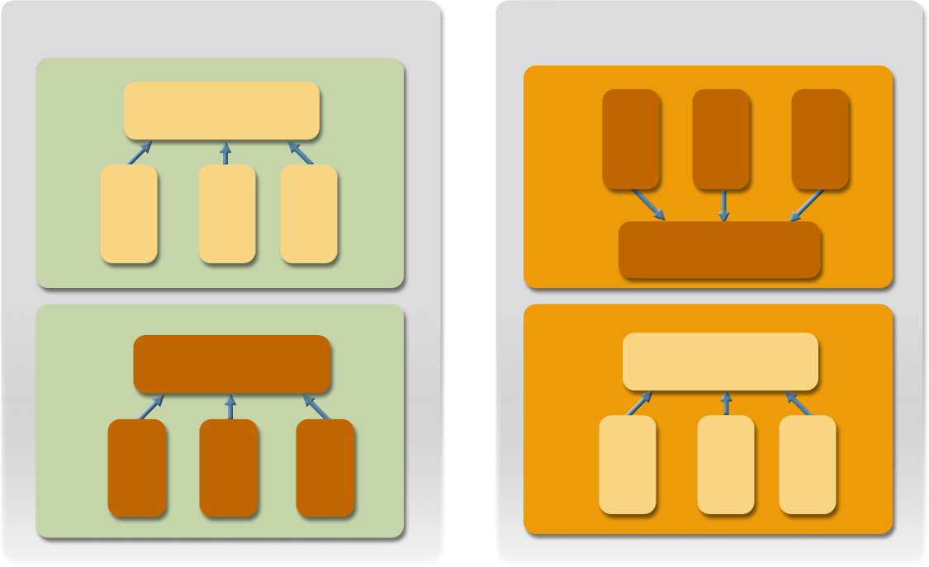
JVM Isolates and OS Processes Analogy
Operating System
Squawk JVM
Process
Isolate
Resources
thread1
thread2
thread3
thread1
thread2
thread3
Resources
Process
Isolate
Resources
Resources
thread1
thread2
thread3
thread1
thread2
thread3

Slide 10
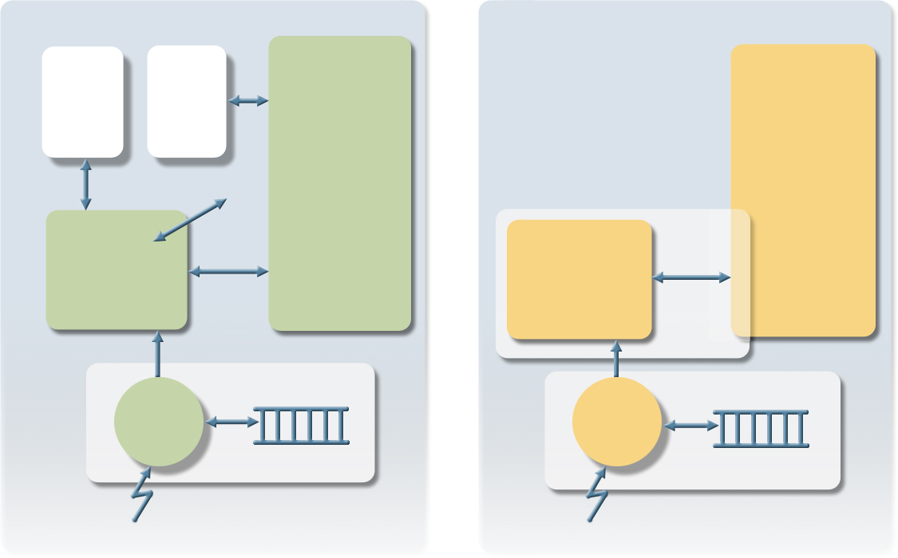
The Interrupt Architecture:
Device Drivers in Java
OS
Squawk
User Process
User Isolate
Kernel Memory
User Memory
Device Driver
syscall
Interrupt Service Routine Isolate
IIC
device driver
Interrupt Handler
Interrupt Handler
IRQ
IRQ

Slide 11
Doug Simon, Cristina Cifuentes
  doug.simon@sun.com, cristina.cifuentes@sun.com

