Slide 1
Java for Small Devices:
The Squawk Java Virtual Machine
Cristina Cifuentes
    Sun Labs

Slide 2
The Squawk JVM:
J2ME + OS Functionality
Written in Java
Programmable, i.e., extensible, flexible
Runs without an OS on ARM
Runs also on Solaris, Linux, MacOS, Windows
Optimized for small devices
AppServer model (isolates)
Connected: network/wireless/sensors/actuators
Ports easily

Slide 3
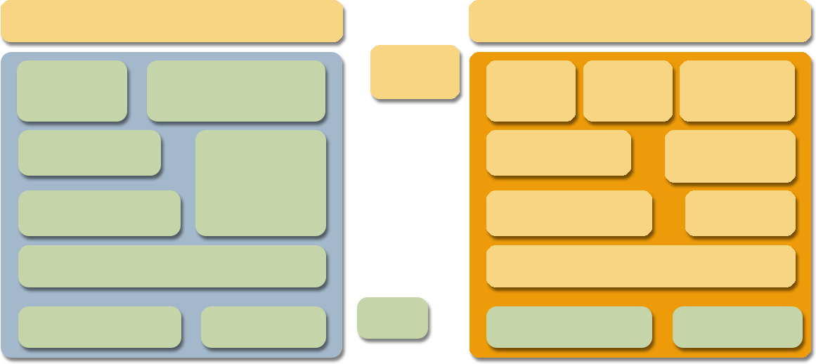
Standard JVM vs Squawk JVM
Standard JVM
Squawk JVM
Java class library
Java class library
Java code
Loader
Verifier
Loader
Verifier
Transformer
Garbage
collector
Garbage
collector
Interpreter
Interpreter
Thread Scheduler
Thread Scheduler
Exporter
Dynamic Compiler
Dynamic Compiler
I/O library
Native code
C code
I/O library
Native code

Slide 4
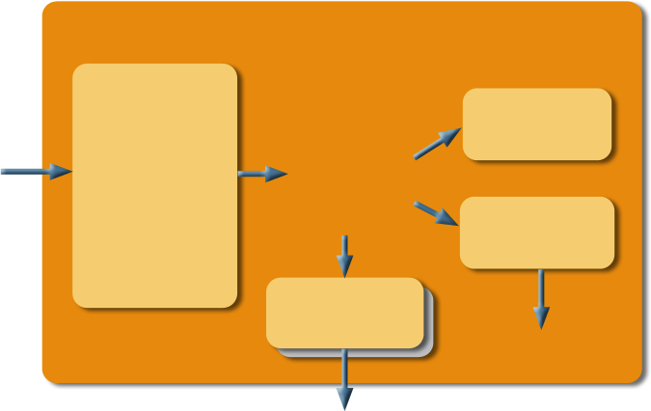
The Squawk Architecture
Interpreter
Loader
Verifier
Transformer
(Optimizer)
.class.
Squawk
bytecodes
Compiler
Exporter
machine code
.suite

Slide 5
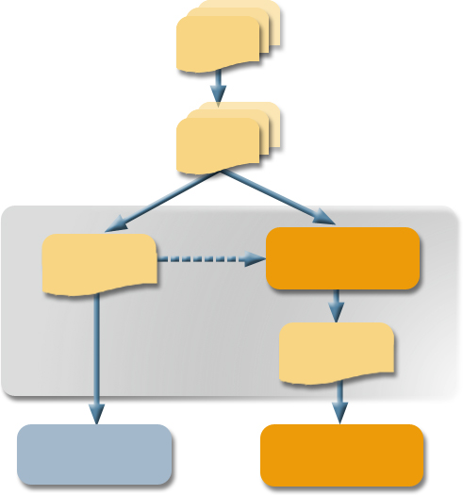
The Execute-in-Place File Format: Suites
.java
.class
Transformer +
exporter
app.jar
bundled application or library
app.suite
J2ME VM
Squawk VM

Slide 6
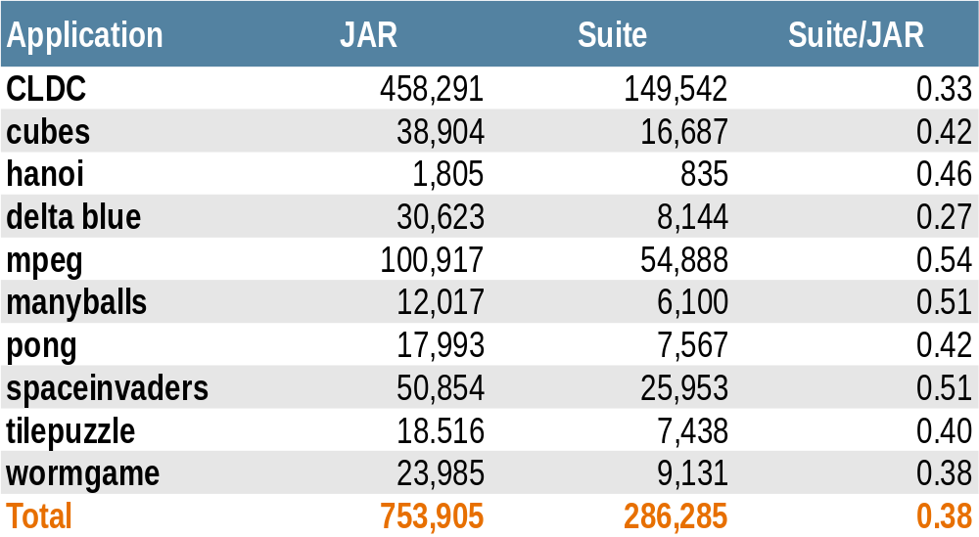
Uncompressed JAR vs Suite File Size Comparison

Slide 7

Squawk Bytecodes vs.
Java Bytecodes
Squawk Bytecode Property
Benefit
Commonly used bytecodes are
2 bytes instead of 3 bytes
References to fields and methods
resolve into physical offsets
Local variables are typed
One OOP map per method, nothing on the operand stack at GC points
More compact
More efficient for interpretation
More efficient for compilation
Simplifies garbage collection
Eliminates need for static interpretation to decipher activation frames

Slide 8
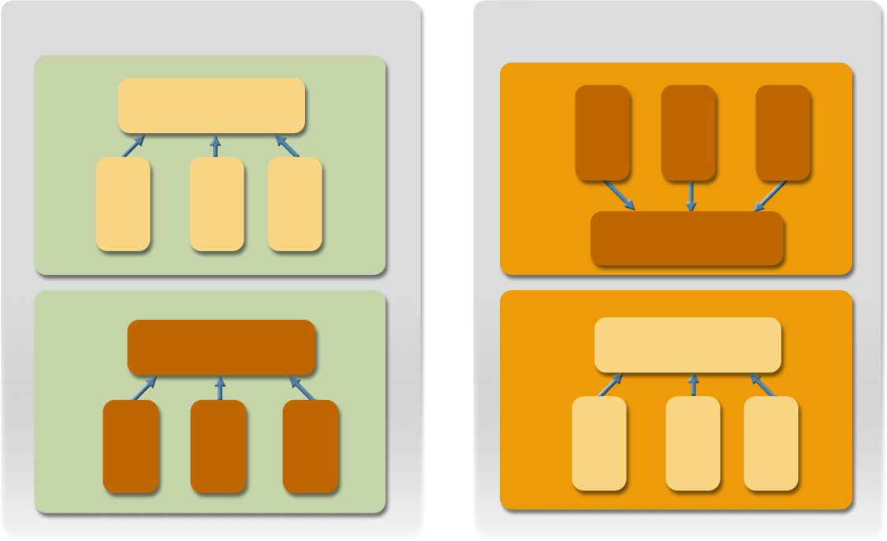
JVM Isolates and OS Processes Analogy
Operating System
Squawk JVM
Process
Isolate
Resources
thread1
thread2
thread3
thread1
thread2
thread3
Resources
Process
Isolate
Resources
Resources
thread1
thread2
thread3
thread1
thread2
thread3

Slide 9
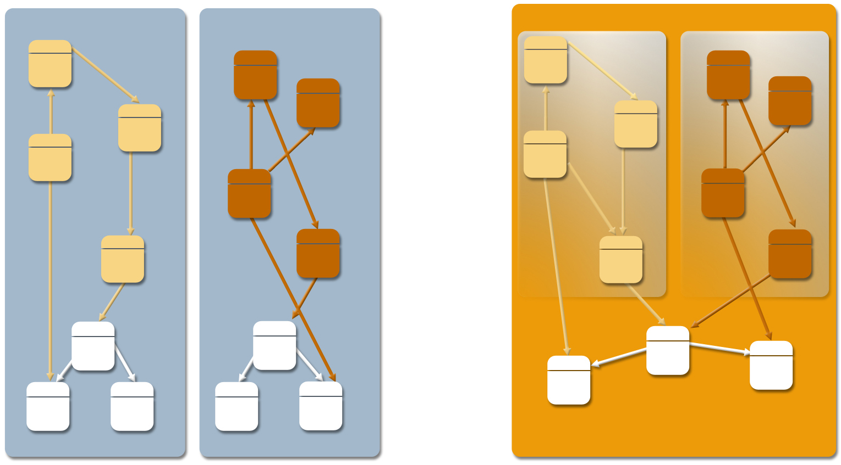
AppServer Model Allows Multiple Applications Within One VM (JSR121)
Standard JVM
Squawk JVM
Isolate
Isolate
Non-shareable object memory
Shareable object memory
JVM OS process
JVM OS process
JVM OS process

Slide 10
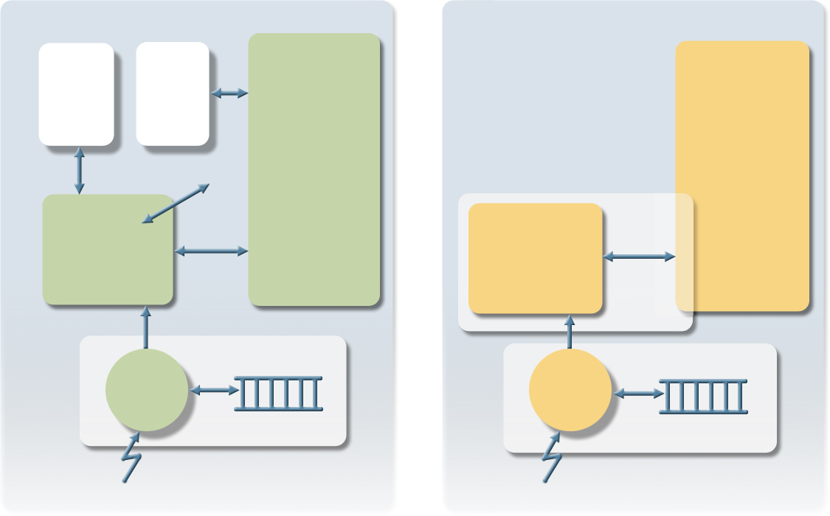
Low-Level Hardware Support from Java (“Device Drivers in Java”)
OS
Squawk
User Process
User Isolate
Kernel Memory
User Memory
Device Driver
syscall
Interrupt Service Routine Isolate
IIC
device driver
Interrupt Handler
Interrupt Handler
IRQ
IRQ

Slide 11
Current Squawk Deployment:
Sun Labs Sun Spot Platform
Hardware
  32-bit ARM core
  Chipcon CC2420 based wireless platform
  SPI based peripherals
  Simple sensor board
  “Bot”-type device with variety of interfaces
Software
  Squawk Java VM
  Desktop build and deploy scripts
  Libraries for
    Driving hardware: radio, sensor boards, ...
    Basic 802.15.4 network functionality
  SpotWorld: graphical desktop interface

Slide 12
Squawk Software Libraries
Standard J2ME Java libraries
  CLDC 1.0
Hardware libraries
  SPI, AIC, TC, PIO drivers all in Java
  Sensor board hardware driven by Java (no C)
    ADCs, GPIO, IRDA, etc.
Radio libraries
  Drive Chipcon CC2420 hardware from Java (no C)

Slide 13
Squawk Software Libraries (2)
Network libraries
  802.15.4 MAC layer in Java (no C)
  Simple GCF implementations of connections
Desktop libraries
  Create connections from standard J2SE VMs to wireless devices
  Utilize Spot in testboard as a gateway

Slide 14
Example: Application
//Open a stream over the radio
StreamConnection conn = (StreamConnection) Connector.open
("radio://"+otherSpotAddress+":100");
DataOutputStream output = conn.openDataOutputStream();
//Read pin 4 of the ADC on the Sensor board (ADT7411 is the type of ADC)
RangeInput input = new ADT7411RangeInput(Sensorboard.getADC(),4);
//Loop and send the data
while(true) {
try {
output.writeInt(input.getValue());
output.flush();
Thread.yield();
} catch (Exception e) {
System.err.println("SENDER problem "+e);
}

Slide 15
Example: Sensor
public synchronized static Accelerometer3D getAccelerometer() throws IOException {
if (accelerometer == null) {
//get the ADC inputs
RangeInput xInput = new ADT7411RangeInput(getADC(),4);
RangeInput yInput = new ADT7411RangeInput(getADC(),5);
RangeInput zInput = new ADT7411RangeInput(getADC(),6);
//get the contol pins
SingleBitOutput selfTest = new MAX6966SingleBitOutput(getIOPort1(),7);
SingleBitOutput powerDown = new MAX6966SingleBitOutput(getIOPort1(),8);
SingleBitOutput fullScale = new MAX6966SingleBitOutput(getIOPort1(),9);
accelerometer = new LIS3L02AQAccelerometer
(xInput,yInput,zInput,selfTest,powerDown,fullScale);
}
return accelerometer;
}

Slide 16
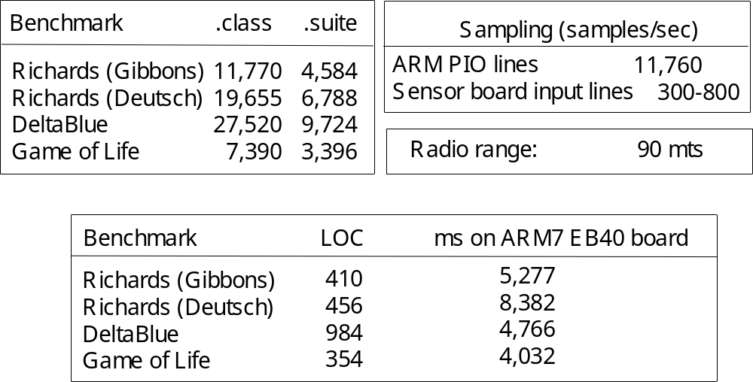
Experimental Results (April 15, 2005)

Slide 17
Squawk on SunSpot Facts
Java VM written in Java
Interpreter based (at present)
Memory sizes:
  80K RAM for VM
  Libraries 380K flash
Suites
  38% smaller than jar’d class files
Performance: comparable to KVM
Device drivers written in Java (no C)
802.15.4 MAC layer in Java (no C)

Slide 18
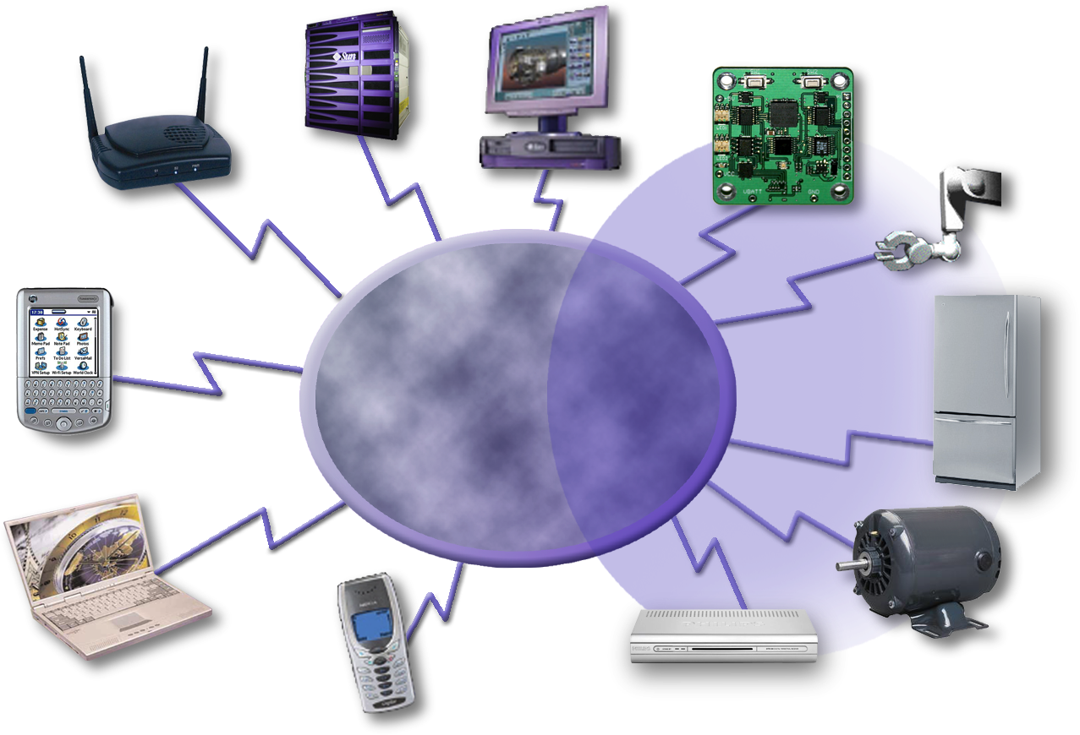
Future:
A Platform for Cooperating Devices
Network/ wireless
  Cell phones
  Set top boxes
  Home appliances
  Robots
Sensors
Server
Gateway
PC
Robot
Wireless
Wireless
Transducer
PDA
Fridge
Laptop
Cell Phone
Motor
Set Top Box

Slide 19
Summary
Developers
  Fully capable J2ME that runs on “bare” metal
  Portable: no native code nor OS needed
  Standard Java development and debugging tools
Business
  Powerful and flexible technology for connecting mobile devices and big computers using Java
  Reduces programming and testing complexity across multiple OS/CPU configurations

Slide 20
Cristina Cifuentes
  cristina.cifuentes@sun.com

