Slide 1
Squawk Java Virtual Machine Compiler Architecture
David Liu
    Manager: Cristina Cifuentes

Slide 2
Presentation Outline
What is Squawk?
Standard JVM vs Squawk JVM
Squawk architecture
Compiler interface
Multiple compilers - simple vs optimizing
Execution of Squawk code
Future work

Slide 3
What is Squawk?
Small, execute-in-place JVM
Written in Java, not C
Optimized for small devices
Squawk architecture has an interpreter, compiler and jitter
Current use: Sun Spot sensors platform
Why write a JVM in Java?
  Portability
What performance can the Squawk JVM achieve?

Slide 4
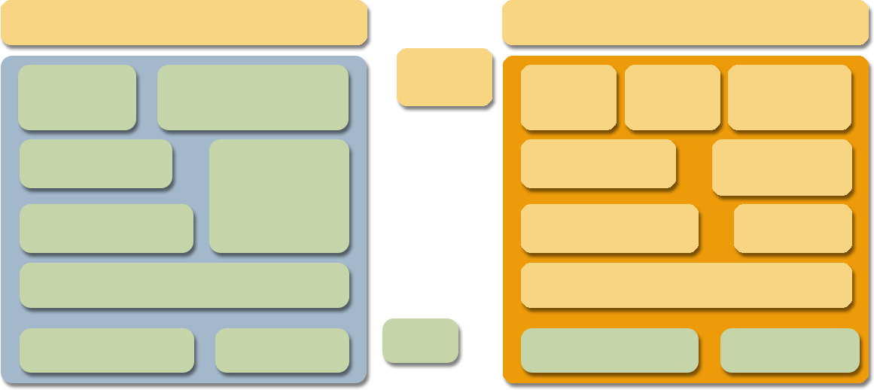
Standard JVM vs Squawk JVM
Standard JVM
Squawk JVM
Java class library
Java class library
Java code
Loader
Verifier
Loader
Verifier
Transformer
Garbage
collector
Garbage
collector
Interpreter
Interpreter
Thread Scheduler
Thread Scheduler
Exporter
Dynamic Compiler
Dynamic Compiler
I/O library
Native code
C code
I/O library
Native code

Slide 5
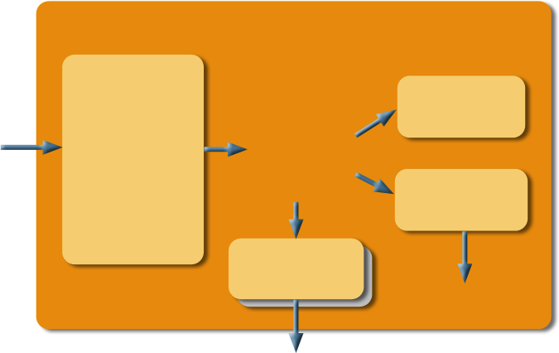
The Squawk Architecture
Interpreter
Loader
Verifier
Transformer
(Optimizer)
.class.
Squawk
bytecodes
Compiler
Exporter
machine code
.suite (object memory)

Slide 6
Compiler Interface
Stack-based, machine-independent instruction interface
Allows multiple compiler implementations for Squawk
Two types of compilers will be used by Squawk - simple and optimizing (collaborative research)
Squawk bytecode
Bytecode deconstructor
Compiler interface
const_char 1004
const_byte 32
ushr_i
c.literal(1004);
c.push();
c.literal(32);
c.push();
c.pop(INT);
c.pop(INT);
c.ushr();
c.push();

Slide 7
Simple Compiler
Light-weight, single pass, non-optimizing compiler
Designed for fast code compilation
Currently supported back-ends - x86, ARM
Will be used for jitting classes loaded at run time
Compiler Interface
Machine Independent Compiler
Instruction Decoder
X86 Instr. Emitter
ARM Instr. Emitter
X86 Assembler
ARM Assembler

Slide 8
Optimizing Compiler
Collaborative research with Usyd - Dr Bernhard Scholz
Aim to test a new instruction selection technique - Partitioned Boolean Quadratic Programming as applied to general purpose machines
Will be an optimizing compiler:
  Constant folding
  Dead code elimination
  Partial Redundancy Elimination
  Etc
Will be used for:
  Ahead-of-time compilation of system code (interpreter, libraries)
  Potential jitting of frequently executed code for better performance

Slide 9
Squawk Bytecode Execution
Currently using a Java interpreter macro-expanded and converted to C
Future interpreter will be generated through the compiler interface
Future bytecode execution modes:
  Interpreted
  Ahead-of-time compiled
  Just-in-time compiled
Mix of bytecodes and compiled code in system memory
System Memory Layout
…
Bytecode Interpreter
…
System Class (eg GC)
…
User Class (bytecodes)
…
User Class (jitted)
…
Misc data
Native code
Bytecodes

Slide 10
Future Work
Completion of Squawk compiler integration
  Testing and debugging the interpreter
  Compiling classes ahead-of-time
Other compiler back-end implementations as needed
Integration with Scholz’s optimizing compiler framework
Runtime profiling for better jitting
Running benchmarks with standard JVMs vs Squawk using an optimizing compiler

Slide 11
Summary
Squawk is a small, execute-in-place CLDC 1.0 compliant Java Virtual Machine
Written in Java, not C
Compiler interface for multiple compiler support
Simple compiler for jitting classes at run time
Optimizing compiler for ahead-of-time compilation
Squawk code executed using mix of interpretation, ahead-of-time and just-in-time compilation
Future work - compiler integration, benchmarking

