Slide 1
Java for Small Devices:
The Squawk Java Virtual Machine
Cristina Cifuentes
    Sun Labs

Slide 2
The Squawk JVM:
J2ME + OS Functionality
Written in Java
Programmable, i.e., extensible, flexible
Runs without an OS on ARM
Runs also on Solaris, Linux, MacOS, Windows
Optimized for small devices
AppServer model (isolates)
Connected: network/wireless/sensors/actuators
Ports easily

Slide 3
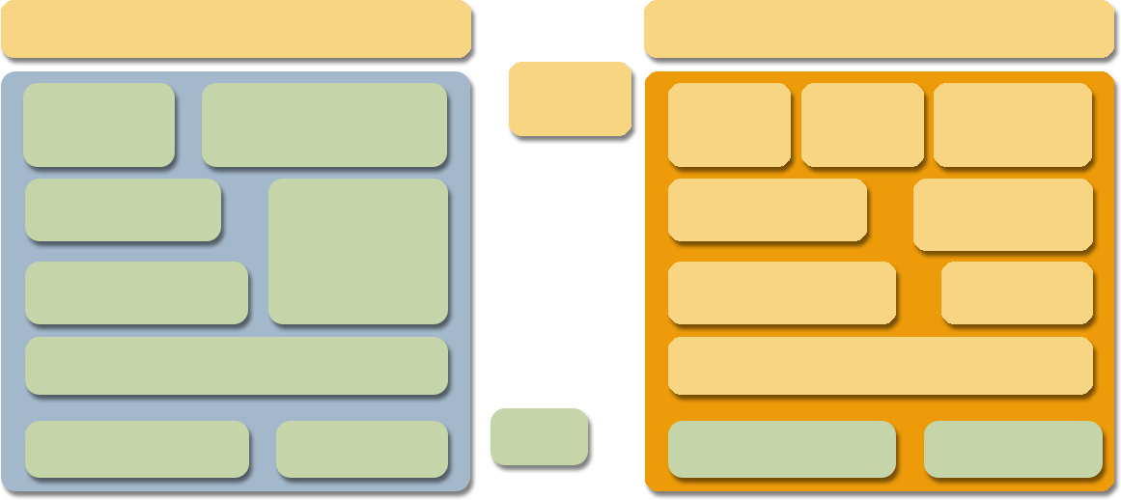
Standard JVM vs Squawk JVM
Standard JVM
Squawk JVM
Java class library
Java class library
Java code
Loader
Verifier
Loader
Verifier
Transformer
Garbage
collector
Garbage
collector
Interpreter
Interpreter
Thread Scheduler
Thread Scheduler
Exporter
Dynamic Compiler
Dynamic Compiler
I/O library
Native code
C code
I/O library
Native code

Slide 4
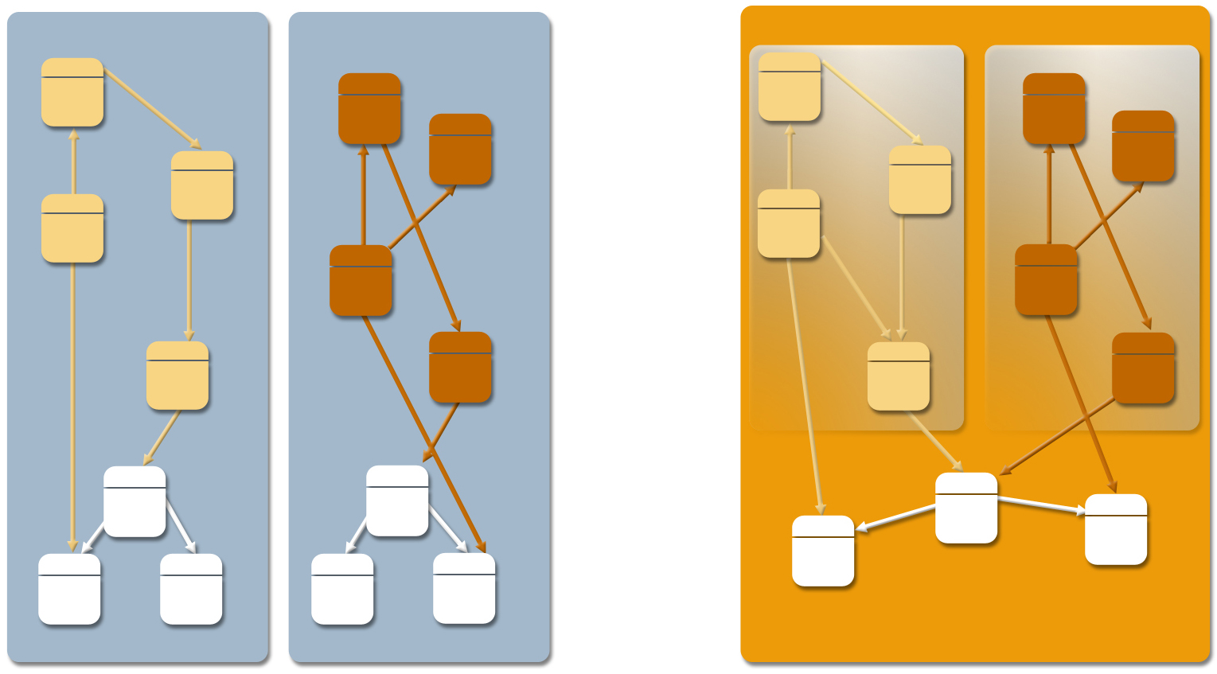
AppServer Model Allows Multiple Applications Within One VM (JSR121)
Standard JVM
Squawk JVM
Isolate
Isolate
Non-shareable object memory
Shareable object memory
JVM OS process
JVM OS process
JVM OS process

Slide 5
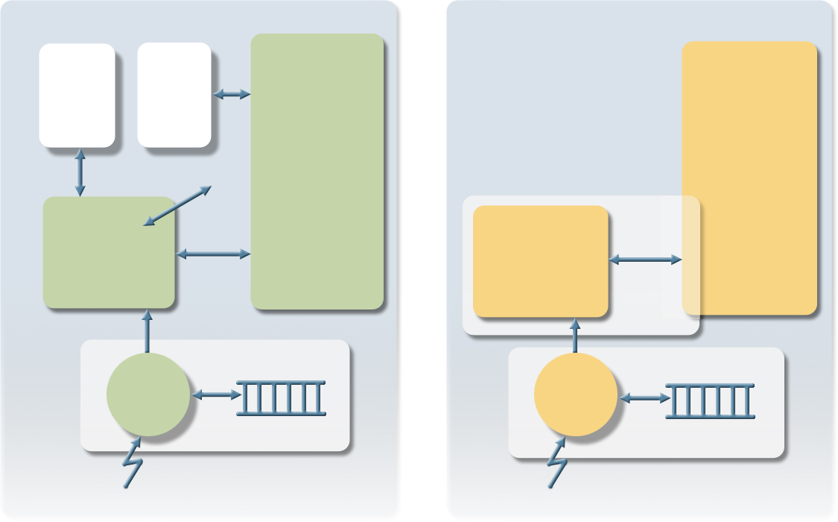
Low-Level Hardware Support from Java (“Device Drivers in Java”)
OS
Squawk
User Process
User Isolate
Kernel Memory
User Memory
Device Driver
syscall
Interrupt Service Routine Isolate
IIC
device driver
Interrupt Handler
Interrupt Handler
IRQ
IRQ

Slide 6
Current Squawk Deployment:
Sun Labs SunSpots Platform
Hardware
  32-bit ARM core
  Chipcon CC2420 based wireless platform
  SPI based peripherals
  Simple sensor board
  “Bot”-type device with variety of interfaces
Software
  Squawk Java VM
  Desktop build and deploy scripts
  Libraries for
    Driving hardware: radio, sensor boards, ...
    Basic 802.15.4 network functionality
  SpotWorld: graphical desktop interface

Slide 7
Squawk on SunSpot Facts
Java VM written in Java
Interpreter based (at present)
Memory sizes:
  80K RAM for VM
  Libraries 380K flash
Suites
  38% smaller than jar’d class files
Performance: comparable to KVM
Device drivers written in Java (no C)
802.15.4 MAC layer in Java (no C)

Slide 8
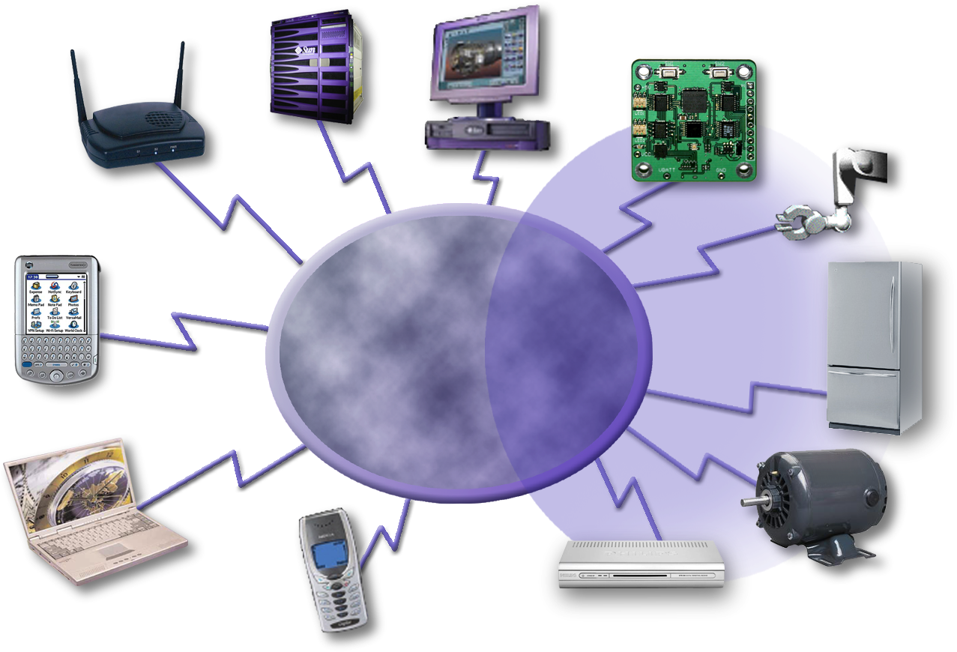
Future:
A Platform for Cooperating Devices
Network/ wireless
  Cell phones
  Set top boxes
  Home appliances
  Robots
Sensors
Server
Gateway
PC
Robot
Wireless
Wireless
Transducer
PDA
Fridge
Laptop
Cell Phone
Motor
Set Top Box

Slide 9
Summary
Developers
  Fully capable J2ME that runs on “bare” metal
  Portable: no native code nor OS needed
  Standard Java development and debugging tools
Business
  Powerful and flexible technology for connecting mobile devices and big computers using Java
  Reduces programming and testing complexity across multiple OS/CPU configurations

Slide 10
Cristina Cifuentes
  cristina.cifuentes@sun.com

