Slide 1

KJIT
A Just-In-Time compiler for memory constrained low-power devices
Nik Shaylor
Sun Microsystems Inc.
Santa Clara, California USA

Slide 2
Overview
Background
Project Objectives
Method
Results
Conclusions

Slide 3
Background
KJIT is an experimental JIT for KVM.
KVM is Sun’s reference implementation of CLDC (Connected limited device configuration).
CLDC is subset of the Java™ platform that is intended for cell phones, PDAs, pagers, etc.

Slide 4
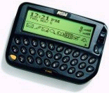







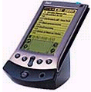
Target Devices
Minimum requirements for CLDC 1.0:
- 160 KB memory available for Java
- Processor speed at least 8 MHz
- Limited power, usually battery operation
- Connectivity to network; often very limited
bandwidth (9600 baud or less)
- Application provisioning is done in in terms
of whole applications

Slide 5
Typical Hardware
About 128-512KB Flash memory
About 32-128KB or working memory.
8-32MHz CPU.
Slow network connectivity

Slide 6
Project Objectives
Examine some simple compilation strategies suitable for small devices that will accelerate the speed of compute intensive applications (typically small games).

Slide 7
What is a good in a JIT?
Server Java
  High throughput.
Desktop Java
  Low execution latency.
Mobile Java
  Low memory utilization.

Slide 8
Compilation options
Compile the same stack based VM operations.
  Simple to implement.
  Makes transitioning between interpreted and compiled code trivial.
Compile a register based program.
  Higher quality compiled code.
  However transitioning between interpreted and compiled is more complex.

Slide 9
Bytecode Preprocessing?
Unlike server and desktop Java systems mobile Java programs are quite small.
They often arrive over very slow networks.
It may be more effective to pre-process whole applications rather than rely upon the dynamic analysis of “hot” areas of code.

Slide 10
Pre-compilation by bytecode transformation
Eliminate the use of the Java stack where a transition can be made between interpreted and compiled code (all expression boundaries).
The compiled and interpreted code can therefore use the same activation record format.
The resulting bytecodes can then easily be compiled into a 3-address RISC architecture.

Slide 11
KVM
Loader
Verifier
Interpreter

Slide 12
KVM + KJIT
Loader
Verifier
Transformer
Interpreter
Code generator

Slide 13
Bytecode Transformation
a = 1 – (b * c)
Before
After
iconst_1
iload_1
iload_2
imul
isub
istore_3
iload_1
iload_2
imul
istore_4
iconst_1
iload_4
isub
istore_3

Slide 14
RISC instruction generation
a = 1 – (b * c)
Before
After
iload_1
iload_2
imul
istore_4
iconst_1
iload_4
isub
istore_3
mul r4, r1, r2
sub r3, #1, r4

Slide 15
Interpreter / compiler loop
Attempt to enter
compiled code
Interpret next
bytecode

Slide 16
Interpreter / compiler loop
Time to
Reschedule?
Switch Thread
Y
N
Attempt to enter
compiled code
Interpret until
next basic block

Slide 17
JIT buffer management
A single fixed length buffer was used to contain
the compiled code.
Start
Current
End
Used
Unused
The unused part was used for memory needed for the bytecode transformer.

Slide 18
JIT buffer management
The JIT buffer was flushed if:
  It was full and the code generator needed more memory.
  The unused part was not large enough to contain the IR for the transformer.
  A class with compiled code referring to it was sub-classed.

Slide 19
Debugging
Debugging was made much easier by executing each basic block of compiled code on the interpreter and comparing the results
Heap
after
compiled
execution
Heap
before
Compare
results
Heap
after
interpreter
execution

Slide 20
Benchmark Applications
Cubes
  A small 3D graphical program in which one could navigate through a virtual world of rotating cubes.
DeltaBlue
  A constraint solving program.
MPEG-1
  An MPEG video decoder

Slide 21
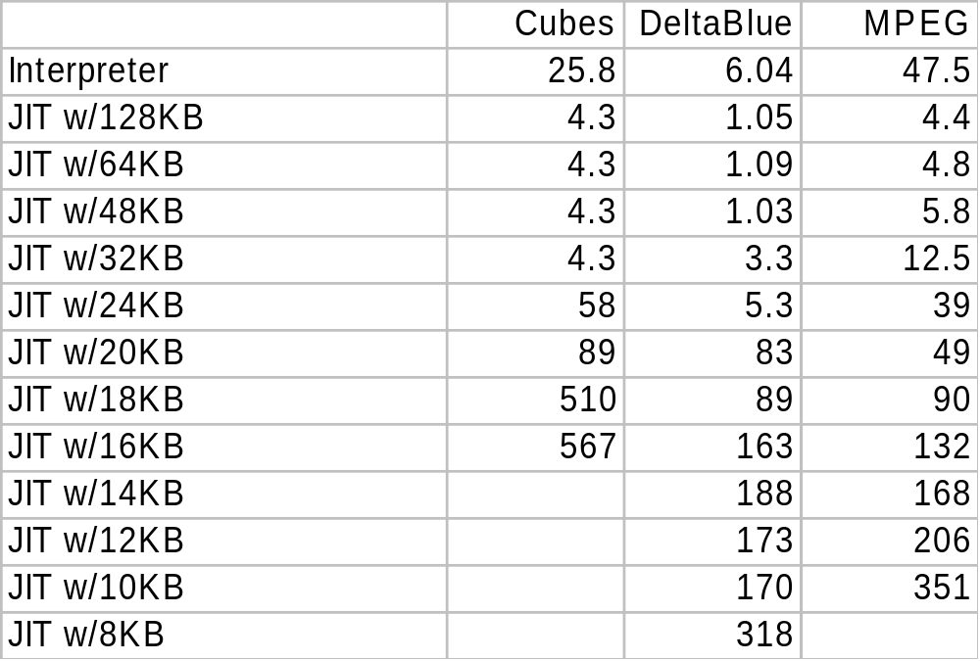
Results

Slide 22
Results
47.5
Interpreted
Compiled
25.8
4.4
4.3
6.04
1.05
MPEG - 10.7
Cubes - 5.7
DeltaBlue - 5.7

Slide 23
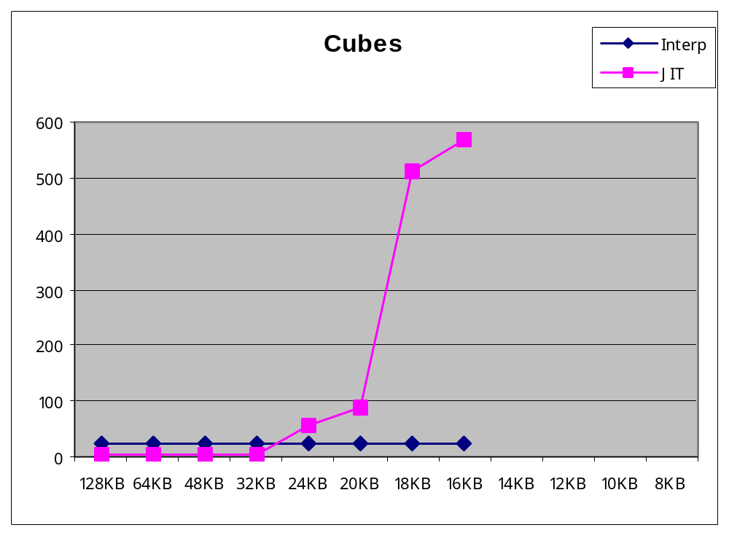
Results

Slide 24
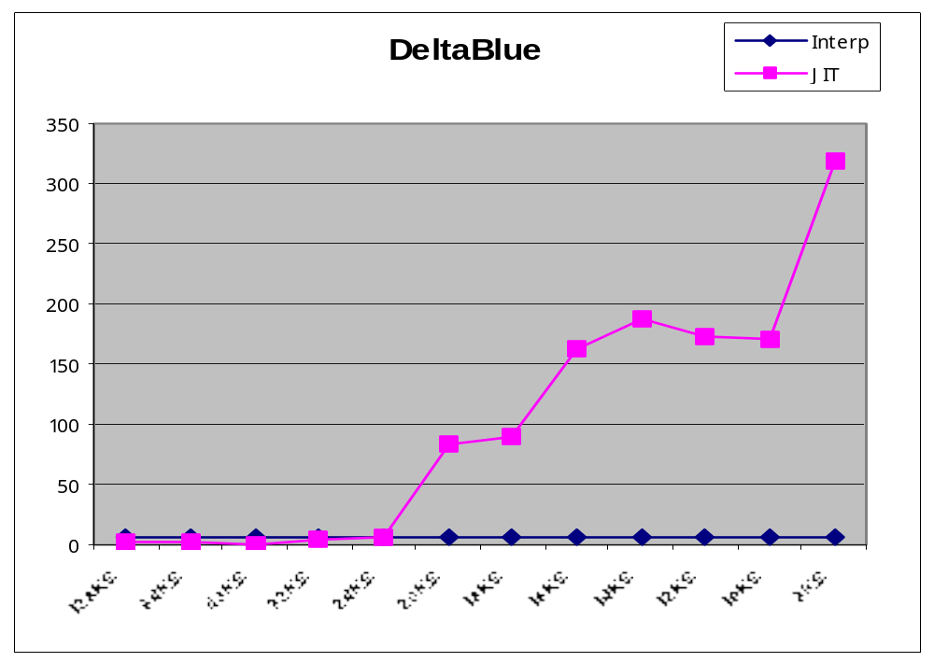
Results

Slide 25
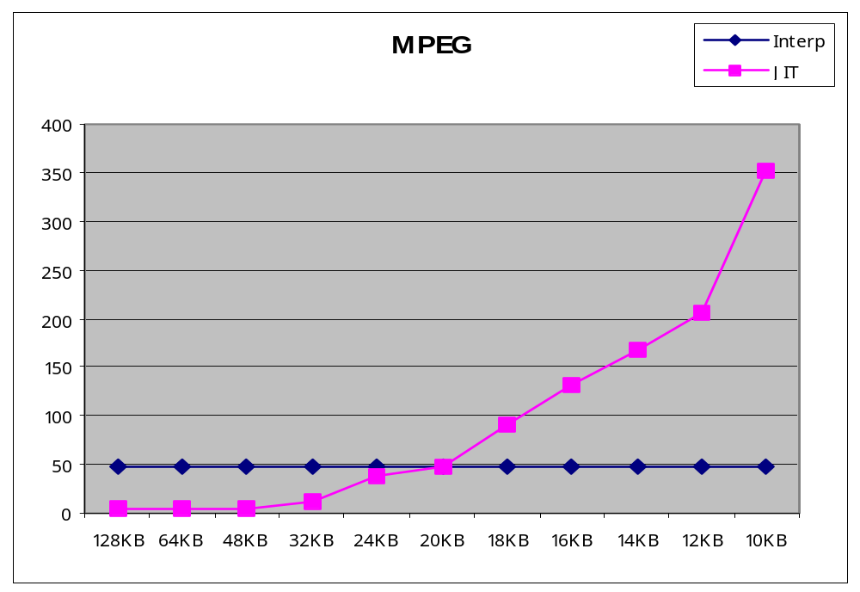
Results

Slide 26
Future Work
More analysis of the code buffer usage.
Adaptive heuristic for buffer size.
Measure more applications.
Translate to a new bytecode set that is smaller and easier to interpret / compile.

Slide 27
Conclusions
Pre-compilation by bytecode transformation simplifies the code generator.
A simple 60KB JIT compiler can produce good performance benefits.
Simple code buffer management can work well when the cost of code generation is low.

Slide 28
Questions…

