Slide 1
Squawk – Status Update
Doug Simon

Slide 2
What’s new
Loader
  Real numbers
  Optimized memory usage
New String implementation

Slide 3
Loader

Slide 4
Benchmarks
 | helloworld | hanoi | delta | cubes | mpeg
Methods & Fields | 7 | 18 | 159 | 219 | 362
Bytecode (in bytes) | 23 | 243 | 3214 | 9767 | 42997
Suite (in bytes) | 448 | 1117 | 9737 | 15848 | 54487
Dynamic memory (in bytes) | 3276 | 3500 | 7288 | 7664 | 10680

Slide 5
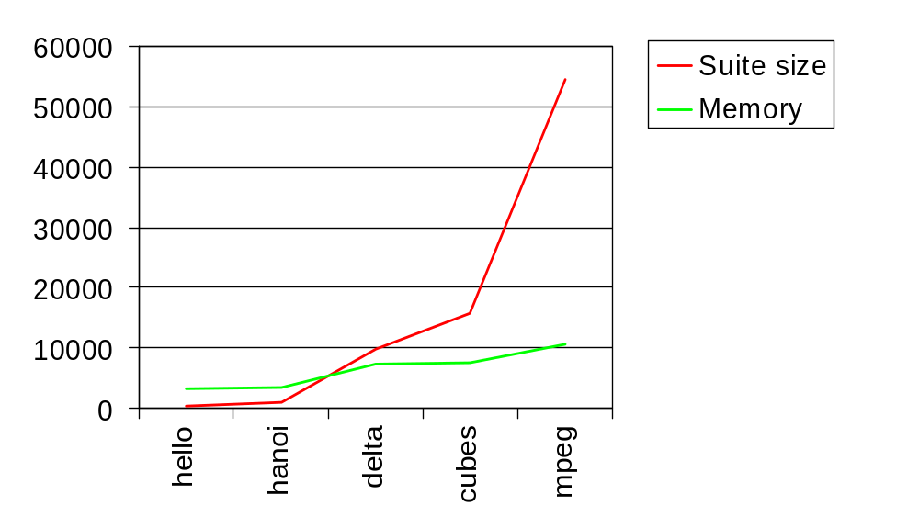
Loading memory requirements

Slide 6
New String implementation

Slide 7
Old implementation
public final class String {
private char value[];
private int offset;
private int count;
// methods
}

Slide 8
New implementation
public class String {
// methods
}
public class StringOfBytes extends String {
}

Slide 9
Empty string (old)
String empty = “”;
java.lang.String
char[]
empty
value
offset
0
count
0
16 bytes
+
4 bytes
=
20 bytes

Slide 10
Empty string (new)
String empty = “”;
java.lang.StringOfBytes
empty
4 bytes

Slide 11
Non-empty string (old)
String name = “JCF”;
java.lang.String
char[]
empty
value
‘J’
‘C’
offset
0
‘F’
count
0
16 bytes
+
12 bytes
=
28 bytes

Slide 12
Non-empty string (new)
String name = “JCF”;
java.lang.StringOfBytes
empty
‘J’
‘C’
‘F’
8 bytes

Slide 13
Substring (old)
String name = “Bertrand”;
String nickname = name.substring(0, 4);
java.lang.String
char[]
java.lang.String
name
value
‘B’
‘e’
value
nickname
offset
0
‘r’
‘t’
0
offset
count
8
‘r’
‘a’
4
count
‘n’
‘d’
16 bytes
+
20 bytes
+
16 bytes
=
52 bytes

Slide 14
Substring (new)
String name = “Bertrand”;
String nickname = name.substring(0, 4);
java.lang.StringOfBytes
java.lang.StringOfBytes
name
nickname
‘B’
‘e’
‘r’
‘t’
‘B’
‘e’
‘r’
‘t’
‘r’
‘a’
‘n’
‘d’
16 bytes
+
8 bytes
=
24 bytes

Slide 15
Details
String instances are arrays internally (bytes or chars).
Only 3 non-byte array strings in Squawk:
  Tables describing instructions properties encoded as char arrays
  Wrapped in a String for immutability
Does not impact String interning

