Slide 1
Sun MicroSystems 22nd July 2003
32 Bit Smart card Controller

Slide 2
32 Bit Smart card Controller
- Target Applications.
- Key Features
- How this controller addresses future requirements.
- Architecture of 32 bit controller.
- Security Concept
- Performance
- Road map.
- Over view of the 32 Bit controller.
- Functional Blocks of the controller.
- Platform Support Layer
- Tools.(SDK and Emulator.)

Slide 3



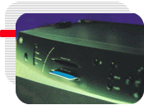


SLE88 Family Overview
Target Applications
Mobile
Communication
UMTS (USIM Card)
m-commerce
Multi-Tasking
GSM (SIM Card)
Banking
Security
e purse
Credit Card
Home Banking
Identification
PayTV /
Network Access
Data Encryption
Applications Architecture Security Tools Products
Notes:
Trainer Notes
Do not copy.
Company confidential according to the Non-Disclosure Aggreement with Infineon Technologies AG as lawful successor of Siemens AG Semiconductor.
All rights reserved.

Slide 4
88 Overview Training - Applications
Key Features
Maximum Security
SLE88CXxxxS/P
High Performance
Low Power Consumption
Information Density
Applications Architecture Security Tools Products
Notes:
Trainer Notes
Security is the 1st priority
Dedicated smart card 32-bit core
Enhanced Memory Management & Protection Unit
Encryption of ROM, RAM and EEPROM
Security sensors and filters
Security layout techniques to avoid screening
Security Peripherals
Low Power Consumption
=> Important for a 32 bit because need more power.
=> Save battery
=> New standard 1.8 V GSM compliant
Code Density
=> save memory resources
Performance
=> up to 55 MHz internal frequency
=> only 15 MHz on 66
Do not copy.
Company confidential according to the Non-Disclosure Aggreement with Infineon Technologies AG as lawful successor of Siemens AG Semiconductor.
All rights reserved.

Slide 5
SLE88
Future requirements .... best addressed by 88 family
Unique proven future platform for real multi-application chip cards
Market requirements
Increased memory requirements
Performance headroom
Fast execution of Java applets
Secure execution of multi-applications
Fast and secure Over The Air downloads
Fast and secure m-commerce transactions
Easy & flexible SW development
Fast and incremental migration paths
Fast time-to-market
Cost efficiency
Security, security, security, .....
„ proven future platform“
Infineon‘s solution
32 Bit pipelined CPU with data/instruction caches, 55MHz
Virtual Memory System with 4 GByte of linear address space
Virtual Language acceleration (i.e. Java)
Advanced Crypto Engine
Platform Support Layer
1,8V low power technology
0,22 µm technology
Integral Security Concept
Outstanding level of security and performance

Slide 6
SLE88
Today’s Market Requirements
32-Bit Performance
Large memory sizes
Fast task switch capability
Field update capabilities
Multi-
Applications
Virtual Languages
e.g. JavaSCTM
Security
Secure Execution of Multi-Applications
Highest crypto performance
Best in class DPA/SPA countermeasures
To be always ahead of the Hackers
Fast Memory Access
HW Byte Code Acceleration
Open Platform Support

Slide 7
Infineon’s Answer:
The SLE88CX720P
Up to 55 MHz internal frequency
4 GB of linear address space
240k ROM, 80k E², 8k RAM
HW support for fast application switches
Advanced
32-bit Architecture
SLE88CX720P
VL Accelerator,
PSL
Integral
Security Concept
MMU with secure package concept
RSA signature 2048 bit within 0.17s
EC DSA signature 160 bit within 20 ms
Integral Security Concept
  Sparkling Bus Encryption
  Dual Rail Precharge Logic
  Memory Encryption
Data/Instruction Caches
Dedicated VL Instructions
Highest CPU performance
Platform Support Layer (PSL)
  providing all peripheral drivers
  enabling fast SW development

Slide 8
SLE88
Feature Overview
Revolutionary Integral Security Concept
  Strongest DPA/SPA HW Countermeasures
  Complete Memory Encryption
  Sparkling Bus Encryption
High Performance 32-bit Architecture
  “Real” Multi-Tasking
  Four Gigabytes of Virtual Memory per Task
  High-Performance Advanced Crypto Engine
Virtual Machine Language Acceleration for
  JavaTM
  MultOSTM
  Windows Powered Smart CardsTM
Flexibility
Notes:
Notes:

Slide 9

88 Overview Training - Security Concept
MMU
SLE88CXxxxS/P
code+ data
access protection
hardware
attack protection
Sensors
authenticity
in applications
chip and data
manipulation protection
chip and data
analysis
Memory
Encryption
Security
Peripherals
Anti Screening
Mechanism
Encryption on all ROM, RAM, NVM
with mask-, session and chip individual keys
Applications Architecture Security Tools Products
Notes:
Do not copy.
Company confidential according to the Non-Disclosure Aggreement with Infineon Technologies AG as lawful successor of Siemens AG Semiconductor.
All rights reserved.
Trainer Notes
Ensure that following questions are answered:

Slide 10
Security features
Data Encryption According to DES
Low and High Voltage/frequency sensors
Intrernal/external Glitch sensor
Light sensor
Active shielding
Unique Chip ID or each chip
High security self test software concept.
Fast , complete erasure of RAM triggered by sensors.
Scrambling of data bus contents between security devices and core.
Sparkling encryption and memory encryption.

Slide 11
SLE88
Revolutionary Integral Security Concept
Dual-Rail bus architecture
  Data-independent power profile to prevent known SPA and DPA attacks
Sparkling Bus Encryption
  Data encryption with continuously changing transport keys
Automatic Memory Encryption
  Encryption on all ROM, RAM and non-volatile memory areas with mask-, session and chip individual keys
Memory Management Unit with HW Firewalls
  Provides real and secure multitasking with different levels of access rights
Active Metal Shield
  Implemented to avoid direct physical attacks
Notes:
Notes:

Slide 12
SLE 88
Dual Rail Precharge Logic
Signal on single rail:
Data dependent current profile ➔ Strong SPA/DPA countermeasures necessary ➔ Increased current consumption due to additional countermeasures in conventional logic
Vcc
High
Low
0
1
0
0
1
1
signal
Dual Rail Precharge Logic:
Data independent current profile ➔ Target is that no additional SPA/DPA
countermeasures are necessary ➔ No short circuit currents in precharge logic ➔ In total low power consumption
High
signal
Vcc
1
Low
Vcc
High
Low
0
0
1
0
0
1
1
signal
=> Eliminating data dependent power consumption by hardware is the best way to prevent from SPA/DPA
Both data lines are precharged before every bit transmission

Slide 13
SLE88CX720P
The Performance Edge
Up to 55 MHz internal frequency
Fast memory access
  Fast access times
  Prefetching of Instructions
  Instruction Cache 1kB, Data Cache 2kB
Multi-Tasking
  “Parallel” and independent execution of multiple tasks
  Fast context switch through optimized call & return processes
  Parallel use of different peripherals (e.g. UART, ACE, RNG etc.)
Low power consumption for the complete chip
  0,5 mA/MHz 88P
  Automatic power limitation mode for GSM/UMTS
Notes:
Notes:

Slide 14
SLE88
Virtual Language Support
Intelligent acceleration of virtual languages
  Dedicated instructions for acceleration of stack oriented languages like JavaTM and MultOSTM and also Windows Powered Smart CardsTM
Flexibility for future enhancements of virtual language specification without HW modifications
Possibility of secure Over The Air upgrades for applets and even VMs
SW simulator support for performance estimations
Notes:
Notes:

Slide 15
SLE88
Flexibility
Migration path between high-end 88P and cost optimized 88S
Flexible feature set, e.g.
  2048 bit Crypto2000-engine
  CL-Interface
  USB...
Hardware customization by chip-integrated FPGA or Standard Cell building blocks on request
Notes:
Notes:

Slide 16
SLE88
Virtual Memory System
Virtual Memory System (VMS) offers 32-Bit linear address space
  Virtual to physical memory mapping is automatically handled by sophisticated Memory Management Unit (MMU)
  VMS offers most convenient programming model
    automatic memory allocation
    automatic “de-fragmentation”
    substitution and re-programming mechanism for memory bit errors
Notes:
Notes:

Slide 17
Coming Next
88 Family of 32-bit Chip Card Controllers: 88P and 88S
88 Family of 32-bit Smart Card Controller
Proven future platform
Leading edge performance
Revolutionary Integral Security Concept
Built-in Java accelerator
Compliant to ETSI standard for SIM/USIM
88Plus
32-bit solution tailored to meet requirements of future applications
Largest memories
Highest performance
Best in class clock rates up to 55MHz
88S
Cost optimized 32-bit solution
GSM dedicated memory configuration
Optimized performance/cost ratio
Reduced clock rates up to 33MHz
Easy and fast migration within 88 family

Slide 18
Main Differences
88 Family of 32-bit Chip Card Controllers: 88P and 88S
The 88P
Integral security concept
  target CC EAL5+
Highest performance at 55 MHz
  2k data and 1k instruction caches
  RSA signature 2048 bit with CRT 0,17s
Java acceleration
Largest memories in the market
  80k E² /240k ROM/8k RAM
3 - 5 V
Low power consumption (500µA/MHz)
The 88S
Integral security concept
  target CC EAL5+
High performance at 33 MHz
  1k data and 0.5k instruction caches
  RSA signature 2048 bit with CRT 0,27s
Java acceleration
GSM optimized memory configuration
  72k E² /192k ROM/6k RAM
1.8 - 5 V
Lowest power consumption
(350µA/MHz)

Slide 19
SLE88CX4000
Feature Highlights (1)
C11FL: 0.13 µm
Higher Internal Frequency: 66MHz
Larger memories:
  80kByte “hidden” ROM for PSL
  400kByte EEPROM (“Flash”)
  16kByte RAM
“Flash”:
  Reduced programming time: 2ms
  Increased page size: 128 bytes
  Configurable in code/data memory spaces with 4Kbytes granularity
Notes:
Notes:

Slide 20
SLE88CX4000P
Feature Highlights (2)
Reduced Power Consumption: 350 µA/MHz
Supply voltage range: 1.62 V to 5.5 V
Crypto@1408Bit:
  Larger register length: 1408 bits
  SPA/DPA HW countermeasures
  At least four times faster than ACE:
    RSA1024 signature with CRT within 36 ms
    RSA2048 signature within 4 ms
  Support of ECC GF(p) and GF(2m)
Notes:
Notes:

Slide 21
SLE88
“Flash” Technology
C11FL: 0.13µm
Configurable in code/data memory spaces with 4Kbytes granularity
Page size: 128 Bytes
Byte wise addressable
Erase cycle time 1ms
Write cycle time 1 ms
500,000 write/erase cycles
Data retention: min. 10 years @ 25°C
Notes:
Notes:

Slide 22
SLE88
“Flash” Personalization
240kBytes NVM
10 MHz External Frequency
Division Factor 16
32-fold programming
25 s total programming time
0.78 s / chip
0.42 ms / page / chip
Notes:
Notes:

Slide 23
88 Overview - Architecture
Overview
Protected by Active Shield
Crypto
Coprocessors
Peripherals
32 bits RISC CPU
+ Virtual Language Accelerator
5 stages pipeline
IO 1
I/O
Ports
MMU
Encrypted 32-bits bus
Data Cache
Instruction
Cache
IO 2
Encrypted Memories
Memory Encryption Decryption
Sensors: light, temperature,frequency, external/internal voltage, spikes
Applications Architecture Security Tools Products
Notes:
Do not copy.
Company confidential according to the Non-Disclosure Aggreement with Infineon Technologies AG as lawful successor of Siemens AG Semiconductor.
All rights reserved.
Trainer Notes
Ensure that following questions are answered:
- what is a cache ?
- what is a MMU ?
- what is a spike ?
Example to explain the Cache Concept
Imagine that you work at your desk
all important/recent used document are on your desk
you can :
bring back to the filing cabinet the files that you do not use anymore
bring new files from filing cabinet to your desk
...etc...
desk = cache
filing cabinet = memory
Example to explain the MMU
Refer to next slide

Slide 24
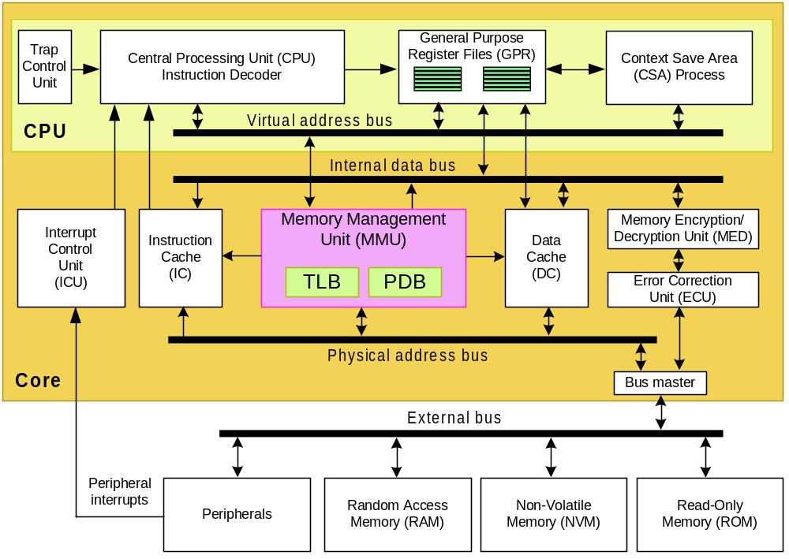
SLE88
Architecture

Slide 25
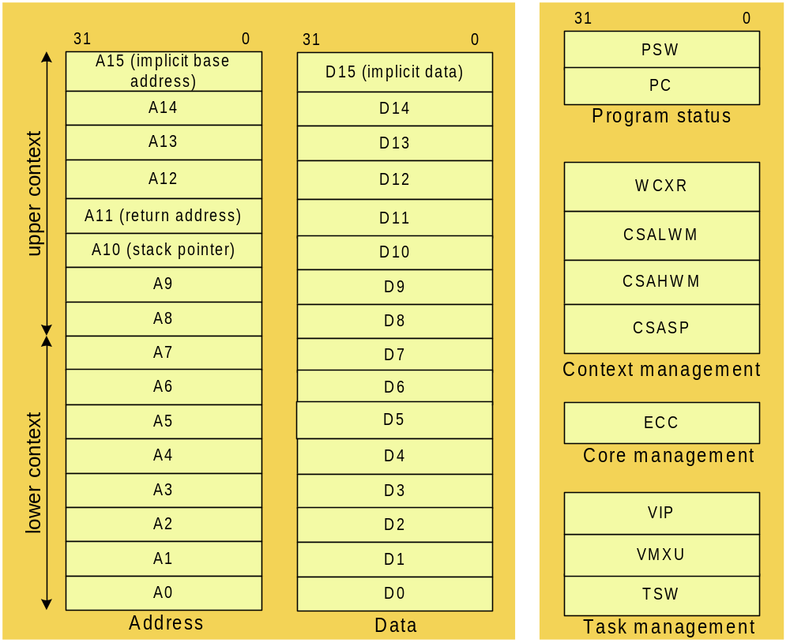
SLE88
General Purpose Registers

Slide 26
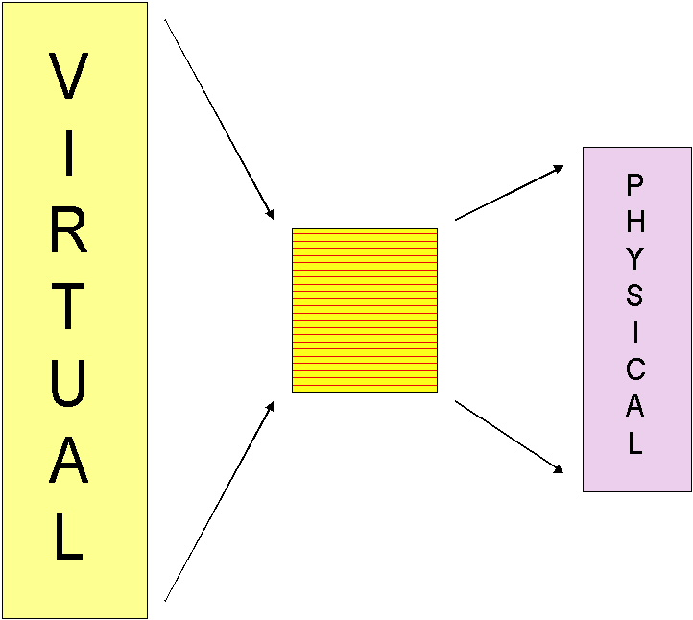
88 Overview Training - Architecture
Memory Management Unit
large address range (32 bits)
one can address: 2^32 items = 4 GB
Physically <<<<< 4 GB
(4GB = hard disk of a PC)
That is the virtual Memory !
MMU contains mechanism to protect applications against each other
=> Secure download of application/patches in the field
=> Firewalls protect application against each other (GSM, Banking)
Applications Architecture Security Tools Products
Notes:
Do not copy.
Company confidential according to the Non-Disclosure Aggreement with Infineon Technologies AG as lawful successor of Siemens AG Semiconductor.
All rights reserved.
Trainer Notes
Ensure that following questions are answered:
- what is the MMU translation? Firewalls?
- what is a patch ? download in the field?
Example to explain the MMU Firewalls
Windows NT that we use at CC
In logistic, you can access to the logistics disk but maybe not to AE disk
Message “Access Denied” is well known
..etc…
Example to explain the patching
On our PC, install/uninstall shield
=> see Patches/Services
Patch = correction of a program (word, excel, outlook,...)
Example to explain the secure download in the field
Ex: Remote access for a CC worker: read emails, etc..
he needs to download securely maybe a correction for Outlook

Slide 27
Access to Core Special Function Registers
System Register
31
0
mfcr.w d3, psw
mfcr.a a3, csasp
mtcr.w psw, d3
mtcr.a csasp, a3
PSW
FROM
PC
Program Status
WCXR
CSALWM
CSAHWM
CSASP
Context Management
TO
ECC
ECCPA
Core Management
VIP
VMXU
TSW
Task Management
Notes:
Access to Core Special Function Registers
The CSFRs can be accessed by four instructions:
MFCR.A, MFCR.W, MTCR.A and MTCR.W
mfcr.w d3, psw (move from core register) moves the contents of the PSW to data register d3
mfcr.a a5, csasp moves the contents of the CSA stack pointer to address register a5
mtcr.w psw, d3 (move to core register) moves the contents of the data register d3 to PSW
mtcr.a csasp a5 moves the contents of the address register a5 CSA stack pointer.
To prevent unauthorized reads from and writes to the CSFRs, only the privileged layers (OS, HAL, SL) can execute these instructions without restrictions.
Do not copy.
Company confidential according to the Non-Disclosure Aggreement with Infineon Technologies AG as lawful successor of Siemens AG Semiconductor.
All rights reserved.

Slide 28
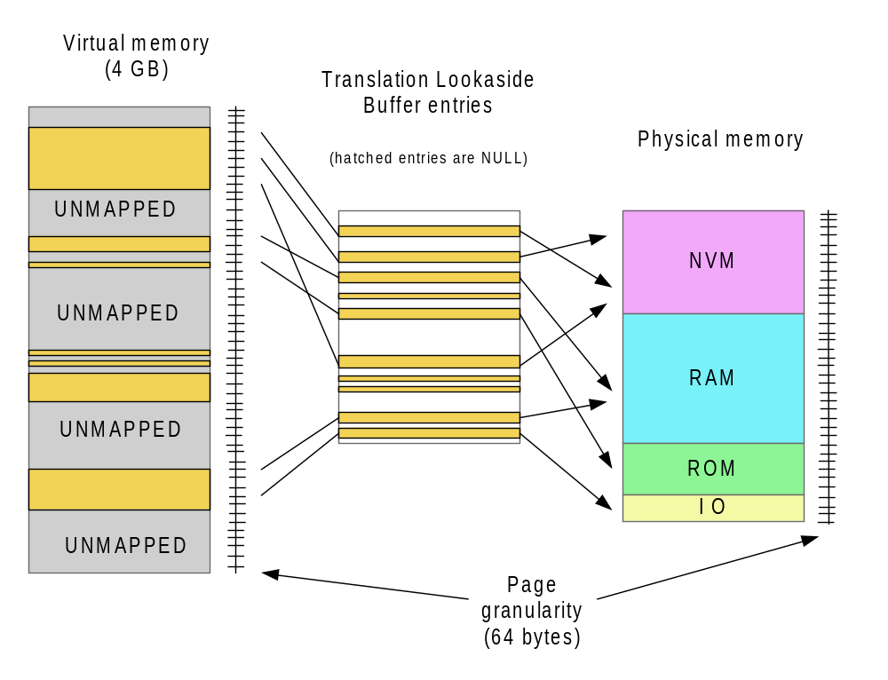
SLE88
Page Translation in VMS

Slide 29
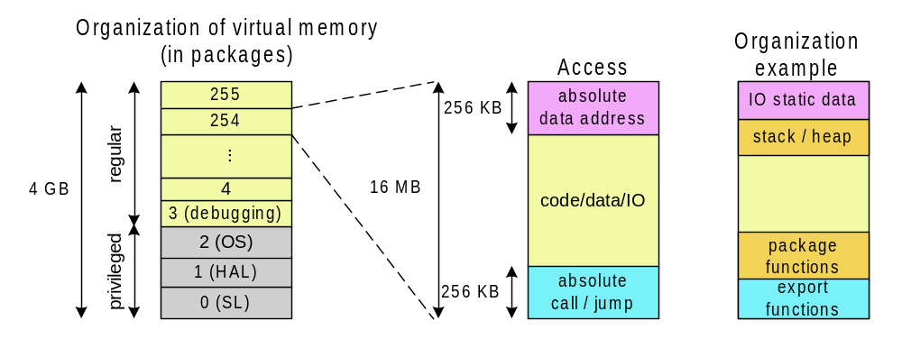
SLE88
Memory Model

Slide 30
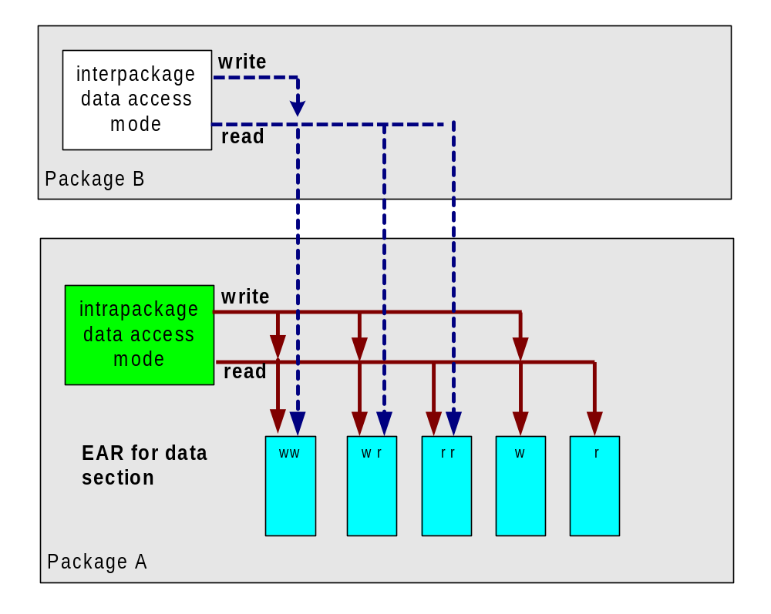
SLE88
Data Access Types

Slide 31
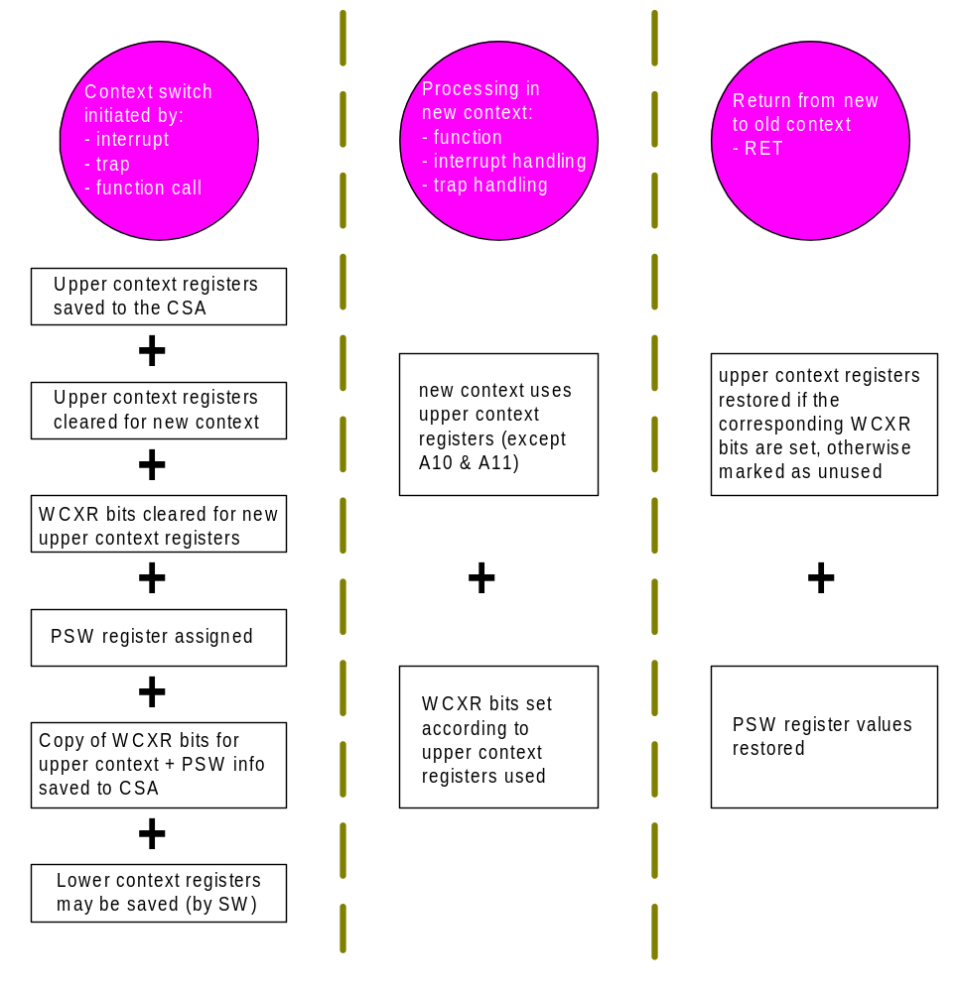
SLE88
Principle of Context Switch

Slide 32
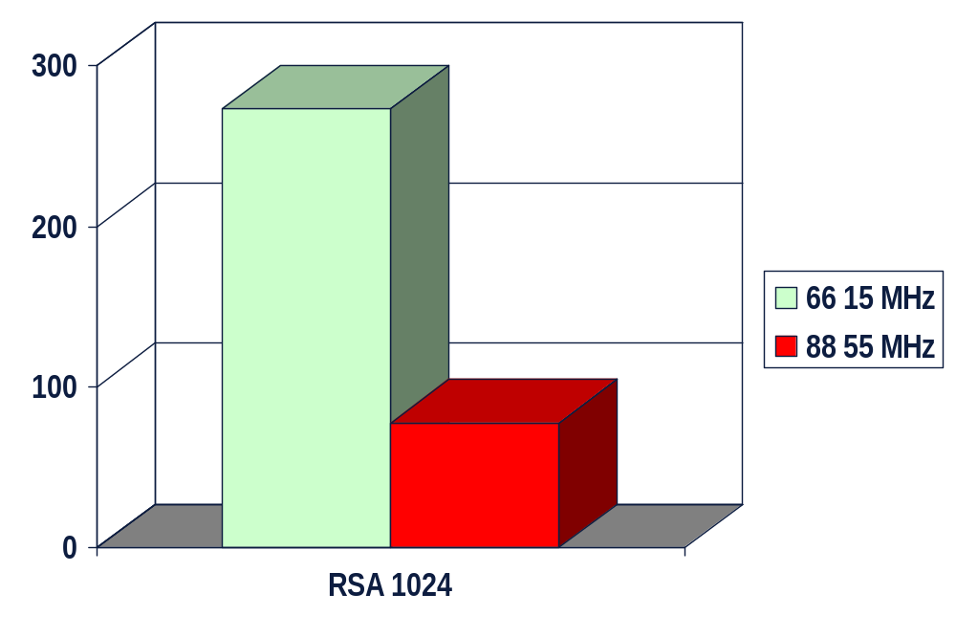
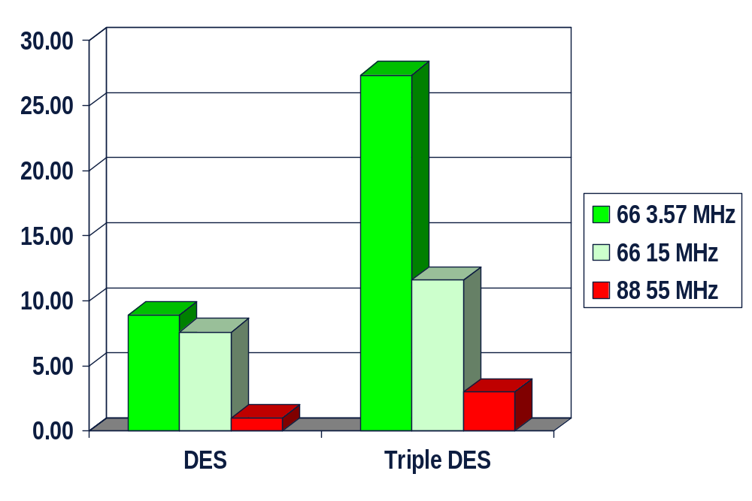
88 Overview Training - Architecture
Coprocessors for Cryptography
DES (DES, Triple DES)
ACE
µs
ms
Applications Architecture Security Tools Products
Notes:
1
1
1
1
1
2
3
3
2
2
Do not copy.
Company confidential according to the Non-Disclosure Aggreement with Infineon Technologies AG as lawful successor of Siemens AG Semiconductor.
All rights reserved.
Trainer Notes

Slide 33
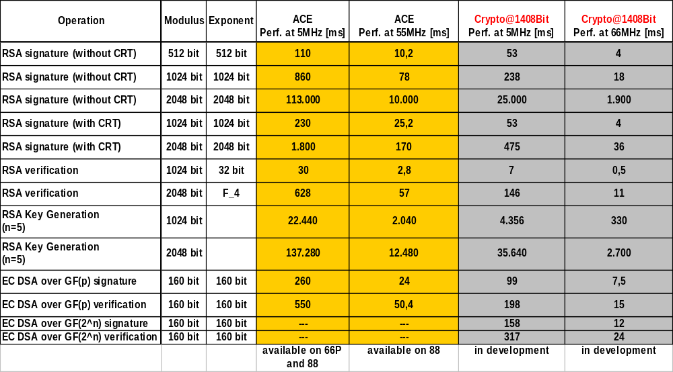
Crypto Performance Comparison

Slide 34
Random Number Generator, RNG
Analog
Source
RNGWORD
31
0
Digital Post-
Processing
NOINT = 1
15
0
Vector 3
rng_int
RNGCHK
res
NOINT
RDV
NOINT = 0
Notes:
Random Number Generator, RNG (continued)
Valid random numbers are available in SFR RNGWORD when bit RDV in SFR RNGCHK is set to “1”.
If bit NOINT in SFR RNGCHK is “0”, Interrupt rng_int (vector 3) is triggered to inform the operating system
Read access to SFR RNGWORD is allowed only if bit RDV is set, otherwise value 0x00000000 is read. After read access bit RDV and RNGWORD are reset to “0” and 0x00000000, respectively.
The minimum rate of creating random numbers is 10Kbit/s. Creating a 64 bit key can take up to several ms and at least 100 system clock cycles. To ensure highest entropy, after system reset the first two random numbers should be discarded.
Do not copy.
Company confidential according to the Non-Disclosure Aggreement with Infineon Technologies AG as lawful successor of Siemens AG Semiconductor.
All rights reserved.

Slide 35
Timer 0,1,2
Interrupt
Timer x Control Logic
Request
tim0_int: vector 0
tim1_int: vector 1
tim2_int: vector 2
f
system
Pre-
scaler
16 Bit Counter
f
Terminal
Start/Reload
Counter
TSRCx
TPRx
Value
Value
TCON
Tx
Tx
TCFG
UART Reload
write
read
8
16
16
Data (X Bus)
Notes:
Timer
The SLE88Cxx contains three identical timers, that are independent of each other: timer0, timer1 and timer2.
After a reset the counter and the prescaler are set to zero.
When the timer is started by setting the timer run bit (TRx = “1” in TCONx), the reload value stored in Tx is loaded into the counter.
The timer is incremented.
On overflow timer interrupt signal and timer overflow flag (bit TFx) are set. Timer is reloaded.
Reload can also be forced by external signal from UART (programable in TCFGx).
The input signal for the prescaler can be the system clock from ICO module (after reset) or the external clock provided from a terminal.
The prescaler value can be programed: 1, 4, 16, 64, 256, 1024, 4096 (bits TPR2x...TPR0x).
The counter register value can be read with a SFR Tx read access.
Do not copy.
Company confidential according to the Non-Disclosure Aggreement with Infineon Technologies AG as lawful successor of Siemens AG Semiconductor.
All rights reserved.

Slide 36
Timer SFR and Interrupt Mapping
BPF Value
(SL)
BondOut
Size / bit
Page
Physical
Address
Seg.
Module
SFR
Address
Reset Value
0x000100h -
IO
Timer0
TCON0
8
0x000100
000b
0x00h
0x00013Fh
TCFG0
8
0x000110
000b
0x00h
T0
16
0x000120
000b
0x0000h
0x000140h -
IO
Timer1
TCON1
8
0x000140
000b
0x00h
0x00017Fh
TCFG1
8
0x000150
000b
0x00h
T1
16
0x000160
000b
0x0000h
0x000180h -
IO
Timer2
TCON2
8
0x000180
000b
0x00h
0x0001BFh
TCFG2
8
0x000190
000b
0x00h
T2
16
0x0001A0
000b
0x0000h
Notes:
Timer SFR and Interrupt Mapping
All registers of a timer are within a page (64 Byte). An application has full access to all timer registers if the page is mapped into the applications address space.
Timer Interrupt Mapping
Name Vector
tim0_int 0
tim1_int 1
tim2_int 2
Do not copy.
Company confidential according to the Non-Disclosure Aggreement with Infineon Technologies AG as lawful successor of Siemens AG Semiconductor.
All rights reserved.

Slide 37
UART Block Diagram
Uart0_int: vector 4
Interrupt
UART Control Logic
Request
Receive Shift
Register
Baudrate
I/O
Generator
Transmit Shift
f
Register
Term
Status Register
4 Byte
Transmit Buffer
Div Register
Receive
Buffer
Mode Register
(FIFO)
Data bus
Notes:
UART, Universal Asynchronous Receiver/Transmitter
The UART handles the serial interface to the SLE88 Controller.
It supports the transmission protocols T=0 and T=1 as specified in
ISO 7816.
UART Features
Half and full duplex transmission (when second I/O pad available)
Direct and inverse convention
One byte transmit buffer, four byte receive buffer
Parity bit (even, odd, no, mark)
Divisor for baud rate generation adjustable from 16 to 2047
One to eight stop bits
Collision detection (half duplex mode)
Block guard time
Frame checking
Character repetition (half duplex mode)
Automatic input select
Do not copy.
Company confidential according to the Non-Disclosure Aggreement with Infineon Technologies AG as lawful successor of Siemens AG Semiconductor.
All rights reserved.

Slide 38
Block Diagram I/O Ports
iop0_int: vector 5
Interrupt
I/O Control Logic
Request
UART-RxD
>=1
uart_disable
Vdd
IOPORT
I/O Filter
I/O
Register
Detector
Pad
IO0
I
INT
O
&
0
UART-TxD
Mux
Data bus
Notes:
Block Diagram I/O Ports
The I/O module contains a serial bidirectional port, IO0 at the ISO contact C7.
A second I/O port (IO1) can also be implemented.
Do not copy.
Company confidential according to the Non-Disclosure Aggreement with Infineon Technologies AG as lawful successor of Siemens AG Semiconductor.
All rights reserved.

Slide 39
ICO Functional Overview
⬇ The ICO module covers the clock supply for the SLE88 Family
   It generates system clock for the CPU and
   Synchronized external clock for the peripherals
   The system clock is derived from a terminal or from the
  internal oscillator, depending on the programmed
  operating mode
   For the external clock a spike filter and a frequency sensor
  can be configured
⬇ The ICO supports a dual interface mode to combine
contact based and contactless operations
Notes:
Functional Overview
The ICO module covers the clock supply for the SLE88 Family.
It generates system clock for the CPU and
synchronized external clock for the peripherals.
The system clock is derived from from a terminal or from the internal oscillator, depending on the programmed operating mode.
For the external clock a spike filter and a frequency sensor can be configured.
The ICO supports a dual interface mode to combine contact based and contactless operations.
Do not copy.
Company confidential according to the Non-Disclosure Aggreement with Infineon Technologies AG as lawful successor of Siemens AG Semiconductor.
All rights reserved.

Slide 40
Operation Modes Overview
V-enable on
V-enable off
High Performance Mode
High Performance Mode
system clock = f
VCO
/m
system clock = f
VCO
/m
timer clock = external clock
timer clock = external clock
Fast Mode
Fast Mode
system clock = k * external clock
system clock = k * external clock
timer clock = external clock
timer clock = external clock
Power Saving Mode
Power Saving Mode
system clock = external clock
system clock = external clock
timer clock = external clock
timer clock = external clock
Sleep Mode
system clock = 0
timer clock = external clock
Notes:
Operation Modes Overview
The ICO offers 4 programmable operation modes and one test mode.There are operation modes to provide maximum performance, or minimum power consumption, or mixed mode.
High Performance Mode and Fast Mode are used for maximum system performance.
Power Saving Mode is the slowest operation mode with the lowest power consumption.
In Sleep Mode system clock is turned off until a wake-up signal appears.
With V-enable on frequency of system clock is adjusted to a given maximum possible power consumption, automatically, when Voltage Regulator signals overload.
Do not copy.
Company confidential according to the Non-Disclosure Aggreement with Infineon Technologies AG as lawful successor of Siemens AG Semiconductor.
All rights reserved.

Slide 41
High Performance Mode
MPSCAL
m
f
system
ICOCNT[11:8]
0000
0
f
/1
0001
1
f
VCO
/2
.....
.....
.....
1110
14
f
VCO
/15
1111
15
f
VCO
/16
Oscillator
VCO
f
fsystem
System Clock
VCO
66 MHz
f
/(m+1)
VCO
31
24
23
16
15
14
12
11
8
7
3
2
0
ICOCNT
rfu
PCNT
CMODE
REMODE
MPSCAL
KBURST
MODE
Notes:
High Performance Mode
Used for maximum system performance.
The system clock is derived from the internal voltage controlled oscillator,VCO. Up to 66 MHz, divided by a programmable factor (m+1) are possible (programmable in the bits MPSCAL in the SFR ICOCNT).
V-enable can be switched on or off
V-enable should be switched on, to adjust fsystem to a given maximum current supply. Than Voltage Regulator slows down fsystem automatically to a programmed maximal current supply. Programmable in register RSTVR.
Do not copy.
Company confidential according to the Non-Disclosure Aggreement with Infineon Technologies AG as lawful successor of Siemens AG Semiconductor.
All rights reserved.

Slide 42
Sleep Mode
Wake-up
External Clock
System Clock
External Clock
System Clock
31
24
23
16
15
14
12
11
8
7
3
2
0
ICOCNT
rfu
PCNT
CMODE
REMODE
MPSCAL
KBURST
MODE
Notes:
Sleep Mode
In the Sleep Mode, the system clock is turned off.
On a wake up signal the ICO switches to the programmed reentry mode.
Wake up can be caused by a signal from the timer or on a received byte in receive buffer on the UARTor I/O port.
Reentry mode after sleep mode can be programmed in SFR ICOCNT in bits REMODE.
Only the timers and the UART are supplied with external clock in sleep mode.
V-enable on is not possible in this mode
Do not copy.
Company confidential according to the Non-Disclosure Aggreement with Infineon Technologies AG as lawful successor of Siemens AG Semiconductor.
All rights reserved.

Slide 43
Virtual SFR DESdat
Data bus
32
X-Bus Interface
32
bus_FSMs
32
8
8
32
8
DESDat
DESINC
DESCTRL
status
DESSTAT
32
Data Control Interface
32
des_permuted
(keyA, keyB, data)
DDES core
Key A ( 2 x 28 = 56 bit )
subkey A
DES logic
including
S boxes
subkey B
32
Key B ( 2 x 28 = 56 bit )
L_{I}
+
f (R_{I})
IP
DES data [ L, R ] ( 2 x 32 = 64 bit )
R_{I}
IP⁻¹
des_result
Notes:
Virtual SFR Desdat
The virtual SFR DESdat can be seen as a multiplexer, providing channels from and to the registers in the core.
For Loading keys to the internal key registers, writing and reading data to and from the internal DES data register the appropriate channel must be programmed in the control register DESCtrl.
Do not copy.
Company confidential according to the Non-Disclosure Aggreement with Infineon Technologies AG as lawful successor of Siemens AG Semiconductor.
All rights reserved.

Slide 44
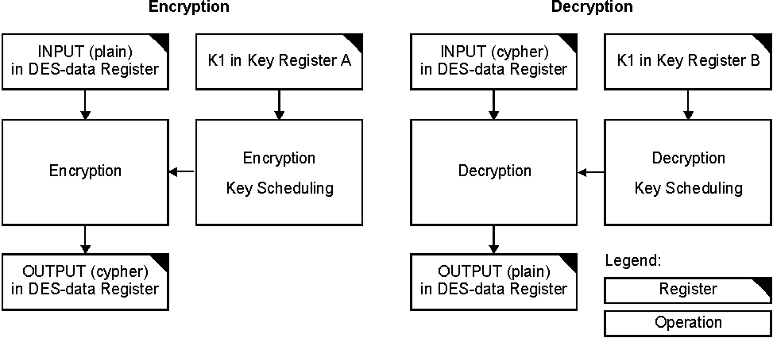
Single DES High Performance Mode, HPM
Notes:
Single DES
In principle, key register A is used for encryption and key register B is used for decryption.
In most cases, both registers are loaded with the same key.
Immediately after selecting HPM encryption or decryption for Single DES, the module waits for two words to encrypt or decrypt.
The Module starts operation when 2 words are written.
After 32 clock cycles, result can be read out (5MHz: 6,4 µs, 33MHz: <1µs).
The module is ready for the next 2 words to be encrypted or decrypted.
Do not copy.
Company confidential according to the Non-Disclosure Aggreement with Infineon Technologies AG as lawful successor of Siemens AG Semiconductor.
All rights reserved.

Slide 45
Virtual Machine
Program
c = a + b
Virtual
Machine
iload a
iload b
iadd
istore c
iload:
Vlpar.w d15
vlfst.w [-a10],d15,[+[a15]5
iadd:
ld.w d14,[a10]4
add d15,d14
istore:
vlfld.w [+a10],d15,[+a15]1
Hardware
Notes:
Virtual Machine
A Virtual Machine is an abstract computing machine, consisting of dedicated hardware and/or software. It transparently renders the real machine‘s behavior, at the same time, emulating another - the virtual one.
A VM allows exchanging programs between various hardware platforms and therefore gives flexibility to react fast to new market requirements as new applications can be loaded down as needed.
The virtual machine specification describe a VM instruction set (virtual language).
The VM instruction set is a byte code (0 to 255) that is not inherently interpreted, it may be implemented by compiling its instruction set to that of the real CPU or it may be implemented in microcode or directly in silicon.
Today three major VMs for smart cards have been specified or are in process of beeing introduced:
Java Card
MultOS
Windows© Powered Smart Card
Do not copy.
Company confidential according to the Non-Disclosure Aggreement with Infineon Technologies AG as lawful successor of Siemens AG Semiconductor.
All rights reserved.

Slide 46
Memory used by the VM
VM Code Memory
Execution Unit
c
istore
iadd
iadd
Program Counter
c
+
PC
iload
b
VMXU
VM Execution Unit Base
iload
Operand Stack
a
Virtual Instruction Pointer
SP
iload
VIP
Virtual Program Counter
VPC
Notes:
Memory used by the Virtual Machine
The SLE88 Virtual Machine uses various memory areas
-for VM code,
- for execution unit (Interpreter)
-for operand stack is the normal stck
VM instructions are one byte followed by none, one or more parameters that reside in the VM code memory. VM instructions are addressed by a virtual program counter (VPC).
The virtual program counter, VPC (A15) points always to the instruction that is currently being executed.
The virtual instruction pointer, VIP is used to address parameters. It is increased whenever a byte (code or data) is fetched from the byte code stream in VM code memory.
Do not copy.
Company confidential according to the Non-Disclosure Aggreement with Infineon Technologies AG as lawful successor of Siemens AG Semiconductor.
All rights reserved.

Slide 47
Executing a VM instruction
Execution Unit
VM Code Memory
iload a
iload b
iload c
iadd
iadd
istore d
SNI
c
istore
SNI
iadd
iadd
Program Counter
SNI
c
+
PC
iload
SNI
b
VMXU
VM Execution Unit Base
iload
Operand Stack
a
Virtual Instruction Pointer
SP
iload
VIP
Virtual Program Counter
VPC
Notes:
Executing a Virtual Machine Instruction
The byte value of the virtual instruction added to the contents of the base address of the execution unit (VMXU) is loaded to the program counter (PC).
This is a branch to the execution unit where the action takes place implied by that VM instruction.
The Execution Unit is a set of all sequences of native instructions (SNI) implementing all VM instructions.
- SNI set size can be defined as 8 bytes or 16 bytes,
programmable in the SM bits in the CSFR VMXU
- The start address of the virtual machine execution unit has to be
aligned to a 4 KB boundary
Do not copy.
Company confidential according to the Non-Disclosure Aggreement with Infineon Technologies AG as lawful successor of Siemens AG Semiconductor.
All rights reserved.

Slide 48
Sequence of native Instructions
VM Code Memory
Execution Unit
iload a
iload b
iload c
iadd
iadd
istore d
SNI
c
istore
SNI
iadd
iadd
Program Counter
SNI
c
+
PC
iload
SNI
b
VMXU
VM Execution Unit Base
iload
Operand Stack
a
Virtual Instruction Pointer
SP
value_a
iload
value_b
VIP
value_c
Virtual Program Counter
VPC
Notes:
Sequence of native instructions
A virtual instruction is implemented by a sequences of native instructions (SNI).
This native instructions must
-copy parameters (if available) from VM code memory to the stack
-perform the operation with the stack parameters
-store result to memory or register
- set VPC to next VM instruction code
Parameters in VM code memory are addressed via the VIP and pushed to the stack via the SP.
The virtual instruction pointer, VIP is increased whenever a byte (code or data) is fetched from the byte code stream in VM code memory.
Do not copy.
Company confidential according to the Non-Disclosure Aggreement with Infineon Technologies AG as lawful successor of Siemens AG Semiconductor.
All rights reserved.

Slide 49
Stack Operations
iload a
iload b
iload c
iadd
iadd
istore d
a
a
a
a
C+b+a
b
b
C+b
C
Iload a ; push a onto stack
iload b ; push b onto stack
iload c ; push c onto stack
iadd ; reads c and b from stack, perform addition
; and stores result back onto the stack
iadd ; reads c+b and a from stack, perform addition
; and stores result back onto the stack
istore d ; reads c+b+a from stack,
; and stores result into memory or register
Notes:
Stack Operations
Do not copy.
Company confidential according to the Non-Disclosure Aggreement with Infineon Technologies AG as lawful successor of Siemens AG Semiconductor.
All rights reserved.

Slide 50
VM Register Usage
Address Register
Data Register
System Register
31
0
31
0
31
0
A15 (VPC)
D15 (TOS)
PSW
A14
D14 (offset)
PC
A13
D13
Program Status
A12
upper
context
D12
A11 (Return Address)
D11
WCXR
A10 (Stack Pointer)
D10
CSALWM
A9 (
D9
CSAHWM
A8
D8
CSASP
Context Management
A7
D7
A6
D6
ECC
A5
D5
Core Management
A4
lower
context
D4
A3
D3
VIP
A2
D2
VMXU
A1
D1
TSW
A0
D0
Task Management
Notes:
VM Register Usage
Virtual Machine Execution Unit register, VMXU
-start address of the virtual machine interpreter code memory
-EOM bit controls the endianness (little or big)
-SM bits define the size (8 byte or 16 byte) of a set containing the
sequences of native instructions (SNI).
Virtual Instruction Pointer Register, VIP
The virtual instruction pointer, VIP is increased whenever a byte (code or data) is fetched from the byte code stream in VM code memory.
It can be read or written by instruction in privileged layers only
Virtual Program Counter Register, VPC
Register A15 is used as the virtual program counter, VPC. It points always to the instruction that is currently being executed.
D15 is used to holt the top of stack, TOS.
D14 is the preferred destination for parameters.
A10 contains the stack pointer, SP, for both standard code and VM code.
Do not copy.
Company confidential according to the Non-Disclosure Aggreement with Infineon Technologies AG as lawful successor of Siemens AG Semiconductor.
All rights reserved.

Slide 51
Implementing a Virtual Machine (1)
Basic steps to execute a Virtual Machine`s Bytecode:
  Read byte code instruction
  increment virtual PC
  branch to byte code specific execution sequence
  execute sequence
switch: ld.bu D8,[A15+]1
addsc.a A9,A8,D8,3
ji A9
sequence: ...
  j switch

Slide 52
Implementing a Virtual Machine (2)
Stack machine fundamentals
  Every operation is executed using parameters from TOS
  The result is returned to TOS
  Data are pushed to / popped from TOS
  e.g. Java code: a = b + c
sload b
sload c
A10
A10
0005
0028
0028
0028
0028
A10
sadd
A10
0023
A10
sstore a

Slide 53
SLE88CxxS Smart Card Controller Family
Virtual Machine Support
VM Instructions:
  VLFLD.x Fetch VM bytecode, branch to code sequence, load data
  VLFST.x Fetch VM bytecode, branch to code sequence, store data
  VLPAR.x Fetch VM parameter byte
  VLPOFF.x Fetch VM positive offset byte
  VLNOFF.x Fetch VM negative offset byte
  VLJ Jump to new bytecode location

Slide 54
Roadmap 32 Bit Security Controller: SLE88 S/P
C9FLR (0.22µ) C11FL (0.13µ)
272K
SLE 88CX2560P
300 KB Flash
16 KB RAM
272 KB EEPROM
Crypto2000/DES/AES
Caches 1kB / 2kB
66 MHz, 1,8-5V
PSL
EEPROM-Size
SLE 88CX1280P
256 KB Flash
10 KB RAM
144 KB EEPROM
Crypto2000/DES
Caches 1kB / 2kB
66 MHz, 1,8-5V
PSL
144K
qualified
SLE 88CUX723P
240 KB ROM / Flash
8 KB RAM
80 KB EEPROM
Crypto2000/DES
Caches 1kB / 2kB
66 MHz, 1,8-5V
PSL
USB 2.0
SLE 88CX720P
240 kB ROM
8 kB RAM
80 kB E²PROM
ACE/DES
Caches 1kB / 2kB
55 MHz, 3-5V
PSL
SLE 88CX722P
240 KB ROM / Flash
8 KB RAM
80 KB EEPROM
Crypto2000/DES
Caches 1kB / 2kB
66 MHz, 1,8-5V
PSL
80K
SLE 88CLX723P
240 KB ROM / Flash
8 KB RAM
80 KB EEPROM
Crypto2000/DES
Caches 1kB / 2kB
66 MHz, 1,8-5V
PSL
Contactless Interface
Type A / B (& FeliCa?)
SLE 88CX644S
192 kB ROM
6 kB RAM
72 kB EEPROM
ACE/DES
Caches 0.5kB / 1kB
33 MHz, 1,8-5V
PSL
72K
Availability of ES
Functionality
available
Q4/2003
Q1/2004
Q3/2004
Schedule tbd.
available
in development
new idea
discontinued

Slide 55
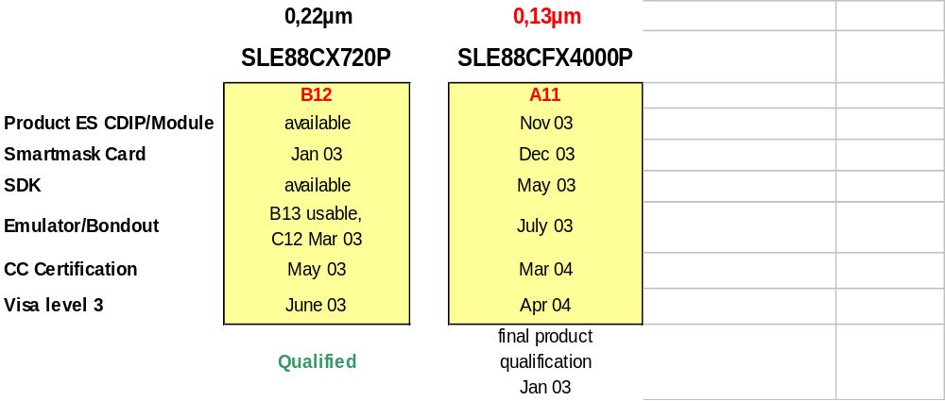
Availability
88 Family of 32-bit Chip Card Controllers: 88P and 88S

Slide 56
Overview
Platform Support Layer
PSL
Notes:
Do not copy.
Company confidential according to the Non-Disclosure Aggreement with Infineon Technologies AG as lawful successor of Siemens AG Semiconductor.
All rights reserved.

Slide 57
Architectural Overview
Customer’s Value Add
Application 1
Application 2
Virtual Machine
with Applications
Operating System
Platform Abstraction Layer
Platform Support Layer
I/O Manager
Object
Manager
Other Platform
Services
Device
Driver 1
Device
Driver 2
SLE 88
Supplied by Infineon
Notes:
Architectural Overview
The Platform Support layer, PSL, is a comfortable interface to all functions of the SLE88 Family Hardware (peripherals, MMU, coprocessors, ...).
It makes it very easy to adapt an operating system to the hardware.
The PSL is totally independent. The operating system needs only one fix entry point to the PSL. All further information (e.g. entry points to functions) are provided in a data base, the so called registry. Therefore it is very easy to add or replace new functions.
The PSL consists of the
Object Manager
Registry
I/O Manager
Device Drivers
Other Services
The PSL is located in the HAL package.
Do not copy.
Company confidential according to the Non-Disclosure Aggreement with Infineon Technologies AG as lawful successor of Siemens AG Semiconductor.
All rights reserved.

Slide 58
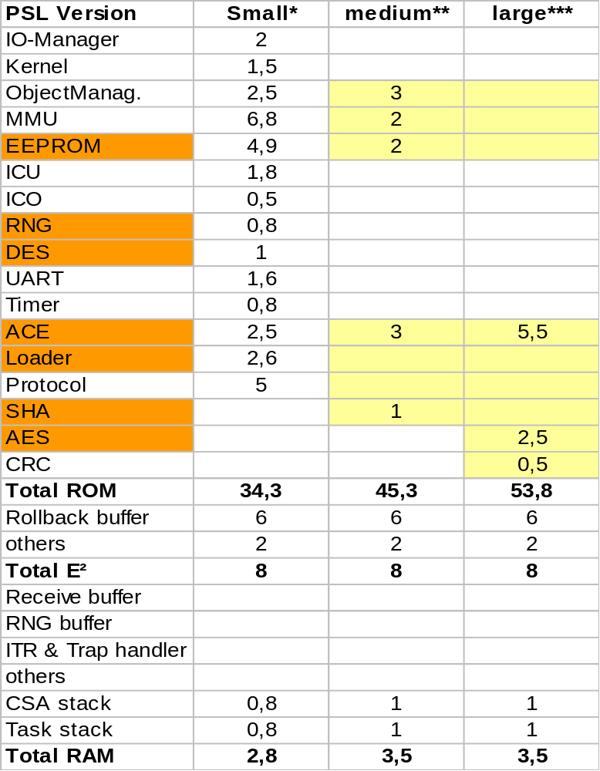
PSL Versionen
* Recommendation for „s“ Version
** Recommendation for „p“ Version
*** Contents of Smartmask

Slide 59
SLE88 Family Tool Concept
SLE88 Family
Tool Concept
Notes:
Do not copy.
Company confidential according to the Non-Disclosure Aggreement with Infineon Technologies AG as lawful successor of Siemens AG Semiconductor.
All rights reserved.

Slide 60
SLE88 Family Tool Concept
Contents
Single Package Concept
Multiple Package Concept
Package Generation
Mask Generation
ROM Mask Generation
Starting an Application
Notes:
Do not copy.
Company confidential according to the Non-Disclosure Aggreement with Infineon Technologies AG as lawful successor of Siemens AG Semiconductor.
All rights reserved.

Slide 61
Single Package Concept
Packages
Virtual Address Space
Application
Application
OS
HAL
SL
OS
HAL
SL
Notes:
Single Package Concept
One Application is manged by the operatingsystem
Do not copy.
Company confidential according to the Non-Disclosure Aggreement with Infineon Technologies AG as lawful successor of Siemens AG Semiconductor.
All rights reserved.

Slide 62
Multiple Package Concept
Virtual Address Space
Package C
Application C
Application C
OS
Application B
HAL
SL
Application A
Application
B
Application
A
OS
HAL
Package B
Package A
SL
Notes:
Multiple Package Concept
Multiple Applicatins are manged by the operatingsystem.
The applications are place in different packages.
One common set of OS / HAL/ SL Layer are available for all packages.
With this model both a cooperative multi tasking system or a preemptive multi tasking system can be established.
Do not copy.
Company confidential according to the Non-Disclosure Aggreement with Infineon Technologies AG as lawful successor of Siemens AG Semiconductor.
All rights reserved.

Slide 63
Package Build Process Overview
source files
object files
library files
package file
assembler
code
.asm
.obj
C code
Library Manager
.lib
.dsc
.obj
.elf
.c
Assembler
.src
Compiler
.elf
Locator
Linker
.c
.src
.obj
ELF/
DWARF
TIOF
TIOF
ELF
.h
.inc
.stb
header files
include files
stub files
ELF Extentable Linkable Format
TIOF Target Independent Object fFormat
.stb Stub File
Notes:
Compiler - Assembler - Linker - Locator
A package consist of several
C Files
Assembler Files
Library Files (including modules)
The files are processed by the
Compiler
Assembler
Linker/Locator:
links the modules together
combines sections
locates sections inside of a package
resolves intra package references
The Linker/Locator output file is
Package file (file.elf) containing one package
STUB file (file.stb) for resolving inter package references
Do not copy.
Company confidential according to the Non-Disclosure Aggreement with Infineon Technologies AG as lawful successor of Siemens AG Semiconductor.
All rights reserved.

Slide 64
Mask Generation
relocatable
Packages
Mask.ebf
255
254
Library
.elf
<product>.mconfig
Linker/
Locator
Post
Locator
Application B
.elf
TIOF
Application A
<tree_rules>.tpg
.stb
3
2
1
0
DEBUG
OS
ELF
HAL
absolute
Packages
SL
Notes:
Mask Generation
The tasks of a Post-Locator are:
combining the packages to a task
resolving the upper eight bits of the inter package
references (exported symbols)
generating the page table tree structure and assigning virtual pages to physical pages in the target chip.
Do not copy.
Company confidential according to the Non-Disclosure Aggreement with Infineon Technologies AG as lawful successor of Siemens AG Semiconductor.
All rights reserved.

Slide 65
ROM Mask Generation
Infineon Technologies
Process
<tree_rules>.tpg
HAL
SL
<product>.mconfig
.EBF
Chip Pro-
duction
Encryp-tion
Remapper
EBF
.elf
Post-Locator
.ebf
ELF/DWARF
EBF
.NVM
NVM-Init
EBF
.ebf
EBF
NVMPers
EBF Extended Binary Format
ELF Extentable Linkable Format
DWARF Standard Debug Format
.pnr package number
further processing
Notes:
ROM Mask Generation
The ROM mask of a chip card is generated by Infineon.
There are different possible ways to generate a ROM mask.
All information assigned to ROM memory must be delivered by the
customer. The file is the Post-Locator output file (file.EBF).
The contents of the post-locator output file are:
data pages including code and data sections
tree pages including the Q-nodes
package descriptors including access rights, physical
pointers
All non-ROM information can be stored in a separate file .
The personalization is done by the customer.
Do not copy.
Company confidential according to the Non-Disclosure Aggreement with Infineon Technologies AG as lawful successor of Siemens AG Semiconductor.
All rights reserved.

Slide 66
Starting an Application
Library
Application
4th
Application is called first time by OS layer,
it process the user application
OS
3rd
OS layer is called first time by HAL layer,
it will call the application
HAL
2nd
HAL layer is called first time by SL layer,
it will call the OS layer
SL
1st
Processed first and will call the HAL layer
Notes:
Starting an Application
To start an Application three steps need to be processed:
1st step: after reset the Security Layer (SL) is started
2nd step: the SL calls the Hardware Abstraction Layer (HAL)
3rd step: the HAL calls the Operating System (OS) which
finally calls the user application
4th step is the processing of the user application
Do not copy.
Company confidential according to the Non-Disclosure Aggreement with Infineon Technologies AG as lawful successor of Siemens AG Semiconductor.
All right reserved.

Slide 67

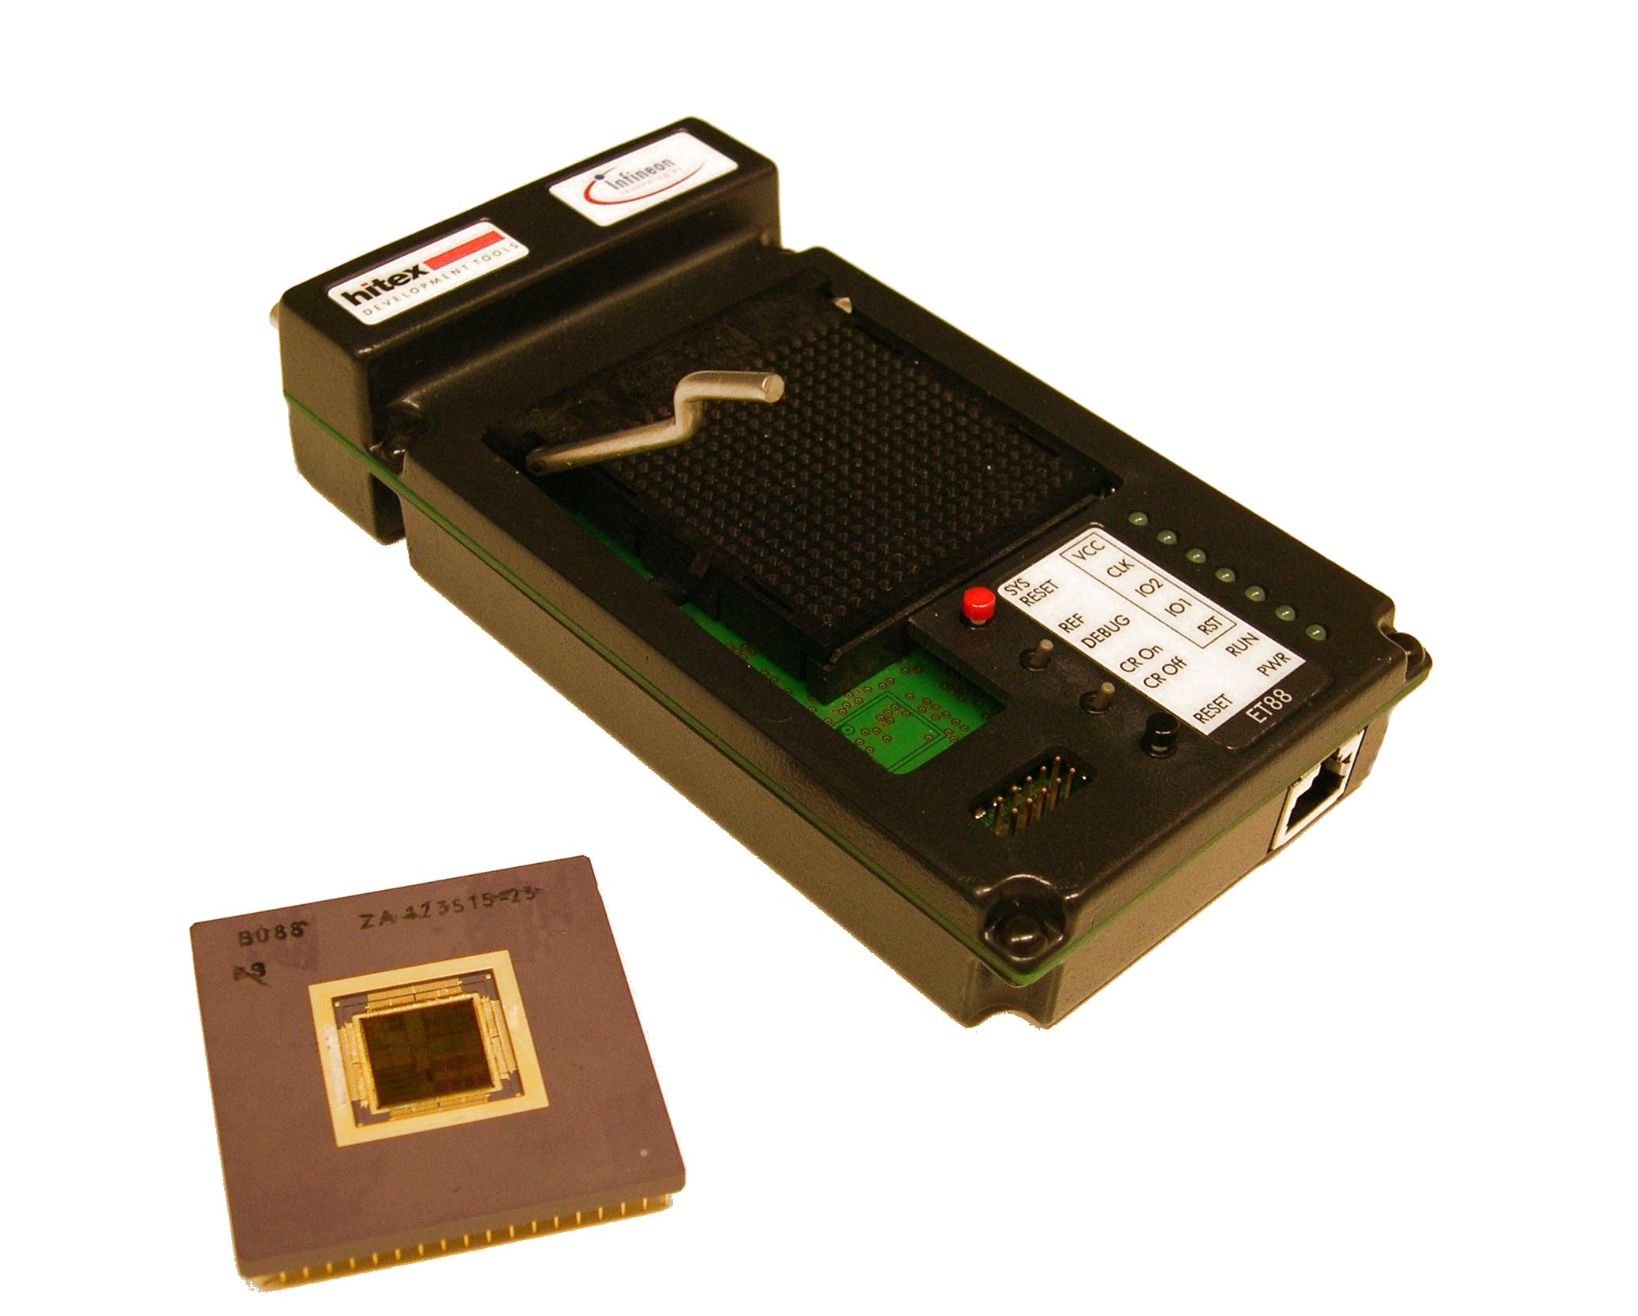
SLE88 Tools
Emulator Hitex

Slide 68

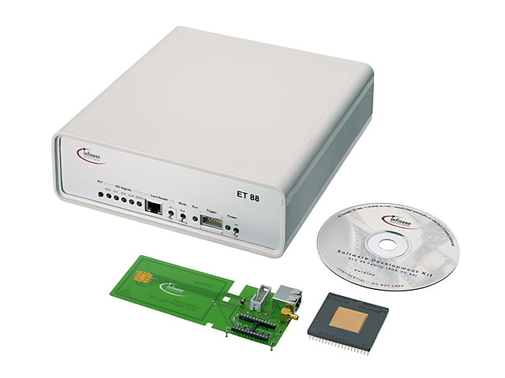
SLE88 Tools
Emulator Sci Worx

Slide 69

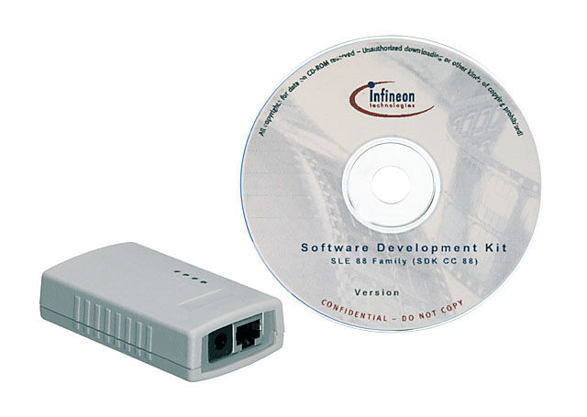
SLE88 Tools
SDK

Slide 70
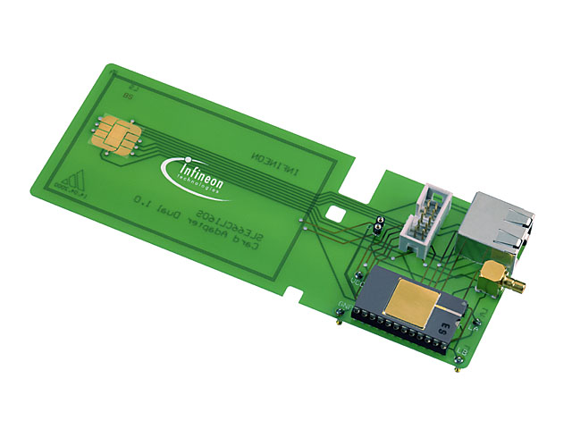
SLE88 Tools
CDIP + Card Adapter

Slide 71
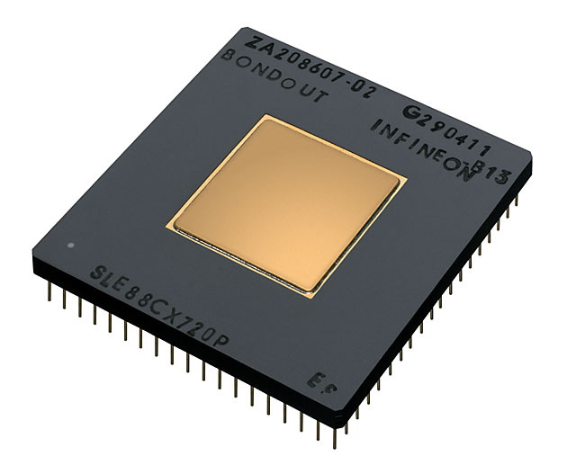
SLE88 Tools
Bondout

Slide 72
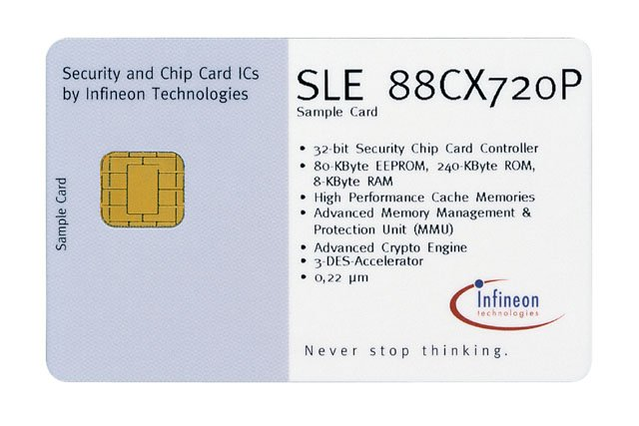
SLE88 Tools
Sample Card

Slide 73
Memory Protection Mechanisms
Virtual Address Space
Package C
Application C
Application C
OS
Application B
HAL
SL
Application A
Application
B
Application
A
OS
HAL
Package B
Package A
SL
Notes:
Memory Protection Mechanisms
Operating System must be protected against the applications.
The applications must be protected against each other.
Do not copy.
Company confidential according to the Non-Disclosure Aggreement with Infineon Technologies AG as lawful successor of Siemens AG Semiconductor.
All rights reserved.

Slide 74
Security Layer Overview
Virtual Address
Space
⇨ Virtual Address Space
⇨ Packages
⇨ Pages
⇨ Page Blocks
4 GB
pages
Page Block
packages
255
254
Package
Descriptor
4
3 (Debug)
2 (OS)
privileged
1(HAL)
16 MB
0 (SL)
pagetables
Notes:
Protection Layers
Setting up a secure operating system and writing secure application programs is supported by the virtual memory, package and the page concept.
Virtual Memory
The supported virtual address space is 4 Gbyte wide. Operating System and applications are addressed in the linear virtual address space.
Package
The virtual address space is divided into 256 packages of 16 MB, described by an descriptor including access rights to the package (Q-Node Access Rights, QACR).
Page
The packages are divided into pages of 64 Bytes, addressed via page tables, including access rights to the page (Effective Access Rights, EAR).
Each page is divided into four page blocks.
Page Block
A Page Block contains the128 bit Block Data Field (BDF), a 12 bit Block Protection Field (BPF) containing the Security Layer Tag Rights (SL) and an Error Correction Code (ECC).
Do not copy.
Company confidential according to the Non-Disclosure Aggreement with Infineon Technologies AG as lawful successor of Siemens AG Semiconductor.
All rights reserved.

Slide 75
Protection on Package Level
Virtual Address
Space
⇨ Libraries placed in different packages
⇨ HW Protected Access to Library
without Task Switch
4 GB
pages
Page Block
packages
255
254
Package
Descriptor
4
3 (Debug)
2 (OS)
privileged
1(HAL)
16 MB
0 (SL)
pagetables
Notes:
Protection on Package Level
Non trusted libraries can be separated into different packages.
A function call from one package into another package is protected by hardware and may be performed directly without control of the operating system.
Do not copy.
Company confidential according to the Non-Disclosure Aggreement with Infineon Technologies AG as lawful successor of Siemens AG Semiconductor.
All rights reserved.

Slide 76
Access Control
Virtual Address
Space
⇨ Code Section
⇨ Inter package code access is controlled
by PORT instruction
4 GB
  ⇨ Data section are specified by a data access modifier
  ⇨ no access
  ⇨ read only
  ⇨ readable/write-able
pages
Page Block
packages
255
254
Package
Descriptor
4
3 (Debug)
2 (OS)
privileged
1(HAL)
16 MB
0 (SL)
pagetables
Notes:
Access Control
Packages are made up of sections exclusively containing either code (code section) or data (data section).
Code:
Inter package code access is controlled by the PORT instruction.
Data:
Inter and intra data access can be controlled by access rights for each data section.
no access
read only
readable/write-able
Do not copy.
Company confidential according to the Non-Disclosure Aggreement with Infineon Technologies AG as lawful successor of Siemens AG Semiconductor.
All rights reserved.

Slide 77
Code Access Control
Package A
Package B
⇨ Inter-Package code access
  ⇨ Inter-package jumps are illegal.
  ⇨ Inter-package calls only via PORT
  ⇨ Return addresses cannot be manipulated.
⇨ Intra-Package code access
  ⇨ without any restriction
  ⇨ any illegal jump or call results in a trap PRIV.
export function (PORT)
direct or indirect function call
jump
Notes:
Code Access Control
A jump or call to the wrong entry point would lead to uncontrollable execution flow and possibly a data corruption. To avoid this the following code access rights are defined:
Inter-Package code access
Inter-package jumps are illegal.
Inter-package calls are only possible to export functions that are marked by a PORT instruction at the entry point (no side entry possible). Otherwise a trap PRIV is thrown.
Return addresses from inter-package calls cannot be manipulated.
Intra-Package code access
Any calls or jumps within the same package are allowed without any restriction.
Any illegal jump or call results in a trap PRIV.
Do not copy.
Company confidential according to the Non-Disclosure Aggreement with Infineon Technologies AG as lawful successor of Siemens AG Semiconductor.
All rights reserved.

Slide 78
Data Access Control
Data Access Modes
Package A
Source Package
(package access type)
code
Intrapackage
Interpackage
executing package type
regular SL,HAL,OS
EAR
code
Intra-package
access
WW
0x8
rw
rw
rw
WR
0x9
rw
r
r
data
SL
RR
0x1
r
r
r
W
0xD
rw
MPA
MPA
R
0x5
r
MPA
MPA
Inter-package
access
Target Package
code
0xF
MPA
MPA
MPA
other
-
MPA
MPA
MPA
WW
0x8
rw
rw
rw
WR
0x9
rw
r
rw
RR
0x1
r
r
rw
code
not SL
W
0xD
rw
MPA
rw
R
0x5
r
MPA
rw
code
0xF
MPA
MPA
rw
other
-
MPA
MPA
MPA
data
Package B
Notes:
Data Access Modes
There are two access modes to access data of a package from the same package or another package:
1. Inter-package access
A package accesses the data of another package.
2. Intra-package access
A package accesses the data of the same package.
Code has always read access to data in its own package
All regular packages have no read or write access to code sections of the same or another package.
Trojan Horse
A package A passes a pointer to a service function in package B to access data from package A (e.g. an operating system memcopy routine). Package B has to check by software (examine the return address) whether A has permission to access this data.
Do not copy.
Company confidential according to the Non-Disclosure Aggreement with Infineon Technologies AG as lawful successor of Siemens AG Semiconductor.
All rights reserved.

Slide 79
Access Rights for Data and Code Access
Virtual Address
Space
  ⇨ Effective Access Rights (EAR)
  ⇨ Security Layer Tag Rights (SL)
  ⇨ PORT Instruction
4 GB
Level 0
Level 1
pages
Level 2
Page Block
Level 3
packages
Level 4
255
Level 5
254
Package
Descriptor
4
3 (Debug)
2 (OS)
privileged
1(HAL)
16 MB
0 (SL)
pagetables
Notes:
Access Rights for Data and Code Accesses
Access rights for data and code accesses (load/store, jump, call) are determined by:
1. The Effective Access Rights (EAR)
represent the access rights specified by the QACR at
level 2. If level 2 is skipped the rights are derived from
the QACR entry in the q-node pointer in the relevant
package descriptor.
2. The Security Layer Tag Rights (SL)
stored in the Block Protection Field of a page block frame. If SL tag is set to “1”, this page frame block can only be accessed from a program that is running in the
SL package.
3. PORT Instruction
Access is allowed if all checks are passed independently.
If one of the checks failed a Trap is executed.
MPA Trap on Effective Access Rights (EAR) violation and inter package jumps.
MPSF Trap on Security Layer Tag Rights (SL).
MPBF Trap on package boundary violation.
PRIV Trap on PORT violation.
RLCP Trap on illegal returns.
Do not copy.
Company confidential according to the Non-Disclosure Aggreement with Infineon Technologies AG as lawful successor of Siemens AG Semiconductor.
All rights reserved.

Slide 80
Effective Access Rights, EAR
Translation Look Aside Buffer
.
.
.
.
.
.
4 physical pointers
EAR from Level 2 Q-Node Pointer
or Package Descriptor
Package Descriptor Buffer
Package
Descriptor
Q-Node Pointer
.
.
.
Page Block
Level 5
Level 4
Level 3
Level 2
Level 1
Level 0
Notes:
Automatic and Semi Automatic TLB Refill Mode
In automatic and semi automatic TLB refill mode the Effective Access Rights are calculated from the Q-Node Access Rights (QACR) in level 2 page table entry. If no level 2 page table available, access rights are calculated from Q-Node Access Rights (QACR) in the package descriptor.
As all entries in a level 1 page table have same access rights, access rights are valid for 32 consecutive virtual pages (2KB).
The Effective Access Rights are calculated from:
the access rights specified by the QACR at level 2. If level 2 is skipped the rights are derived from the QACR entry in the q-node pointer in the relevant package descriptor.
Manual TLB Mode
In manual TLB mode TLB entries are programmed manually.
As an entry in the TLB points to 4 consecutive virtual pages, the EAR are valid for this 4 pages (256 Byte).
Do not copy.
Company confidential according to the Non-Disclosure Aggreement with Infineon Technologies AG as lawful successor of Siemens AG Semiconductor.
All rights reserved.

