Slide 1

Java™ Technology in Devices
KVM Internals
Frank Yellin, Antero Taivalsaari
KVM Team, Java Software
Sun Microsystems, Inc.

Slide 2
KVM Technical Overview
Compatible with standard Java™ Virtual Machine, with some restrictions
Modular implementation, with various compile-time options for tuning the VM (size vs speed) and for debugging
Non-portable code minimized
Platform independent, fully deterministic multithreading using green threads
Small and easy to port garbage collection (GC) algorithm

Slide 3
KVM Technical Facts
Implemented in C
Core of the VM
  24,000 lines of well-commented source code
Static size of VM executable:
  40-80 KB depending on the platform and compilation options (e.g., on PalmOS, approximately 45-70KB for static KVM, total memory required for running KVM:128KB)
Runs anywhere form 30-80% of the speed of JDK 1.1 without a JIT.
  Optimized for portability; no built-in optimizations for performance

Slide 4
KVM Portability
Sun provides KVM ports for 3 different platforms
  Win32
  PalmOS (3.01 or newer)
  Solaris™ Operating Environment
  Linux
Sun partners and customers have had very positive porting experiences
  More than 25 ports have been done
Notes:
KVM static size around 40KB
Targeted at 16 bit and 32 bit CPUs
Licensees porting KVM include Motorola (at least
12 platforms ported to, as of 3-Nov-1999),
Nokia, DoCoMo handset manufacturers (NEC,
Mitsubishi, Matsushita/Panasonic, etc.), Research
In Motion (RIM), etc.

Slide 5
KVM Design Overview

Slide 6
KVM Design
Unlike other small Java implementations,
  KVM reads regular class files
  Supports JAR file format
  Supports standard Java class loading
Supports full Java byte code set (basic word size is 32 bits)
Object representation is conventional, except
  No handles; all object references are direct
  (better efficiency and cleaner VM code)

Slide 7
Important Data Structures
cell
CLASS
  INSTANCE_CLASS
  ARRAY_CLASS
FIELD
METHOD
FIELDTABLE
METHODTABLE
OBJECT
  INSTANCE
  ARRAY
  STRING_INSTANCE
FRAME
THREAD
BYTEARRAY
SHORTARRAY
POINTERLIST
HASHTABLE

Slide 8
Variable length
typedef struct instanceStruct {
INSTANCE_CLASS ofClass;
monitorOrHashCode mhc
unsigned int debuggerID; /* if debugging */
union {
cell *cellp;
cell cell;
} data[1];
}
#define SIZEOF_INSTANCE(n) \
StructSizeInCells(instanceStruct) + (n - 1)
Every User Java Object

Slide 9
Combined Monitor/Hash Code
Compacting GC requires hash code field
Very few objects need hash codes
Very few objects need monitors
Slot is either:
  30 bit hash code, with two zeros at end
  Pointer to monitor
  Possible expansion in future

Slide 10
Hash Tables
Three system hashtables
ClassTable
  Package/base to CLASS
InternStringTable
  Char*/length to unique java.lang.String
UTFStringTable
  Char*/length to unique instance

Slide 11
UTFStringTable and UString
bucket count
next
next
len
len
key
key
“abcde....”
“java.lang”
next
len
key
“Connector”

Slide 12
UString Creation
getUString(const char *string)
getUStringX(const char *string,
int length)
strcmp(x,y) == 0 iff
getUString(x) == getUString(y)

Slide 13
ClassTable and Classes
count
ofClass
ofClass
ofClass
monitorHash
monitorHash
monitorHash
base name
base name
base name
package name
package name
package name
next
next
next
superclass
superclass
primitiveType
field table
field table
itemSize
method table
method table
GC type
constant pool
constant pool
interfaces
interfaces
key
key

Slide 14
Interned String Table
next
next
next
string
string
string
java.lang.String
monitorHash
charArray
class [C
offset
monitor
length
length
a b
c d

Slide 15
Key Spaces
Classes (and field types)
  Raw classes
  Array classes
Names
  Field and method names
  Class packages
  Class base names
Method signatures

Slide 16
Class Keys
0 - 0xff: primitive type
  Integer = ‘I’; boolean = ‘Z’, etc
0x100 - 0x1fff: instance class
  Find the item in classtable
0x2000 - 0xdfff: array class, dim <= 6
  High three bits give the dimension,
0xe000 - 0xffff: array class, dim >= 7
  Look up low 13 bits in the class table

Slide 17
Name Keys
1. Look up name in UTFStringTable
2. Get the key
getUTFString(name)->key

Slide 18
Method Signature
1. Encode signature into a string
  Algorithm
    1 byte gives number of arguments
    1-3 bytes for each argument
    1-3 bytes for the return value
  Encoding
    Primitive types encoded as ‘A’ - ‘Z’
    Non primitives encoded as high/low
    unless high in range ‘A’ - ‘Z’, then use ‘L’
2. getUTFStringX(str, len)->key

Slide 19
Signature Encoding
Class com.sun.cldc.io.j2me.datagram.Protocol {
Datagram newDatagram(byte[], int, String);
}
([BILjava/lang/String;)Ljavax/microedition/io/Datagram;
3
0x20
‘B’
‘I’
0x01
0x19
0x01
0x70
byte[]
java.lang.String
javax.microedition.io.Datagram

Slide 20
Why Keys?
Saves space for C strings
Makes comparisons faster
Much less space
But. . . .
Makes debugging more complicated
Debug functions exist to convert keys to strings, and vice versa

Slide 21
KVM Internal Class Representation
CLASS
name
superclass
instance_size
flags
ConstantPool
MethodTable
FieldTable
InterfaceTable
1-n
1-n
1-n
POOLE
METHOD
FIELD
name
name
...
type
type
various subclasses
flags
flags
exec req's
index/value
ByteCodeObject
ExceptionHandlerTable
ExceptionHandler
bytecode[]
start_pc, end_pc
handler_pc
exception_name

Slide 22
Virtual Machine Overview
Straightforward bytecode
interpreter with five
VM registers:
UP thread pointer
IP instruction pointer
SP stack pointer
FP frame pointer
LP locals pointer
Runnable Threads
CurrentThread
Java stack of the
current thread
(instruction pointer)
IP
(top of stack)
SP
(current frame)
FP
(current thread)
(locals of the
current frame)
LP
All the structures (classes, objects, threads, internal data structures) reside in the same heap

Slide 23
Interpreter Speed up in KVM1.1
interpreter.c: support routines
bytecodes.c: actual code to implement
execute.c: execution engine
Execution engine is configurable:
  Caching some variables in registers
  Separating into two routines
  GCC style instruction threading
Experiment to find what’s best for your port!

Slide 24
Virtual Machine Overview
Monitor
Timer Queue
Wait Queue
Condvar Queue
Monitor Owner

Slide 25
KVM Stack Frame Representation
Towards
next
frame
SP (top of Java stack)
… operands …
Operand stack starts here
Towards
previous
frame
locals
Pointer to local variables inside the frame
syncObject
Pointer to locked object (if synchronized call)
previousIp
Previous instruction pointer
previousFp
Pointer to previous stack frame
returnCode
What to do upon returning from method
thisMethod
Pointer to the method that is under execution
constPool
Pointer to the current constant pool
… locals …
FP (frame pointer)
… params …
‘this’
LP (parameters + local variables)

Slide 26
Multithreading Support in KVM
KVM supports fully platform-independent multithreading (“green threads”)
  Note: This makes porting the KVM to new consumer devices easier and faster
All active threads kept in a simple linked queue, and given execution time based on priority

Slide 27
Multithreading Support in KVM
Thread switching is fully deterministic
  Based on number of byte codes executed by thread
  Makes debugging of threads easy
  Substantially more portable & much cleaner code base than with native threads
  Very fast thread switches (since context of thread consists of only five VM registers)
Multithreading may be disabled easily if current device does not need multiple threads

Slide 28
Compacting Garbage Collector

Slide 29
Memory Model
Flat address space
Separated into permanent space and heap space.
32kb - 64meg (but 2meg, realistically)
Special code for the Palm
Every heap-allocated object has a header
No explicit use of malloc() or free()

Slide 30
Object Header
reserved
(static)
24 bits size (in words)
type
marked
32-bit header word

Slide 31
Header Types
Objects types
  GCT_INSTANCE
  GCT_ARRAY
  GCT_OBJECTARRAY
  GCT_POINTERLIST
  GCT_NOPOINTERS
  GCT_WEAKPOINTERLIST (new)
  GCT_THREAD
  GCT_EXECSTACK
(A lot fewer than in KVM1.0)

Slide 32
Memory Layout
FreePointer
free
Free
free
Permanent Space

Slide 33
Add Permanent Space
Heap Space
  User objects
  Temporary structures
Permanent Space
  Class structures, field tables, method tables
  Interned strings
  UTF8-stings
  Other permanent structures

Slide 34
The GC interface
Separate common features from separate ones
Consistent names for heap variables
Functions called from the outside
  InitializeHeap()
  FinalizeHeap()
  mallocHeapBytes(size, type)
  callocPermanentBytes(size)
  garbageCollectForReal(arg)

Slide 35
Roots
Permanent space is not scanned
  Except for some explicit things
Other roots
  Explicit temporary roots and global roots
  Objects on any thread stack
  That’s all

Slide 36
Global Roots
Created using makeGlobalRoot
Cannot be undone
Native code can create new roots
makeGlobalRoot(&globalVariable)

Slide 37
Temporary Roots
Roots used in a stack-like manner
Can be nested
Address of a root is a “Handle”

Slide 38
The three GC algorithms
Cheney n-space
Cheney two space
Haddon-Waite compact in place
  The Computer Journal, August 1967
  Initial KVM implementation by Matt Seidl

Slide 39
Cheney n-space
Intended for debugging non-GC code
If your code runs with this and EXCESSIVE_GARBAGE_COLLECTION, almost certainly okay.

Slide 40
Cheney 2-space
Not “officially” supported
Created by setting undocumented preprocesser variable
Permanent space at end of heap
  Expands as necessary
Heap Space 0
Heap Space 1
Permanent

Slide 41
Compacting 1-space
(Haddon-Waite)
The “officially supported” GC
Simple to make compaction be an “option”
Supports “finalization”

Slide 42
The Steps
Same as KVM1.0
1. Mark the heap
2. Sweep the heap
a. Finalize dead objects
b. Merge dead objects into a free list
3. Use the free list to compact the heap
4. Indicate a single free item at end of
heap
5. Update all pointers in the heap using break table (n log n)

Slide 43
Collector stack maps
(“Exactification”)
Built by ROMizer or the verifier
Converts Verifier stack maps into a simple piece of info:
  Code offset
  Stack size
  Bitmap of pointers
Most can be encoded in 32-bits
Room for improvement

Slide 44
Garbage Collecting
Can happen any time an object is allocated
EXCESSIVE_GARBAGE_COLLECTION

Slide 45
KVM Optimizations
Some performance-related optimizations supported
  Constant pool reference caching
  Monomorphic inline caching (not used on the Palm Computing Platform)
  Quick byte codes (not used on the Palm Computing Platform)
Optimizations configurable via conditional compilation, same as debugging support
  All internal VM structures and central operations have debug/print functions that can be included/enabled if necessary

Slide 46
Generic File Loading
struct filePointerStruct;
typedef struct filePointerStruct *FILEPOINTER;
FILEPOINTER openClassfile(const char* className);
loadByte(FILEPOINTER);
loadShort(FILEPOINTER);
loadCell(FILEPOINTER);
loadBytes(FILEPOINTER, char *buffer, int len);
skipBytes(FILEPOINTER, unsigned int len);
closeClassfile(FILEPOINTER);
initializeClassPath()

Slide 47
File Loading
Loaderfile.c
  Generic code for reading from classpath
  Reads classes from directories or zip files
  Supports “resources” from the classpath
  Uses standard IO to read files
  Uses jar reader (next slide) to read Jar/Zip files

Slide 48
jar.c
Reads jar files and zip files
Standard IO or memory-mapped
Can be used outside of KVM
(Doesn’t handle encrypted entries)
Can be used by native code
openJARFile
closeJARFile
loadJARFileEntry
loadJARFileEntries

Slide 49
inflate.c
Inflates compressed JAR files
Also used by PNG image format
Can be used outside of KVM
  more generic than in 1.0

Slide 50
64-bit Support
#define COMPILER_SUPPORTS_LONGS 1
  long64, ulong64
  NEED_LONG_ALIGNMENT
  NEED_DOUBLE_ALIGNMENT
#define COMPILER_SUPPORTS_LONGS 0
  ll_mul, ll_div, ll_rem,
  ll_shl, ll_shr, ll_ushr
  BIG_ENDIAN, LITTLE_ENDIAN

Slide 51
Verification

Slide 52
Class File Verification
Standard JVM™ technology, class file verifier is too large for a typical CLDC target device:
  The size of the JVM verifier is larger than KVM itself
  Dynamic memory consumption is excessive
  (>100 kb for typical applications.)
CLDC/KVM introduces a new, two-pass class file verifier

Slide 53
Old Verifier
Theorem prover:
Consistent set of values for the stack
Consistent set of values for each register
Consistent use of jsr/ret instruction

Slide 54
Old Verifier
Required no information outside the class
Complex data flow analysis
Can require multiple passes
Can require large amount of space
Jsr and ret instructions cause massive difficulties

Slide 55
New Verifier
Theorem verifier
Single pass through the code
Very little space needed
Theorem proving occurs off line
May improve garbage collection in the future!

Slide 56
Old Vs. New Verifier
static void test(Long x) {
Number y = x;
while (y.intValue() != 0) {
y = nextValue(y);
}
return result;
}

Slide 57
Old Verifier
Long <>
0. aload_0
Long Long
1. astore_1
Long Long <>
2. goto 10
Number
Long Long <>
5. aload_1
Number
Number
Long Long Long
6. invokeStatic nextValue(Number)
Number
Long Long Number
9. astore_1
Long Long <>
Number
10. aload_1
Long Long Long
Number
Number
11. invokevirtual intValue()
Number
Long Long int
14. ifne 5
Number
Long Long <>
Done!
17. return

Slide 58
New Verifier
Long <>
0. aload_0
Long Long
1. astore_1
Long Long <>
2. goto 10
Long Number <>
5. aload_1
Long Number Number
6. invokeStatic nextValue(Number)
Long Number Number
9. astore_1
Long Number <>
10. aload_1
Long Number Number
11. invokevirtual intValue()
Long Number int
14. ifne 5
Long Number <>
Done!
17. return

Slide 59
Native Methods
void <JNI name for Function> (void) {
pop arguments off stack;
pop <this> off stack (if instance)
perform calculations
push result (if any) onto stack;
return;
}

Slide 60
Native Function Table
Automatically generated
  Romized build
  Non-romized build
Full documentation in porting guide
Catches missing implementations
No support for runtime loading of object code

Slide 61
Native Function Caveats
Object allocation functions
Using the right push/pop macro
  Don’t use type coercion!
Popping the right number of values
Garbage collection issues

Slide 62
Asynchronous Native Functions
Readers and writers
Two implementations:
  Call back with continuation
  Start a separate thread to perform the task
Allows KVM to use the most wanted features of OS-level threads, without the hassle

Slide 63
KVM Debugger

Slide 64
KVM Debugger
Provides an implementation of the JPDA for the KVM, while addressing memory and processor constraints on target device
Enable any third party debugger to connect and operate with the KVM as if it were a fully JDPA compliant VM

Slide 65
Debugger problems
Small devices have limited bandwidth
Small devics have limited power and/or low CPU horsepower
Very small heap space
JNI not available
Solution
Use a “debug agent” to handle some of the commands on the location machine

Slide 66
KVM
KDWP
Source/Class files on
Host system
Debug Agent
JDWP
JDI
Debugger
Host system

Slide 67
Debug Agent
Presents a subset of the JDWP API to the debugger
Handles parsing of debug information in class files.
Tied to a particular implementation of the KVM.
API documented is between the DA and the KVM (KDWP).

Slide 68
KDWP
Semantically similar to JDWP
Same packet structure
Allows for extending KVM support of more JDWP commands than the base or core specification.

Slide 69
Current status
Working with Forte and javadt debuggers
Set/clear breakpoints in source code.
  stack trace
  get/set local data (except arrays)
Display/modify thread information
Single step (into/over/out of)

Slide 70
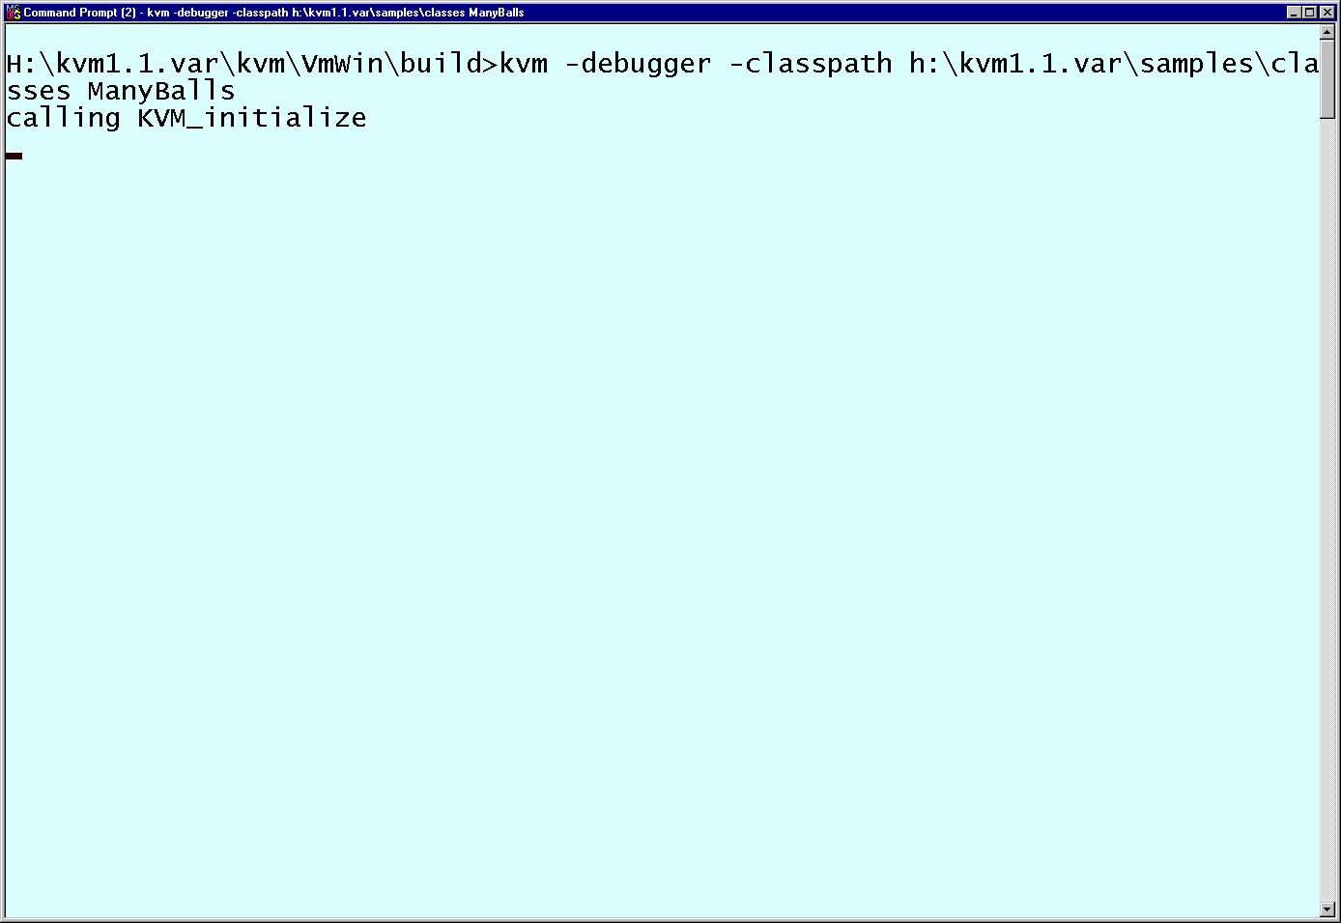

Slide 71
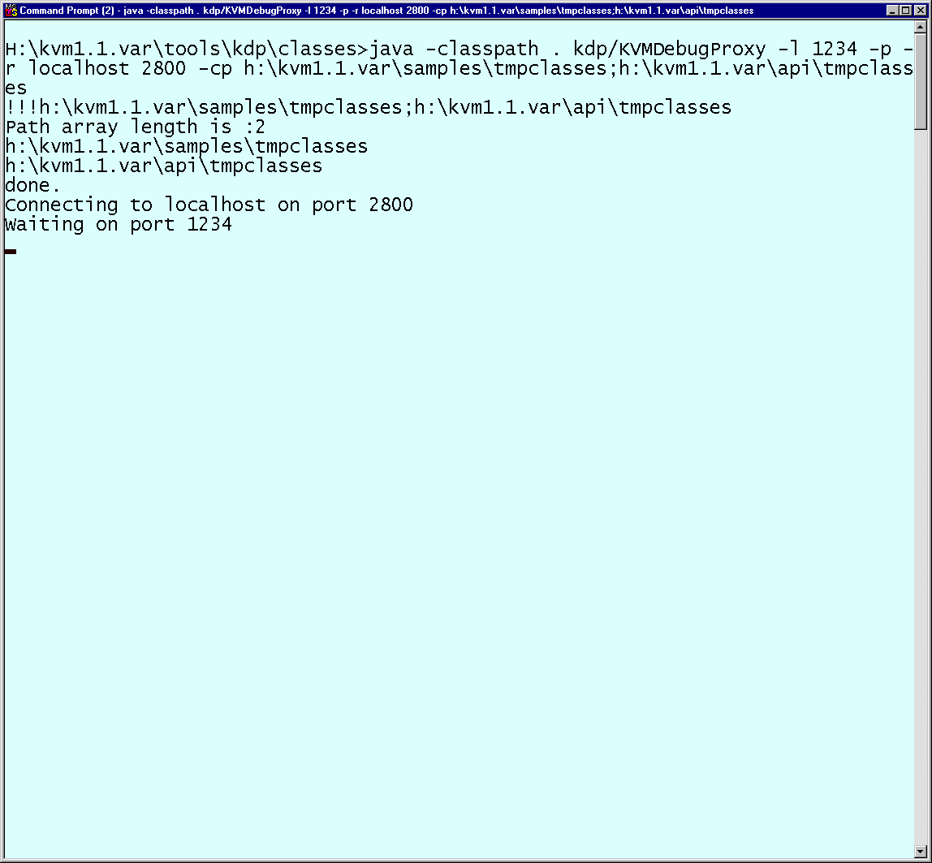

Slide 72
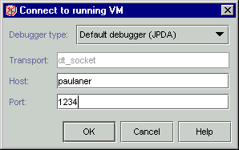

Slide 73
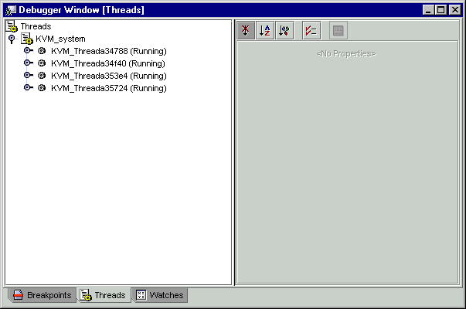
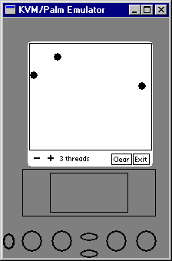

Slide 74
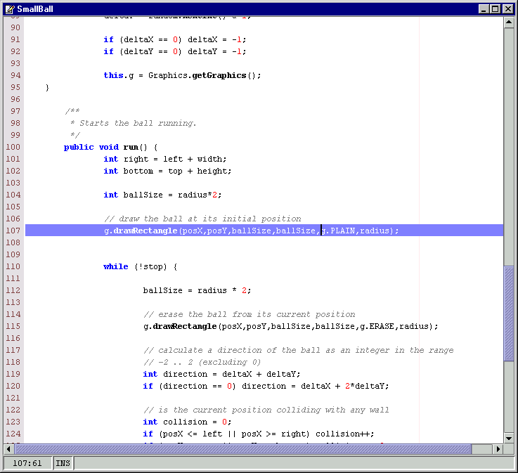

Slide 75
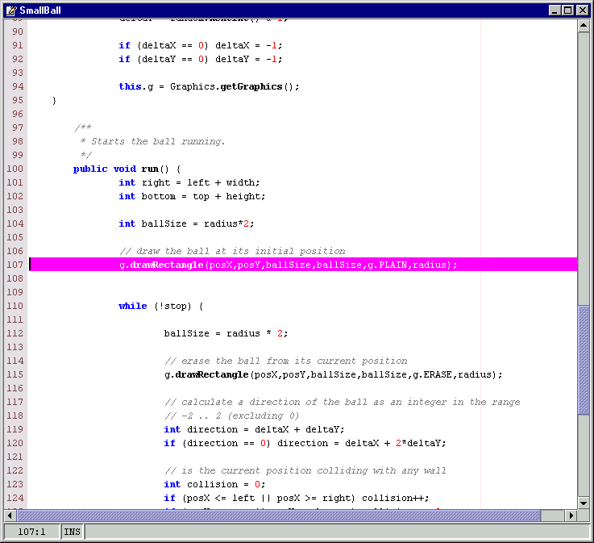

Slide 76
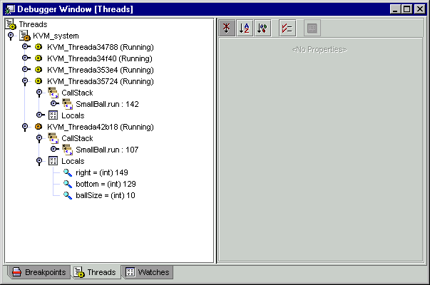

Slide 77
Palm-Specific Optimizations and Features

Slide 78
Palm-Specific Space Optimization
Database memory on the Palm Computing Platform is slow to write, fast to read, and there’s lots of it
Once loaded, the read-only parts of classes are moved into static database memory
  Demo app before: 25 kB of heap space
  Demo app after: 4 kB of heap space, 18 kB of static space

Slide 79
Palm-Specific Features
Palm application launcher is used as the primary Java application manager
User Interface
  Originally inherited from Spotless
  Sun/Palm joint technical collaboration to replace the UI interface :
    to be simple
    to have look-and-feel of Palm
    to have some subset of AWT functionality

Slide 80
Subscribe to kvm-interest
The kvm-interest mailing list is a free KVM developers list hosted by Sun
  To subscribe, send email to: listserv@java.sun.com
  In the body of the message, type: subscribe kvm-interest
  For digest mode, include the following line: set kvm-interest digest
The kvm-interest archive is searchable online at: archives.java.sun.com/archives/kvm-interest.html

Slide 81


