Slide 1
Class - 13
Notes:
Are your classroom colors different than what you see in this template? That’s OK! Click on Design -> Variants (the down arrow) -> Pick the color scheme that works for you!
Feel free to change any “You will…” and “I will…” statements to ensure they align with your classroom procedures and rules!

Slide 2

Agenda
Single inheritance
Hierarchical inheritance
Multilevel inheritance
Multiple inheritance implemented by interface

Slide 3
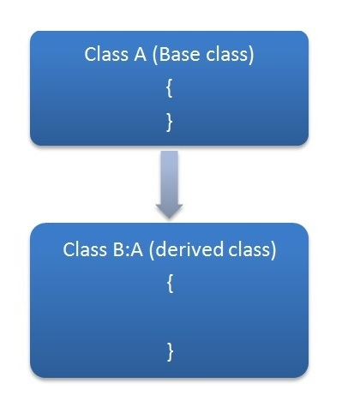
single Inheritance in C#
When one class inherits another class, it is known as single level inheritance. Let's see the example of single level inheritance which inherits the fields only.

Slide 4
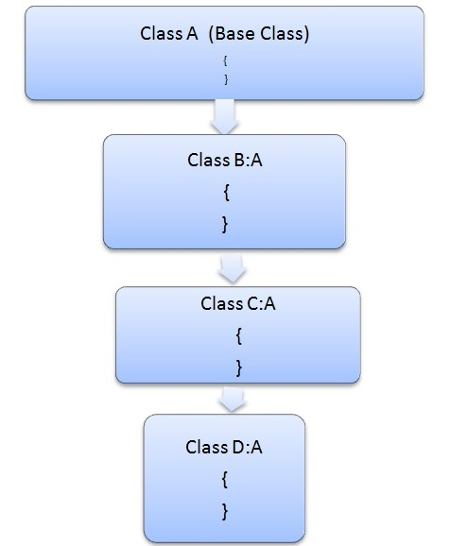
Hierarchical inheritance
This is the type of inheritance in which there are multiple classes derived from one base class. This type of inheritance is used when there is a requirement of one class feature that is needed in multiple classes.

Slide 5
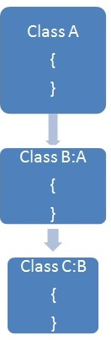
multilevel Inheritance in C#
When one class inherits another class which is further inherited by another class, it is known as multi level inheritance in C#. Inheritance is transitive so the last derived class acquires all the members of all its base classes.

Slide 6
A=doui,eddy
B= john,raj
C=good
B:A
C:B

Slide 7
Multiple inheritance using interfaces
In multiple inheritance, one class can have more than one bas class and inherit methods from all its parent class ( base class).
But C# doesn’t support multiple class inheritance , because it may give ambiguity problem.
So to overcome this problem , we use interfaces

Slide 8
Thank you
You can follow me
Website :- https://dotnetoffice.com/
YouTube :- https://www.youtube.com/c/TheDotNetOffice
Twitter : - https://twitter.com/TheDotNetOffice

