Slide 1
Class - 14
Notes:
Are your classroom colors different than what you see in this template? That’s OK! Click on Design -> Variants (the down arrow) -> Pick the color scheme that works for you!
Feel free to change any “You will…” and “I will…” statements to ensure they align with your classroom procedures and rules!

Slide 2

Agenda
Method hiding
Polymorphism
Method overriding
Method overriding Vs hiding
Method overloading

Slide 3
Method Hiding
C# provides a concept to hide the methods of the base class from derived class, this concept is known as Method Hiding. It is also known as Method Shadowing. In method hiding, you can hide the implementation of the methods of a base class from the derived class using the new keyword
Variable hiding is also same as method hiding… it is based on same variable name in base class and derived class

Slide 4
Polymorphism
Polymorphism means "many forms", and it occurs when we have many classes that are related to each other by inheritance.

Slide 5
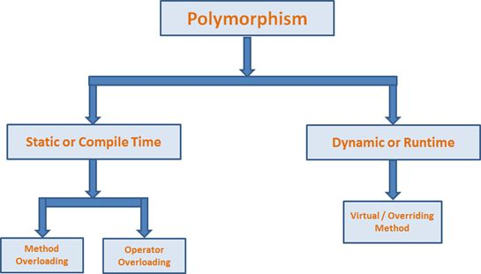
Types of Polymorphism
There are two types of polymorphism in C#:
Static / Compile Time Polymorphism.
Dynamic / Runtime Polymorphism.

Slide 6
Method overriding
Overriding can be defined as: being able to change or augment the behavior of methods in classes, known as overriding their logic; it is one of the most powerful aspects of Object Oriented Programming.
Car _car = new Car();
_car.Pize();
Vehicle _vehicle = new Vehicle();
_vehicle.Pize();
Vehicle car1 = new Car();
car1.Pize();
// method overriding is depand on which class you are initilizing
// //method hiding is depand on which class object you are creating, and it will print same class method msg

Slide 7
Method override
Method overriding implemented ,
1. in base class method should be decorated with Virtual keyword
2. in derived class , same method name should decorated with override keyword.

Slide 8
public new void Pize() // either you make this method as a method hiding or method overriding
{
Console.WriteLine("Car prize");
}
public override void Pize() // either you make this method as a method hiding or method overriding
{
Console.WriteLine("Car prize");
}

Slide 9
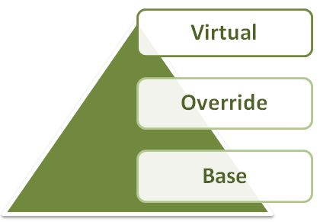
Keywords in Method Overriding
There are the following 3 types of keywords used in C# for method overriding:

Slide 10
Thank you
You can follow me
Website :- https://dotnetoffice.com/
YouTube :- https://www.youtube.com/c/TheDotNetOffice
Twitter : - https://twitter.com/TheDotNetOffice

