Slide 1
Class - 16
Notes:
Are your classroom colors different than what you see in this template? That’s OK! Click on Design -> Variants (the down arrow) -> Pick the color scheme that works for you!
Feel free to change any “You will…” and “I will…” statements to ensure they align with your classroom procedures and rules!

Slide 2

Agenda
Method overriding Vs hiding
Method overloading

Slide 3
Method overriding
Overriding can be defined as: being able to change or augment the behavior of methods in classes, known as overriding their logic; it is one of the most powerful aspects of Object Oriented Programming.

Slide 4
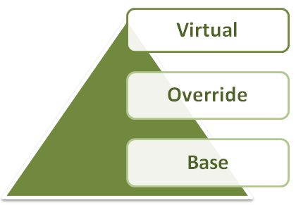
Keywords in Method Overriding
There are the following 3 types of keywords used in C# for method overriding:

Slide 5
Method Overloading
Having two or more methods with same name but different in parameters, is known as method overloading in C#.
The advantage of method overloading is that it increases the readability of the program because you don't need to use different names for same action.
public static int add(int a,int b){
return a + b;
}
public static int add(int a, int b, int c)
{
return a + b + c;
}

Slide 6
// int; string; decimal; bool; char; var; object; dynamic; date; datetime; float; long; doule; short, byte
// value type store in stack (memory)
// reference type store in heap( memory)
// in C# three are two type of memory allocation
//value type -> short, char, boolean, decimal, int, float, double, Structure( struct) (stack memory)
// reference type -> string , class, object, interface ( heap memory)

Slide 7
Int a = 10;
String b = “doui”;
Class1 obj = new class1();
Stack
A = 10;
Obj(reference)
Heap
Obj

Slide 8
Thank you
You can follow me
Website :- https://dotnetoffice.com/
YouTube :- https://www.youtube.com/c/TheDotNetOffice
Twitter : - https://twitter.com/TheDotNetOffice

