Slide 1
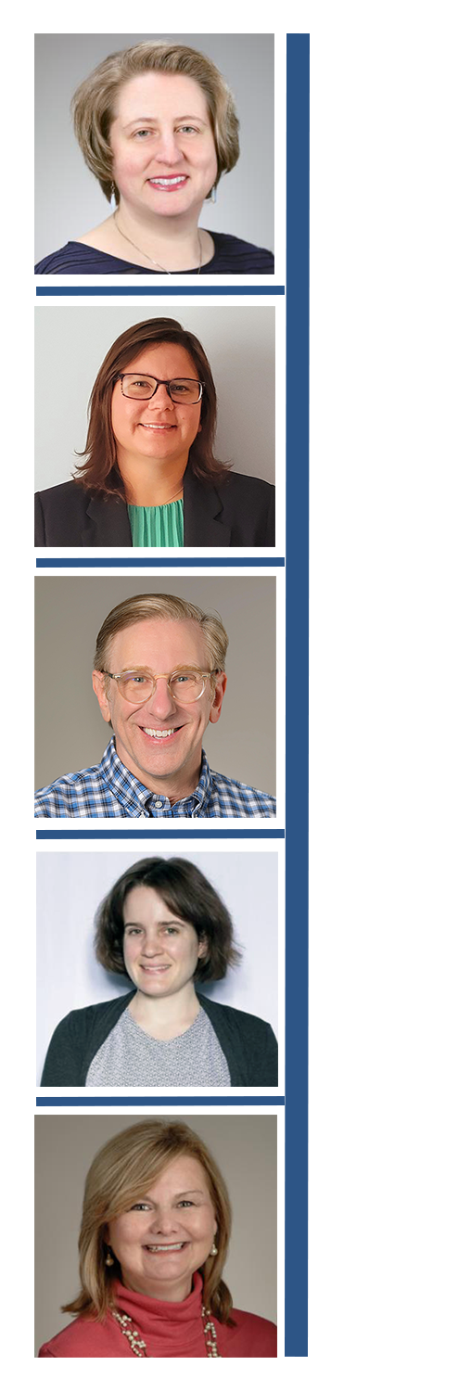
We Can Help
Classes on a variety of data-related topics, including:
Data management
Data visualization
Data analysis
R and RStudio
Biostatistics
Computers which offers a suite of tools for data analysis, processing, and visualization

