Slide 1
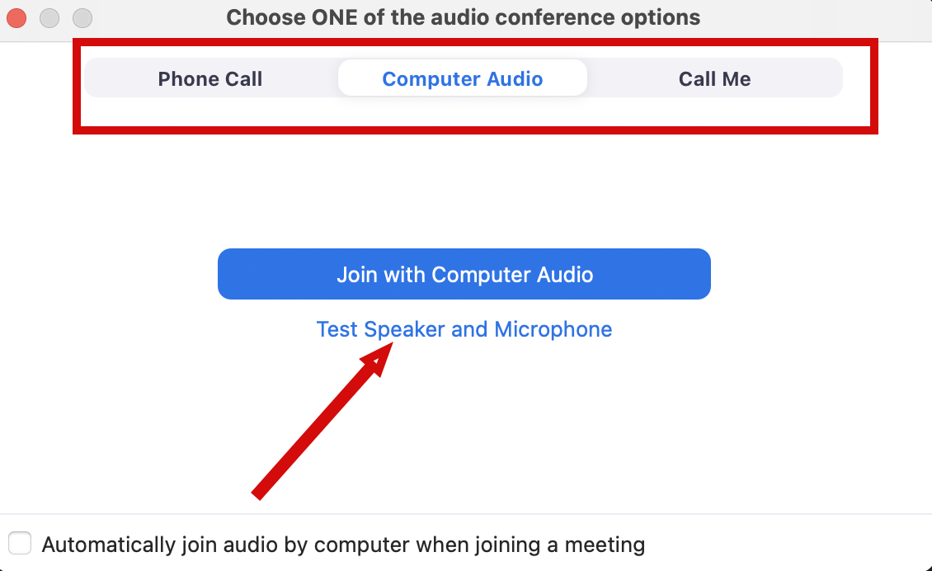
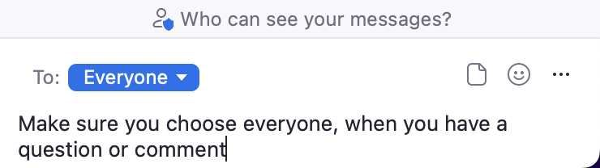
Audio Connection and Chat (Zoom)
You will not hear any sound until the webinar starts.
Connect Audio
When you join Zoom, the Join Audio preferences box pops-up (Phone Call, Computer Audio, or Call Me)
Choose an option that works best for you
Join using that option
Use Test Speakers and Microphone option to optimize your webinar experience
Chat
Please send your chat to Everyone to make sure the monitor sees your question

Slide 2
Project Management and Reproducibility In Rstudio (Part 1)
Doug Joubert
2022-10-11

Slide 3
Class Objectives
Understand the role of scientific reproducibility in research
Discuss the advantages of using RStudio for managing projects
Demonstrate how to create and clone a GitHub repository
Demonstrate how to create a Git project in Rstudio
Identify good practices for managing projects in RStudio

Slide 4
Scientific Reproducibility
According to the U.S. National Science Foundation (NSF) subcommittee on replicability in science (2015):
Science should routinely evaluate the reproducibility of findings that enjoy a prominent role in the published literature. To make reproduction possible, efficient, and informative, researchers should sufficiently document the details of the procedures used to collect data, to convert observations into analyzable data, and to perform data analysis.

Slide 5
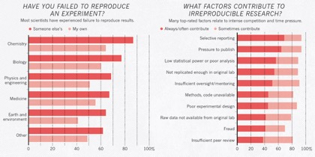
Problem of Reproducibility
A 2016 Nature survey revealed reproducibility problems across all domains of science

Slide 6
Embracing Reproducibility Practices
If contributing to science and other researchers seems not to be compelling enough, here are 5 selfish reasons to work reproducibly according to Markowetz (2015):
Helps to avoid data loss and disaster
Makes it easier to write papers
Helps reviewers see it your way
Enables continuity of your work
Helps to build your reputation

Slide 7
Using RStudio for Project Management
RStudio is an integrated development environment (IDE) for R and Python:
Free and open-source
Designed to make it easy to write and reuse code
Convenient to view and interact with the objects stored in your environment
Collaboration and Publishing Tools
Documents using R Markdown

Slide 8

GitHub and RStudio Project Demo

Slide 9
Outline for Demo
Defining version control
Creating a new repository on GitHub
Creating a “versioned” project in RStudio
Brief discussion about “best practices”
Using version control in RStudio

Slide 10
Practices for Managing Projects

Slide 11

Files and folders
Using the chat, list some problems that you have encountered when dealing with files and folders?

Slide 12
Files and folders
Cannot find your files on your computer (or your cloud storage)
Multiple versions of files with names such as "finaldraft_4.txt”
Path issues when trying to run code
Reviewers or colleagues cannot re-run your code/analyses

Slide 13

Storage and Sharing Issues
Using the chat, list some problems that you have encountered when dealing with storage or sharing?

Slide 14
Storage and Sharing Issues
Files are only saved to your computer
Collaborators don't share the files needed
Files are shared via email attachments
Difficult to know if you have the latest version of documents

Slide 15
Practice Good File Organization
Good Enough Practices for Scientific Computing gives the following recommendations for project organization:
Each project in its own directory, which is named after the project
Text documents associated with the project in the doc directory
Raw data and metadata in the data directory (raw-data)
Files generated during cleanup and analysis in a results directory

Slide 16
Practice Good File Organization
Good Enough Practices for Scientific Computing gives the following recommendations for project organization:
Project's scripts and programs in the src directory
Programs brought in from elsewhere or compiled locally in the bin directory
Name all files to reflect their content or function
README file to a repository to communicate important information about your project
CITATION.cff file to the root of a repository to let others know how you would like them to cite your work

Slide 17
Practice Good File Organization
Additional filles to include:
README file, to communicate important information about your project
LICENSE file, so that others are free to use, change, and distribute the software
CITATION.cff file, to let others know how you would like them to cite your work
Student version of the PowerPoint has more resources to explore

Slide 18
Using Version Control in RStudio Demo

Slide 19
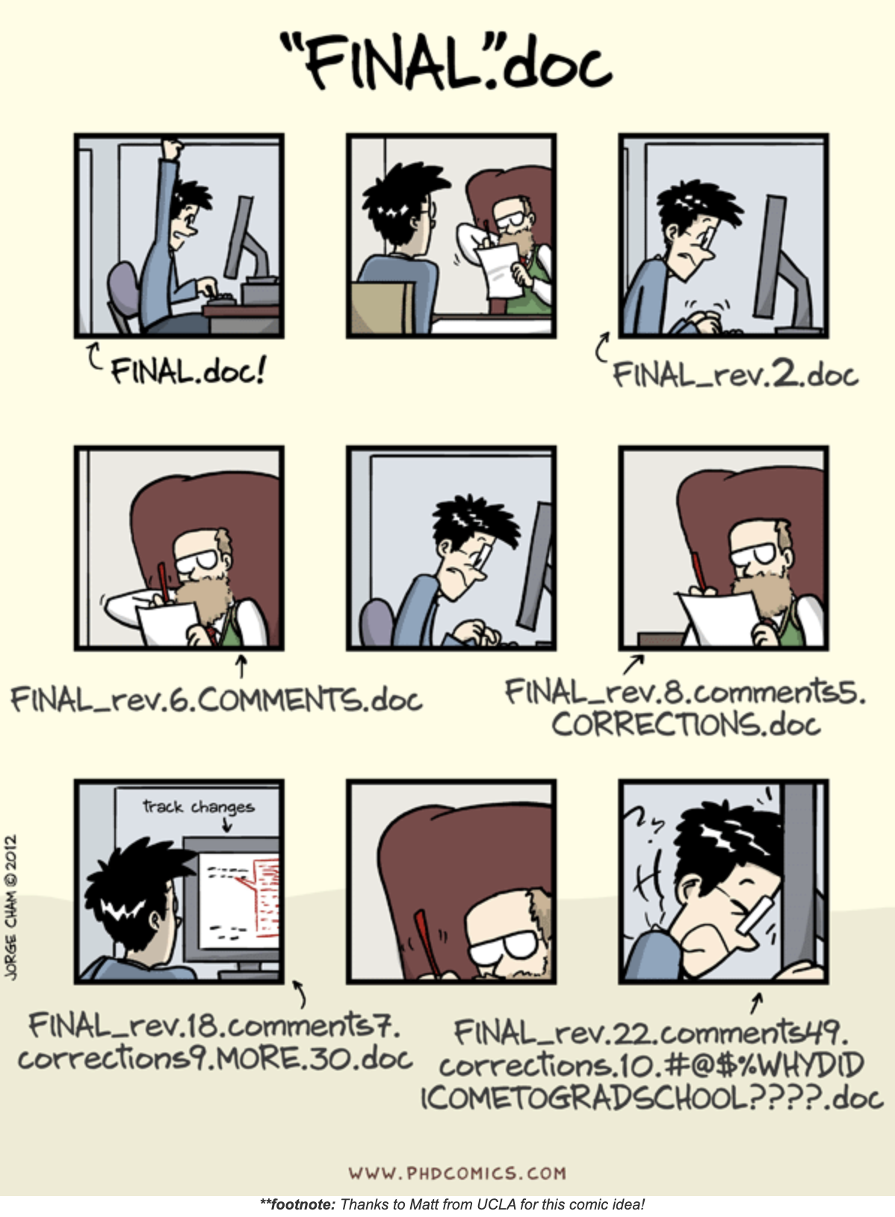
Workflows in Git

Slide 20
Outline for Demo
Using version control in RStudio

Slide 21
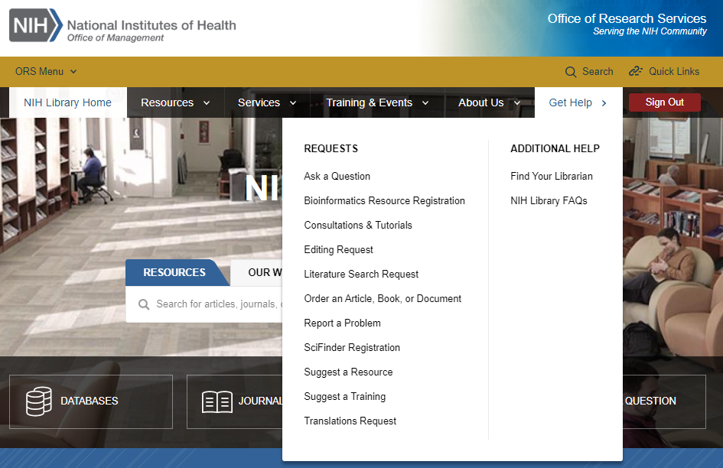
Contact Us for Ongoing Support
Doug Joubert
Bioinformatics Support Program
301-827-3829
douglas.joubert@nih.gov
NIH Library Help Desk (301) 496-1080
Ask a Question: https://www.nihlibrary.nih.gov/get-help/ask-question
Request a Tutorial: https://www.nihlibrary.nih.gov/get-help/consultations-tutorials
Sign up for Additional Classes: https://www.nihlibrary.nih.gov/training/calendar

Slide 22
Questions & Comments

