Slide 1
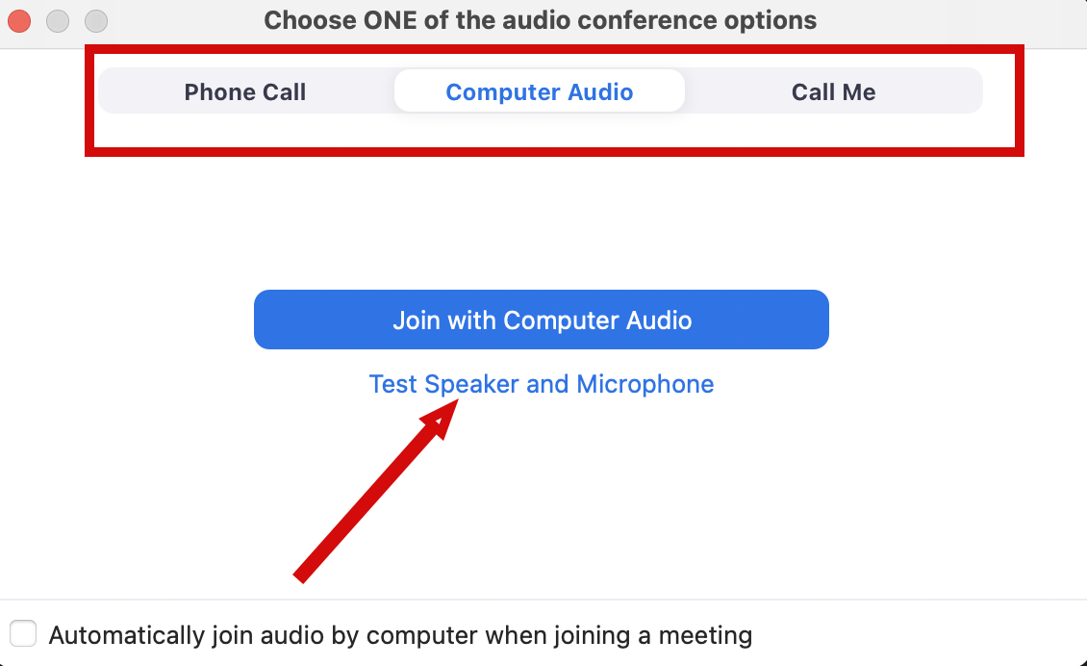
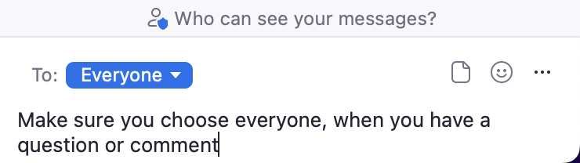
Audio Connection and Chat (Zoom)
You will not hear any sound until the webinar starts.
Connect Audio
When you join Zoom, the Join Audio preferences box pops-up (Phone Call, Computer Audio, or Call Me)
Choose an option that works best for you
Join using that option
Use Test Speakers and Microphone option to optimize your webinar experience
Chat
Please send your chat to Everyone to make sure the monitor sees your question

Slide 2
Project Management and Reproducibility In RStudio: Part 1
Doug Joubert
2022-10-11

Slide 3

We Can Help
Classes on a variety of data-related topics, including:
Data management
Data visualization
Data analysis
R and RStudio
What Marie can do
Computers which offers a suite of tools for data analysis, processing, and visualization

Slide 4
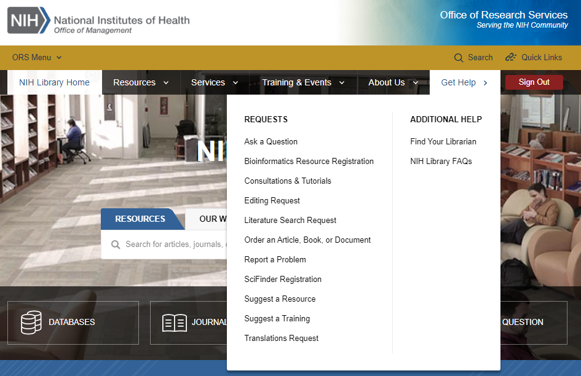
Contact Us for Ongoing Support
Doug Joubert
Bioinformatics Support Program
301-827-3829
douglas.joubert@nih.gov
NIH Library Help Desk (301) 496-1080
Ask a Question: https://www.nihlibrary.nih.gov/get-help/ask-question
Request a Tutorial: https://www.nihlibrary.nih.gov/get-help/consultations-tutorials
Sign up for Additional Classes: https://www.nihlibrary.nih.gov/training/calendar

Slide 5
Works Cited
Bollen, K., Cacioppo, J. T., Kaplan, R. M., Krosnick, J. A., & Olds, J. L. (2015). Social, Behavioral, and Economic Sciences Perspectives on Robust and Reliable Science. National Science Foundation.
Camerer, C. F., et al. (2018). Evaluating the replicability of social science experiments in Nature and Science between 2010 and 2015. Nature Human Behaviour, 2(9), 637-644.
Markowetz, F. (2015). Five selfish reasons to work reproducibly. Genome Biology, 16(1), 274.

Slide 6
Works Cited
Munafo, M. R., Nosek, B. A., Bishop, D. V. M., Button, K. S., Chambers, C. D., du Sert, N. P., Simonsohn, U., Wagenmakers, E. J., Ware, J. J., & Ioannidis, J. P. A. (2017). A manifesto for reproducible science. Nature Human Behaviour, 1(1), Article 0021.
Teal, T. K., Cranston, K. A., Lapp, H., White, E., Wilson, G., Ram, K., & Pawlik, A. (2015). Data carpentry: workshops to increase data literacy for researchers. International Journal of Digital Curation, 10(1), 135-143.

Slide 7
Works Cited
Wilson, G. (2016). Software Carpentry: lessons learned [version 2; peer review: 3 approved]. F1000Research, 3(62), 62. https://doi.org/10.12688/f1000research.3-62.v2
Wilson, G., Bryan, J., Cranston, K., Kitzes, J., Nederbragt, L., & Teal, T. K. (2017). Good enough practices in scientific computing. PLOS Computational Biology, 13(6), e1005510-e1005510.

Slide 8
Review
Reproducibility in science
5 reasons why you might want to create reproducible documents
Git Versus GitHub
Authentication to GitHub
Creating a GitHub repository and linking that repository to Rstudio
Practices for managing projects in RStudio
Version control in RStudio

