Slide 1
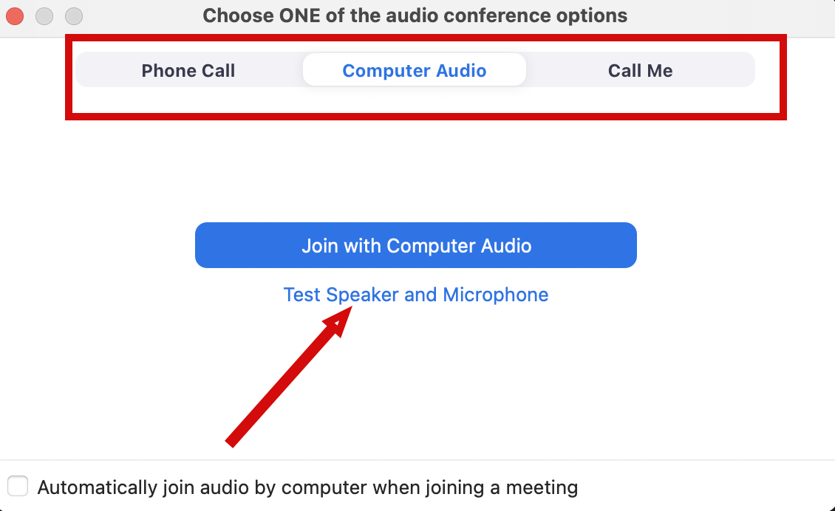
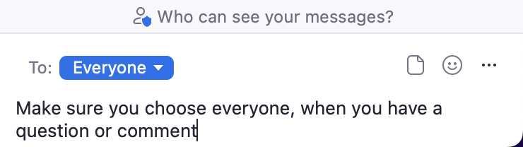
Audio Connection and Chat (Zoom)
You will not hear any sound until the webinar starts.
Connect Audio
When you join Zoom, the Join Audio preferences box pops-up (Phone Call, Computer Audio, or Call Me)
Choose an option that works best for you
Join using that option
Use Test Speakers and Microphone option to optimize your webinar experience
Chat
Please send your chat to Everyone to make sure the monitor sees your question

Slide 2
Project Management and Reproducibility In RStudio (Part 2)
Doug Joubert
2022-10-11

Slide 3
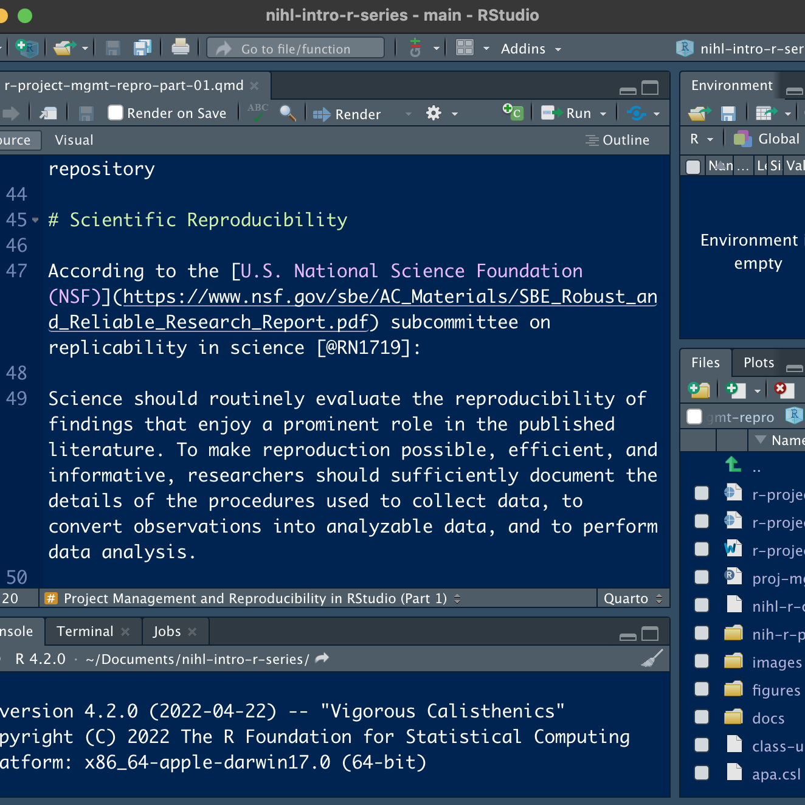
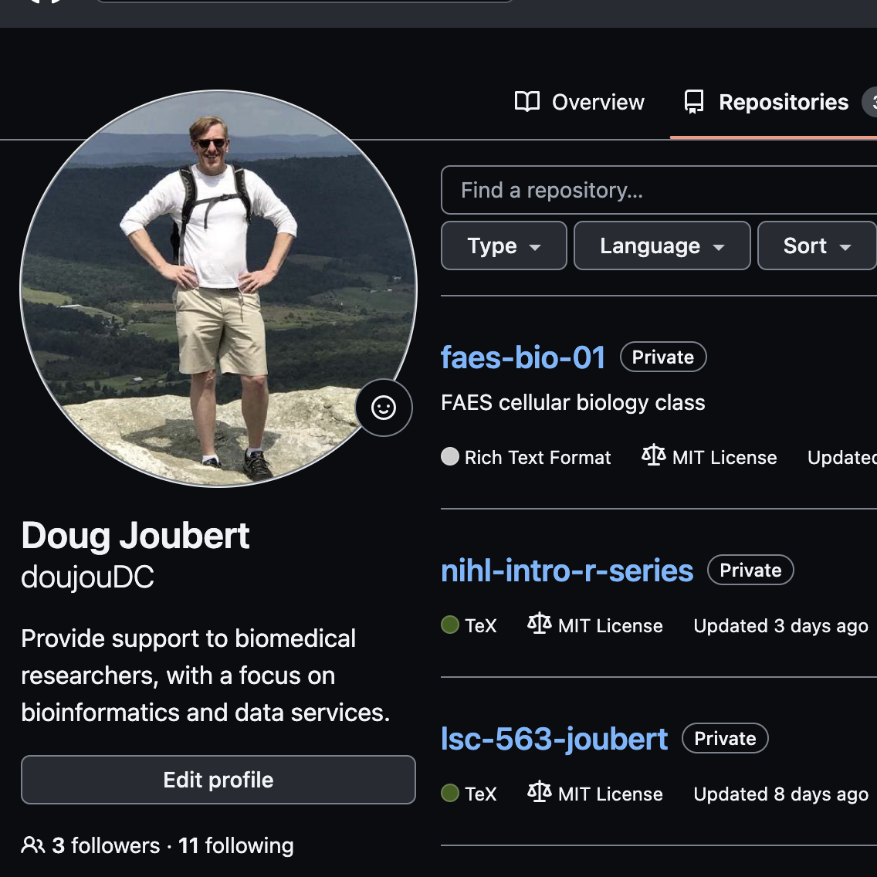
Project Management Series
(Part 2)
(Part 1)

Slide 4
Class Objectives
Understand the role of scientific reproducibility in research
Discuss the advantages of using RStudio for managing projects
Demonstrate how to create and clone a GitHub repository
Demonstrate how to create a Git project in RStudio
Identify good practices for managing projects in RStudio

Slide 5

GitHub Demo

Slide 6

Outline for Demo
Creating a new repository on GitHub
Defining Git attributes in RStudio and Git Hub

Slide 7
RStudio Project Demo

Slide 8
Outline for Demo
Creating a “versioned” project in RStudio
Brief discussion about “best practices”
Using version control in RStudio

Slide 9
Using RStudio for Project Management
RStudio is an integrated development environment (IDE) for R and Python:
Free and open-source
Designed to make it easy to write and reuse code
Convenient to view and interact with the objects stored in your environment
Collaboration and Publishing Tools
Documents using R Markdown

Slide 10
Best Practices for Managing Projects

Slide 11
Using Version Control in RStudio

Slide 12
Using Version Control in RStudio Demo

Slide 13
Outline for Demo
Git in RStudio
Commits and diffs
Verifying changes in repository

Slide 14
Review

Slide 15
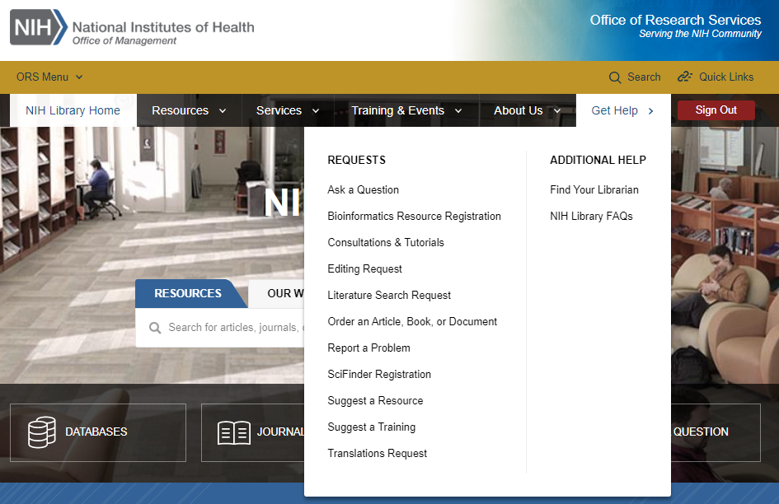
Contact Us for Ongoing Support
Doug Joubert
Bioinformatics Support Program
301-827-3829
douglas.joubert@nih.gov
NIH Library Help Desk (301) 496-1080
Ask a Question: https://www.nihlibrary.nih.gov/get-help/ask-question
Request a Tutorial: https://www.nihlibrary.nih.gov/get-help/consultations-tutorials
Sign up for Additional Classes: https://www.nihlibrary.nih.gov/training/calendar

Slide 16
Works Cited
Bollen, K., Cacioppo, J. T., Kaplan, R. M., Krosnick, J. A., & Olds, J. L. (2015). Social, Behavioral, and Economic Sciences Perspectives on Robust and Reliable Science. National Science Foundation.
Camerer, C. F., et al. (2018). Evaluating the replicability of social science experiments in Nature and Science between 2010 and 2015. Nature Human Behaviour, 2(9), 637-644.
Markowetz, F. (2015). Five selfish reasons to work reproducibly. Genome Biology, 16(1), 274.

Slide 17
Works Cited
Munafo, M. R., Nosek, B. A., Bishop, D. V. M., Button, K. S., Chambers, C. D., du Sert, N. P., Simonsohn, U., Wagenmakers, E. J., Ware, J. J., & Ioannidis, J. P. A. (2017). A manifesto for reproducible science. Nature Human Behaviour, 1(1), Article 0021.
Teal, T. K., Cranston, K. A., Lapp, H., White, E., Wilson, G., Ram, K., & Pawlik, A. (2015). Data carpentry: workshops to increase data literacy for researchers. International Journal of Digital Curation, 10(1), 135-143.

Slide 18
Works Cited
Wilson, G. (2016). Software Carpentry: lessons learned [version 2; peer review: 3 approved]. F1000Research, 3(62), 62. https://doi.org/10.12688/f1000research.3-62.v2
Wilson, G., Bryan, J., Cranston, K., Kitzes, J., Nederbragt, L., & Teal, T. K. (2017). Good enough practices in scientific computing. PLOS Computational Biology, 13(6), e1005510-e1005510.

Slide 19
Questions & Comments

