Slide 1
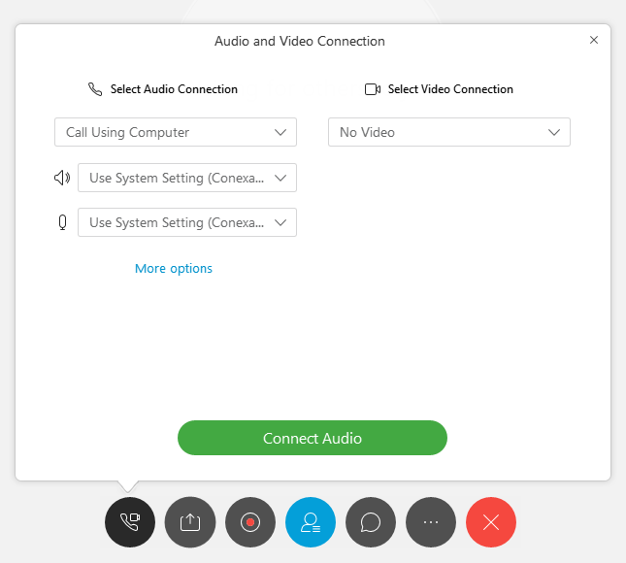

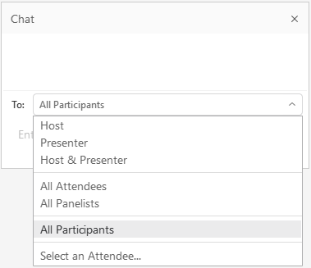
Audio Connection and Chat (WebEx)
You will not hear any sound until the webinar starts.
Connect Audio
When you join WebEx, the Audio and Video Connection dialog box appears.
Choose audio connection preference (computer, phone, or a video device) then select Connect Audio.
If you don’t choose an audio connection at the start of your session, you can select the connect audio and video icon at any time to access the audio connection dialog box.
Chat
Please send your chat to All Participants to make sure the monitor sees your question.

Slide 2
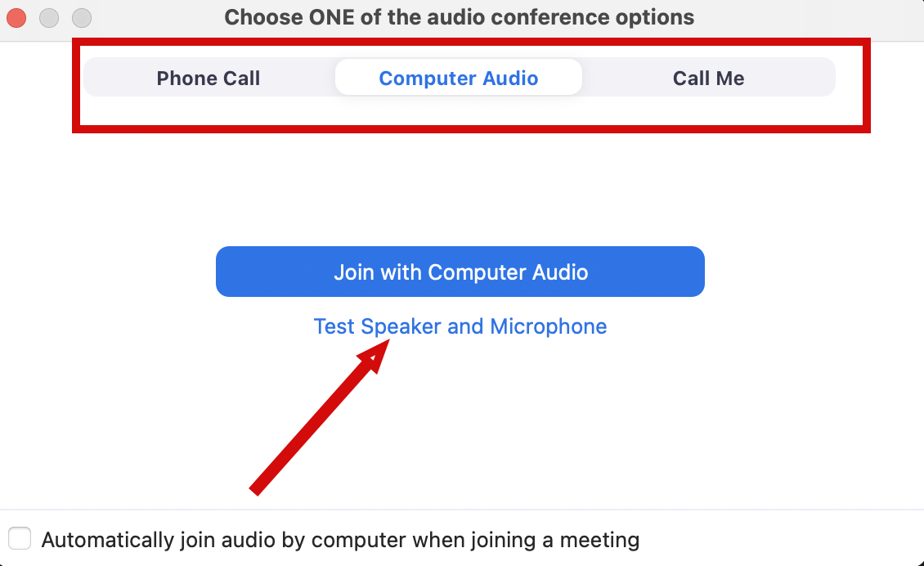
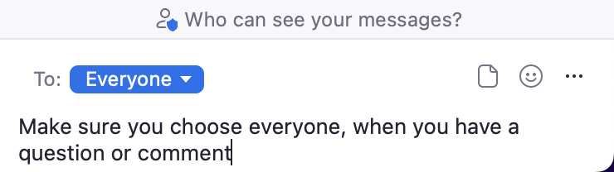
Audio Connection and Chat (Zoom)
You will not hear any sound until the webinar starts.
Connect Audio
When you join Zoom, the Join Audio preferences box pops-up (Phone Call, Computer Audio, or Call Me)
Choose an option that works best for you
Join using that option
Use Test Speakers and Microphone option to optimize your webinar experience
Chat
Please send your chat to Everyone to make sure the monitor sees your question

Slide 3
Project Management and Reproducibility In RStudio
Doug Joubert
TBD

Slide 4
Class Objectives
Understand the role of scientific reproducibility in research
Discuss the advantages of using RStudio for managing projects
Demonstrate how to create and clone a GitHub repository
Demonstrate how to create a Git project in Rstudio
Identify good practices for managing projects in RStudio

Slide 5
Scientific Reproducibility
According to the U.S. National Science Foundation (NSF) subcommittee on replicability in science (2015):
Science should routinely evaluate the reproducibility of findings that enjoy a prominent role in the published literature. To make reproduction possible, efficient, and informative, researchers should sufficiently document the details of the procedures used to collect data, to convert observations into analyzable data, and to perform data analysis.

Slide 6
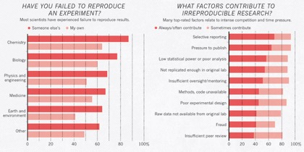
Problem of Reproducibility
A 2016 Nature survey revealed reproducibility problems across all domains of science

Slide 7
Embracing Reproducibility Practices
If contributing to science and other researchers seems not to be compelling enough, here are 5 selfish reasons to work reproducibly according to Markowetz (2015):
Helps to avoid data loss and disaster
Makes it easier to write papers
Helps reviewers see it your way
Enables continuity of your work
Helps to build your reputation

Slide 8
Using RStudio for Project Management
RStudio is an integrated development environment (IDE) for R and Python:
Free and open-source
Designed to make it easy to write and reuse code
Convenient to view and interact with the objects stored in your environment
Collaboration and Publishing Tools
Documents using R Markdown

Slide 9
Outline for Demo
Defining version control
Creating a new repository on GitHub
Creating a “versioned” project in RStudio
Brief discussion about “best practices”
Using version control in RStudio

Slide 10
Practices for Managing Projects
START WHEN I GET BACK TO THE OFFICE ON AUG 1

Slide 11
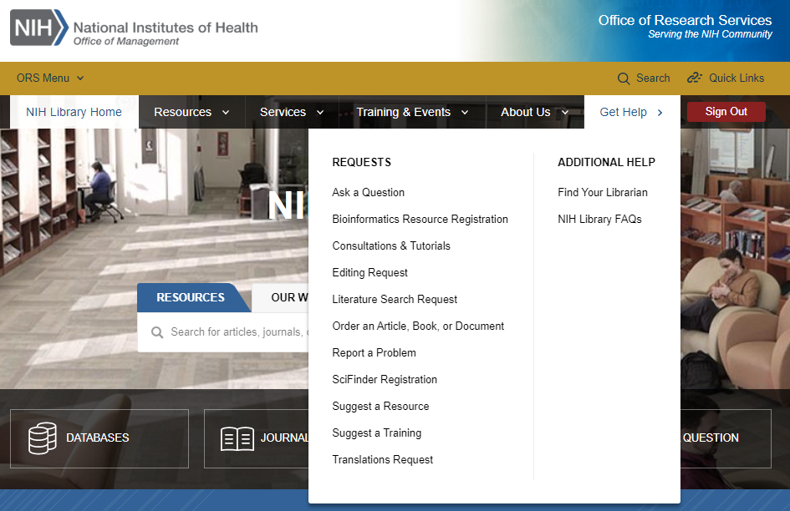
Contact Us for Ongoing Support
Instructor Name
Instructor Title
Phone Number
email@nih.gov
NIH Library Help Desk (301) 496-1080
Ask a Question: https://www.nihlibrary.nih.gov/get-help/ask-question
Request a Tutorial: https://www.nihlibrary.nih.gov/get-help/consultations-tutorials
Sign up for Additional Classes: https://www.nihlibrary.nih.gov/training/calendar

Slide 12
Questions & Comments

