Slide 1

Coin classification and amount Calculation
Created by:
Mkawar Wael (DLSI_MM TD2 TP2)
Douma Hamdi (DLSI_MM TD2 TP1)

Slide 2
summary
Introduction
Problematic
Dataset Creation and Preprocessing
Test preparing
Creating a CNN model
Prediction
result

Slide 3
Introduction
the project is about making an algorithm that can automatically identify coins and calculate their total value.
The goal of this system is to simplify tasks for people.

Slide 4
problematic
Counting coins by hand can take a long time, especially with large amounts.
mistakes in counting or adding up coin values can result in incorrect totals.
identifying coins of different types can be difficult, particularly when they look alike.

Slide 5
Dataset Creation and Preprocessing
creating dataset : We collected images of various coins from different angles, lighting conditions, and backgrounds to ensure a robust dataset.
Preprocessing steps: Before training our model, we resized all images to a standardized resolution and normalized pixel values.
Labelling coins with their corresponding values: Each coin image in our dataset is labelled with its corresponding value (e.g., 100 millime, 50 millime).

Slide 6
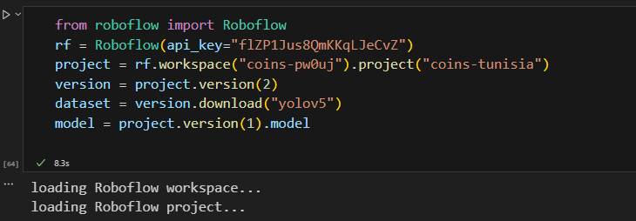
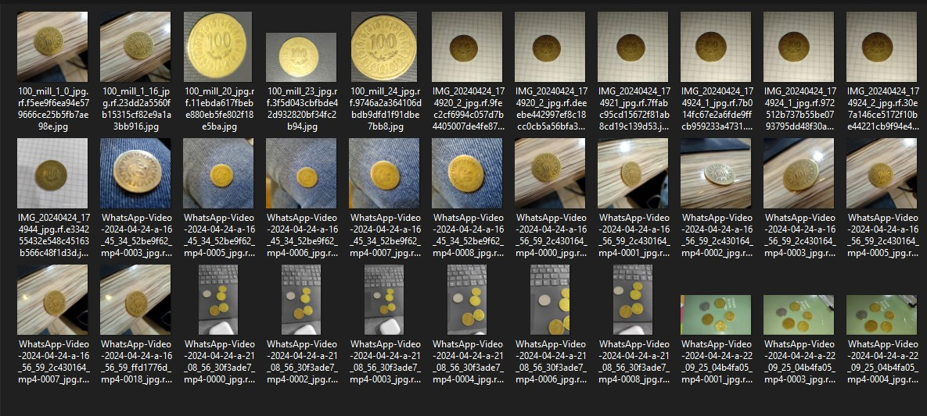
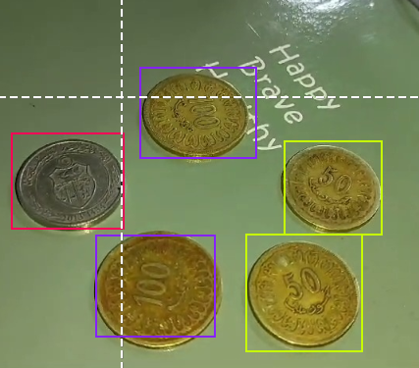
Data used
Creating dataset
coin selecting and labelling

Slide 7
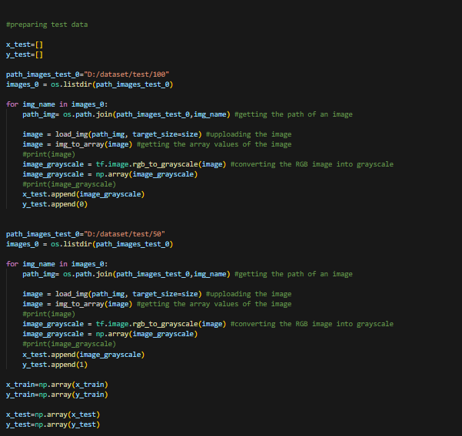
Test preparing

Slide 8
Creating a CNN model
Algorithm Selection : Chose CNN for best results.
Model Architecture : CNN with tuned hyperparameters.
Training Process : Prevented overfitting with dataset split, and used dropout and batch normalization.

Slide 9
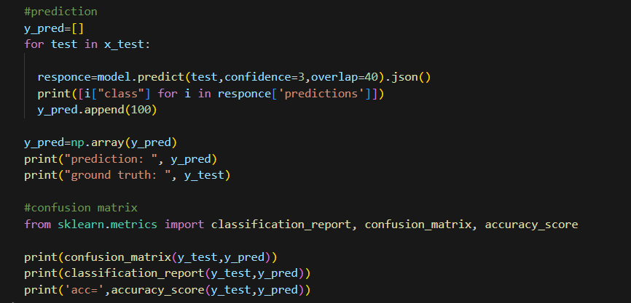
prediction

Slide 10
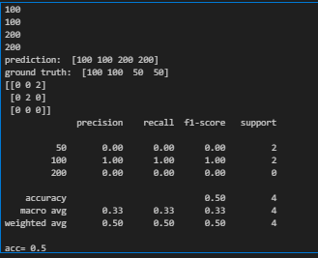
result

Slide 11
References :
https://roboflow.com/
https://opencv.org/
https://tensorflow.org/
https://keras.io/

