Slide 1

Prototype of a document classification system

Slide 2
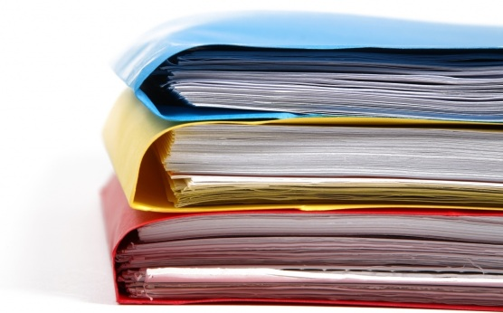
Summary
Problematic
Objective
Working steps
Production
Conclusion

Slide 3
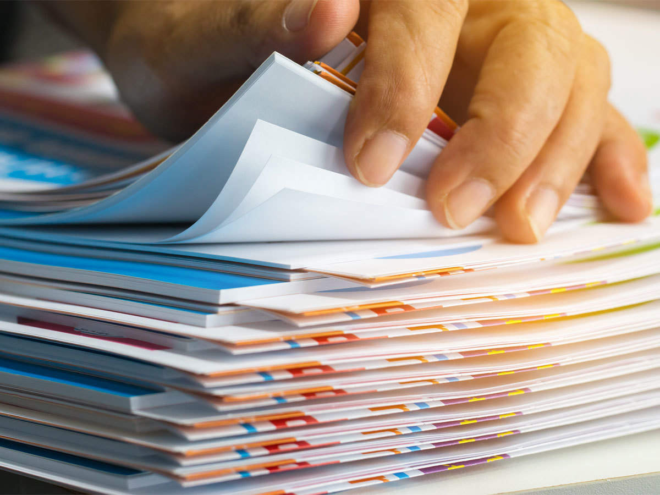
Problematic
The documents classification is important in some areas
but the needs a lot of time and a lot of money
And the possibility of making mistakes

Slide 4
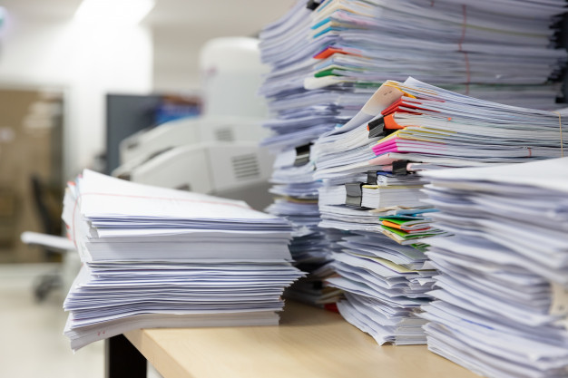
Objective
Our goal of this project is to create an application to facilitate documents classification

Slide 5
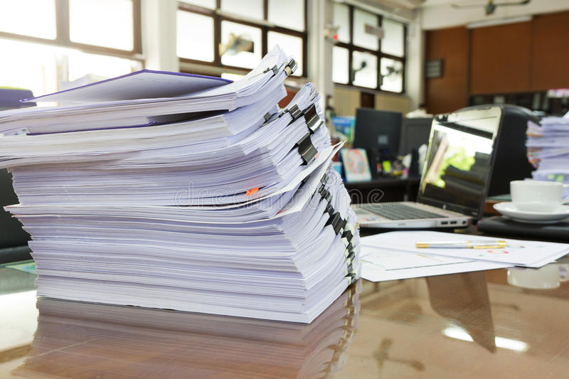
Working steps
Document classification in general way has many steps
The conception of the learning corpus
The corpus representation
The learning algorithm choice

Slide 6
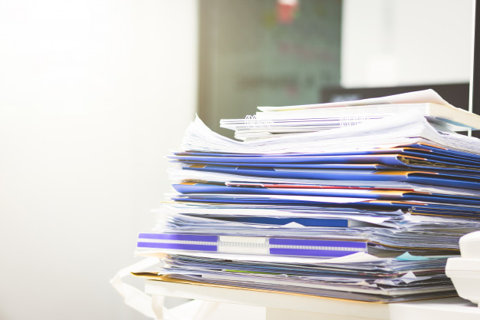
The conception of the learning corpus

Slide 7
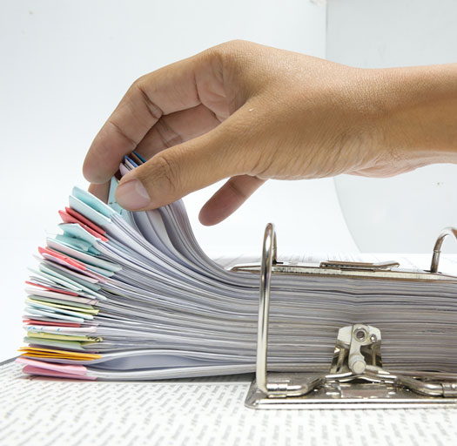
The corpus representation
Countvectorizer
TF-IDF

Slide 8
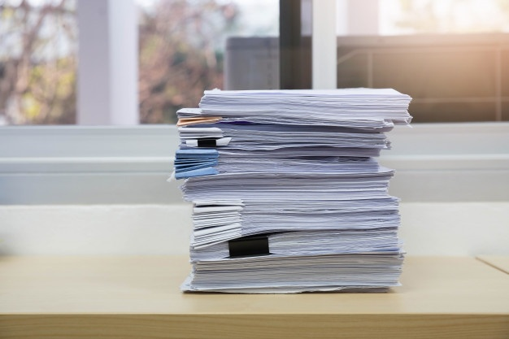

TF-IDF
Countvectorizer
Countvectorizer
Numerical array
Document

Slide 9

TF-IDF
her it learns the IDF from the count matrix obtained from countvectorizer
TF-IDF
Numerical array
Numerical feature matrix

Slide 10

The learning algorithm choice
Random forest algorithm
Support Vector Machine algorithm

Slide 11

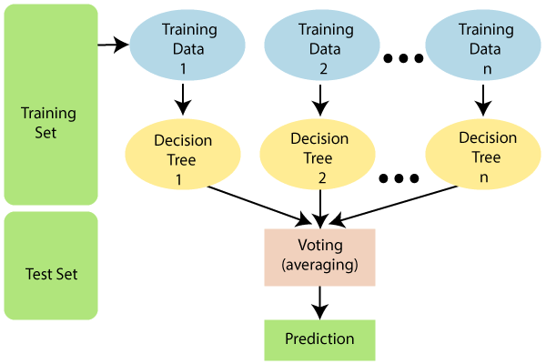
Random forest algorithm

Slide 12
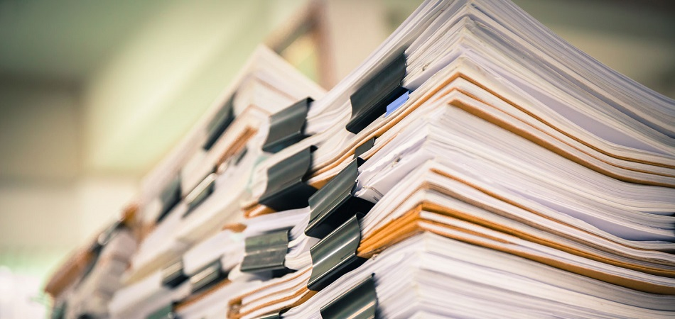
Support Vector Machine algorithm

Slide 13
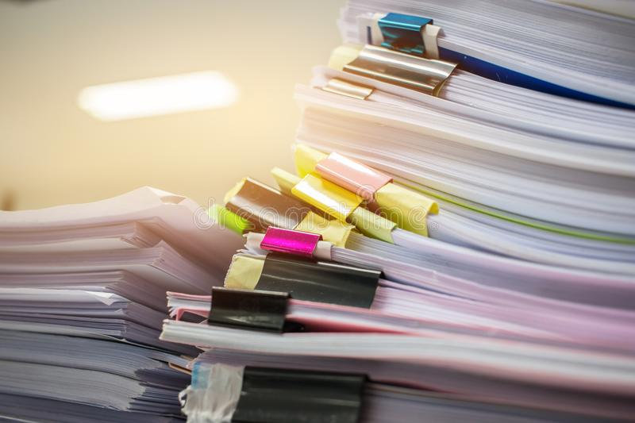
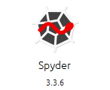
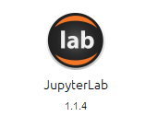

Production

Slide 14
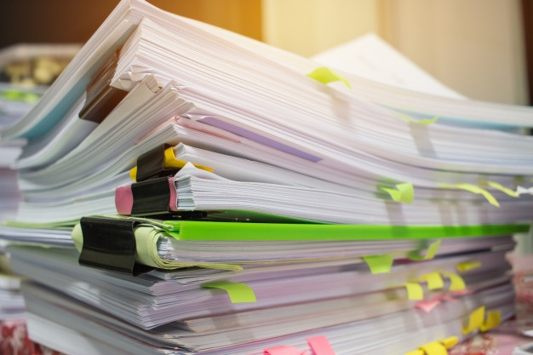
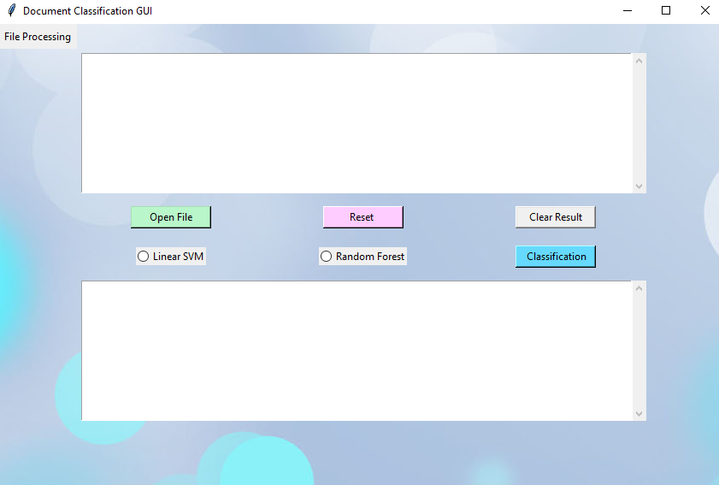
graphic interface

Slide 15
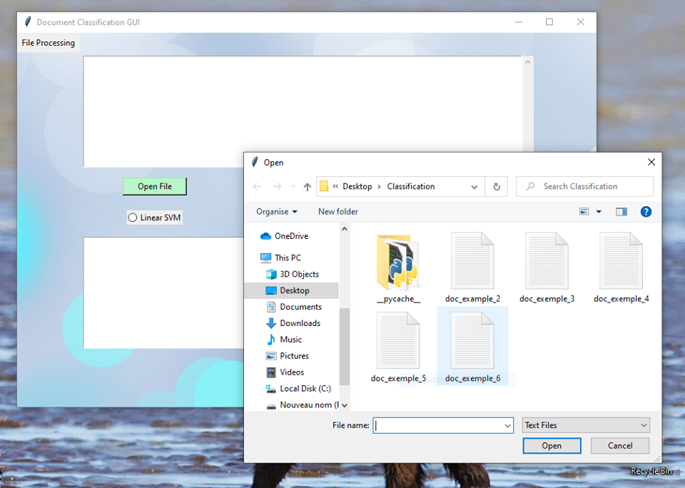
graphic interface
You can access to the document that you want to classify by clicking on the « open file »
button and a window we’ll appear.

Slide 16
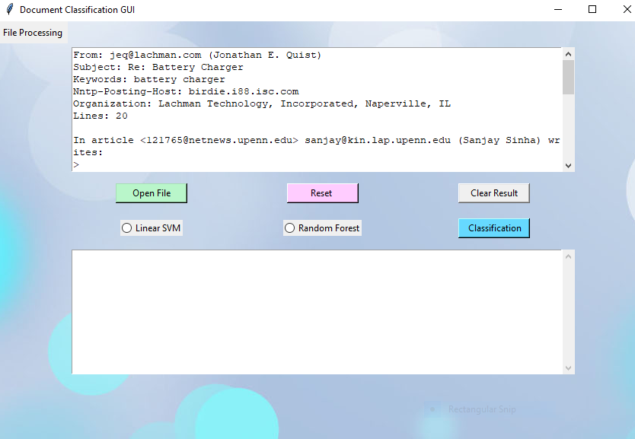
graphic interface
Then you select the document, the text will appear in the first Text area.

Slide 17
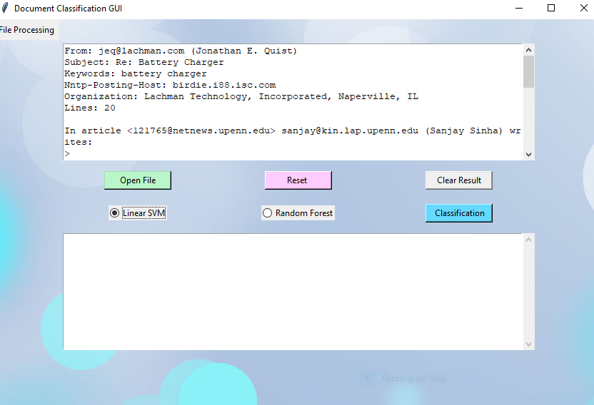
graphic interface
There are two radio Buttons using them you can choose algorithm to classifier your text
document.

Slide 18
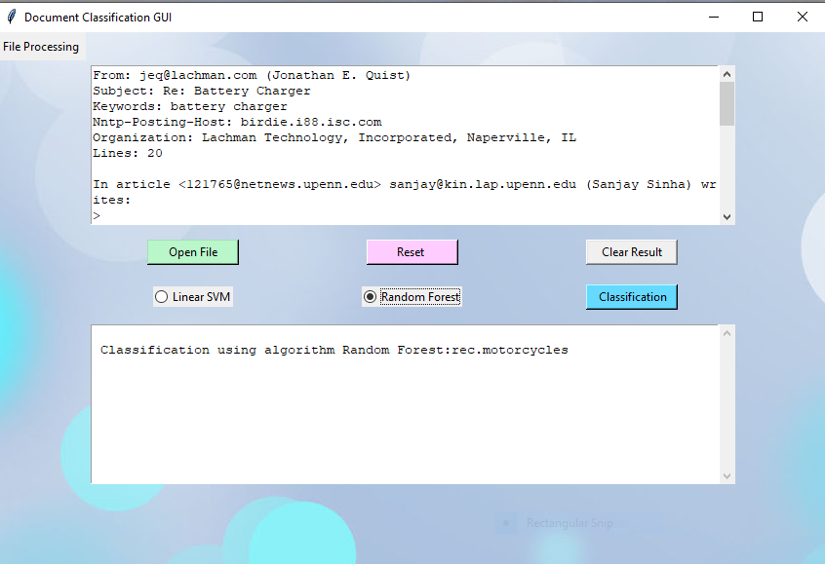
graphic interface
And the same for Random Forest.

Slide 19
graphic interface
You can also remove the text to add another one by clicking “Reset “,
and You can also remove the result clicking « Clear Result »

Slide 20
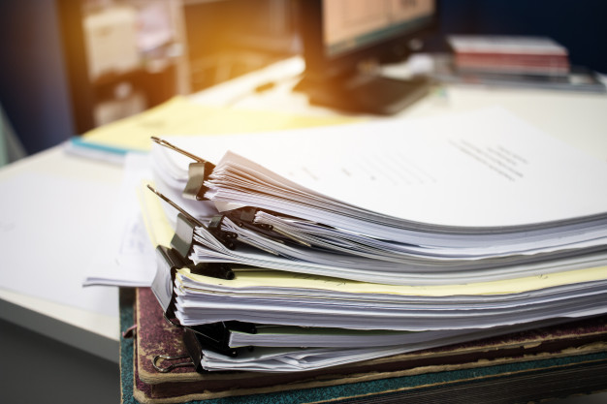
Conclusion

