Slide 1
MYSQL built-in functions
Topic 3
Lesson 4 – MySQL functions

Slide 2
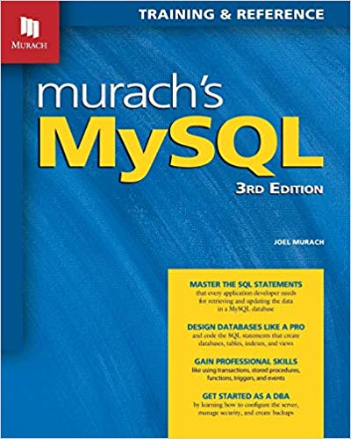
Part of Chapter 9 Murach’s MySQL

Slide 3
Numeric functions
Simple arithmetic operations
The arithmetic operators: +, -, *, /
DIV() division - return value has the same data result as the input values
MOD for the remainder of division or use the modulo key %
POWER(BASE, EXPONENT), synonym POW – power function
ABS(N) - absolute value function
SIGN(N) – returns the sign of the provided number n
Base arithmetic
CONV(NUMBER, BASE, NEWBASE) – convert a number from one base to another. Current My SQL limitation is BASE 36
Rounding Functions
ROUND(n) – round a number to a whole number
ROUND(N, NUMDIGITS) – round specify number of digits
TRUNCATE(N,NUMDIGITS) – limit value of n to numdigits
CEILING(N) - round the number n up
FLOOR(N) – round a number n down
Random number generator
RAND() – generate a random number
RAND(seed) – generate a random number seeded with the number seed – will generate the same collection of numbers for each run
Trigonometric functions, log functions
Complete list:
http://dev.mysql.com/doc/refman/8.0/en/mathematical-functions.html

Slide 4
String Functions
Length(str) – number of bytes in a string
Char_length(str) – number of characters in string
Left (string, num) extract the left most num characters from string
Right(string, num) extract the rightmost num characters from string
Mid(string, start, num) extract num characters from string starting at position start
Concat(string1,string2,…,stringn) concatentate strings together
Concat_ws(delimited, string1, string2) concatenate string2 to string1 using the delimited string as a separator
Locate(substring, string) – returns the character position of substring in string
Upper(string), Lower(string) – change string to the corresponding case
Reverse(string) – reverse the order of the characters in string
Complete list
Substring(string, start [,length] return length characters from string with starting position start
https://dev.mysql.com/doc/refman/8.0/en/string-functions.html

Slide 5
Regular Expressions
Specifies a pattern for a complex search.
Clause: expression REGEXP format
Returns 1 if the format matches the expression else 0
Special characters for matching
^ matches the beginning of a string
$ matches the end of a string
. Match any character
a* match any sequence of zero of more a characters
a+ match any sequence of one of more a characters
a? match either zero or one a character
de|abc match either sequence de or abc
(abc)* match zero or more instances of the sequence abc
a{m,n} match m to n instances of a
2 backslashes allow you to match a special character \\.

Slide 6
NULL Related Functions
COALESCE(EXPR1, EXPR2,…,EXPRN) returns the first expression from the list that is not NULL
IFNULL(expr1, expr2) returns first argument that is NOT NULL, returns expr1, if expr1 is not NULL otherwise returns expr2
NULLIF(expr1, expr2) compares exp1 to exp2. If they are equal returns NULL, if they are not equal returns exp1
NULL SAFE equality operator <=> (MYSQL specific)
SELECT NULL <=> NULL ; -- returns TRUE;
A complete set of comparison and NULL related functions
http://dev.mysql.com/doc/refman/8.0/en/comparison-operators.html

Slide 7
Common date functions
NOW() – returns the current date and time
Dayname(date) – return the day of the provided date Sunday – Saturday
Dayofmonth() – return the day of the month values 1 – 12
Dayofyear() – return the day of the year where Jan 1 = 1
Dayofweek() – returns the day name number ‘Monday’ = 2
Monthname(now()) – return the month of the provided date
Adddate(‘2015-12-31’, INTERVAL exp unit); - add a specific interval to a date
Example: Adddate(‘2010-12-31’, INTERVAL 31 day) 31 days after Dec 31, 2010
SUBDATE(‘2015-01-02’, INTERVAL exp unit); - subtract a specific interval from a date
Description of date and time variables
https://dev.mysql.com/doc/refman/8.0/en/date-and-time-type-overview.html
DATE_FORMAT(date, “%W, %D OF %M %Y) – format a date using the provided format
List of interval formats formats
https://dev.mysql.com/doc/refman/8.0/en/date-and-time-functions.html#function_date-add
Complete list of functions
https://dev.mysql.com/doc/refman/8.0/en/date-and-time-functions.html

Slide 8
Time functions
Time_to_sec(‘00:30:00’) return the seconds portion of a time variable
Sec_to_time() convert seconds variable to a time variable
To_char(date, fmt_specifer) – convert a date to a character string
%d the day of the month, %M the long name of the month, %Y the year
Addtime(time1,time2) – add time together
Subtime( time1,time2) – subtract time
Complete list of functions
https://dev.mysql.com/doc/refman/8.0/en/date-and-time-functions.html

Slide 9
Conversion functions
BINARY string – convert a string to binary
Short hand notation for CAST(string as binary)
CAST(expr as type ) – cast expression to type
CONVERT(expr , type)
ODBC syntax
CONVERT(expr USING type) – convert expression to type
Can specify a particular character set
Standard SQL syntax
Full description of data type conversion function
http://dev.mysql.com/doc/refman/8.0/en/cast-functions.html#function_cast

Slide 10
Aggregate functions
Counting functions
COUNT – count records , COUNT(DISTINCT) – count distinct values
Statistical functions
SUM, MIN, MAX, AVG, STD, STDDEV,VARIANCE
Sample and Population variance and standard deviation
STDDEV_SAMP, STDDEV_POP
VAR_POP, VAR_SAMP
Bit function operations
BIT_AND, BIT_OR, BIT_XOR
One text function
GROUP_CONCAT – Concatenate strings based on groups
Complete list
http://dev.mysql.com/doc/refman/8.0/en/group-by-functions.html

Slide 11
Summary
In this module you learned:
MySQL system defined functions

