Slide 1
Relational Algebra
Topic 3
Lesson 6 – Relational Algebra

Slide 2

Chapter 5 section 1 Connolly and Begg

Slide 3
What is Relational Algebra?
What is an algebra?
A mathematical system consisting of:
Operands --- variables or values from which new values can be constructed.
Operators --- symbols denoting procedures that construct new values from given values.
What is relational algebra?
Operands are relations or variables that represent a relation
Operators are designed to do the most common things that we need to do with relations in a database.

Slide 4
Properties of relational algebra
Relational algebra operations work on one or more relations to define another relation without changing the original relations.
Both operands and results are relations, so output from one operation can become input to another operation.
Allows expressions to be nested, just as in arithmetic. This property is the closure property.
Relational Algebra: a collection of operations that users can perform on relations to obtain a desired result

Slide 5
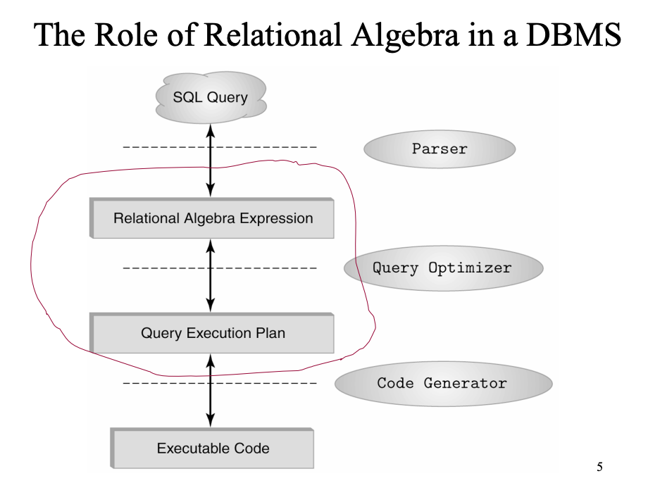
Use of Relational Algebra in a DBMS

Slide 6
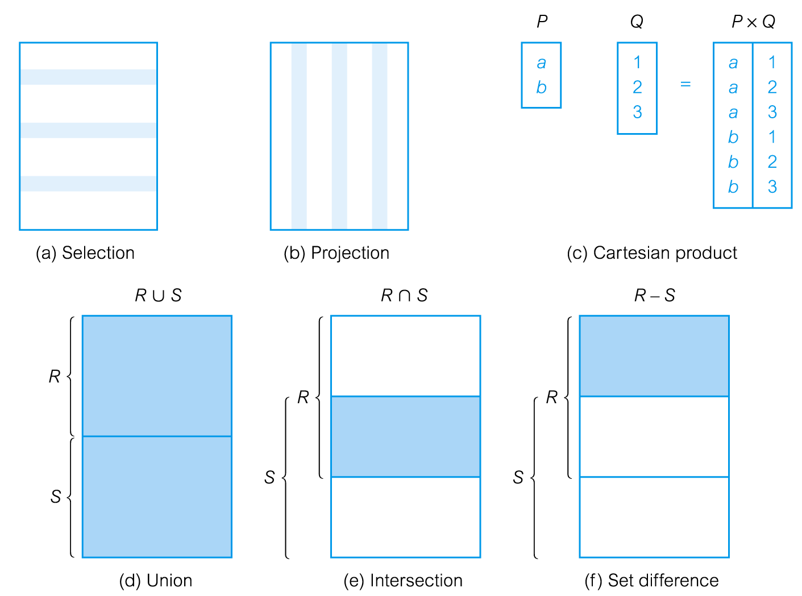
Basic Operations of Relational Algebra

Slide 7
Basic operations
SELECT : filter by rows
PROJECT: filter by columns
UNION: combine n compatible relations into one relation
INTERSECT: of relation A and B
are the tuples in both A and B
SET DIFFERENCE: (A-B) tuples in A but not in B
CARTESIAN PRODUCT: (AxB) each tuple in A is concatenated with each tuple in B
Notes:
Map these operations to the clauses in the SELECT statement

Slide 8
Selection
Provides a filter to the tuples in the relation R. The operation is represented via the 𝛔 (Greek letter sigma). AND (∧) , OR (∨) and NOT (∽ ) are supported for creating compound predicates.
Example:
𝛔_{(sid = 3)} (student)
SQL representation?
SELECT * FROM student where id = 3;
RESULT
sid | Name | School | Credits_Earned | Credits_Req | Yr_grad
3 | Li | Khoury | 50 | 120 | 2020
Notes:
WHERE cllause

Slide 9
Projection
Provides a filter to the columns in the relation R. It defines a result which is a subset of the relation R. The operation is represented via the Π (Greek letter pi)
Example:
Π _{sid, name, school} (student)
SQL representation?
RESULT
sid | Name | School
1 | Smith | Khoury
2 | Shah | D’Amore McKim
3 | Li | Khoury
SELECT id, name, school FROM student
;
Notes:
Maps the the SELECT clause

Slide 10
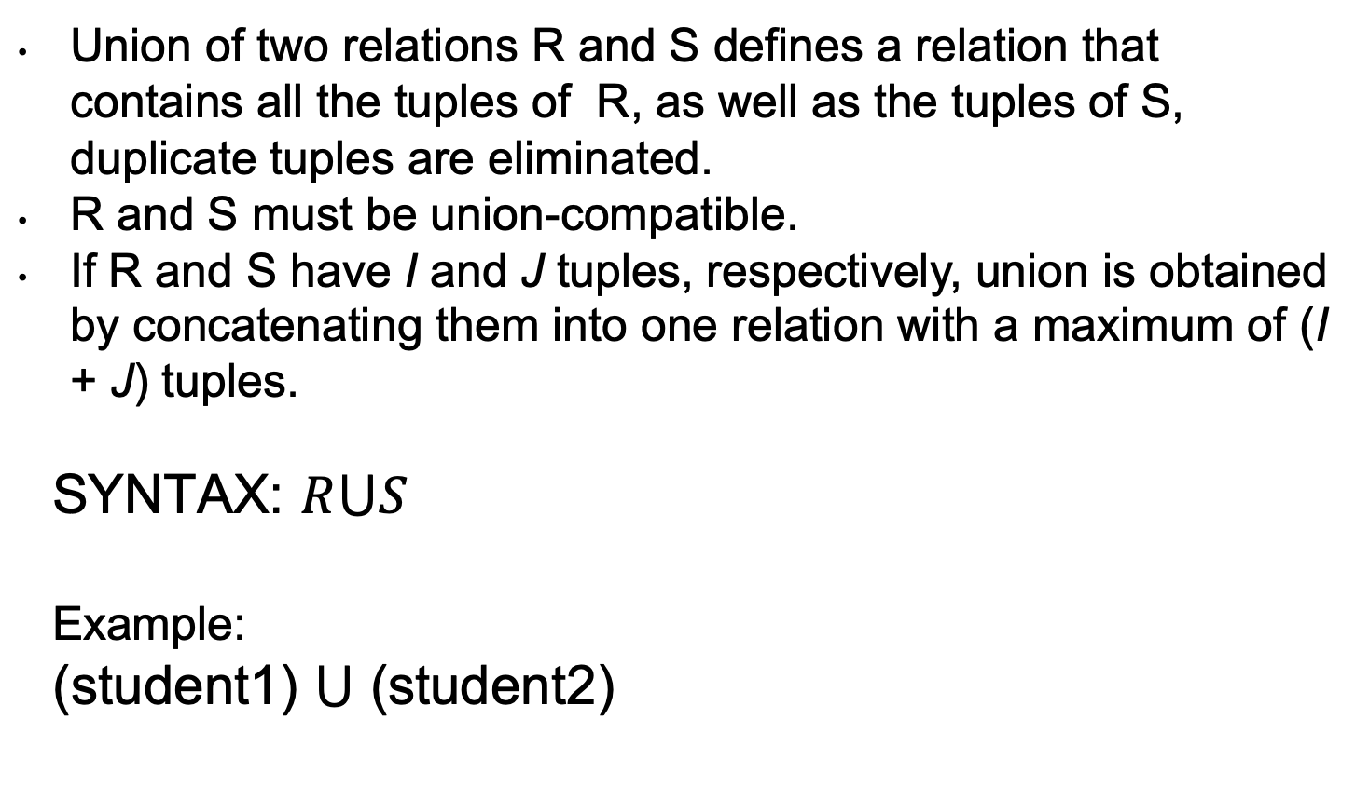
Union
Union of two relations R and S defines a relation that contains all the tuples of R, as well as the tuples of S, duplicate tuples are eliminated.
R and S must be union-compatible.
If R and S have I and J tuples, respectively, union is obtained by concatenating them into one relation with a maximum of (I + J) tuples.
SYNTAX: $R⋃S$
Example:
(student1) $⋃$ (student2)
Notes:
Maps directly to UNION in SQL, UNION ALL not found in RA

Slide 11

UNION Result
Example:
(student1) $⋃$ (student2)
sid | Name | School | Credits_Earned | Credits_Req | Yr_grad
1 | Smith | Khoury | 32 | 120 | 2019
sid | Name | School | Credits_Earned | Credits_Req | Yr_grad
3 | Li | Khoury | 50 | 120 | 2020
1 | Smith | Khoury | 32 | 120 | 2019
sid | Name | School | Credits_Earned | Credits_Req | Yr_grad
1 | Smith | Khoury | 32 | 120 | 2019
3 | Li | Khoury | 50 | 120 | 2020

Slide 12
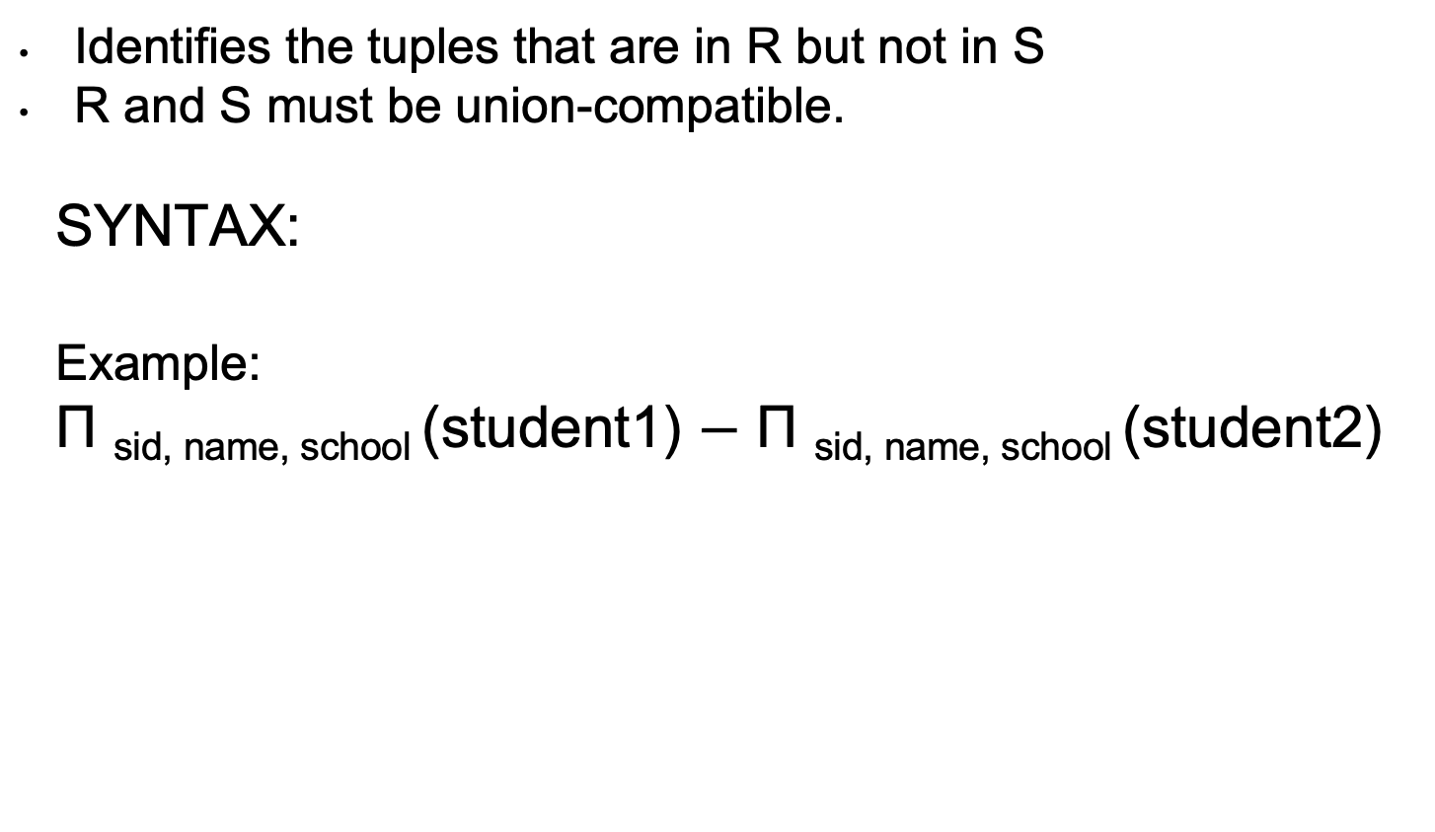
Set Difference
Identifies the tuples that are in R but not in S
R and S must be union-compatible.
SYNTAX:
Example:
Π _{sid, name, school} (student1) $−$ Π _{sid, name, school} (student2)

Slide 13

Set Difference Example
Example:
Π _{sid, name, school} (student3) $−$ Π _{sid, name, school} (student2)
sid | Name | School | Credits_Earned | Credits_Req | Yr_grad
1 | Smith | Khoury | 32 | 120 | 2019
3 | Li | Khoury | 50 | 120 | 2020
sid | Name | School | Credits_Earned | Credits_Req | Yr_grad
3 | Li | Khoury | 50 | 120 | 2020
sid | Name | School
1 | Smith | Khoury

Slide 14
Intersection
Identifies the tuples that are in R as well as in S
R and S must be union-compatible.
Can be derived from set difference R ⋂ S = R – (R – S)
SYNTAX:
Example:
Π _{sid, name, school} (student1) ⋂ Π _{sid, name, school} (student2)
R
S

Slide 15
Example: Intersection
Example:
Π _{sid, name, school} (student3) ⋂ Π _{sid, name, school} (student2)
sid | Name | School | Credits_Earned | Credits_Req | Yr_grad
1 | Smith | Khoury | 32 | 120 | 2019
3 | Li | Khoury | 50 | 120 | 2020
sid | Name | School | Credits_Earned | Credits_Req | Yr_grad
3 | Li | Khoury | 50 | 120 | 2020
sid | Name | School
3 | Li | Khoury

Slide 16
Cartesian Product
Defines a relation that is the concatenation of every tuple of relation R with every tuple of relation S.
SYNTAX:
Example:
Π _{sid, name, school} (student1) X (student_major)
SID | MID
1 | 1
1 | 3
2 | 1
3 | 2
sid | Name | School | Credits_Earned | Credits_Req | Yr_grad
1 | Smith | Khoury | 32 | 120 | 2019
3 | Li | Khoury | 50 | 120 | 2020

Slide 17
Result Cartesian Product
Student.sid | Name | School | Student_major.sid | mid
1 | Smith | Khoury | 1 | 1
1 | Smith | Khoury | 1 | 3
1 | Smith | Khoury | 2 | 1
1 | Smith | Khoury | 3 | 2
3 | Li | Khoury | 1 | 1
3 | Li | Khoury | 1 | 3
3 | Li | Khoury | 2 | 1
3 | Li | Khoury | 3 | 2

Slide 18
Example: Cartesian Product
Example:
Π _{sid, name, school} (student1) X (available_major)
Can I do a cartesian product between relations with no relationship ?
sid | Name | School | Credits_Earned | Credits_Req | Yr_grad
1 | Smith | Khoury | 32 | 120 | 2019
3 | Li | Khoury | 50 | 120 | 2020
mid | major
1 | CS
2 | DS
3 | Accounting
sid | Name | School
1 | Smith | Khoury
3 | Li | Khoury
X

Slide 19
Result Cartesian Product
Yes – but the results are meaningless.
sid | Name | School | mid | Major
1 | Smith | Khoury | 1 | CS
1 | Smith | Khoury | 2 | DS
1 | Smith | Khoury | 3 | Accounting
3 | Li | Khoury | 1 | CS
3 | Li | Khoury | 2 | DS
3 | Li | Khoury | 3 | Accounting

Slide 20
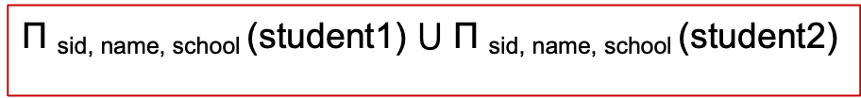
RA and SQL practice work (1)
Select the sid, name, school from student1 and the student2 table
Select the sid, name, school from student for the student with id 3.
Select the sid, name, school from student for the students with sid 3 or sid 2.
Π _{sid, name, school} (student1) $⋃$ Π _{sid, name, school} (student2)
Π _{sid, name, school} 𝛔_{(id = 3)} (student)
𝛔_{(sid = 3} _{V id = 2} ₎ Π _{sid, name, school} (student)

Slide 21
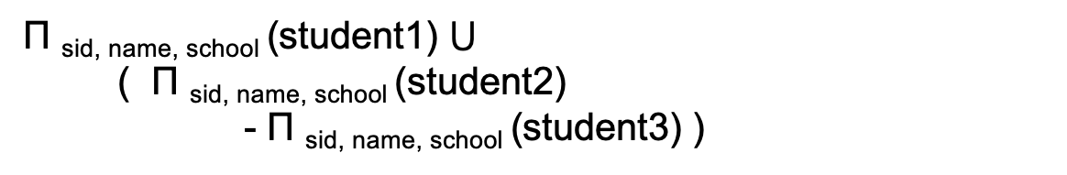
RA and SQL practice work (2)
Select the sid, name, school from student where the name is Smith and the School name is Khoury
Select the sid, name, school from student1 as well as the( sid, name, school from student2 table who are not found in the student3 table)
𝛔_{(school = ‘Khoury’} _{∧ name = ‘Smith’} ₎ Π _{sid, name, school} (student)
𝛔(name = ‘Smith’ ∧ school = ‘Khoury’) Π _{sid, name, school} (student)
Π _{sid, name, school} (student1) $⋃$
( Π _{sid, name, school} (student2)
- Π _{sid, name, school} (student3) )

Slide 22
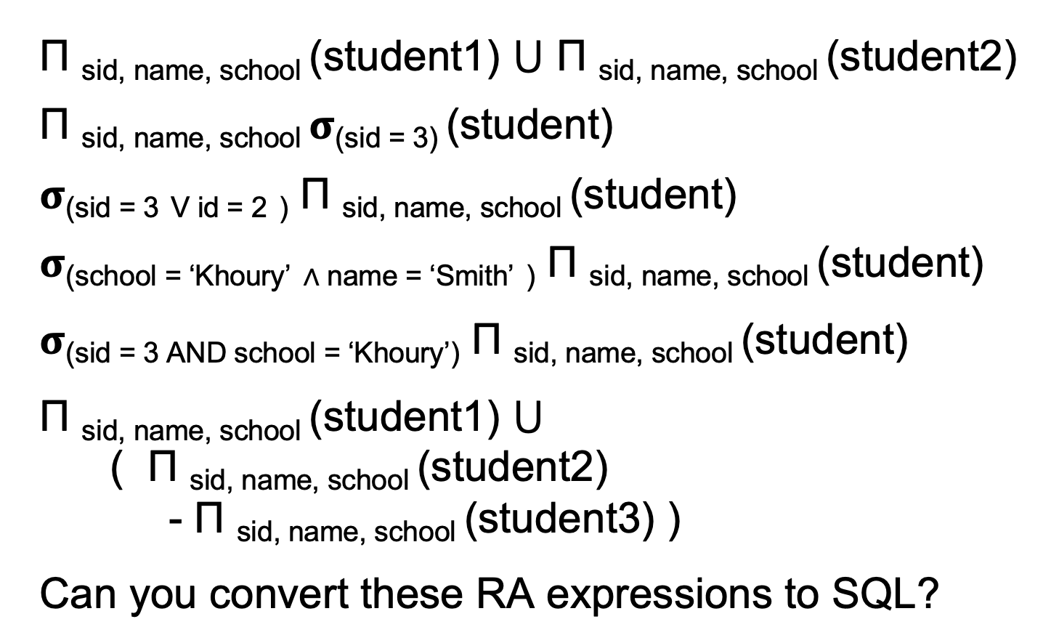
RA for examples
Π _{sid, name, school} (student1) $⋃$ Π _{sid, name, school} (student2)
Π _{sid, name, school} 𝛔_{(sid = 3)} (student)
𝛔_{(sid = 3} _{V id = 2} ₎ Π _{sid, name, school} (student)
𝛔_{(school = ‘Khoury’} _{∧ name = ‘Smith’} ₎ Π _{sid, name, school} (student)
𝛔(sid = 3 AND school = ‘Khoury’) Π _{sid, name, school} (student)
Π _{sid, name, school} (student1) $⋃$
( Π _{sid, name, school} (student2)
- Π _{sid, name, school} (student3) )
Can you convert these RA expressions to SQL?

Slide 23
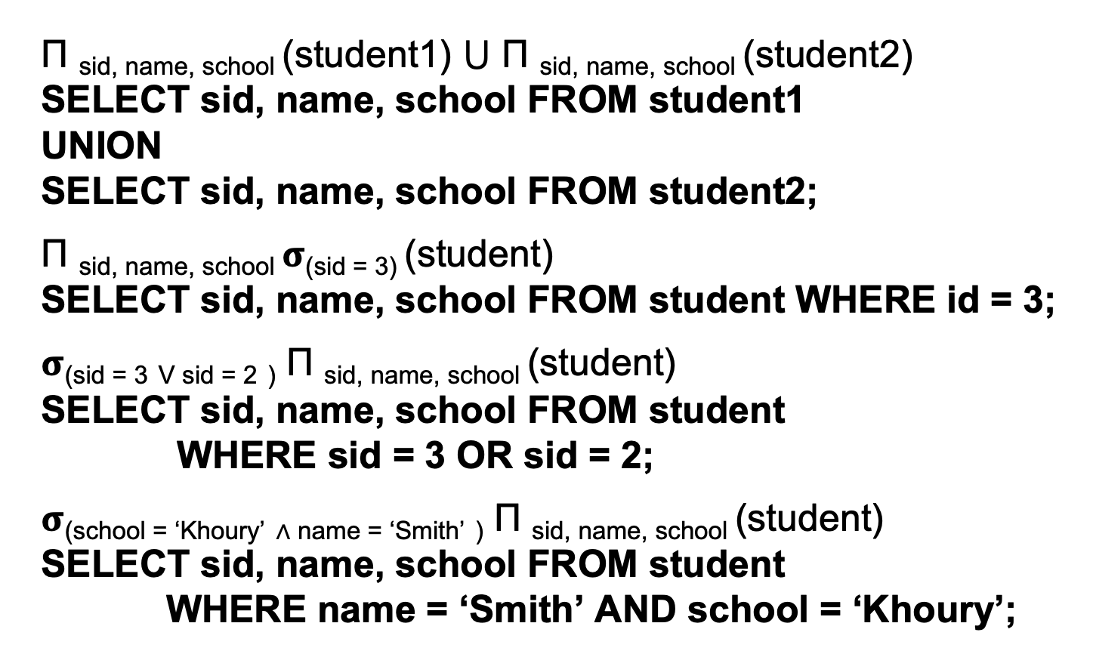
SQL representation (1)
Π _{sid, name, school} (student1) $⋃$ Π _{sid, name, school} (student2)
SELECT sid, name, school FROM student1
UNION
SELECT sid, name, school FROM student2;
Π _{sid, name, school} 𝛔_{(sid = 3)} (student)
SELECT sid, name, school FROM student WHERE id = 3;
𝛔_{(sid = 3} _{V sid = 2} ₎ Π _{sid, name, school} (student)
SELECT sid, name, school FROM student
WHERE sid = 3 OR sid = 2;
𝛔_{(school = ‘Khoury’} _{∧ name = ‘Smith’} ₎ Π _{sid, name, school} (student)
SELECT sid, name, school FROM student
WHERE name = ‘Smith’ AND school = ‘Khoury’;

Slide 24
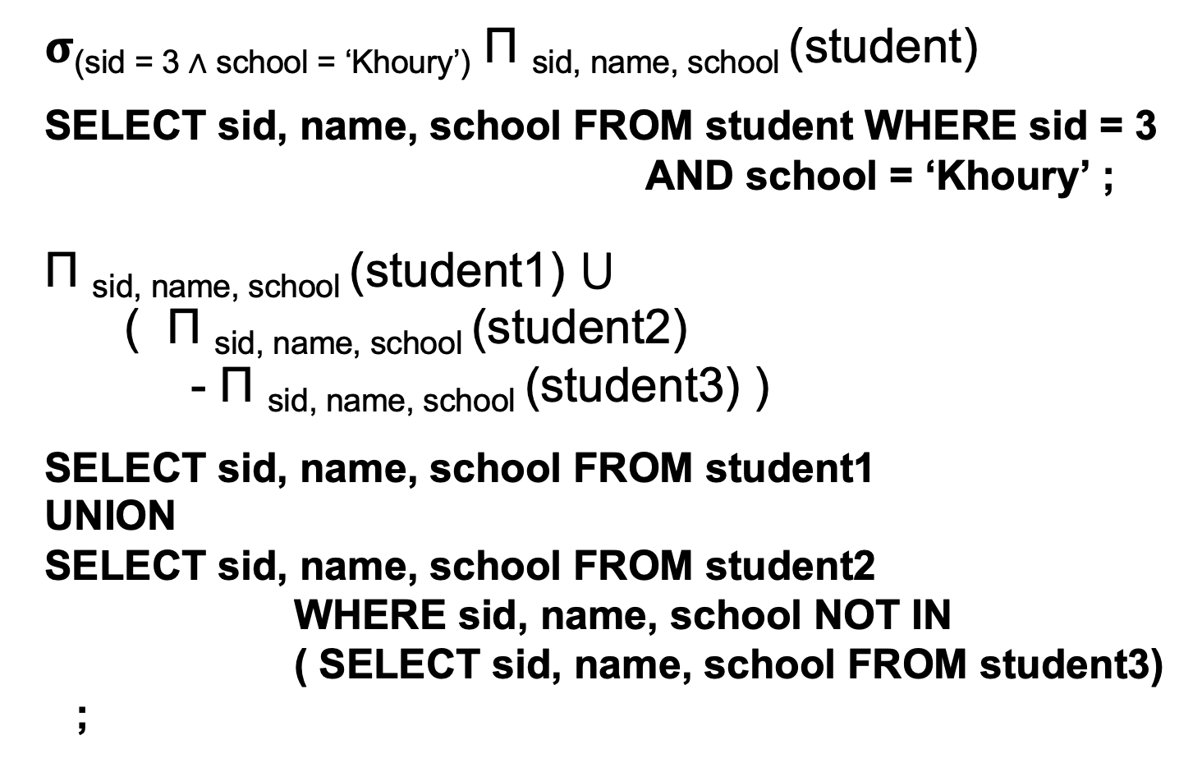
SQL representation (2)
𝛔_{(sid = 3 ∧ school = ‘Khoury’)} Π _{sid, name, school} (student)
SELECT sid, name, school FROM student WHERE sid = 3
AND school = ‘Khoury’ ;
Π _{sid, name, school} (student1) $⋃$
( Π _{sid, name, school} (student2)
- Π _{sid, name, school} (student3) )
SELECT sid, name, school FROM student1
UNION
SELECT sid, name, school FROM student2
WHERE sid, name, school NOT IN
( SELECT sid, name, school FROM student3) ;

Slide 25

SQL representation (2)
𝛔_{(sid = 3 ∧ school = ‘Khoury’)} Π _{sid, name, school} (student)
Π _{sid, name, school} (student1) $⋃$
( Π _{sid, name, school} (student2)
- Π _{sid, name, school} (student3) )

Slide 26
Summary
SELECT : filter by rows
PROJECT: filter by columns
UNION: combine n compatible relations into one relation
INTERSECT: of relation A and B
are the tuples in both A and B
SET DIFFERENCE: (A-B) tuples in A but not in B
CARTESIAN PRODUCT: (AxB) each tuple in A is concatenated with each tuple in B

