Slide 1

EECE 7205 Fundanmentals of Computer Engineering Project 2
Liangshe Li

Slide 2
Part1 Program Setup
Part2 Input and Output
Part3 Conclusion

Slide 3
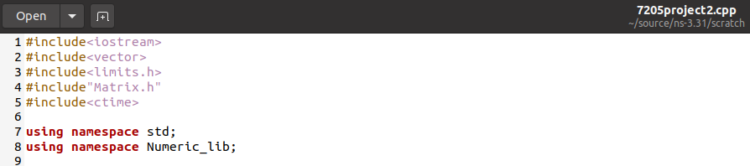
Part1 Program Setup
This part, I will explain the lines in my code.
First is the head files and namespace I set:

Slide 4
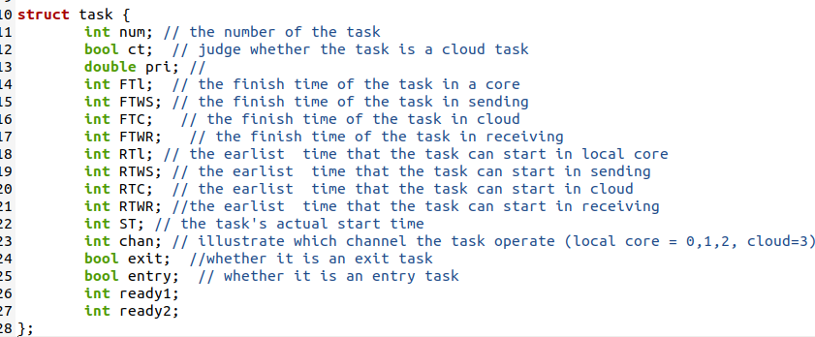
Here I establish a new data structure called “task”.

Slide 5
Here I explain the function of each parameter in the new data structure:
num: the serial number of the task
ct: judge whether the task is a cloud task
pri: the priority level of the task
FTL: if local schedule, the finish time of the task in local core
FTWS: if cloud schedule, the finish sending time of the task in wireless channel
FTC: if cloud schedule, the finish compute time of the task in cloud
FTWR: if cloud schedule, the finish receiving time of the task in wireless channel
RTL: if local schedule, the ready time of the task in local core
RTWS: if cloud schedule, the ready sending time of the task in wireless channel
RTC: if cloud schedule, the ready compute time of the task in cloud
RTWR: if cloud schedule, the ready receiving time of the task in wireless channel
ST: the actual start time of the task
chan: the location of the task(if 0,1,2, is in local core 1,2,3; if 3, is in cloud)
exit: judge whether the task is an exit task
entry: judge whether the task is an entry task
ready1: in kernel algorithm, the number of immediate predecessors of task which have not been scheduled
ready2: in kernel algorithm, the number of tasks in the same channel before the task which have not been scheduled

Slide 6
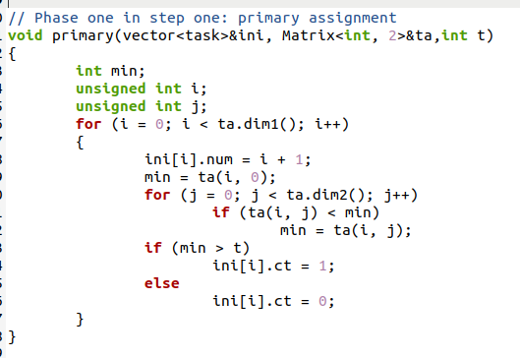
Here is the Phase One in Step One: Primary assignment.

Slide 7
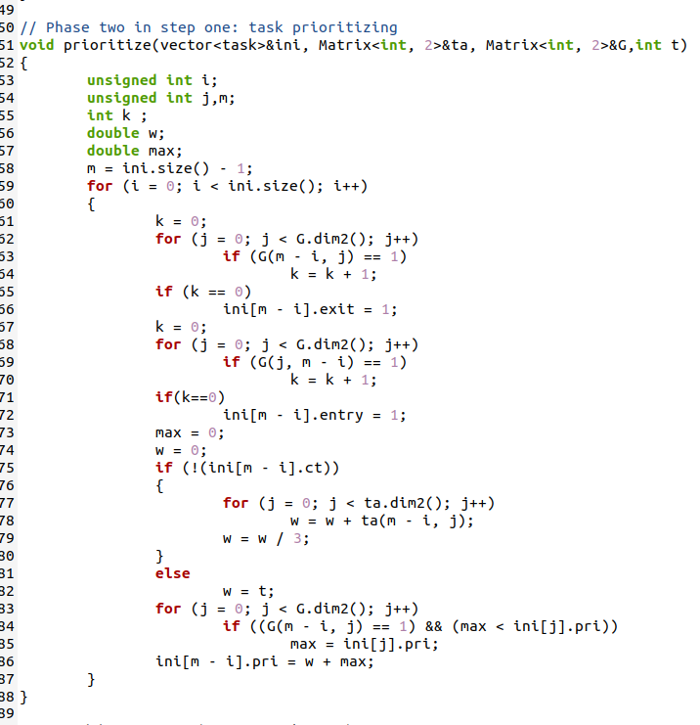
Here is the Phase Two in Step One: Task prioritizing. (I also determine the value of exit and entry)

Slide 8
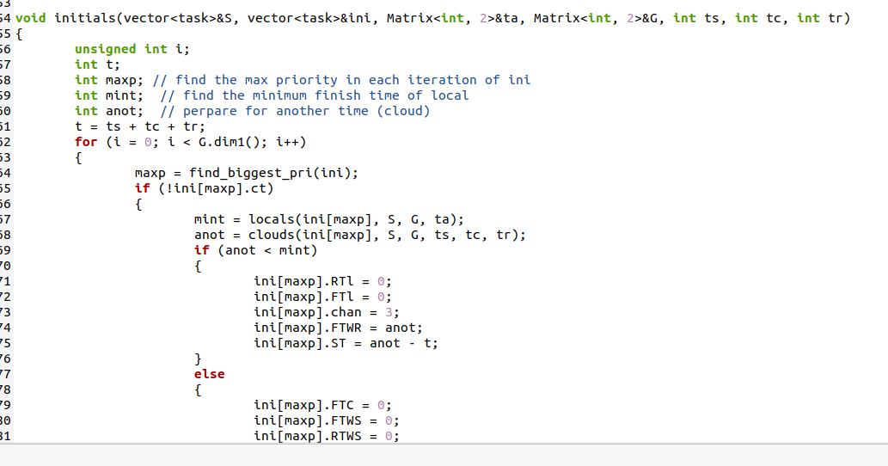
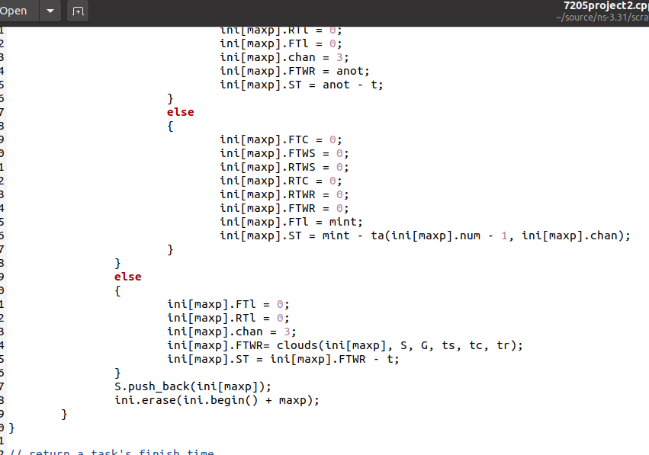
Here is the main function of Phase Three in Step One: Execution unit selection. I use “mint” to compute the minimum finish time in local core and use “anot” to compute the minimum finish time in cloud. Then compare this two values to determine whether the task in cloud or local core.

Slide 9
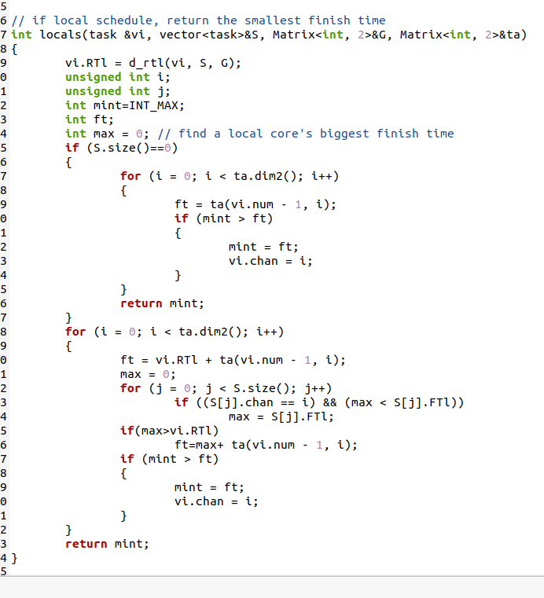
Here is the function which returns the maximum finish time of task in local core.

Slide 10
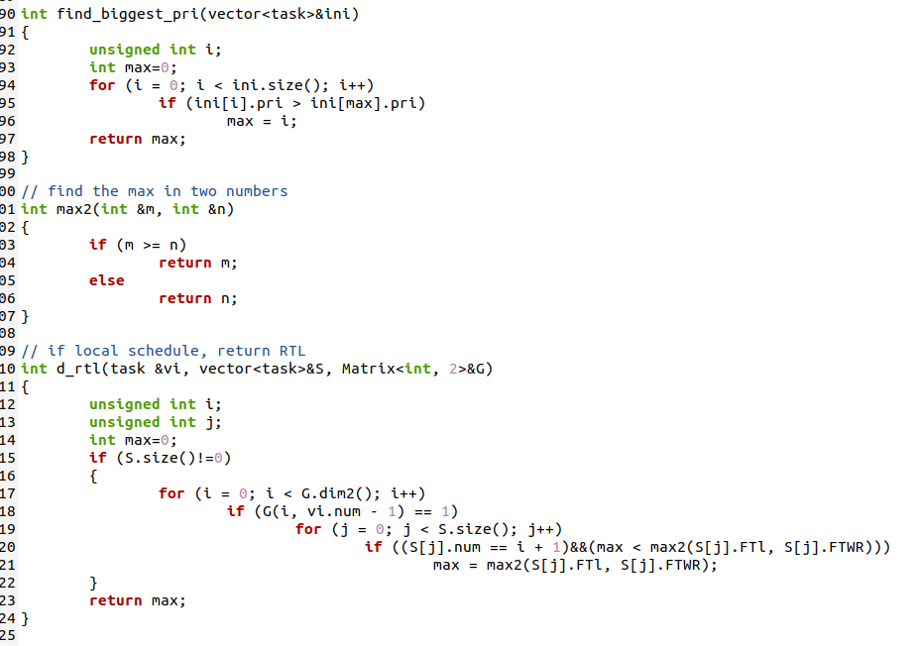
The first function returns the serial number of the task whose priority is biggest. The third function returns RTL of the task if local schedule.

Slide 11
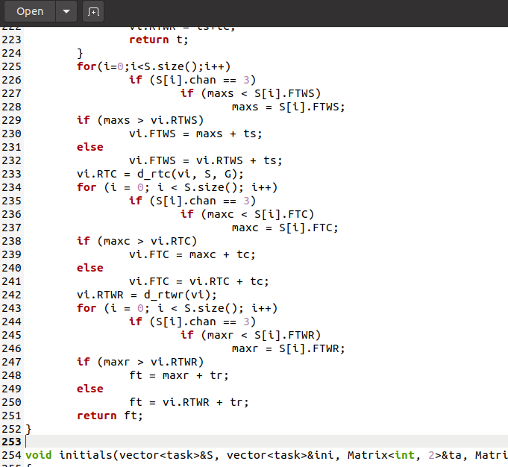
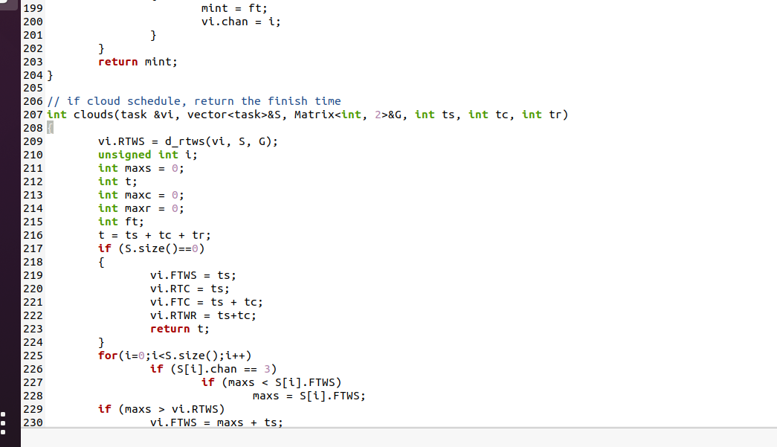
Here is the function which returns the finish receiving time of task in wireless channel if cloud schedule. Also compute FTWS and FTC.

Slide 12
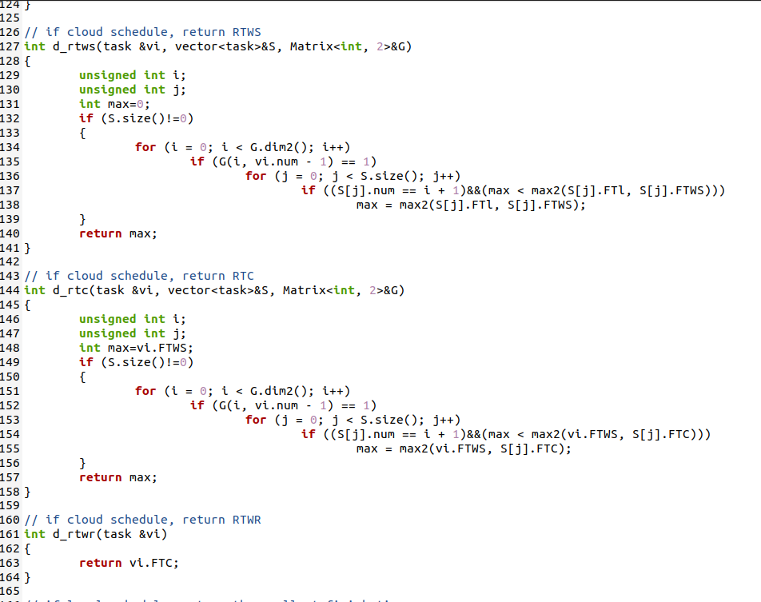
Here I compute RTWS, RTC, RTWR of the task if cloud schedule.

Slide 13
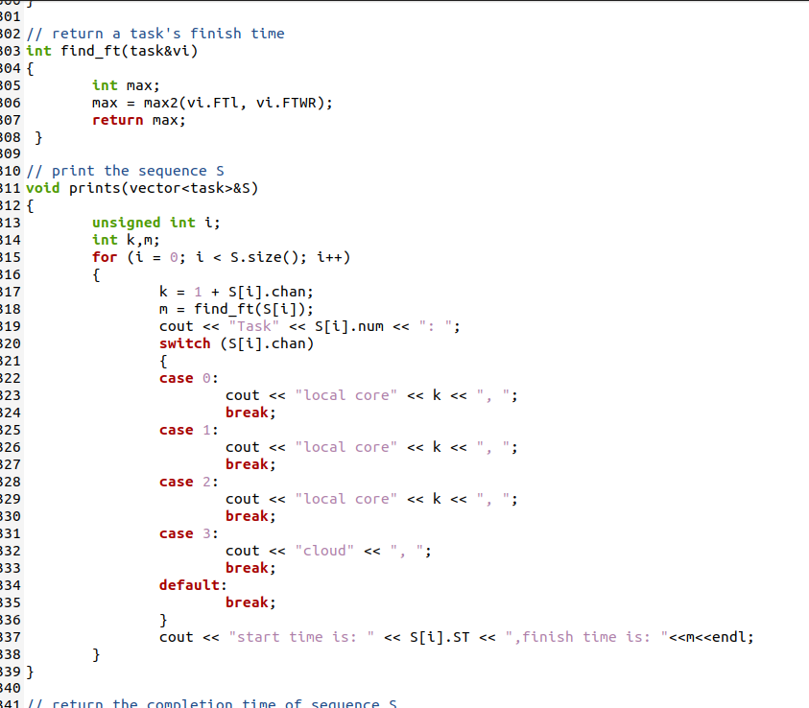
The first function returns the actual finish time of the task. The second function prints the schedule of all tasks (involving the channel of task, the start and finish time of task)

Slide 14
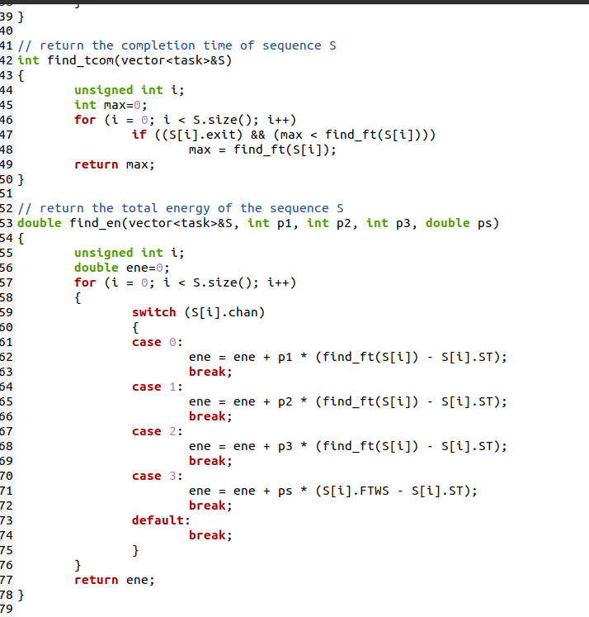
The first function returns the total completion time of the schedule. The second function returns the total energy consumed in the schedule.

Slide 15
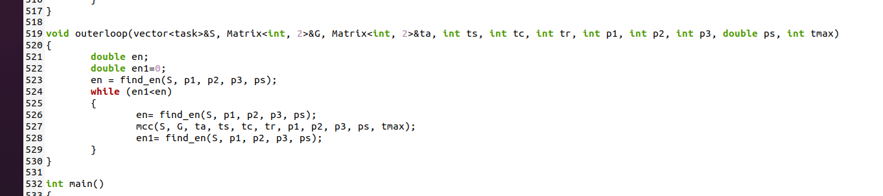
Here is Step Two: Task Migration. The outer loop repeats to run the “mcc” function until the energy consumed is minimized.

Slide 16
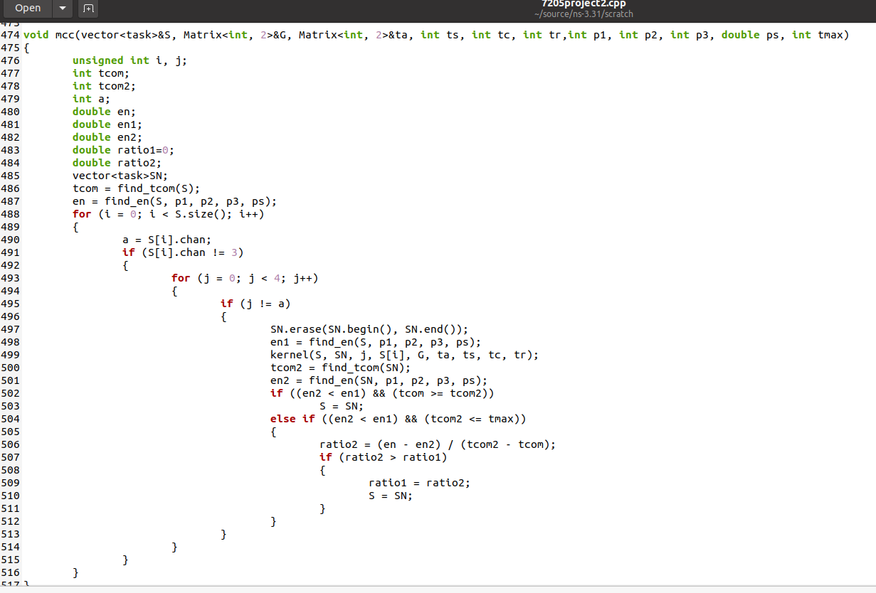
Here is the “mcc” function which involves kernel algorithm.

Slide 17
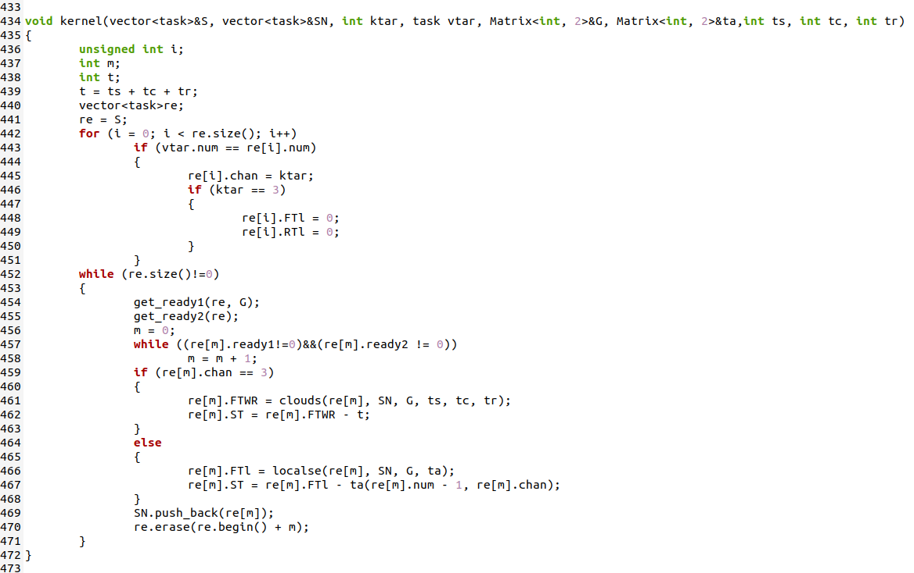
Here is the function which is the implementation of kernel algorithm.

Slide 18
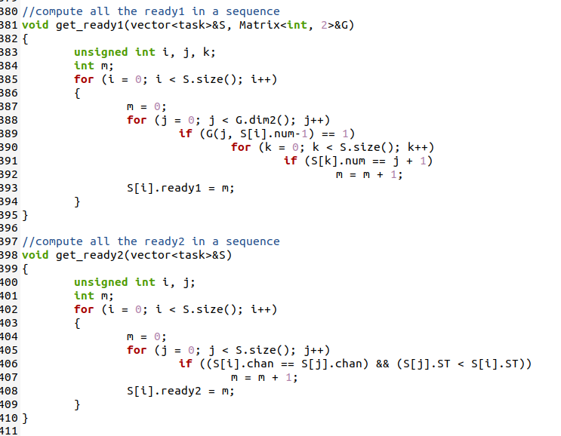
The first function is to compute the value of ready1. The second function is to compute the value of ready2.

Slide 19
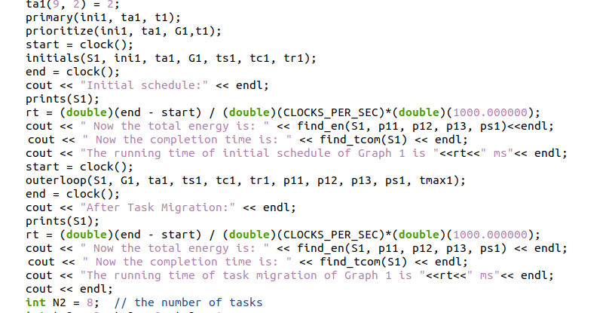
Here is where I compute the running time of the program (in the main function). I use “rt” to compute running time.

Slide 20
Part2 Input and Output
This part I will use two examples to verify the correctness of mu codes.
The first example is the same with paper [1].
The second example is a good example to show how the cloud can save energy for the whole schedule.

Slide 21



Input of the first example
1
Time in each core | local core1 | local core2 | local core3
Task 1 | 9 | 7 | 5
Task 2 | 8 | 6 | 5
Task 3 | 6 | 5 | 4
Task 4 | 7 | 5 | 3
Task 5 | 5 | 4 | 2
Task 6 | 7 | 6 | 4
Task 7 | 8 | 5 | 3
Task 8 | 6 | 4 | 2
Task 9 | 5 | 3 | 2
Task 10 | 7 | 4 | 2
2
3
4
5
6
7
8
9
10
$$\left\{\begin{aligned}P_{1}=1; \\ P_{2}=2; \\ P_{3}=4; \\ P_{s}=0.5;\end{aligned}\right.$$
$$\left\{\begin{aligned}T^{S}=3; \\ T^{C}=1; \\ T^{R}=1;\end{aligned}\right.$$
$$T_{max}=27$$

Slide 22
Output of the first example after initial schedule
local core1
4
0
5
12
local core2
6
8
0
5
11
12
16
1
3
5
7
9
10
local core3
0
5
9
11
14
16
18
wireless sending
2
0
5
8
2
Cloud
0
8
9
wireless receiving
2
0
9
10

Slide 23
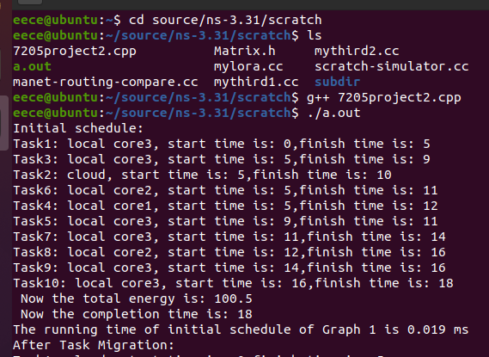
After initial schedule
The completion time of the schedule is 18.
The total energy consumed is 100.5.
The running time of the initial schedule program is 0.019 ms.

Slide 24
Output of the first example after task migration
5
9
local core1
0
5
10
17
22
local core2
0
local core3
0
wireless sending
8
1
3
2
6
4
7
10
0
3
6
9
12
15
18
21
22
25
1
3
2
6
4
7
8
10
Cloud
0
3
4
6
7
9
10
12
13
15
16
18
19
21
22
25
26
wireless receiving
1
3
2
6
4
7
8
10
0
4
5
7
8
10
11
13
14
16
17
19
20
22
23
26
27

Slide 25
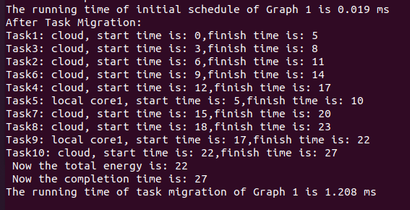
After task migration
The completion time of the schedule is 27.
The total energy consumed is 22.
The running time of the initial schedule program is 1.208 ms.

Slide 26



Input of the second example
1
2
Time in each core | local core1 | local core2 | local core3
Task 1 | 9 | 8 | 6
Task 2 | 8 | 7 | 6
Task 3 | 10 | 9 | 7
Task 4 | 6 | 4 | 2
Task 5 | 5 | 3 | 1
Task 6 | 7 | 5 | 4
Task 7 | 15 | 11 | 10
Task 8 | 6 | 4 | 1
3
4
5
6
7
8
$$\left\{\begin{aligned}P_{1}=2; \\ P_{2}=3; \\ P_{3}=5; \\ P_{s}=1.5;\end{aligned}\right.$$
$$\left\{\begin{aligned}T^{S}=3; \\ T^{C}=2; \\ T^{R}=1;\end{aligned}\right.$$
$$T_{max}=27$$

Slide 27
Output of the second example after initial schedule
local core1
0
local core2
5
0
6
9
1
4
8
local core3
0
6
8
15
16
wireless sending
7
2
3
6
0
3
6
9
12
15
Cloud
2
3
6
7
0
3
5
9
11
12
14
15
17
wireless receiving
3
2
6
7
0
5
6
11
12
14
15
17
18

Slide 28
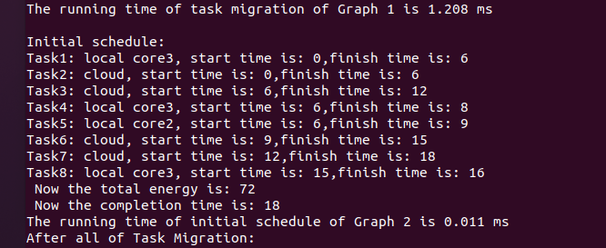
After initial schedule
The completion time of the schedule is 18.
The total energy consumed is 72.
The running time of the initial schedule program is 0.011 ms.

Slide 29
Output of the second example after task migration
local core1
0
local core2
0
local core3
0
wireless sending
8
1
2
3
4
5
6
0
3
6
9
12
15
18
21
24
1
2
3
4
5
6
7
8
Cloud
0
3
5
6
8
9
11
12
14
15
17
18
20
21
23
24
26
wireless receiving
1
2
3
4
5
6
7
8
0
5
6
8
9
11
12
14
15
17
18
20
21
23
24
26
27

Slide 30
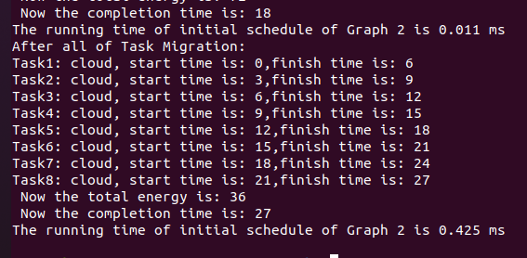
After task migration
The completion time of the schedule is 27.
The total energy consumed is 36.
The running time of the initial schedule program is 0.425 ms.

Slide 31
Part3 Conclusion
Achieve the goal which is to minimize the consumption of the mobile device.
Apply one example in paper [1].
The result of another example is absolutely correct.
The result of the first example is little different from paper [1]

Slide 32
References
[1] X. Lin, Y. Wang, Q. Xie and M. Pedram, "Energy and Performance-Aware Task Scheduling in a Mobile Cloud Computing Environment," 2014 IEEE 7th International Conference on Cloud Computing, Anchorage, AK, 2014, pp. 192-199, doi: 10.1109/CLOUD.2014.35.

