Slide 1
Implementation of the RSA cryptosystem on FPGA

Slide 2
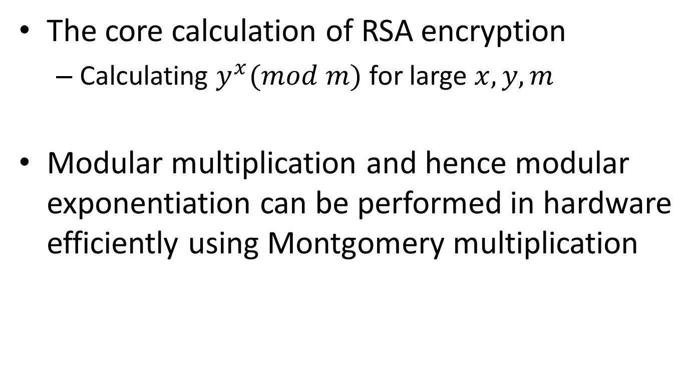
The core calculation of RSA encryption
Calculating $y^{x}(mod m)$ for large $x, y, m$
Modular multiplication and hence modular exponentiation can be performed in hardware efficiently using Montgomery multiplication

Slide 3
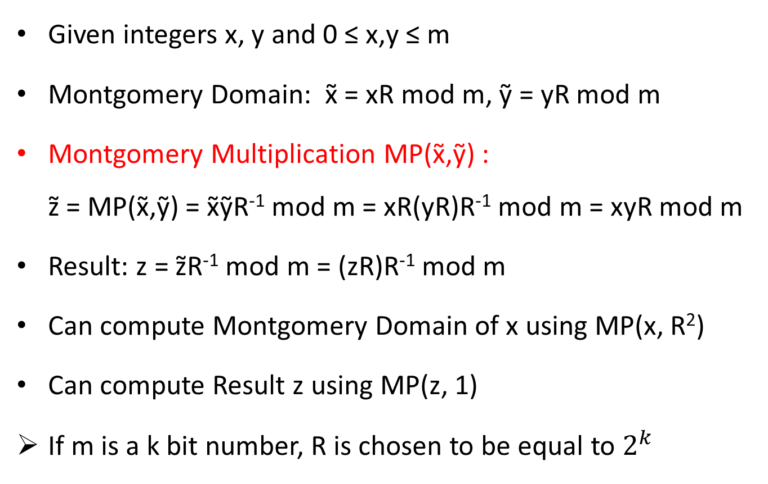
Montgomery Multiplication
Given integers x, y and 0 ≤ x,y ≤ m
Montgomery Domain: x̃ = xR mod m, ỹ = yR mod m
Montgomery Multiplication MP(x̃,ỹ) : z̃ = MP(x̃,ỹ) = x̃ỹR⁻¹ mod m = xR(yR)R⁻¹ mod m = xyR mod m
Result: z = z̃R⁻¹ mod m = (zR)R⁻¹ mod m
Can compute Montgomery Domain of x using MP(x, R²)
Can compute Result z using MP(z, 1)
If m is a k bit number, R is chosen to be equal to $2^{k}$

Slide 4
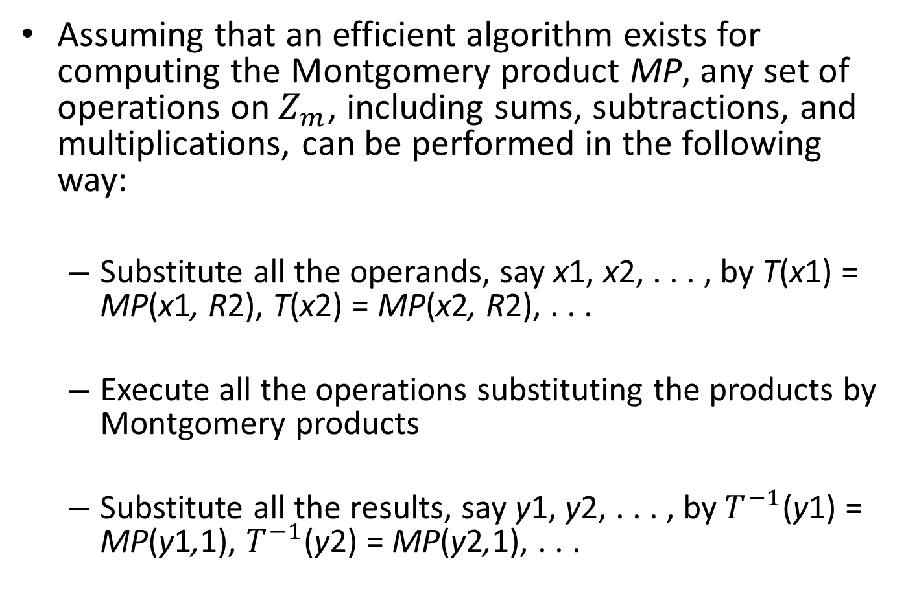
Assuming that an efficient algorithm exists for computing the Montgomery product MP, any set of operations on$Z_{m}$, including sums, subtractions, and multiplications, can be performed in the following way:
Substitute all the operands, say x1, x2, . . . , by T(x1) = MP(x1, R2), T(x2) = MP(x2, R2), . . .
Execute all the operations substituting the products by Montgomery products
Substitute all the results, say y1, y2, . . . , by $T^{−1}$(y1) = MP(y1,1), $T^{−1}$(y2) = MP(y2,1), . . .

Slide 5
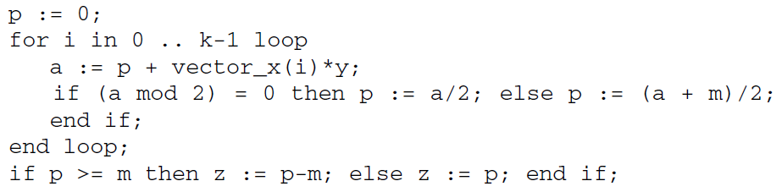
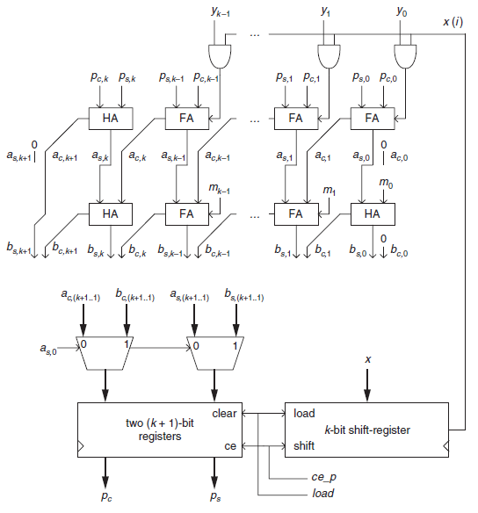
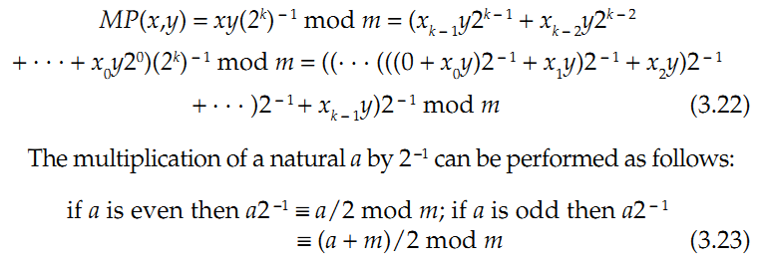
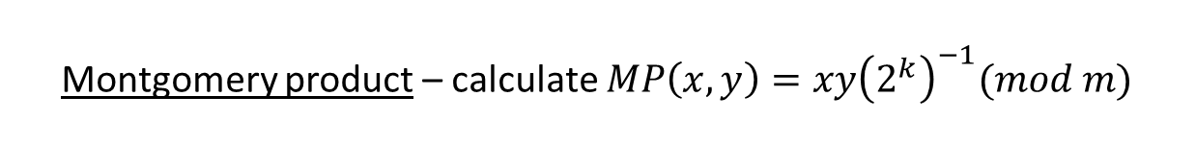
Montgomery product – calculate $MP\left(x,y\right)=xy{\left(2^{k}\right)}^{−1}(mod m)$
a/2
(a+m)/2

Slide 6
S4
ce_p=0
load _tmr=0
time_out = 1
equal_zero = 1
S0
done=1
load_tmr =1
S3
ce_p=1
load =0
start=0
S1
S2
done=0
load =1
start=1

Slide 7
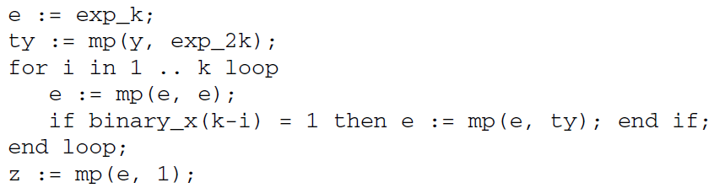
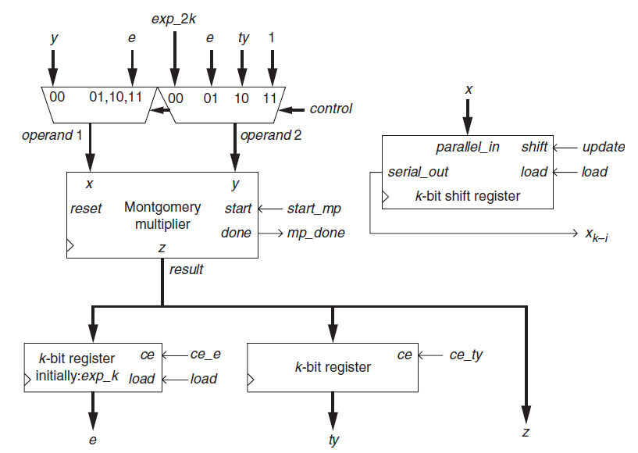
mod m exponentiation

Slide 8




S0:control=0, done=1
S1
S2:load=1
S3:load=0, start_mp=1
S4:start_mp=0
S5:ce_ty=1
S6:ce_ty=0, start_mp=1, control=1
S7:start_mp=0
S8:ce_e=1
start=0
start=1
mp_done=1
mp_done=1
mp_done=1
equal_zero=1
mp_done=1
S16
S15:start_mp=0
S14:start_mp=1, control=3
S13:update=0
S12:ce_e=0, update=1, control=0
S11:ce_e=1
S10:start_mp=0
S9:ce_e=0, start_mp=1, control=2
$$z=mp(e,1)$$
$$ty=mp(y, 2^{2k})$$
equal_zero=0
xkminusi=0
$$e=mp(e,e)$$
$$e=mp(e, 2^{2k})$$
xkminusi=1

