Slide 1



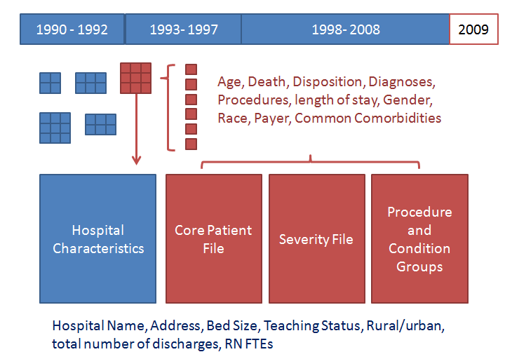
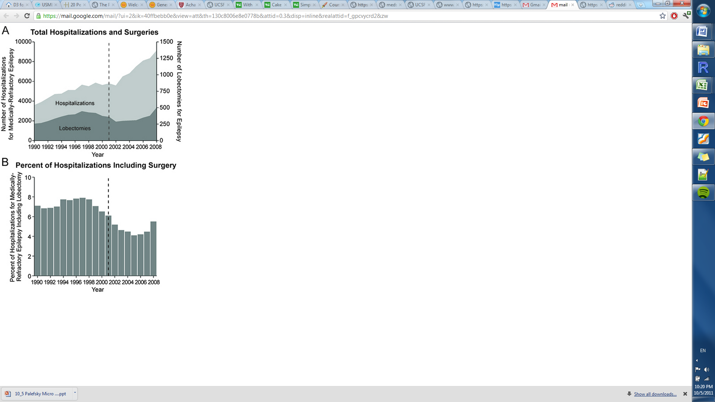
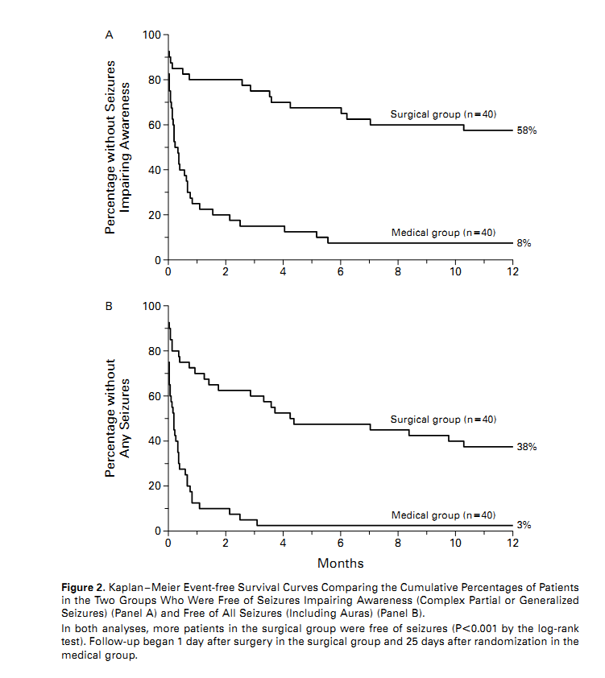
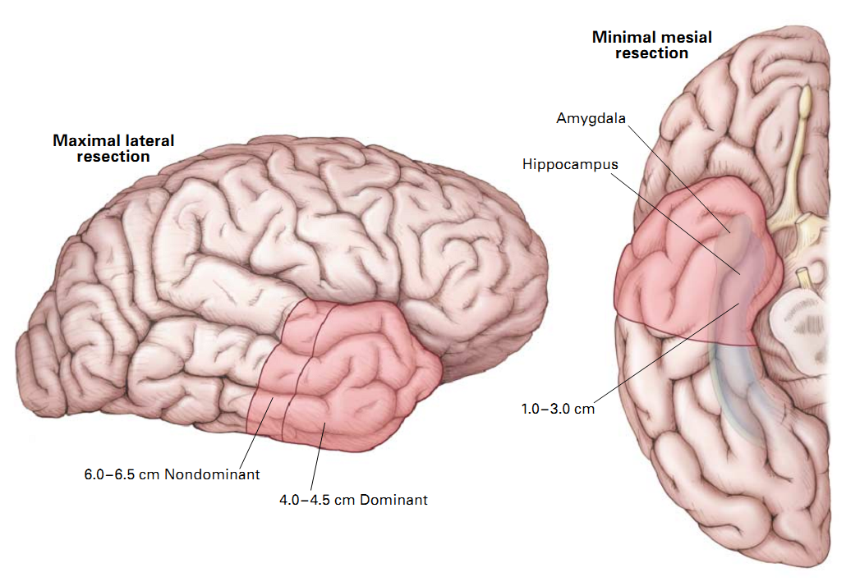
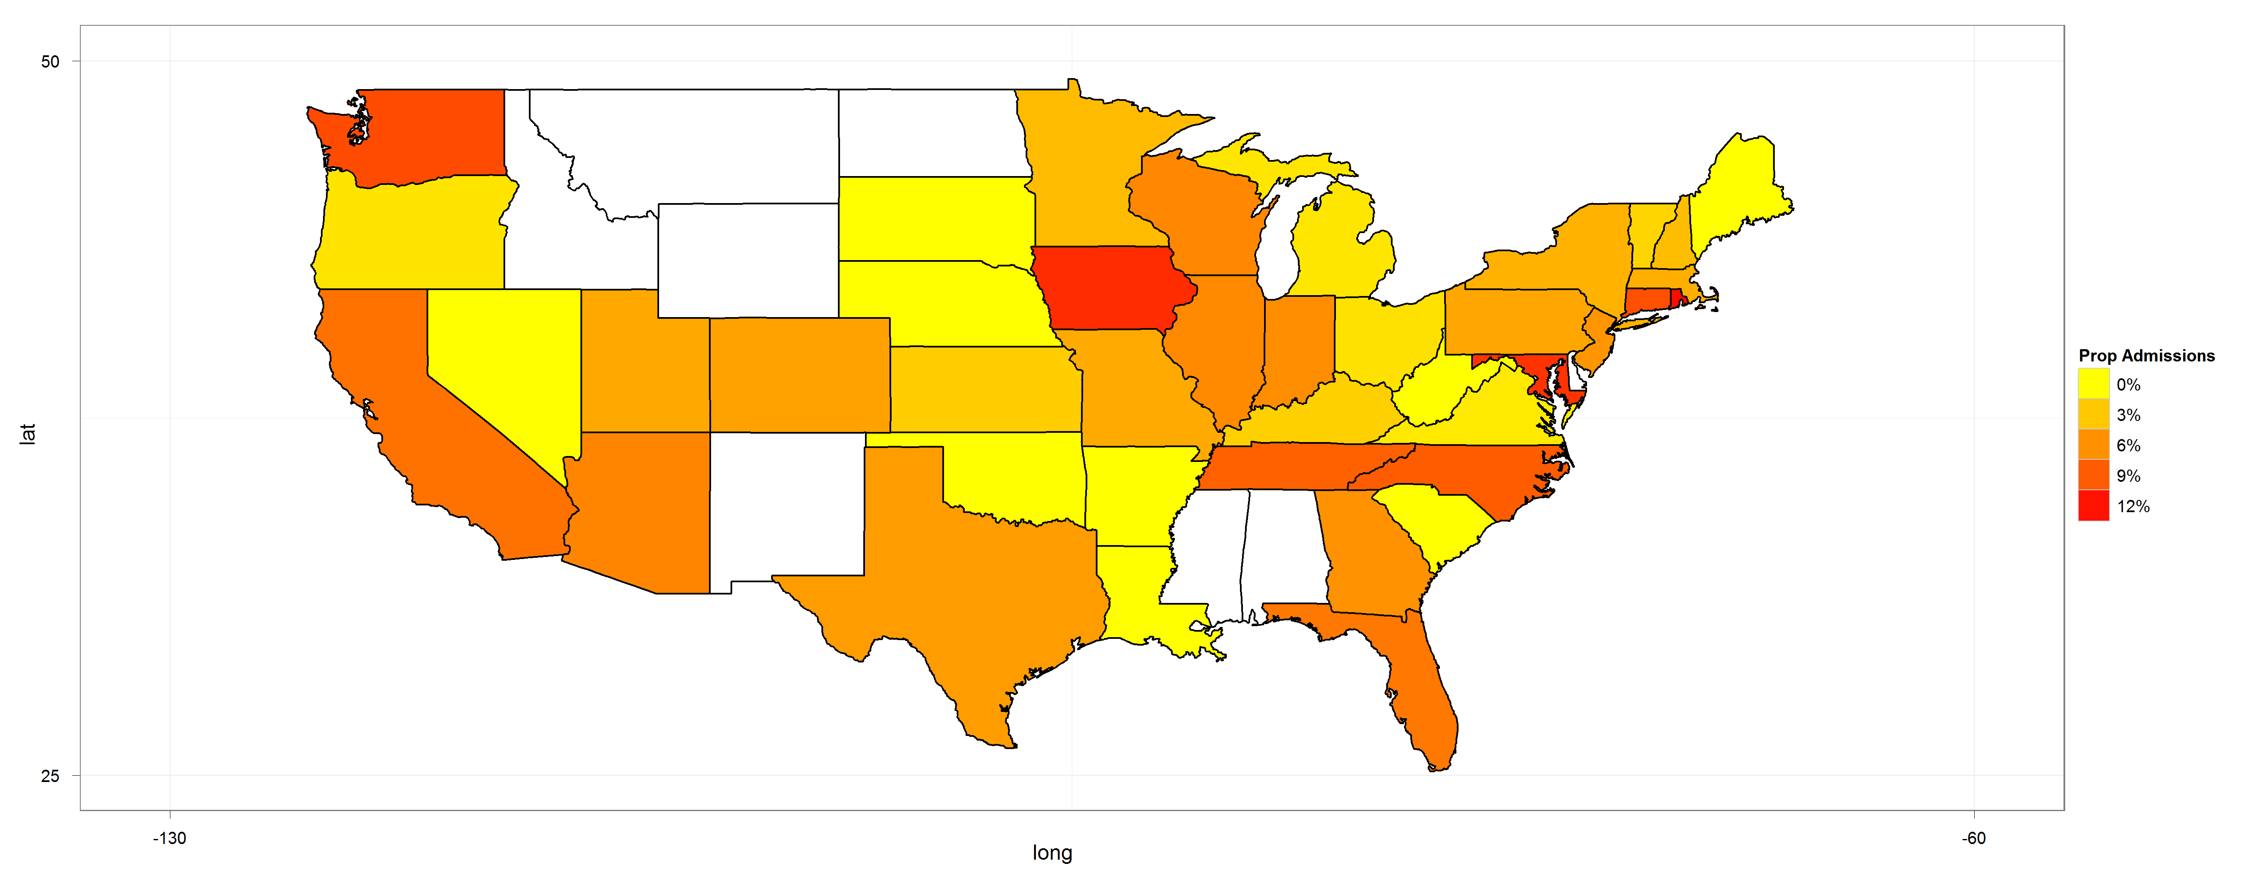
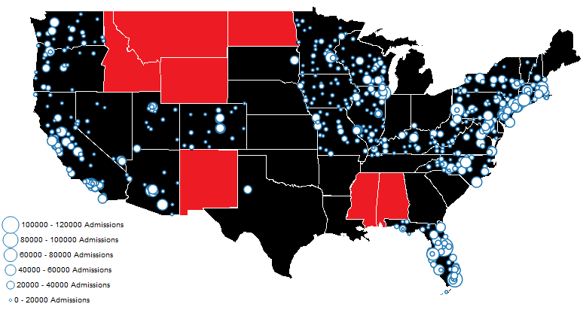
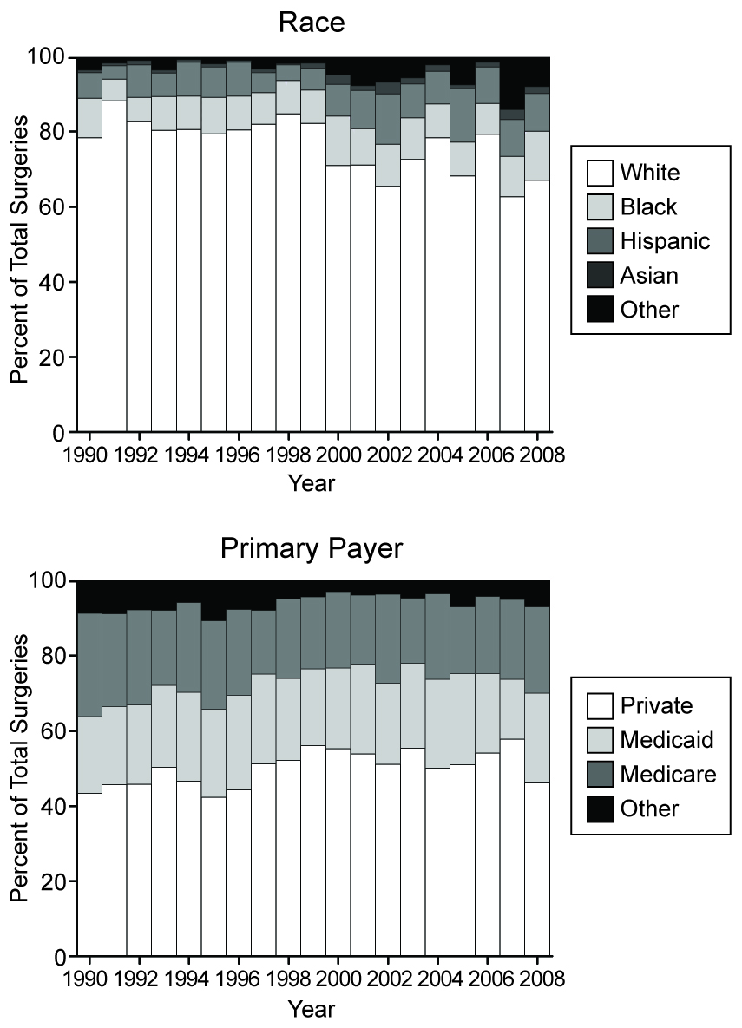
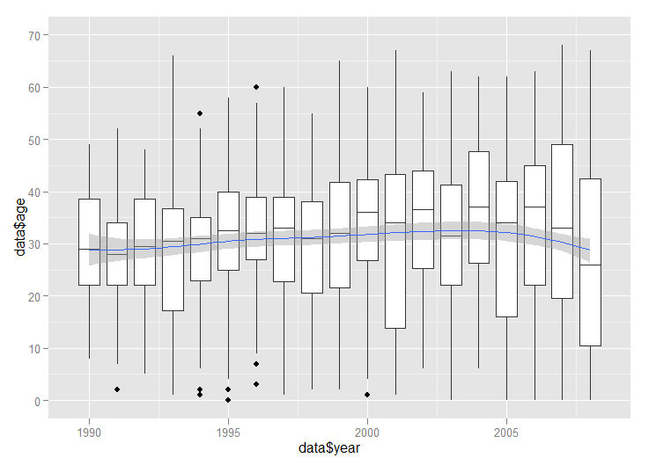
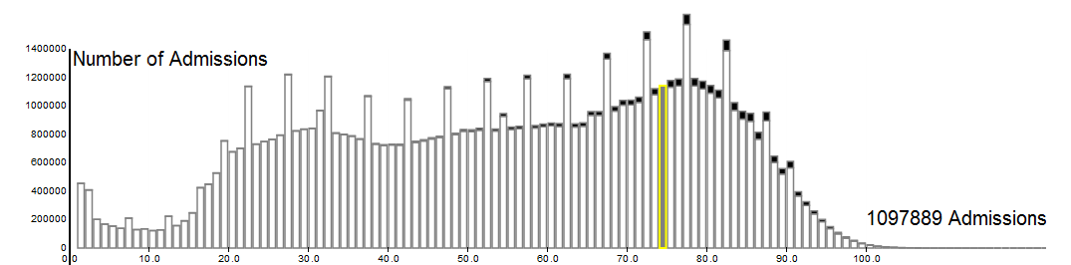

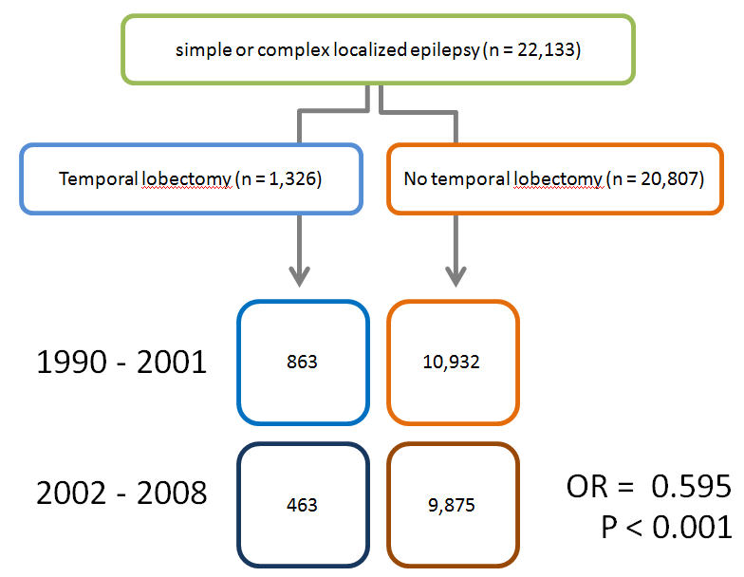
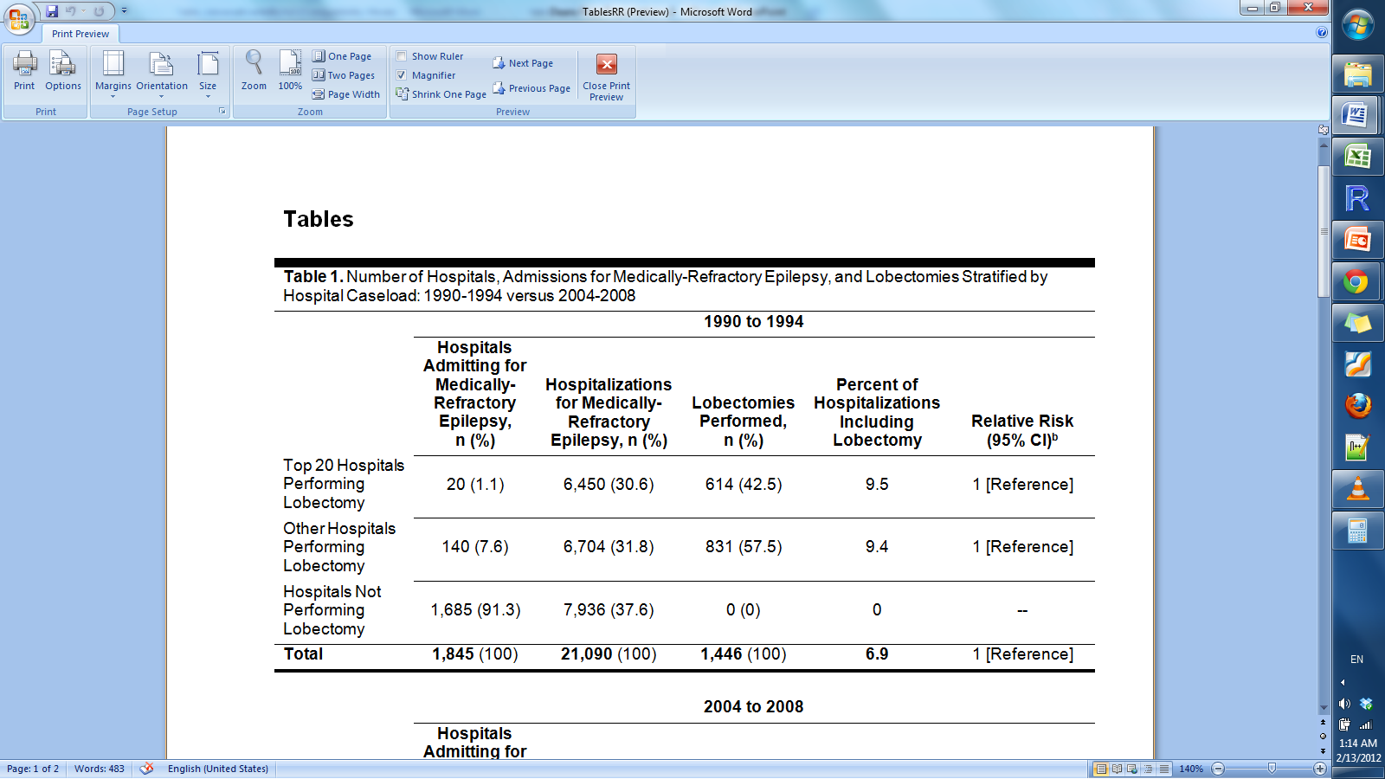
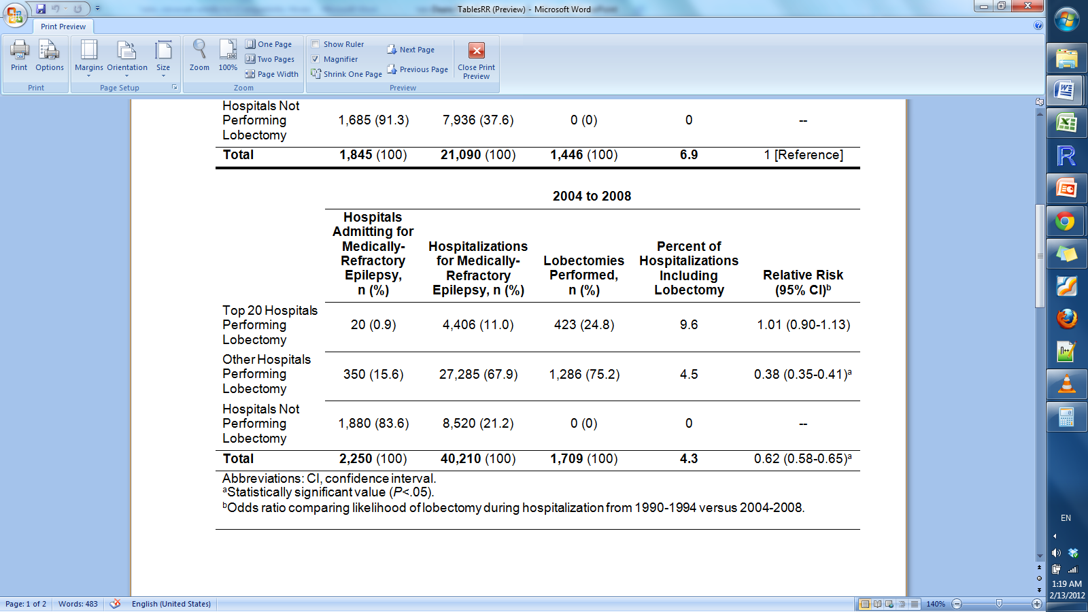
Epilepsy Surgery Trends in the United States from 1990 to 2008
Epilepsy Surgery Trends in the United States from 1990 to 2008
David Ouyang, B.S.^{1,2}, Dario J. Englot, M.D., Ph.D.^{1,2}, Paul A. Garcia, M.D.^{1,3}, and Edward F. Chang, M.D.^{1,2}
¹UCSF Epilepsy Center, ²Department of Neurological Surgery, ³Department of Neurology, University of California, San Francisco, California
David Ouyang, B.S.^{1,2}, Dario J. Englot, M.D., Ph.D.^{1,2}, Paul A. Garcia, M.D.^{1,3}, and Edward F. Chang, M.D.^{1,2}
¹UCSF Epilepsy Center, ²Department of Neurological Surgery, ³Department of Neurology, University of California, San Francisco, California
Background
Retrospective Cohort Analysis with the Nationwide Inpatient Sample
Variations in Surgery Utilization and Performance
Epilepsy is estimated to affect approximately 3 million Americans. The World Health Organization estimates that epilepsy related morbidity is responsible for 1% of the entire global burden of disease in disability adjusted life-years.
In the United States, epilepsy is estimated to cause $12.5 billion in annual direct and indirect costs. Because of its prevalence and high cost to society, there are a variety of pharmacotherapy options used to treat and manage epilepsy. Despite this, pharmacotherapy is unsatisfactory in between 20 – 40% of epilepsy patients.
One particularly surgically salient type of epilepsy is temporal lobe epilepsy. This class of epilepsies presents with partial complex or partial simple seizures that are initiated from the anterior temporal lobe. Good surgical candidates include medically refractory patients with unilateral seizure foci with limited parasthesia or other neurological signs after inactivation of one temporal lobe.
In 2001, a randomized control trial was able to conclusively prove that anterior temporal lobectomy was a superior option compared continued pharmacotherapy for patients with medically refractory epilepsy – epilepsy that is still not well managed after 2 or more medication regimens.
In 1993, it was estimated that there are approximately 100,000 individuals in the United States with temporal lobe epilepsy, while only 1,500 patients having undergone anterior temporal lobectomy.
Has the use of lobectomy for patients with intractable epilepsy increased in light of class I clinical evidence demonstrating efficacy?
Under the model of translational research, one hopes that advances in medical research would shape community and academic practice. Using a large medical database, we sought explore whether that has happened for anterior temporal lobectomy for temporal lobe epilepsy.
Database – Nationwide Inpatient Sample
Time Trends in Anterior Temporal Lobectomy
Epilepsy is a common, highly morbid disease
While there has been an increase in the annual number of hospitalizations for partial simple and partial complex seizures in the United States in the last twenty years, there has not been a comparable increase in the number of temporal lobectomies.
X² = 13.6,
p = 0.0002
Anterior temporal lobectomy as a treatment for temporal lobe epilepsy
Low volume surgical centers are twice as likely to have complications and adverse events compared to high volume centers, in addition to being less likely to refer patients for surgery.
The Nationwide Inpatient Sample is a 20% stratified sample of inpatient admissions of US hospitals. Approximately 1000 of the 5000 hospitals in the United States were represented in stratified weighted sample representing 43 states in 2008. The database contained b Data was extracted from non-delimited ASCII files using Python and R.
There has no concomitant change in patient demographics as race, payer mix, and patient age distributions have remained relatively stable in the twenty years – suggesting few if any diagnostic criteria changes to justify the increase in hospitalizations but not surgeries.
Age
There exists regional, patient, race, and hospital status based disparity in the utilization of lobectomy
Year
.
Although patient characteristics have not greatly changed, hospital characteristics have changed in the last twenty years. High volume academic centers are most likely to perform anterior temporal lobectomy, however the number of patients referred to these large hospitals have remained relatively constant over the time period. In contrast, lower volume hospitals have seen a great growth in the number of temporal lobe epilepsy admissions. These hospitals are less likely to perform surgery, and the relative increase in the number of hospitalizations has decreased the ratio of surgeries to hospitalizations.
Study Design
Patients with relevant diagnoses and procedures were identified and stratified by ICD9 codes and CPT codes. Contrary to expectation, the usage of temporal lobectomy has decreased in the last twenty years.
Conclusions
Lobectomy for medically intractable epilepsy is still underutilized, particularly among racial minorities and the underinsured.
Patients with medically refractory epilepsy should be referred to a comprehensive epilepsy center for surgical evaluation by an experienced epilepsy treatment team.
Our Research Question
1990 - 1994
2004 - 2008
Citations
1. Devinsky O. Diagnosis and treatment of temporal lobe epilepsy. Rev Neurol Dis 2004;1:2-9.
2. Engel J, Jr. Outcome with respect to epileptic seizures. In: Engel J, Jr., ed. Surgical treatment of the epilepsies. New York, NY: Raven Press, 1987: 553–571.
3. Wiebe S. Effectiveness and safety of epilepsy surgery: what is the evidence? CNS Spectr 2004;9:120-122, 126-132.
4. Wiebe S, Blume WT, Girvin JP, Eliasziw M. A randomized, controlled trial of surgery for temporal-lobe epilepsy. N Engl J Med 2001;345:311-318.
6. Jeha L, Najm I, Bingaman W, Dinner D, Widdess-Walsh P, Ludders H. Surgical outcome and prognostic factors of frontal lobe epilepsy surgery. Brain 2007;130:574-584.
7. Engel J, Jr. Surgical treatment for epilepsy: too little, too late? JAMA 2008;300:2548-2550.
8. Kwan P, Sperling MR. Refractory seizures: try additional antiepileptic drugs (after two have failed) or go directly to early surgery evaluation? Epilepsia 2009;50 Suppl 8:57-62.
10. Haneef Z, Stern J, Dewar S, Engel J, Jr. Referral pattern for epilepsy surgery after evidence-based recommendations: a retrospective study. Neurology 2010;75:699-704.
11. Engel J, Jr. Finally, a randomized, controlled trial of epilepsy surgery. N Engl J Med 2001;345:365-367.
12. Engel J, Jr., Shewman D. Overview: who should be considered a surgical candidate? In: Engel J, Jr., ed. Surgical treatment of the epilepsies 2nd ed. New York: Raven Press, 1993: 23-34.

